Slide 1
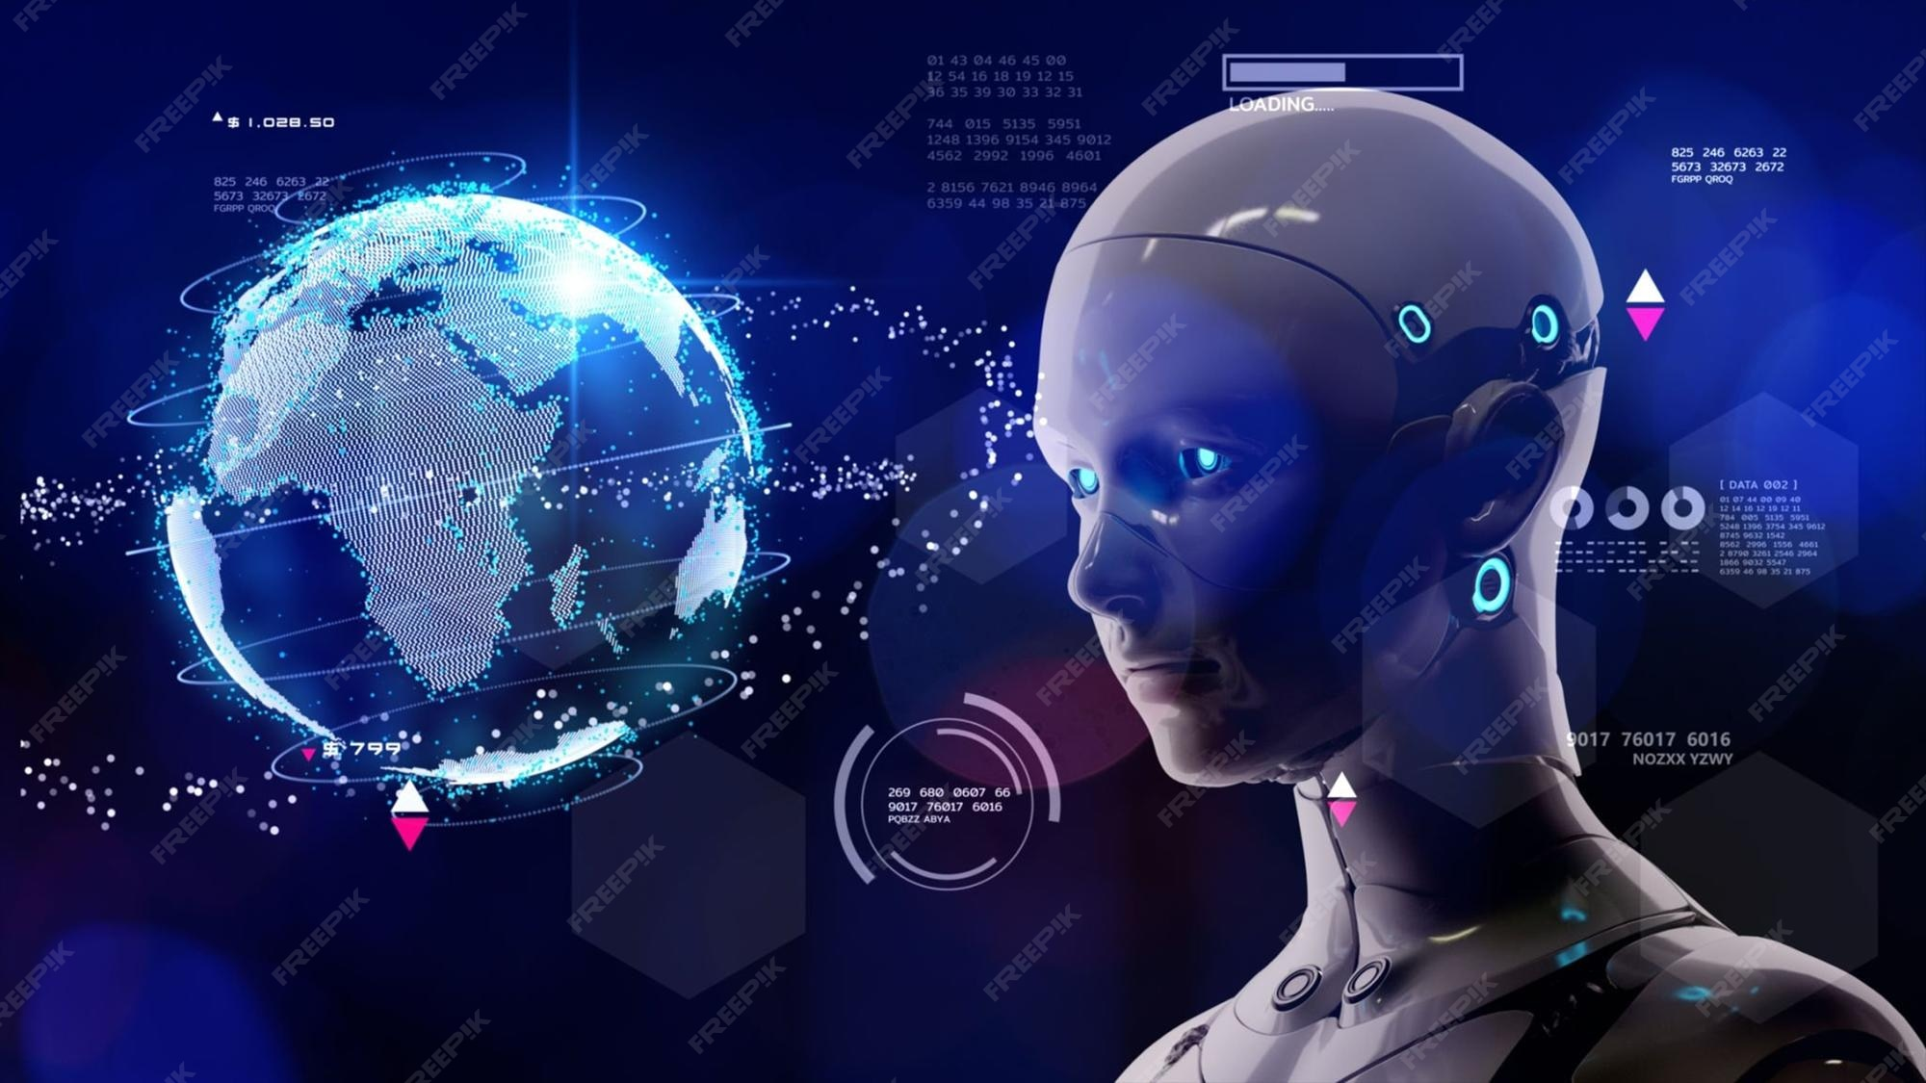
The Future of Artificial Intelligence
This presentation explores the current trends, future predictions, benefits, challenges, and ethical considerations of artificial intelligence. It provides an insightful look into how AI is expected to evolve and impact various aspects of our lives.
by AI Research Team

Slide 2
The Future of Artificial Intelligence
• Content for The Future of Artificial Intelligence

Slide 3
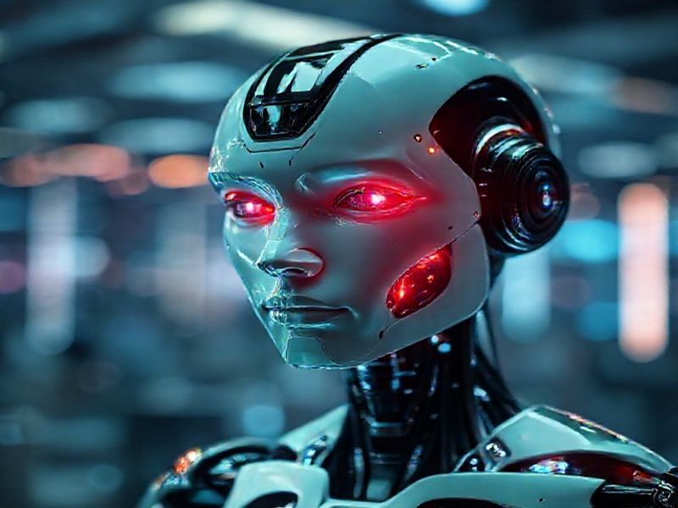
Current Trends in AI
Rapid advancements in machine learning and deep learning algorithms
Increased adoption of AI in various industries, including healthcare, finance, and automotive
Growth of AI-powered virtual assistants and chatbots for customer service

Slide 4
Future Predictions for AI
S
W
AI will become more autonomous, with self-learning and self-improving capabilities
AI will be integrated into everyday devices, creating a seamless and personalized user experience
T
O
AI will revolutionize industries such as education, agriculture, and manufacturing
AI will play a crucial role in addressing global challenges, such as climate change and healthcare

Slide 5
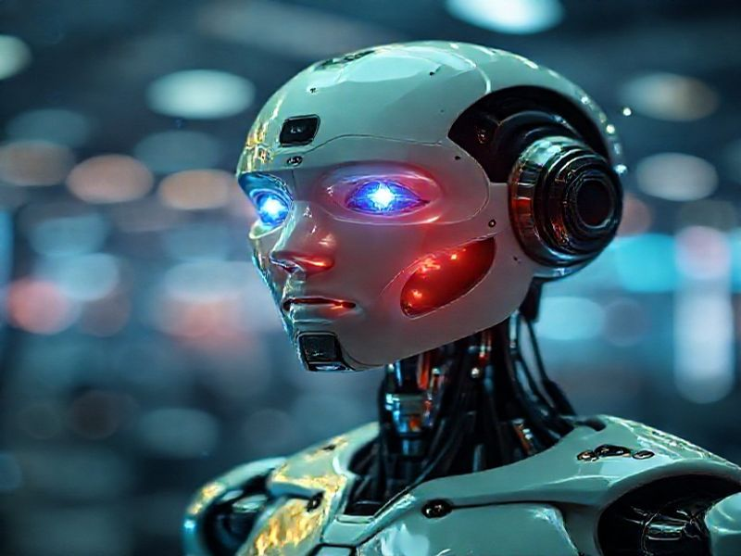
Benefits and Challenges of AI
Benefits: Increased efficiency and productivity, improved decision making, and enhanced personalization
Challenges: Job displacement, privacy concerns, and the potential for AI to be used maliciously

Slide 6
Conclusion: Embracing the Future of AI
• AI is poised to transform our world in profound ways
• We must embrace the opportunities and address the challenges and ethical considerations
• Collaboration between policymakers, industry leaders, and the public is essential
• The future of AI is bright, and it is up to us to shape it responsibly

