Slide 1
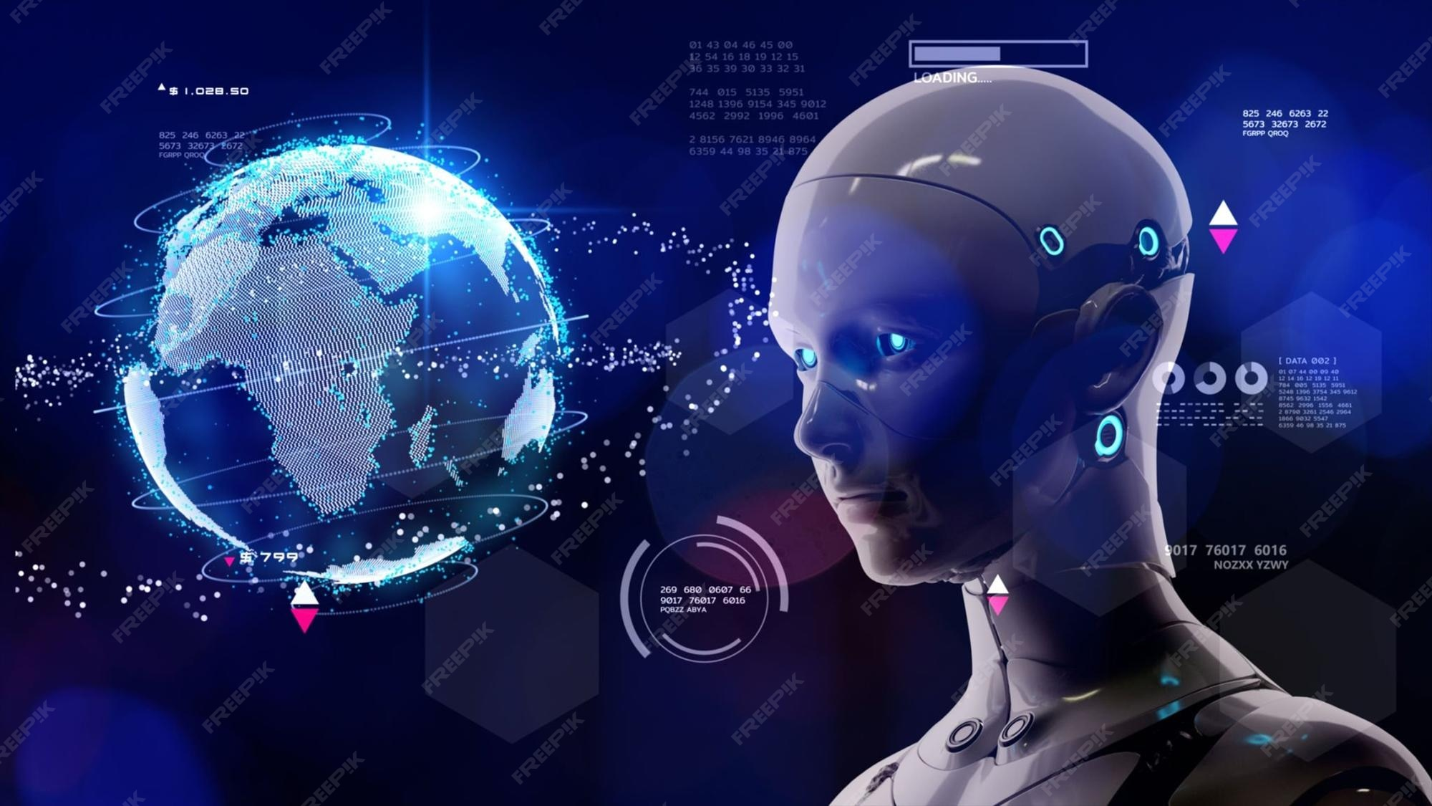
The Future of Artificial Intelligence
This presentation explores the current trends, future predictions, and potential impacts of artificial intelligence. We will also discuss the benefits and challenges that AI may bring in the coming years.
by AI Research Team

Slide 2
The Future of Artificial Intelligence
• Content for The Future of Artificial Intelligence

Slide 3
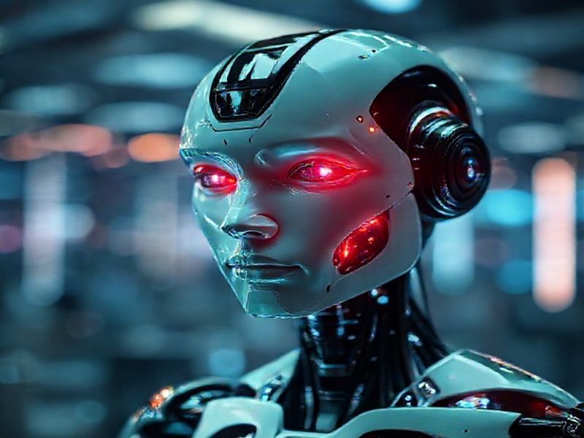
Current Trends in AI
Rapid advancements in machine learning and deep learning
Increased adoption of AI in various industries
Growth of AI-powered tools and platforms

Slide 4
Future Predictions for AI
S
W
AI will become more autonomous and capable of complex decision-making
Integration of AI with other emerging technologies like IoT and blockchain
T
O
Expansion of AI applications in healthcare, education, and environmental conservation
Potential development of artificial general intelligence (AGI)

Slide 5
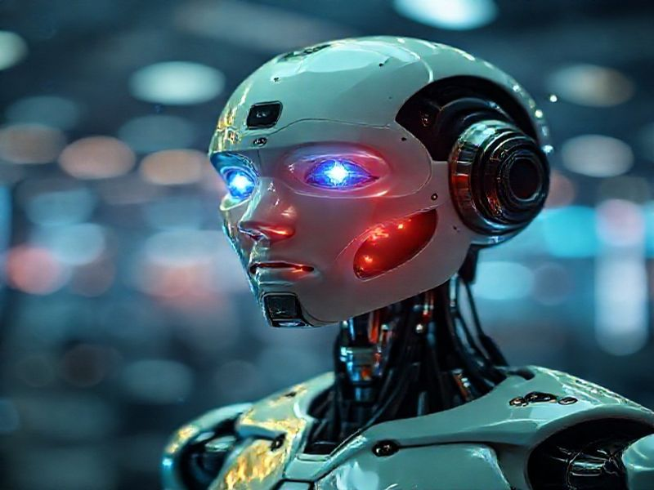
Benefits and Challenges of AI
Benefits: Increased efficiency, improved decision-making, and new opportunities for innovation
Challenges: Job displacement, ethical concerns, and potential misuse of AI

Slide 6
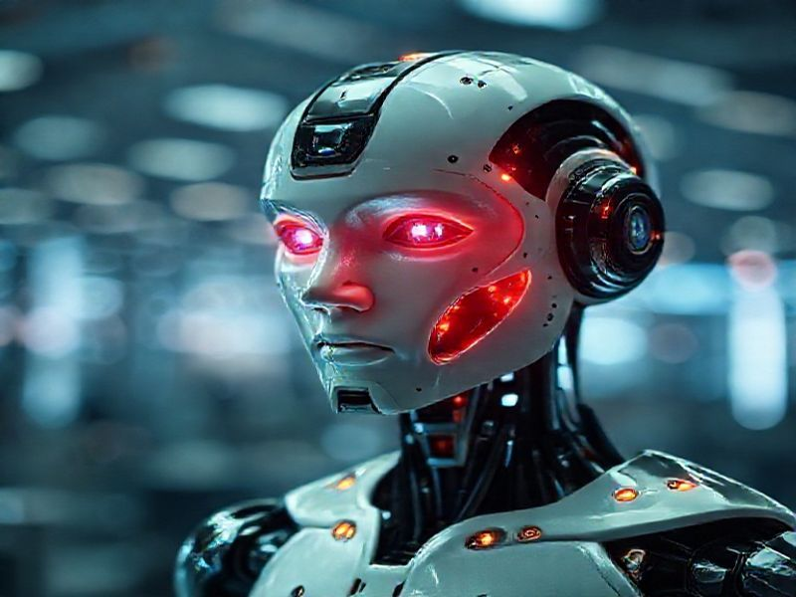
Conclusion
The future of AI is promising but requires careful consideration of its impacts
Collaboration between policymakers, industry leaders, and researchers is crucial
Embracing AI responsibly can lead to a future where technology benefits all of humanity

