Slide 1
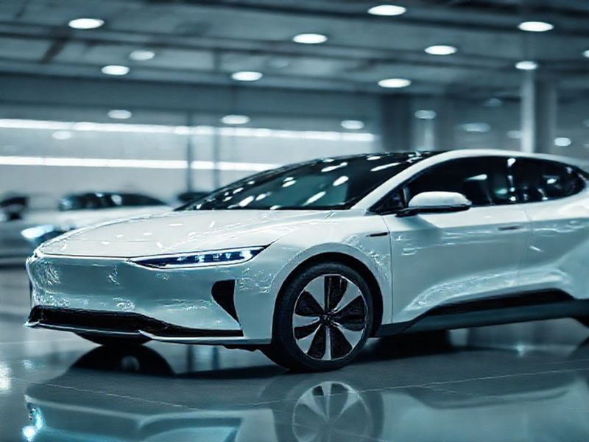
The Future of Electric Vehicles
This presentation explores the current trends, technological advancements, and future predictions in the electric vehicle industry, highlighting the benefits and challenges ahead.
by AI Research Team

Slide 2
The Future of Electric Vehicles
• Introduction to the growing importance of electric vehicles
• Overview of current market trends
• Key factors driving the EV revolution

Slide 3
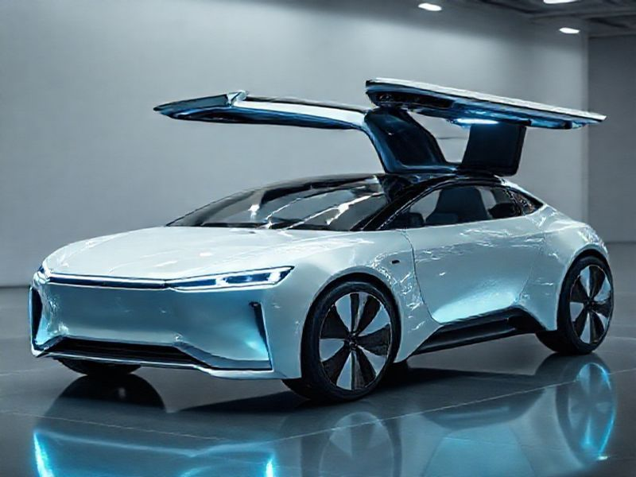
Current Trends in the EV Market
Rapid growth in EV adoption and sales
Expansion of charging infrastructure
Increasing variety of EV models and types

Slide 4
Technological Advancements
S
W
Improvements in battery technology and energy density
Development of solid-state batteries
T
O
Advancements in autonomous driving features
Integration of vehicle-to-grid (V2G) technology

Slide 5
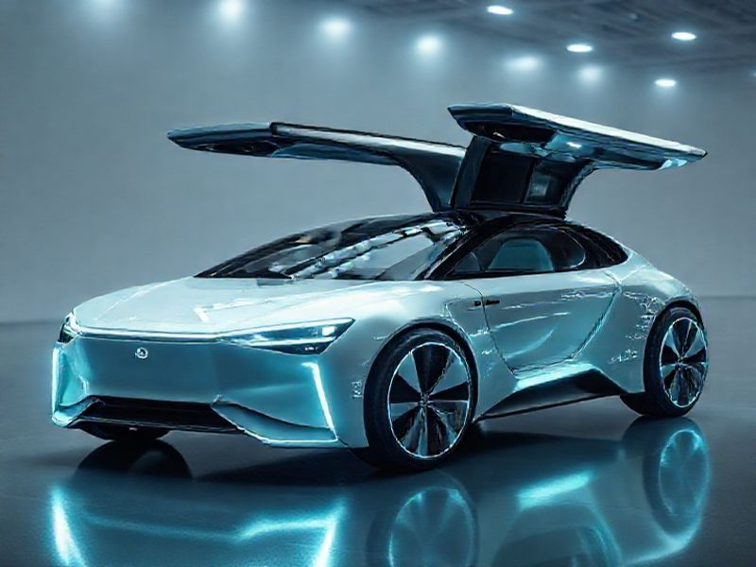
Future Predictions and Innovations
Projected market growth and adoption rates
Emerging technologies like wireless charging

Slide 6
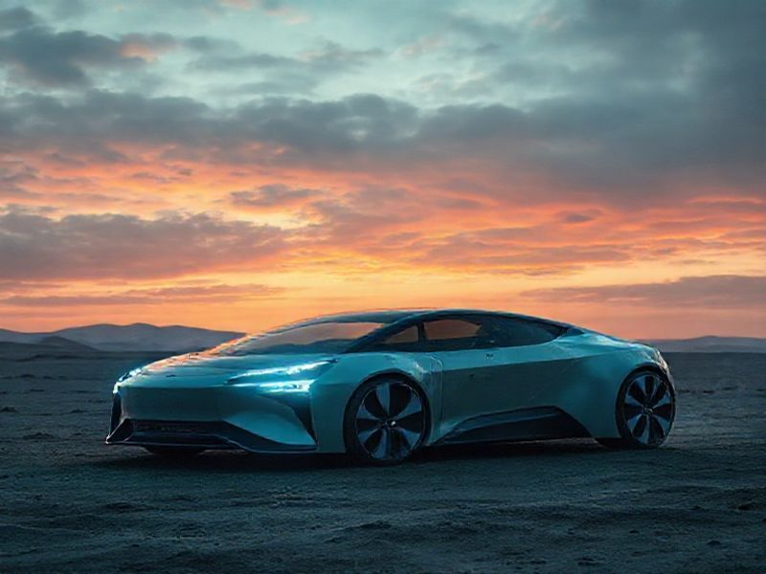
Conclusion
Recap of key points discussed
The future of electric vehicles is bright and promising
Continued innovation and investment are crucial for sustained growth

