Slide 1
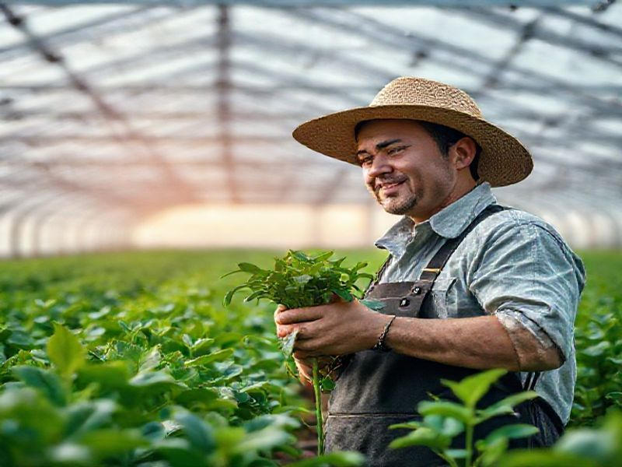
The Future of Farming: Innovations and Trends
This presentation explores the current trends, technological advancements, and future predictions in the agriculture industry. It highlights the benefits and challenges of modern farming practices and offers a glimpse into the future of sustainable agriculture.
by AI Research Team

Slide 2
The Future of Farming: Innovations and Trends
• Content for The Future of Farming: Innovations and Trends

Slide 3
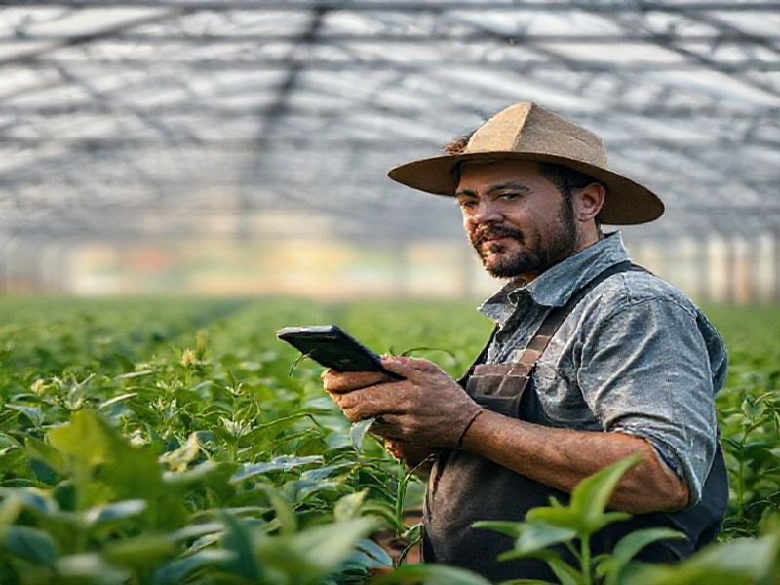
Current Trends in Agriculture
Precision farming using GPS and satellite imagery
Adoption of IoT devices for real-time monitoring
Increase in vertical and urban farming

Slide 4
Technological Advancements
Drones for crop monitoring and pest control
Autonomous tractors and robotic harvesters
S
W
Biotechnology and genetic engineering for crop improvement
Use of blockchain for supply chain transparency
T
O

Slide 5
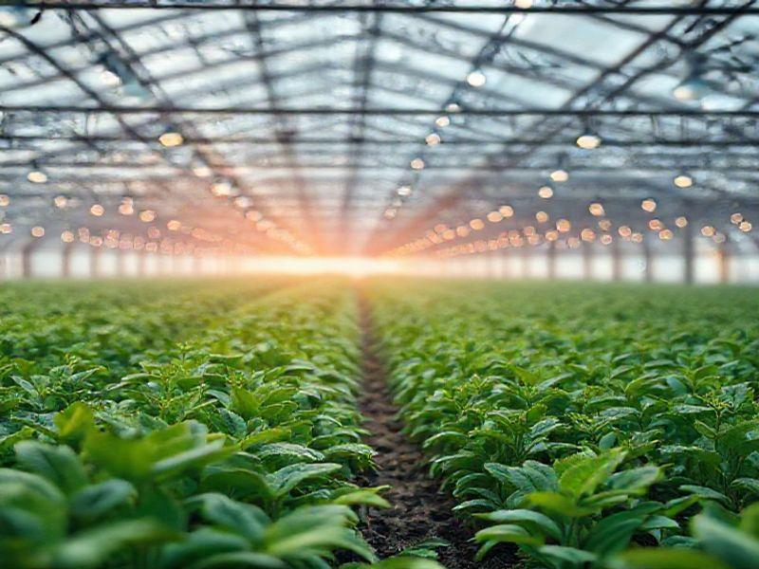
Future Predictions and Challenges
Increased automation and robotics in farming
Climate-smart agriculture to combat global warming

Slide 6
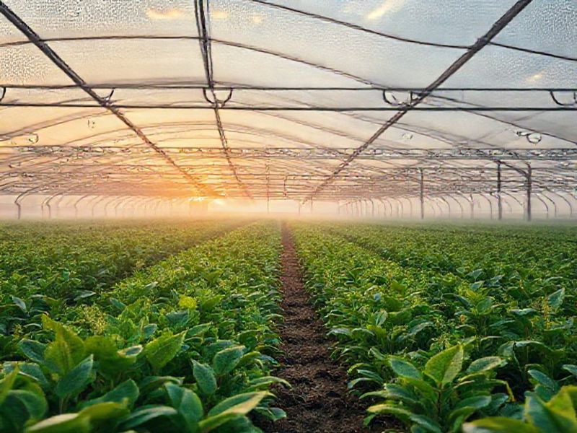
Conclusion: The Path Forward
Embracing technology and innovation for sustainable growth
Investing in research and development for long-term solutions
Promoting education and awareness about modern farming practices

