Slide 1

The Future of Farming: Innovations and Trends
This presentation explores the exciting advancements and trends shaping the future of farming. From technology integration to sustainable practices, we will delve into how these innovations are transforming agriculture.

Slide 2

The Future of Farming: Innovations and Trends
• Exploring the next generation of agricultural advancements
• Understanding the impact of technology on farming
• Sustainable practices for a greener future

Slide 3


Precision Agriculture
• Use of GPS, sensors, and data analytics for targeted farming
• Optimizing crop yields and reducing waste
• Improving resource management and efficiency

Slide 4

Vertical and Urban Farming
• Growing crops in urban environments to reduce food miles
• Utilizing vertical space for increased production
• Sustainable and eco-friendly farming practices

Slide 5


Sustainable and Regenerative Farming
• Promoting biodiversity and healthy ecosystems
• Reducing chemical inputs and enhancing soil health
• Climate-smart agriculture for long-term sustainability

Slide 6
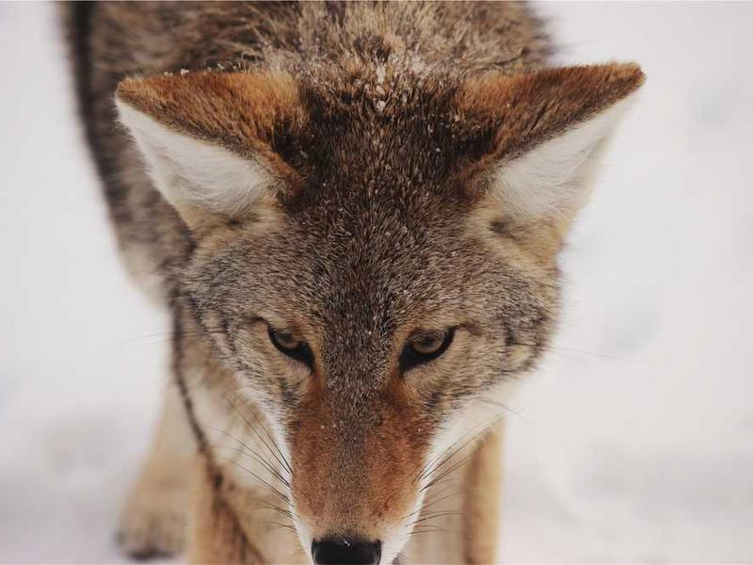
Conclusion
• The future of farming is bright with innovative technologies and sustainable practices
• Embracing these changes can lead to a more efficient and eco-friendly agricultural sector
• Continuous learning and adaptation are key to staying ahead in the ever-evolving world of farming

