Slide 1
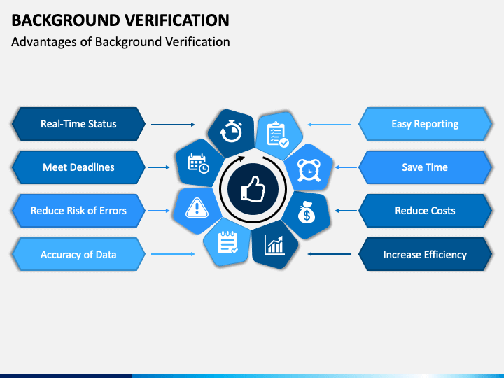
Title Overflow Verification
Verifying dynamic font sizing for titles.
by AI Research Team

Slide 2

Short Title
Content for slide 1

Slide 3
Medium Length Title That Should Fit Nicely
• Content for slide 2

Slide 4
A Very Long Title That Might Need Some Font Scaling To Fit In The Box Without Overflowing
S
Content for slide 3

Slide 5
Extremely Long Title That Is Definitely Going To Overflow If We Do Not Resize The Font Significantly And It Just Keeps Going And Going
• Content for slide 4

