Slide 1
The Future of AI
A visual exploration of Artificial Intelligence trends.

Slide 2
The Future of AI

Slide 3
Key Trends
Multimodal Models
Autonomous Agents
Scientific Discovery

Slide 4
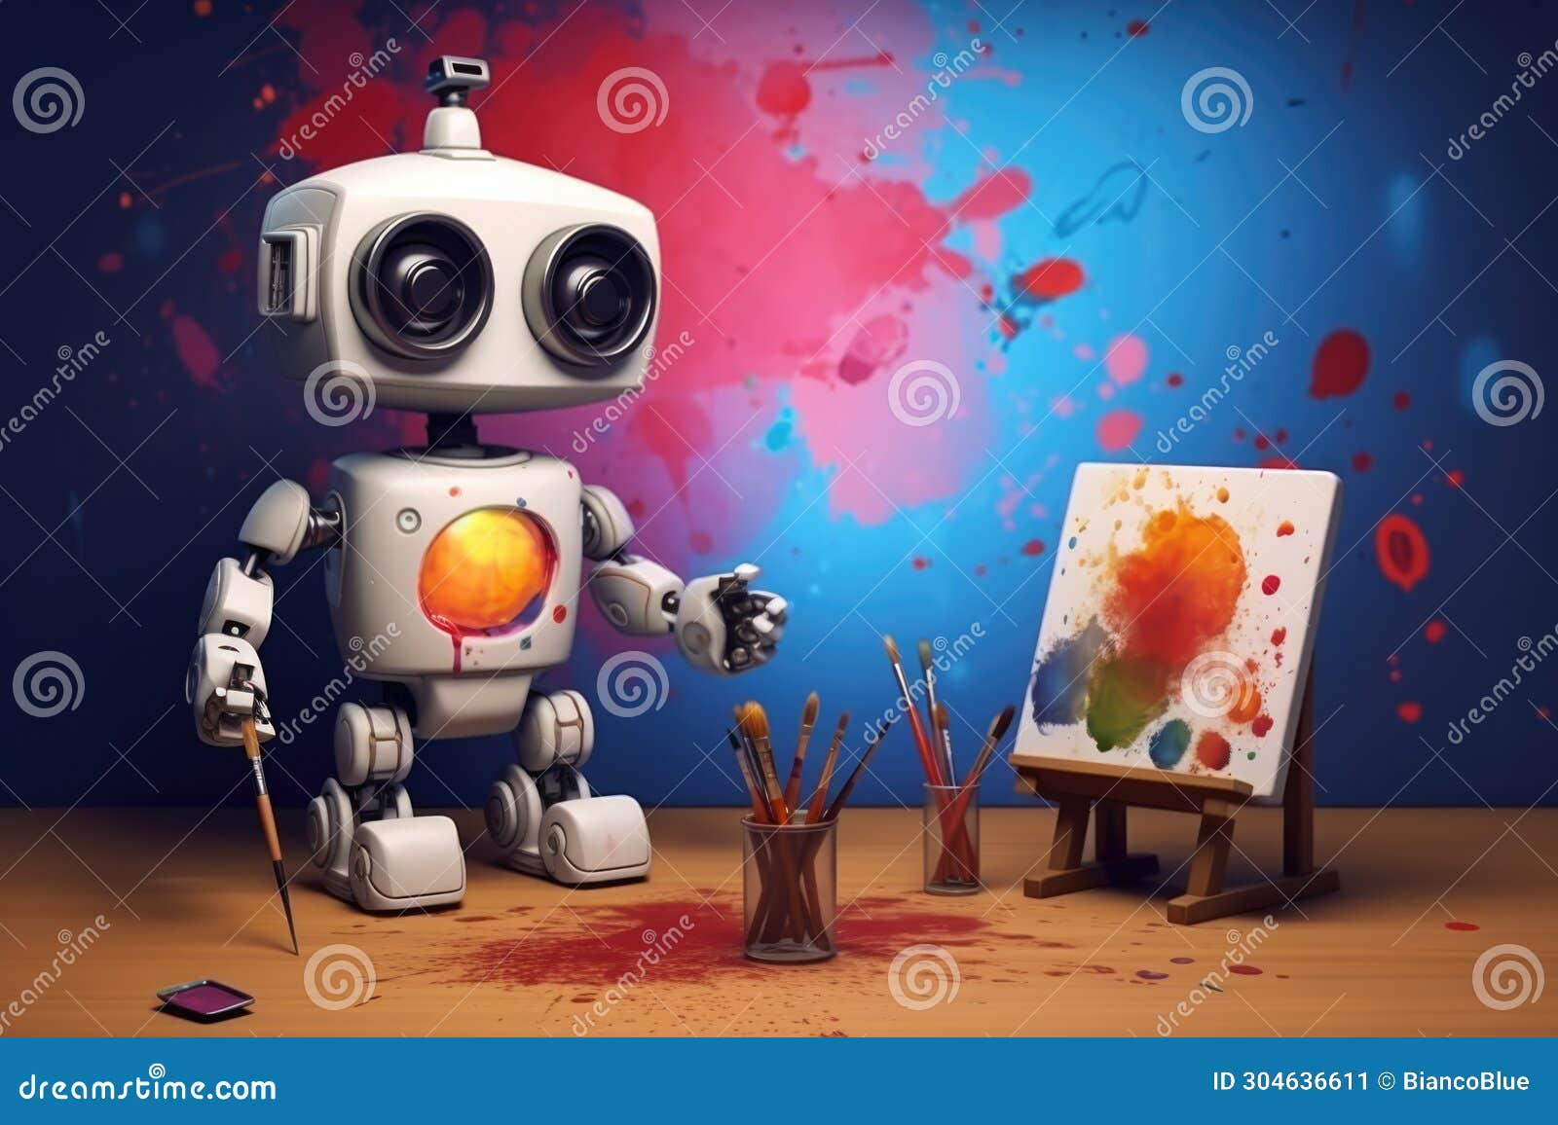
Generative AI
Creating new content from scratch
Images, Text, Audio, Video
Transforming creative industries

Slide 5
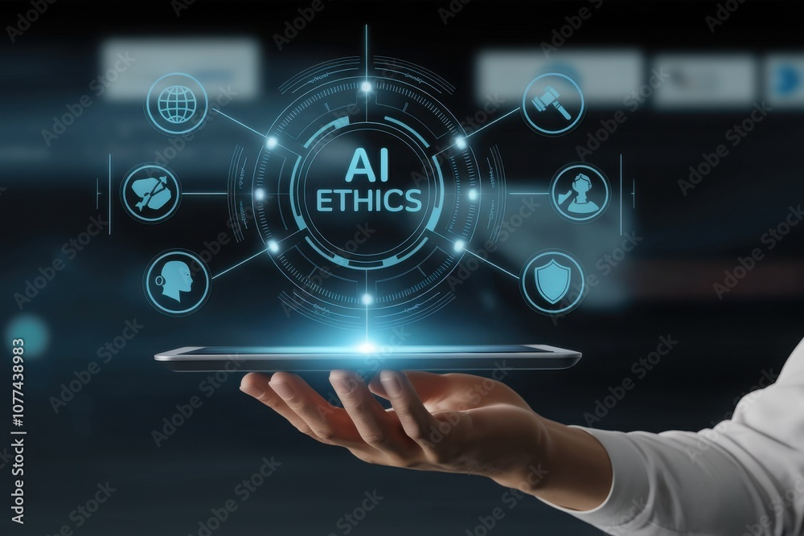
Ethical Considerations
Bias and Fairness
Copyright Issues
Job Displacement

Slide 6
Conclusion

