Slide 1
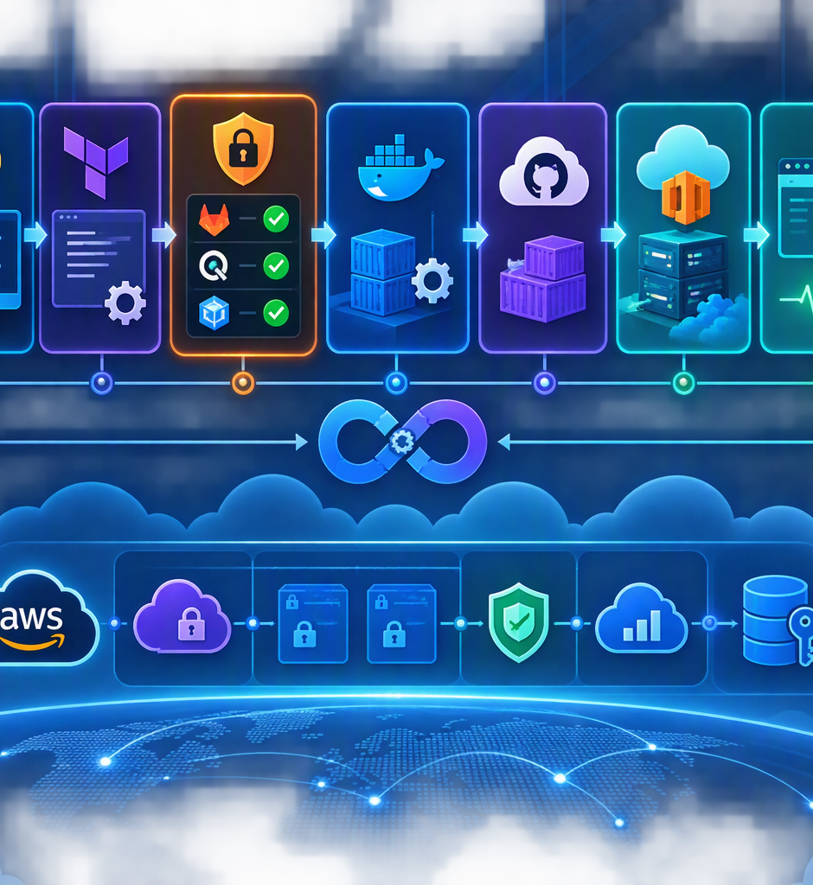
GROUP1 ADVANCED
Cloud & DevSecOps
Capstone Project
Secure software delivery from code to validated development deployment
PYTHON
TERRAFORM
DOCKER
DEVSECOPS
Code → Test → Secure → Build → Release → Deploy → Validate

Slide 2
Project overview
A practical capstone focused on repeatable delivery, infrastructure validation, and built-in security.
Application
Infrastructure
Delivery
Python API
Health and documentation endpoints
Automated pytest validation
Terraform definitions
Formatting and validation gates
Network, logging and encryption controls
GitHub Actions CI/CD
Container build and registry release
Dev deployment and health checks
Outcome
A working, security-focused delivery pipeline with evidence at every stage.

Slide 3
Solution architecture
The primary delivery flow is linear, with infrastructure validation performed alongside application CI.
Source
Test
Secure
Build
Release
Registry
Deploy
Validate
GitHub
Python
Gitleaks
Checkov
Trivy
Docker
release.yml
GHCR
dev
/health
Infrastructure branch
Terraform infrastructure definition & validation
VPC • Private subnet • Security groups • Flow Logs • CloudWatch • KMS
Code → Test → Secure → Build → Release → Deploy → Validate

Slide 4
Python API & automated tests
The application exposes simple endpoints that are exercised locally and inside the deployment workflow.
API surface
Test coverage
Observed evidence
GET / - root response
GET /health - service health
GET /doc - documentation
Pytest health endpoint
Pytest documentation endpoint
Syntax and import validation
Local pytest: 2 passed
Browser health check: status = ok
CI application tests: passed
Health validation is a deployment gate, not only a local test.

Slide 5
Infrastructure as Code
Terraform is treated as a controlled, testable infrastructure definition in the delivery process.
Defined controls
Logging & encryption
Pipeline gates
AWS VPC
Private subnet
Security groups
VPC Flow Logs
CloudWatch logging
365-day retention
KMS encryption
Key rotation
terraform fmt -check
terraform init -backend=false
terraform validate
Checkov IaC scan
Scope note: this capstone demonstrates infrastructure definition and validation; the diagram does not claim live AWS provisioning.

Slide 6
Continuous integration pipeline
ci.yml blocks progression unless application, infrastructure, security, and container checks succeed.
1
2
3
4
Python API
Terraform
Security
Container
Syntax • imports • pytest
fmt • init • validate
Gitleaks • Checkov • Trivy
Build • run • health • scan
Result: all CI jobs passed

Slide 7
DevSecOps security controls
Security is integrated into the pipeline as a set of explicit quality gates.
Gitleaks
Checkov
Trivy
Detects committed secrets
Runs against repository history
Blocks release on findings
Scans Terraform IaC
Identifies configuration risks
Supports documented controls
Filesystem vulnerability scan
Container image scan
HIGH / CRITICAL gate
Security principle
Detect issues before an image reaches the deployment stage.

Slide 8
Release & container registry
release.yml creates a deployable artifact only after a successful security scan.
Build
Scan
Tag
Publish
Release image
Trivy
Version • SHA • latest
GHCR
Registry artifact becomes the controlled input to deployment.

Slide 9
Development deployment
deploy.yml uses the dev environment, pulls the released image, starts the container, and verifies the API.
Deploy
Validate
Observed result
GitHub environment: dev
Authenticate to GHCR
Pull selected tag
Run container on port 8080
Wait for application
GET /health
GET /
GET /doc
Deployment workflow passed
Health endpoint returned status: ok
Cleanup runs after validation
DEV DEPLOYMENT SUCCESSFUL

Slide 10
Testing & evidence
Submission evidence demonstrates both local behavior and automated pipeline results.
✓
✓
✓
✓
✓
Local tests
Health API
CI
Release
Deploy dev
2 passed
status: ok
Passed
Passed
Passed
Evidence set: repository structure • pytest • /health • CI • security • release • dev deployment • architecture

Slide 11
Key challenges & resolutions
The implementation demonstrates iterative troubleshooting across infrastructure, containers, security tooling, and registry delivery.
Terraform formatting
Applied fmt checks and validation before progression
Container image visibility
Loaded the Buildx image for local Trivy scanning
GHCR image naming
Normalized the container repository path to lowercase
Image tag resolution
Aligned release and deployment image references
Deployment confidence
Added health and API verification after container startup

Slide 12
Conclusion
The capstone demonstrates a complete, evidence-driven DevSecOps delivery workflow.
Automated
Secure
Portable
Controlled
Verified
Tests and repeatable workflows
Secret, IaC and vulnerability scanning
Containerized release artifact
Versioned registry publishing
Post-deployment API health checks
READY FOR CAPSTONE SUBMISSION
Code → Test → Secure → Build → Release → Deploy → Validate

