Slide 2
Data Understanding
March 2025
Developing HealthCare Cost Predictor : A Data Science Web Application

Slide 3

Importing Dataset.
Basic Exploration of Dataset.
Basic Terminology.

Slide 4
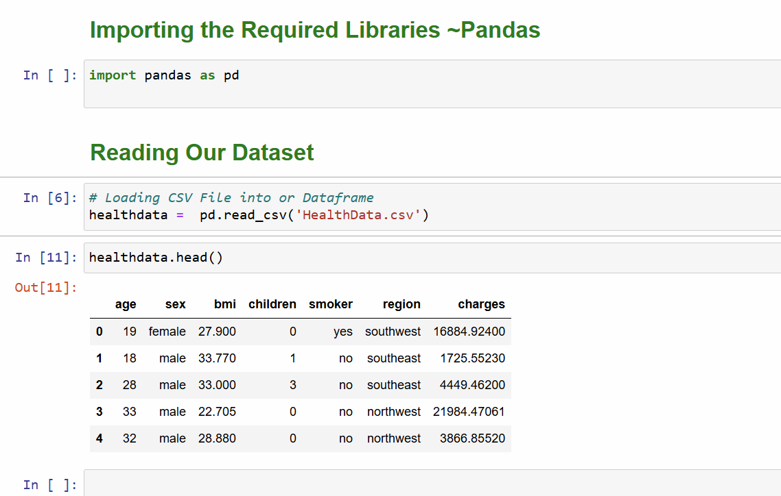
Importing Library & Dataset
Pandas
Open-source Python library for data manipulation and analysis.

Slide 5
Dataset Overview
Age: Age in years. .
Sex: The persons gender (male/female).
BMI (Body Mass Index): A measure of body fat based on height and weight.
Formula: weight (kg) / (height (m))²
Normal range: 18.5-24.9
Higher values indicate increased health risks
Children: Number of dependents covered by the insurance policy. Range: 0-5.
Smoker: Whether the person smokes (yes/no).
Region: residential area in the US (northeast, northwest, southeast, southwest).
Charges: The medical insurance cost in USD. This is the target variable we aim to predict.

Slide 6
Terminology
Data-point/vector/Observation
Data-set.
Feature/Variable/Input-variable/Independent-variable
Label/Dependent-variable/Output-variable/Class/Class-label/Response label

Slide 7
Questions?

