Slide 1
Employee Data Analysis using Excel
STUDENT NAME:J. TAMILARASI
REGISTER NO:422200186
DEPARTMENT:B.COM(ISM)
COLLEGE:C.S.I EWART WOMEN’S CHRISTIAN COLLEGE.

Slide 2
PROJECT TITLE
Employee Performance Analysis using Excel

Slide 3


AGENDA
Problem Statement
Project Overview
End Users
Our Solution and Proposition
Dataset Description
Modelling Approach
Results and Discussion
Conclusion
3/21/2024 Annual Review

Slide 4

PROBLEM STATEMENT
Basic Excel functions may not fully support advanced performance analysis.
Need for complex formulas or additional tools for in-depth analysis.

Slide 5

PROJECT OVERVIEW
Implement charts and graphs to visualize performance trends.
.

Slide 6

WHO ARE THE END USERS?
The end users of employee performance analysis using Excel can include:
HR professionals: Excel is a popular tool for HR professionals to analyze data and visualize it quickly.
Managers: Excel can be used to track employee performance and provide feedback.
Employees: Excel can be used to identify strengths and weaknesses, and set development goals.

Slide 7

OUR SOLUTION AND ITS VALUE PROPOSITION
Solution:
Highlight key features such as dashboards, automated reports, performance tracking metrics, data visualization, and customizable templates.
Value proposition:
Enhanced decision making
Increased efficiency.

Slide 8
Dataset Description
Employee information such as Employee ID, Name, Salary, Location etc..,

Slide 9

THE "WOW" IN OUR SOLUTION
Interactive dashboards
Dynamic charts and graphs.
3/21/2024 Annual Review
9

Slide 10
MODELLING
Visualization
Formulas
Data collection
Measures individual and collective employees
10

Slide 11
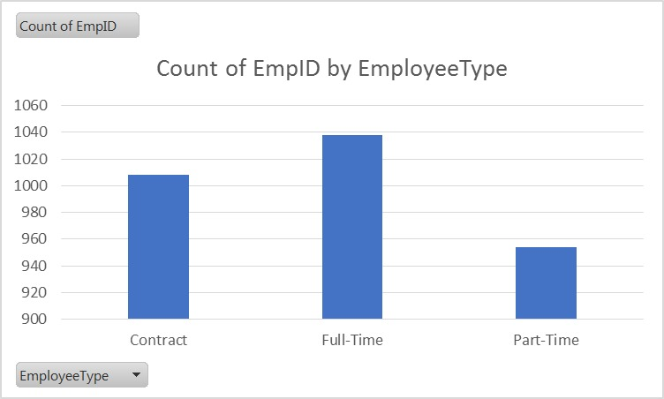
RESULTS
11

Slide 12
conclusion
The conclusion section of an employee performance analysis using Excel should summarize the key insights, evaluate the effectiveness of the analysis, and provide a clear path forward.

