Slide 1

FAKE NEWS
SRM INSTITUTE OF SCIENCE AND TECHNOLOGY
FACULTY OF ENGINEERING AND TECHNOLOGY
DEPARTMENT OF DATA SCIENCE AND BUSINESS SYSTEMS
21CSS202T FUNDAMENTALS OF DATA SCIENCE
Project Review 2
VIMESH SAMUEL RA2311056010275
TAMILINIYAN M RA2311056010272
K ARYA VARDHAN RA2311056010291
CHANDRA MOULI KVS RA2311056010274

Slide 2
Table of contents
Abstract
Objectives
Architecture diagram
Sample Dataset
Visualization
Conclusion

Slide 3
ABSTRACT
This paper explores the phenomenon of fake news, examining its origins, prevalence, and effects on public perception and societal trust. We analyze the mechanisms by which misinformation spreads through social media platforms and the psychological factors that make individuals susceptible to believing and sharing false information. The implications of fake news for democratic processes, public health, and social cohesion are discussed, alongside potential strategies for mitigation, including media literacy initiatives and technological solutions. Through a comprehensive review of existing literature and case studies, we aim to provide a nuanced understanding of how fake news shapes contemporary discourse and to highlight the urgent need for effective responses in an increasingly interconnected world.

Slide 4
OBJECTIVES
Here are some key objectives for studying fake news:
Identify Sources and Mechanisms: Investigate the primary sources of fake news and the mechanisms through which misinformation spreads, particularly on social media platforms.
Analyze Impact: Assess the impact of fake news on public opinion, trust in media, and societal behavior, focusing on specific case studies and demographic factors.
Understand Psychological Factors: Explore the cognitive biases and psychological factors that contribute to the acceptance and sharing of fake news among individuals.
Evaluate Consequences: Examine the broader consequences of fake news on democratic processes, public health, and social cohesion.

Slide 5
5. Foster Critical Thinking: Encourage the development of critical thinking skills in individuals to enhance their ability to discern credible information from misinformation.
6. Promote Responsible Media Consumption: Advocate for responsible media consumption habits among the public to reduce the spread and influence of fake news.
7.Develop Mitigation Strategies: Propose effective strategies for combating fake news, including media literacy programs, fact-checking initiatives, and technological solutions.

Slide 6
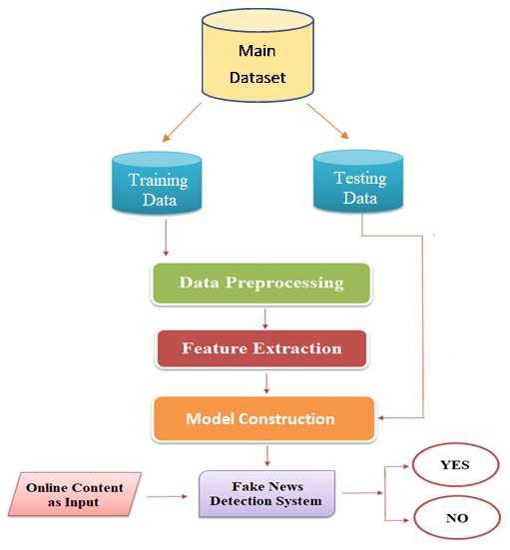
ARCHITECTURE DIAGRAM

Slide 7
SAMPLE DATASET
ID | Title | Content | Source | Label
1 | "Miracle Cure for COVID-19 Discovered!" | "A group of scientists from an undisclosed location have found a miraculous cure for COVID-19, which can cure anyone within 24 hours." | unknown-news.com | Fake
2 | "Global Warming a Hoax, Says New Study" | "A new study claims that global warming is just a fabricated idea created to control governments and increase taxes." | conspiracytheory.net | Fake
3 | "NASA Confirms Water on Mars" | "NASA has officially confirmed that there is liquid water present on the surface of Mars, sparking hope for potential life on the red planet." | nasa.gov | Real
4 | "Aliens Have Landed in Nevada" | "Multiple reports are coming in from Nevada about sightings of alien spacecraft landing. Experts believe this could be the first contact." | extraterrestrialnews.com | Fake
5 | "New Vaccine Effectively Reduces COVID-19" | "Clinical trials have shown that the new vaccine for COVID-19 has a 95% effectiveness rate in reducing symptoms and preventing severe cases." | healthnews.org | Real
6 | "New Renewable Energy Breakthrough" | "Scientists have developed a new type of solar panel that is 50% more efficient than current technologies, marking a huge leap in renewable energy." | greenfuture.org | Real

Slide 8
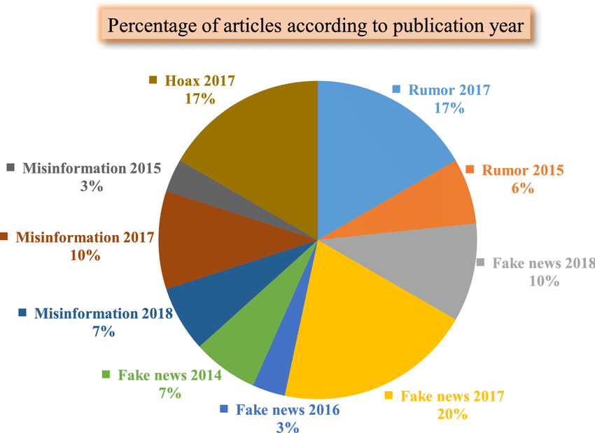
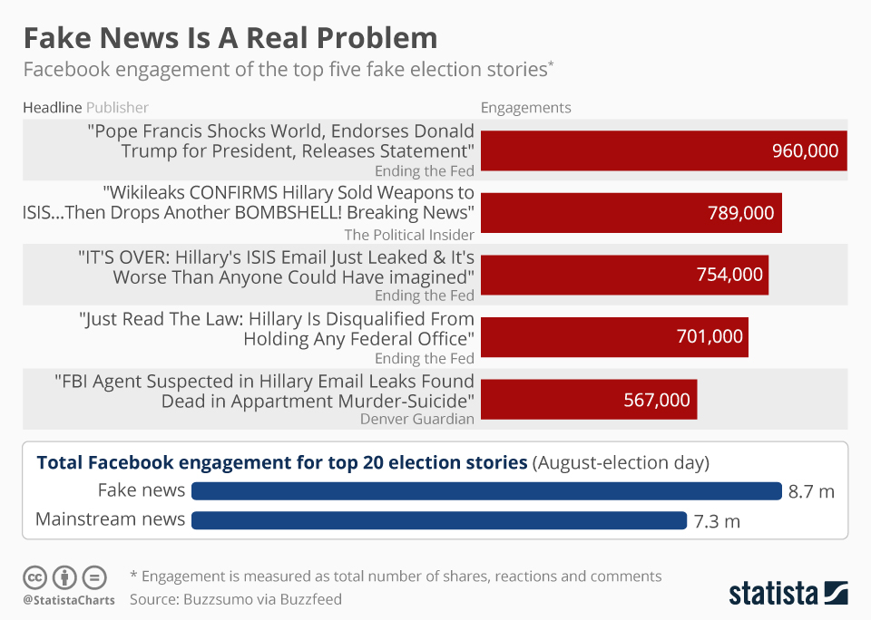
VISUALIZATION

Slide 9
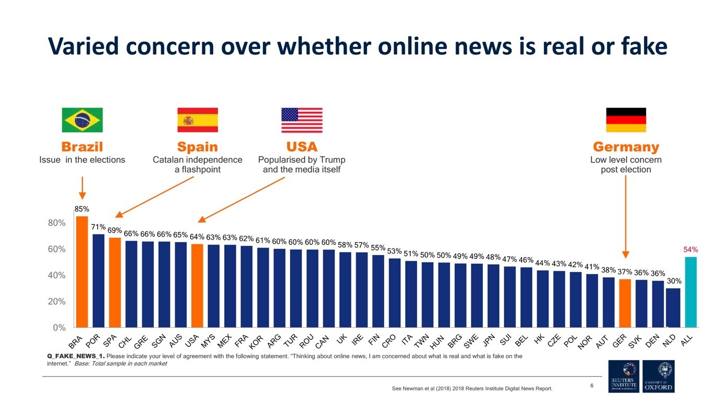
Vizualization of misinformation over the world

Slide 10
Conclusion
In conclusion, the proliferation of fake news poses significant challenges to society, undermining trust in media and distorting public perception. Addressing this issue requires a multifaceted approach that includes enhancing media literacy, fostering critical thinking, and developing robust technological solutions to combat misinformation. By creating dedicated spaces for education, dialogue, and collaboration, we can empower individuals and communities to discern credible information from falsehoods. Ultimately, a collective commitment to promoting truth and transparency is essential for safeguarding democratic processes and nurturing a well-informed society. As we navigate the complexities of the digital age, it is imperative to prioritize the integrity of information and cultivate a culture of responsible media consumption.

Slide 11
Thank you !

