Slide 1


MOST POPULAR COMPONENTS OF SYNCFUSION SOFTWARE
PRESENTER NAME: TAMILPRIYA TS | SF4649

Slide 2

MOST POPULAR COMPONENTS:
Data Grid
Charts
List View
Scheduler
Diagram
PDF Viewver

Slide 3
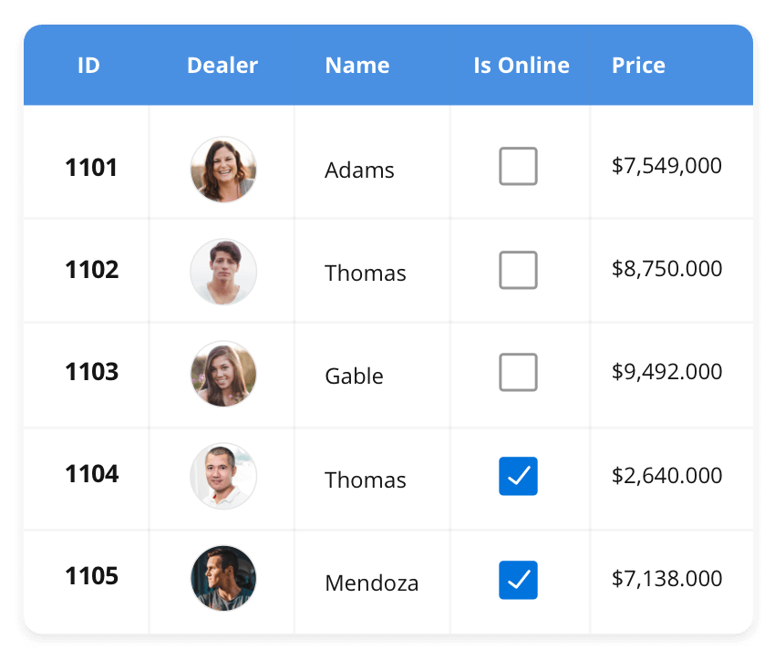




DataGrid | Chart | ListView | Scheduler | Diagram | PDFViewer
DataGrid
The DataGrid control is a high-performance grid component
that helps display and manipulate large amounts of data in a
tabular format. Its rich feature set includes functionalities like
data binding, sorting, grouping, editing, filtering, swiping,
dragging, resizing, loading more items, pull-to-refresh, and
exporting to Excel and PDF file formats.
SUPPORTED PLATFORMS
JavaScript Angular React Vue Blazor
Flutter ASP.NET MVC ASP.NET Core
WinForms WPF WinUI Flutter Xamarin
UWP .NET.MAUI
Xamarin Flutter UWP JavaScript .NETMAUI

Slide 4
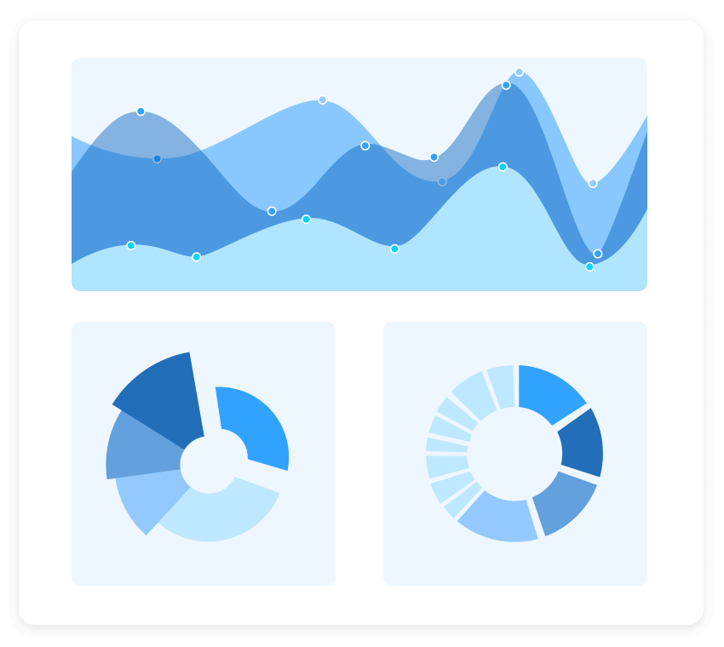
DataGrid | Chart | ListView | Scheduler | Diagram | PDFViewer
Chart
The Charts control can plot a wide range of chart types, ranging from line charts to specialized financial charts. Its rich feature
set includes functionalities like data binding, multiple axes,
egends, animation, data labels, annotations, trackballs,
tooltips, and zooming.
SUPPORTED PLATFORMS
JavaScript Angular React Vue Blazor
Flutter ASP.NET MVC ASP.NET Core
WinForms WPF WinUI Flutter Xamarin
UWP .NET.MAUI
Xamarin Flutter UWP JavaScript .NETMAUI

Slide 5
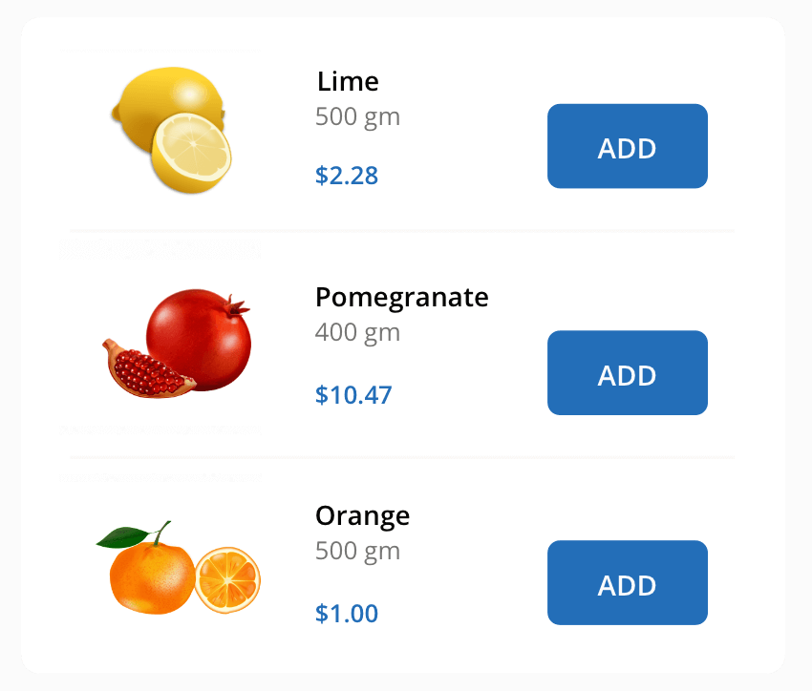
DataGrid | Chart | ListView | Scheduler | Diagram | PDFViewer
Chart
The ListView renders a set of data items with UI views or
custom templates. It has many features like grouping, sorting,
filtering, paging, swiping, multiple selection, drag and drop, and
different layout types. The ListView control has been optimized
to work with large amounts of data.
SUPPORTED PLATFORMS
JavaScript Angular React Vue Blazor
Flutter ASP.NET MVC ASP.NET Core
WinForms WPF WinUI Flutter Xamarin
UWP .NET.MAUI
Xamarin Flutter UWP JavaScript .NETMAUI

