Slide 1

Problem Statement:
Lap Compare –
Laptop Comparison Page
DESIGN DYNAMOS
25AM090 Saran R
25AM089 Santharam S
25AM091 Sathurmugan K
25AM107 Tamilselvan A
U23CS381 – Application Design and Development

Slide 2
Website Workflow / User Flow
Plan & Select Features
– Choose laptop models and decide comparison features (CPU, RAM, storage, GPU).
Create HTML Structure
– Add dropdown menus for selecting two laptops.
– Add a button to trigger comparison.
– Create an empty <div> to display the table.
Store Laptop Data (JavaScript Arrays/Objects)
– Store laptop details inside a JavaScript object/array.
Comparison Logic (JavaScript)
– Check if both laptops are selected.
– Compare features using conditions.
– Dynamically generate a comparison table using DOM.
Display Results on Webpage
– Insert the generated table into the result section.
Upload to GitHub
– Use Git commands to commit and push project to GitHub.
U23CS381 – Application Design and Development

Slide 3
Page Layout & Structure
Header Section
– Title: Lap Compare – Laptop Comparison
Selection Section
– Two dropdown menus to choose Laptop 1 and Laptop 2
– “Compare” button
Comparison Result Section
– Empty <div> where the dynamic comparison table will be displayed.
Footer (Optional)
– Simple note or copyright line
U23CS381 – Application Design and Development

Slide 4
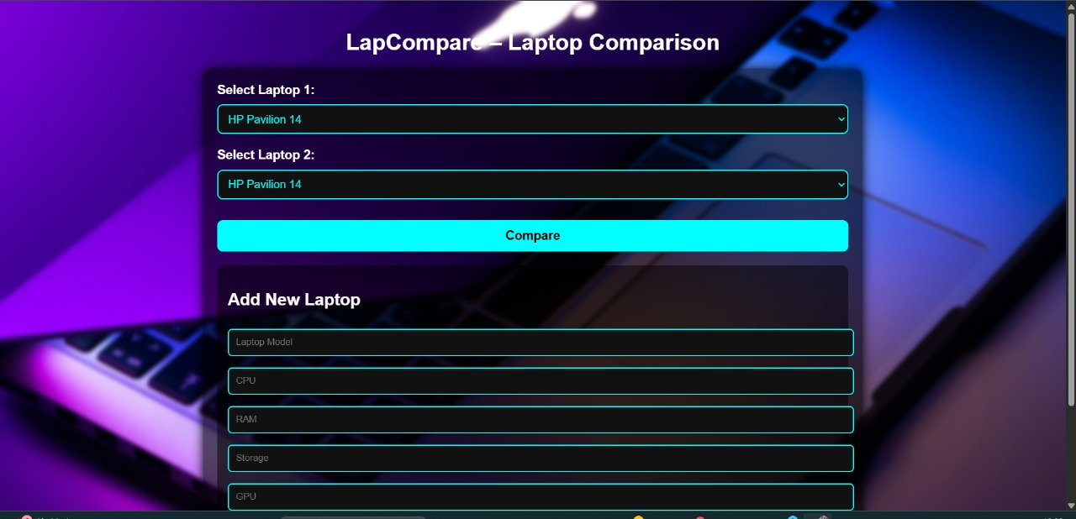
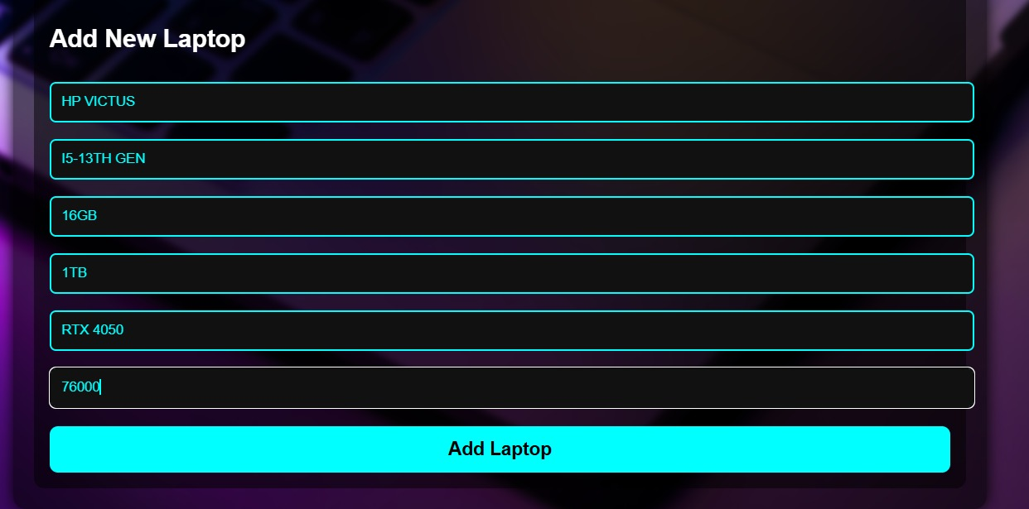
Screenshots
U23CS381 – Application Design and Development

Slide 5
