Slide 1
U.S. Metropolitan Healthcare Landscape Report – Power BI
TAMILSELVAN K M
DATE : 21-04-2025

Slide 2
Introduction
Purpose - Analyze healthcare infrastructure and social security stress in 83 U.S. metropolitan areas.
Problem addressed - Unequal distribution of healthcare resources and rapid growth in elderly population and Medicare recipients.
Importance - Supports better resource planning and healthcare delivery and aims to improve public health outcomes and elderly care

Slide 3
Data collection and quality enhancement
Key steps
Verified completeness of key columns
No missing or duplicated values found
Data types confirmed: City = Text, all others = Numeric
Ensured no negative values for hospitals, beds, or physicians

Slide 4
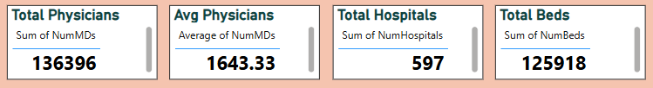
Data analysis and insights
Statistical overview – Total & average physicians, total beds, total hospitals

Slide 5
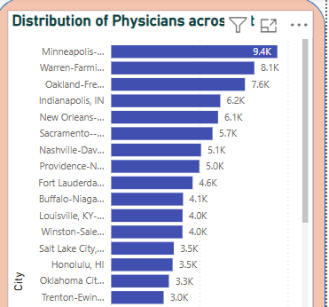
Power bi visuals
Bar chart - Distribution of doctors across cities

Slide 6
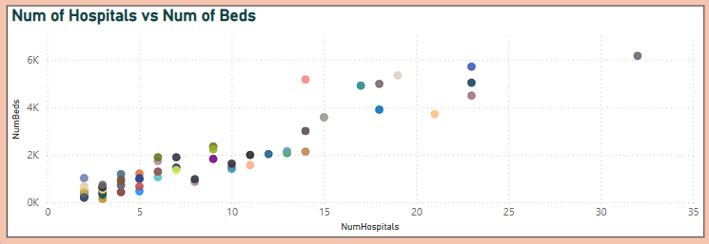
Scatter chart - Hospital vs. Bed relationship

Slide 7
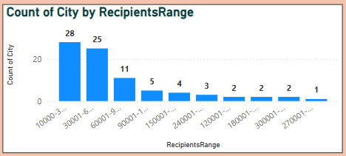
Histogram - Range of Social Security recipients by city

Slide 8
insights
Positive correlation between hospitals and beds
Some cities are under-resourced based on Medicare vs. Physician data

Slide 9
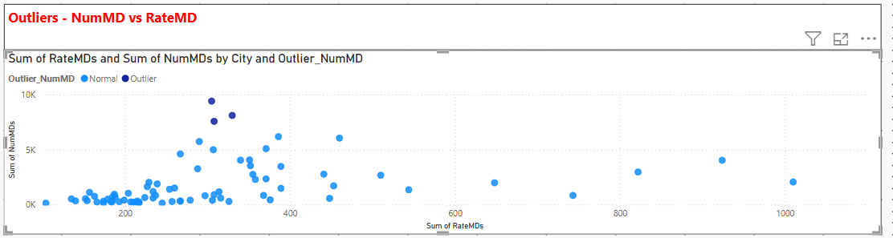
Outlier analysis
Highlighted cities with unusual data points
Found cities that with unusual numbers of doctors compare to population

Slide 10
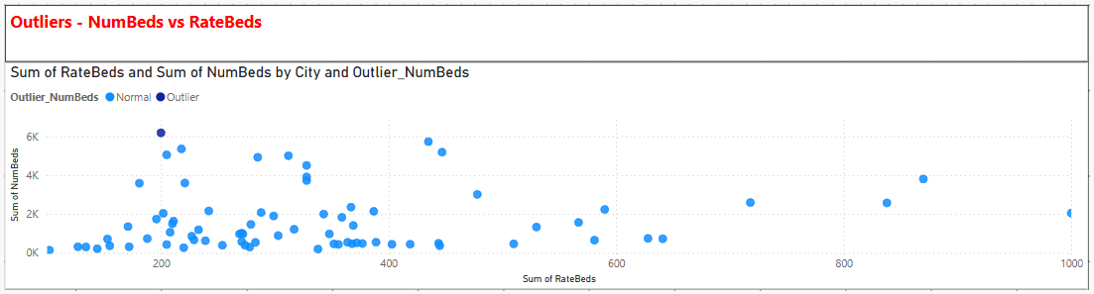
Found cities that have too few or too many hospitals beds

Slide 11
Feature engineering
Created new indicators: beds per hospital, doctors per hospital, Medicare to SSB ratio
Beds per hospitals - BedsPerHospital = MetroHealth83[NumBeds]/MetroHealth83[NumHospitals]
Doctors per hospitals - DoctorsPerHospital = MetroHealth83[NumMDs]/MetroHealth83[NumHospitals]
Medicare to SSB Ratio - MedicareToSSBRatio = MetroHealth83[NumMedicare]/MetroHealth83[SSBNum]

Slide 12
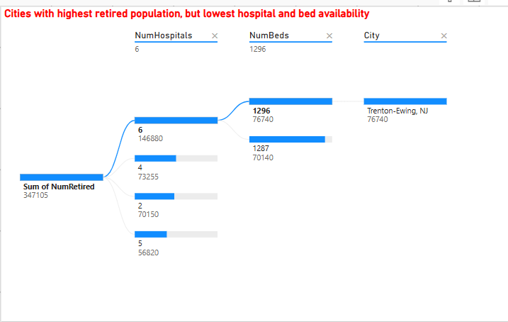
Decomposition tree

Slide 13
Key recommendations
Actions to take
Increase physician hiring in high-retirement areas
Expand hospital and bed capacity in underserved cities
Prioritize Medicare funding in fast-growing regions
Investigate cities with abnormal outlier stats

Slide 14
Real-world applications
Address healthcare inequality
Improve access to timely care
Guide future public health policies

Slide 15
Project conclusion
Summary
Analyzed healthcare infrastructure and retirement-related healthcare stress in 83 metro areas
Key Takeaways
Identified cities with potential healthcare gaps
Outliers provide actionable targets for intervention
Visualization helped uncover patterns and risks

Slide 16
Thank You

