Slide 1
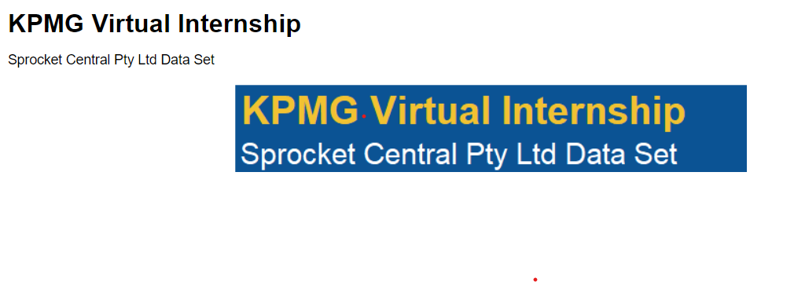
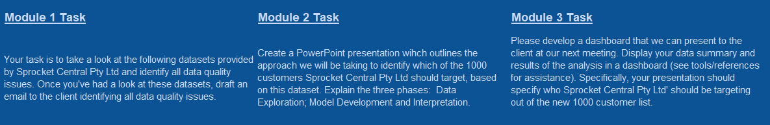

Slide 2
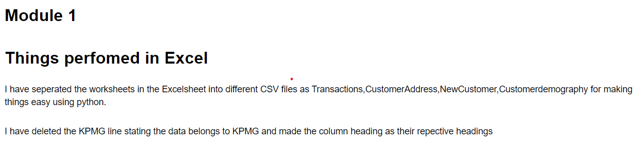
Basic Breakdown - 1

Slide 3
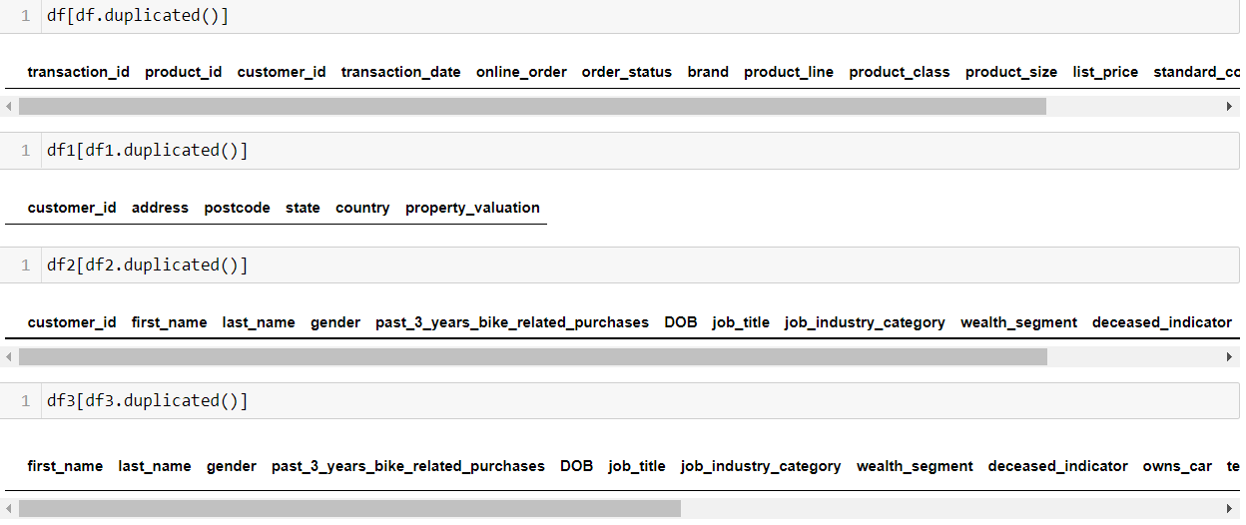
Checking for Duplicates 1. No Duplicates in Dataset.

Slide 4
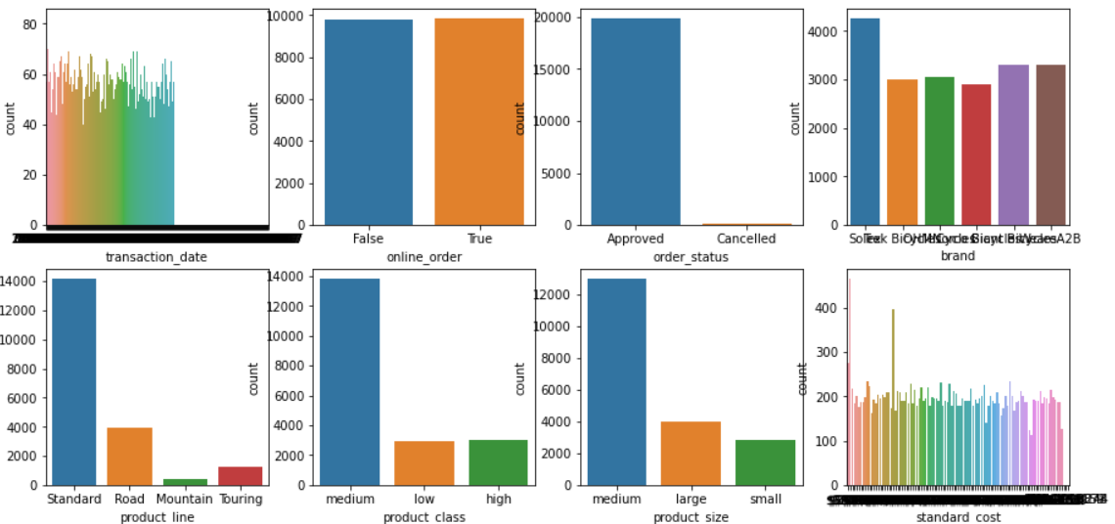
Exploratory Data Analysis Uni_Variant Analysics

Slide 5
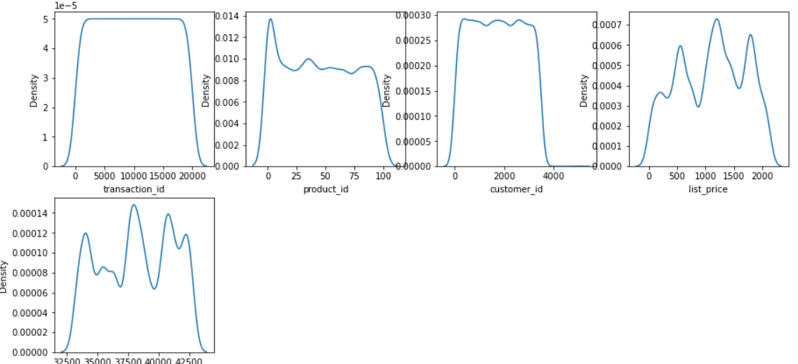
Uni_Variante Analysics [ Count_Plot ]

Slide 6
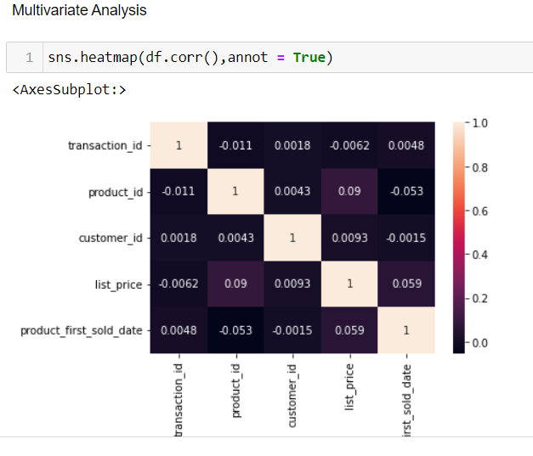
Multi_Variate Analysis

Slide 7
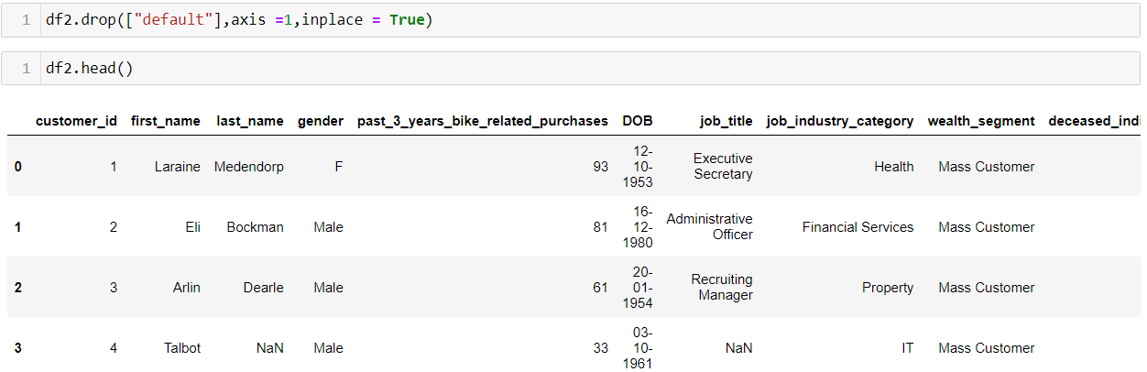
Model and Customer Segmentation 1.Drop the Unwanted Features which doesn’t add value to model prediction

Slide 8
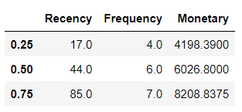
RFM Analysis
RFM values Derived from Dataset
Quantiles of RFM.

Slide 9
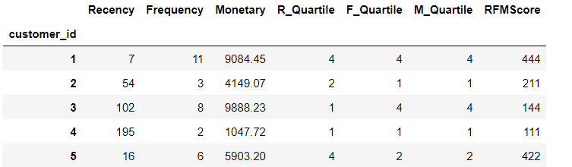
RFM SCORE Calculated from RFM Quantiles

Slide 10
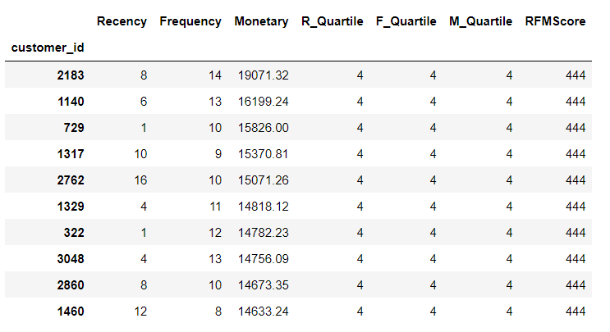
RFM Score For each customers

Slide 11
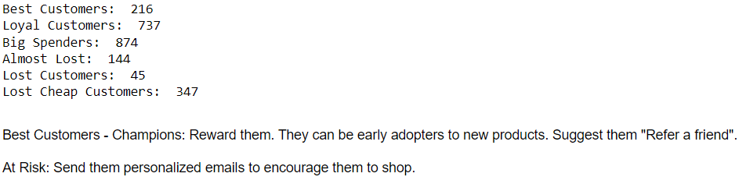
Customer Segmented based on RFM Score

Slide 12
THANK YOU!!

