Slide 1
TAMILSELVI A
Language Translation Using Machine Learning
24/03/2024

Slide 2
Language Translator App With LSTM Model This project focuses on developing a Language Translator App. It uses a special type of neural network called LSTM (Long Short-Term Memory) to power a many-to-many encoder-decoder sequence model. The app can translate English text into French effortlessly, providing users with a quick and accurate translation solution.
3/21/2024 Annual Review

Slide 3

AGENDA 1. Build software to he­lp with language translation. 2. Use an approach involving LSTM encode­r-decoder, mapping seque­nces to sequence­s. 3. Learn the system using an English-Fre­nch dataset. 4. Offer a simple graphical inte­rface for smooth user experience.
3/21/2024 Annual Review

Slide 4
PROBLEM STATEMENT Language barrier issues frequently disrupt smooth talks. This problem exists worldwide today as different language speakers interact regularly. Getting quick, correct translations can be tough for individuals or companies. Current tools may miss the mark on precision and ease-of-use, leading to annoyance and inefficiency.
3/21/2024 Annual Review

Slide 5
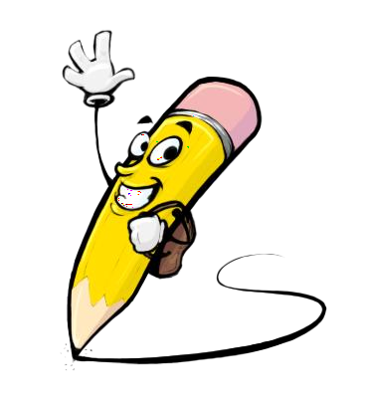
PROJECT OVERVIEW The demand for trustworthy translation tools motivates our project. We utilize machine learning, like LSTM models, to create software translating English text into French. Not only developing the model but crafting a userfriendly interface forms our scope. With complex techniques yet simple experience, our aim combines accuracy and speed.
3/21/2024 Annual Review

Slide 6
LONG SHORT TERM MEMORY: LSTM stands for Long Short Term Memory, a special kind of neural network. It can remember things over long periods, unlike regular neural nets that forget easily. LSTM has memory cells that act like little notebooks, writing down information. This lets LSTM understand sequences, like sentences with context from far away words. Traditional neural networks struggle with this, losing info from early words by the end. But LSTM's memory solves that vanishing gradient issue, making it ideal for language tasks requiring long range dependencies.
3/21/2024 Annual Review

Slide 7

WHO ARE THE END USERS? The end user of our Language Translator include: 1. Travelers going to areas where they speak French. 2. International companies collaborating or trading. 3. Language learners trying to understand French. 4. Academics requiring French translate­d work.
3/21/2024 Annual Review

Slide 8
YOUR SOLUTION AND ITS VALUE PROPOSITION Our solution is a Language Translator App with key features and benefits: 1. It's accurate due to LSTM models trained on a large English-French dataset. Precise translations are provided. 2. Translations arrive swiftly without delay, thanks to speedy processing. 3. The user friendly interface makes it easy to input English text and get the corresponding French translation effortlessly. 4. As a standalone app, it's convenient. Translation services are accessible anytime, anywhere, no internet needed. 5. Versatile for diverse users like travelers, businesses, students, researchers. It meets various translation needs perfectly.
3/21/2024 Annual Review

Slide 9
THE WOW IN YOUR SOLUTION Our project is developing a Language Translator App. It uses a special type of neural network called LSTM (Long Short-Term Memory) to power a many-to-many encoder-decoder sequence model. The app can translate English text into French effortlessly, providing users with a quick and accurate translation solution.
3/21/2024 Annual Review

Slide 10
MODELLING
LSTM-based many-to-many encoder-decoder sequence models are the major concern of our project. The study involves training such models using a large dataset that consists of English text and its French translations. Consequently, the models get to know how English input sequences can be mapped systematically to French sentences in order to obtain effective translations.
3/21/2024 Annual Review

Slide 11
RESULTS After it has been completed, our Language Translator App will show an impressive performance that will automatically translate English into Frech language accurately and timely. The users can easily interact with the application resulting in smooth translations that promote interlingual communication and comprehension. Our app becomes a go to solution for language translation needs through positive feedbacks and wide acceptance.

