Slide 1
ReAct Architecture

Slide 2
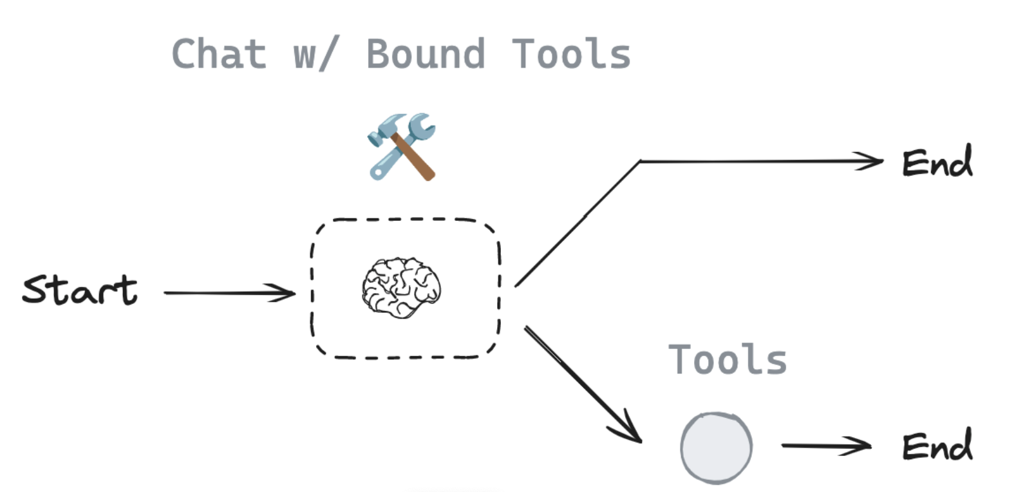
Router
The chat model will decide to make a tool call or not based upon the user input
Use a conditional edge to route to a node that will call our tool or simply end

Slide 3
ReAct
In router, the model is invoked and, if it chose to call a tool, returned a ToolMessage to the user.
But, what if we simply pass that ToolMessage back to the model?
We can let it either (1) call another tool or (2) respond directly.
This is the intuition behind ReAct, a general agent architecture.
act - let the model call specific tools
observe - pass the tool output back to the model
reason - let the model reason about the tool output to decide what to do next (e.g., call another tool or just respond directly)

Slide 4
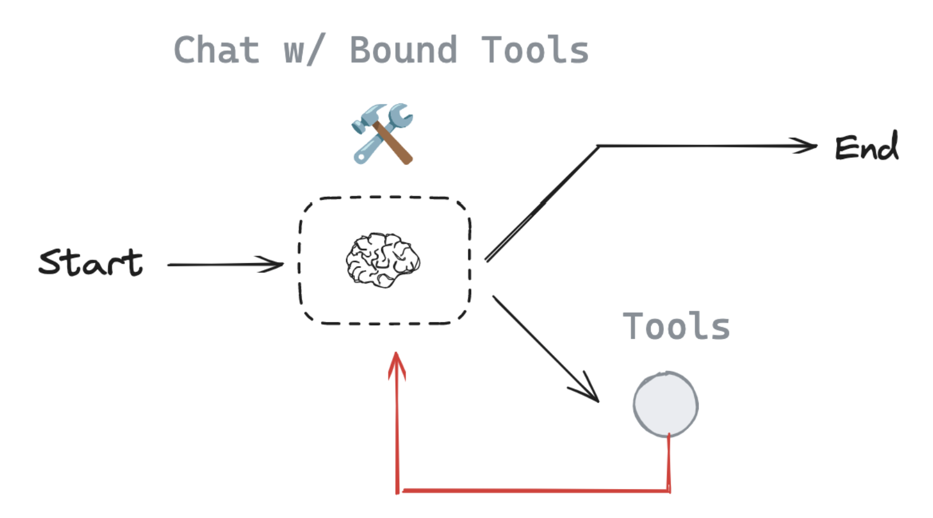
ReAct Architecture

