Slide 1

Presentation Topic: HISTORY OF MOBILE COMMUNICATION
Course Title: English language and literature
Course code: ICT - 1211
Supervised By,
Name: Dr. Nazrul Islam
Associate Professor,
Department of Information and Communication Technology
MBSTU
Presented By,
Nmae : Mushfilur Rahman Tamim
ID : IT – 25028
Session: 2024-25
Department of Information and Communication Technology
MBSTU

Slide 2
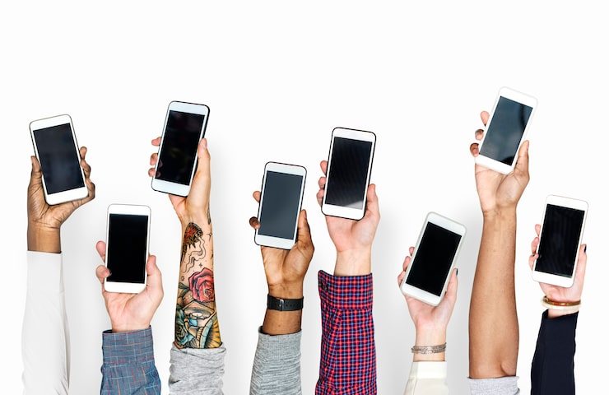
Introduction
Definition of mobile communication
In sort, Communication without physical connection
Example: Used in phones, internet, satellites etc
[1]

Slide 3
Early Communication Methods
Letters and Massage
Smoke signals and Drums

Slide 4
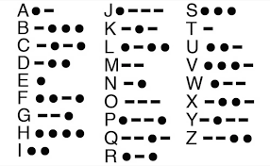
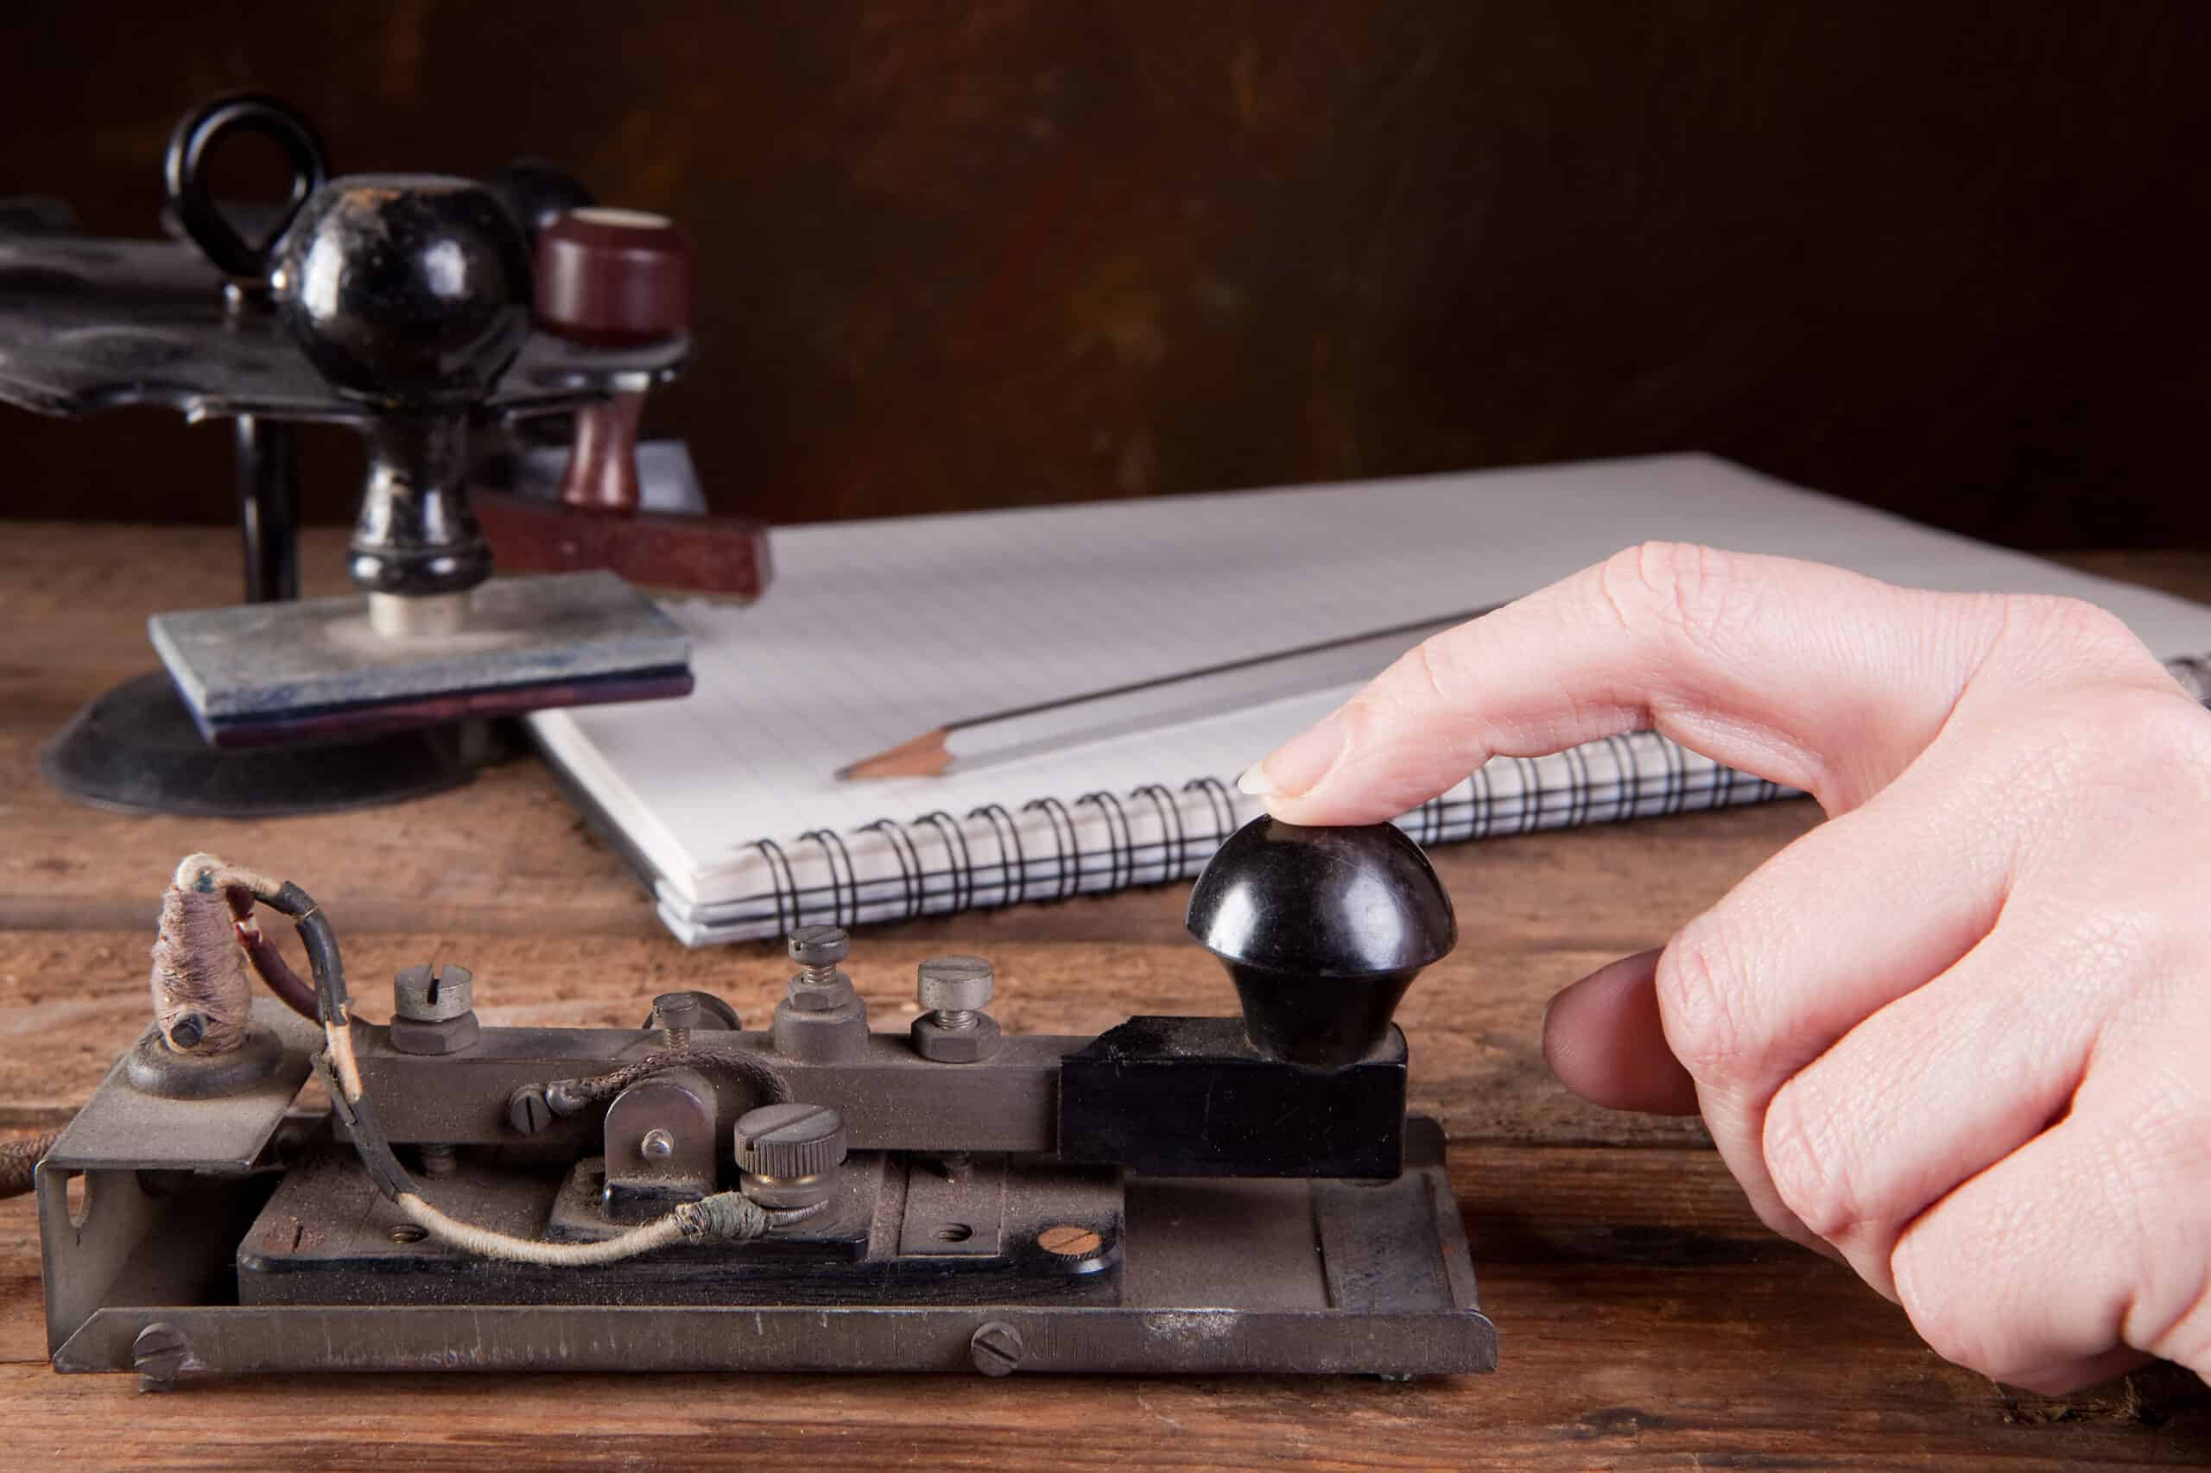
Telegraph (1830s–1840s)
First electrical communication system.
[2]
Used Morse code to sent massage over wires.
But it was very hard to learn and Low Efficiency .
[3]

Slide 5
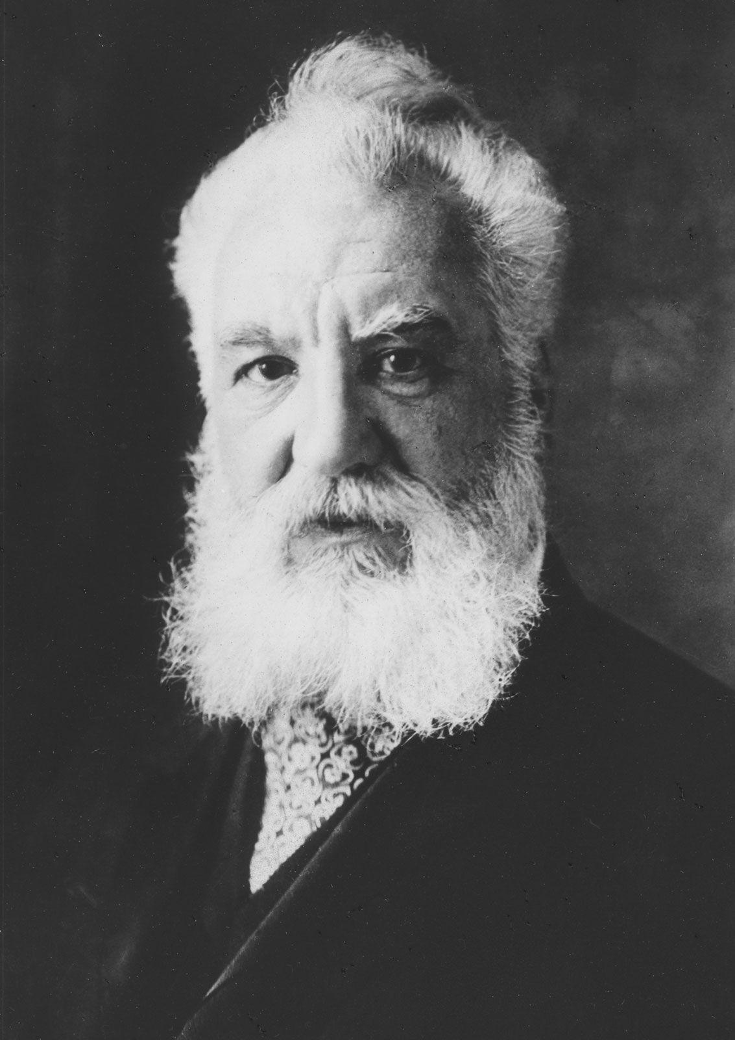
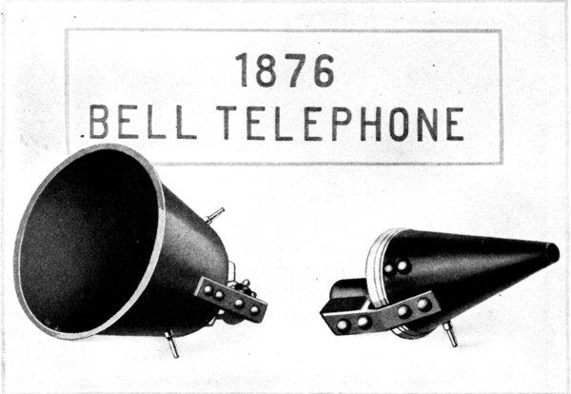
Telephone (1876)
Invented by Alexander Graham Bell
First voice communication devise
Worked through wired network
[4]
[5]

Slide 6
Discovery of Radio Waves
Enabled wireless communication
Used electromagnetic waves
Late 1800s scientific breakthrough

Slide 7
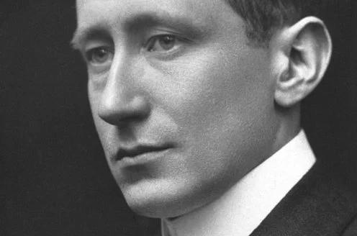
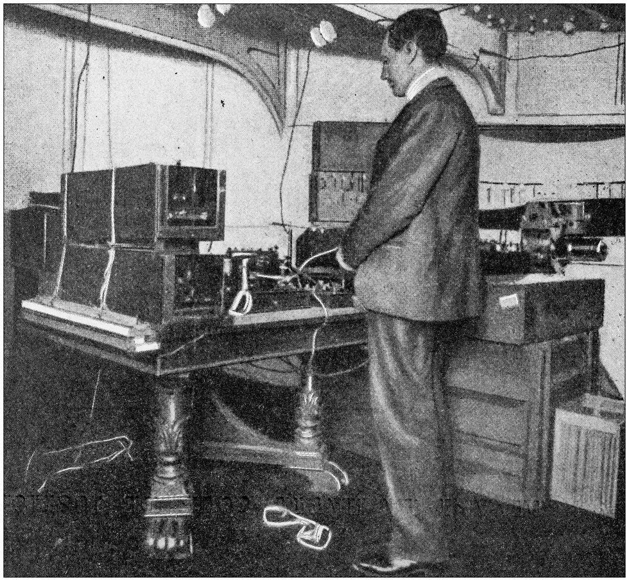
Wireless Telegraphy
Developed by Guglielmo Marconi
First long-distance wireless signals
Used in ships and military
[6]
[7]

Slide 8
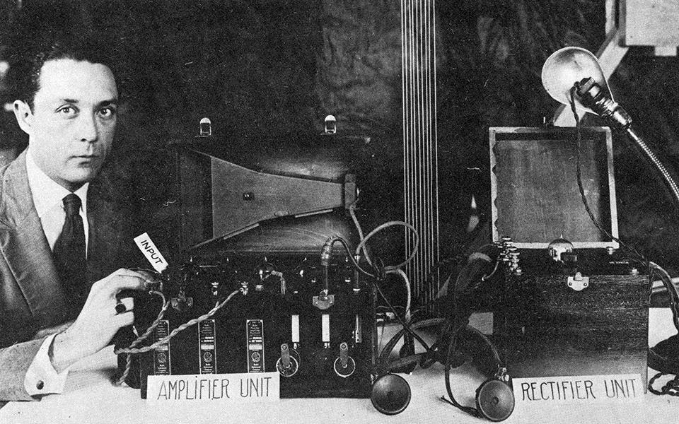
Early Mobile Radio Systems
Used in police and military
Large and heavy equipment
Limited coverage
[8]

Slide 9
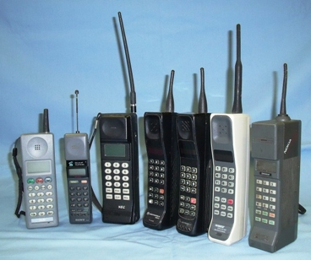
First Generation (1G)
Introduced in 1980s
Analog signals
Voice calls only
[9]

Slide 10
Limitations of 1G
Poor sound quality
No encryption (security issues)
Large and expensive phones

Slide 11
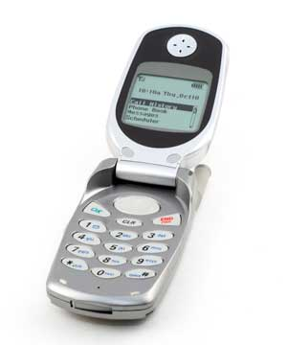
Second Generation (2G)
Introduced in 1990s
Digital communication
SMS (text messaging)
[10]

Slide 12
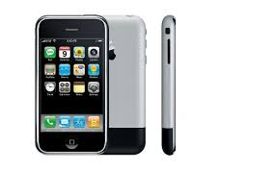
Third Generation (3G) – 2000s
Mobile internet introduced
Video calls possible
Faster data transfer
[11]

Slide 13
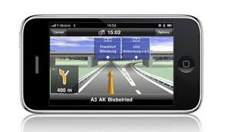
Features of 3G
High-speed internet browsing
Multimedia messaging (MMS)
Video streaming support
GPS navigation services
[12]

Slide 14
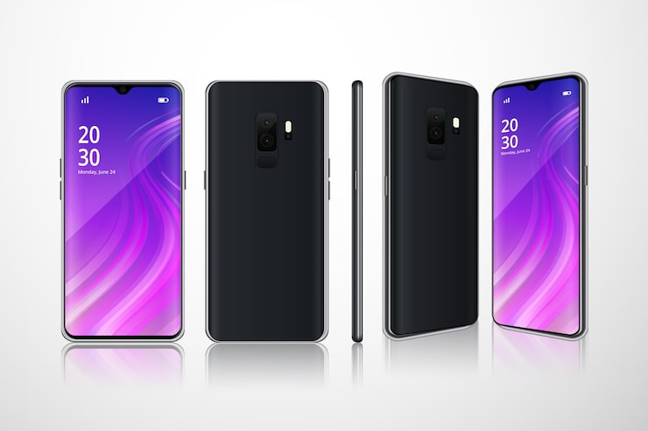
Fourth Generation (4G) – 2010s
LTE technology
High-speed internet
HD video streaming
[13]

Slide 15
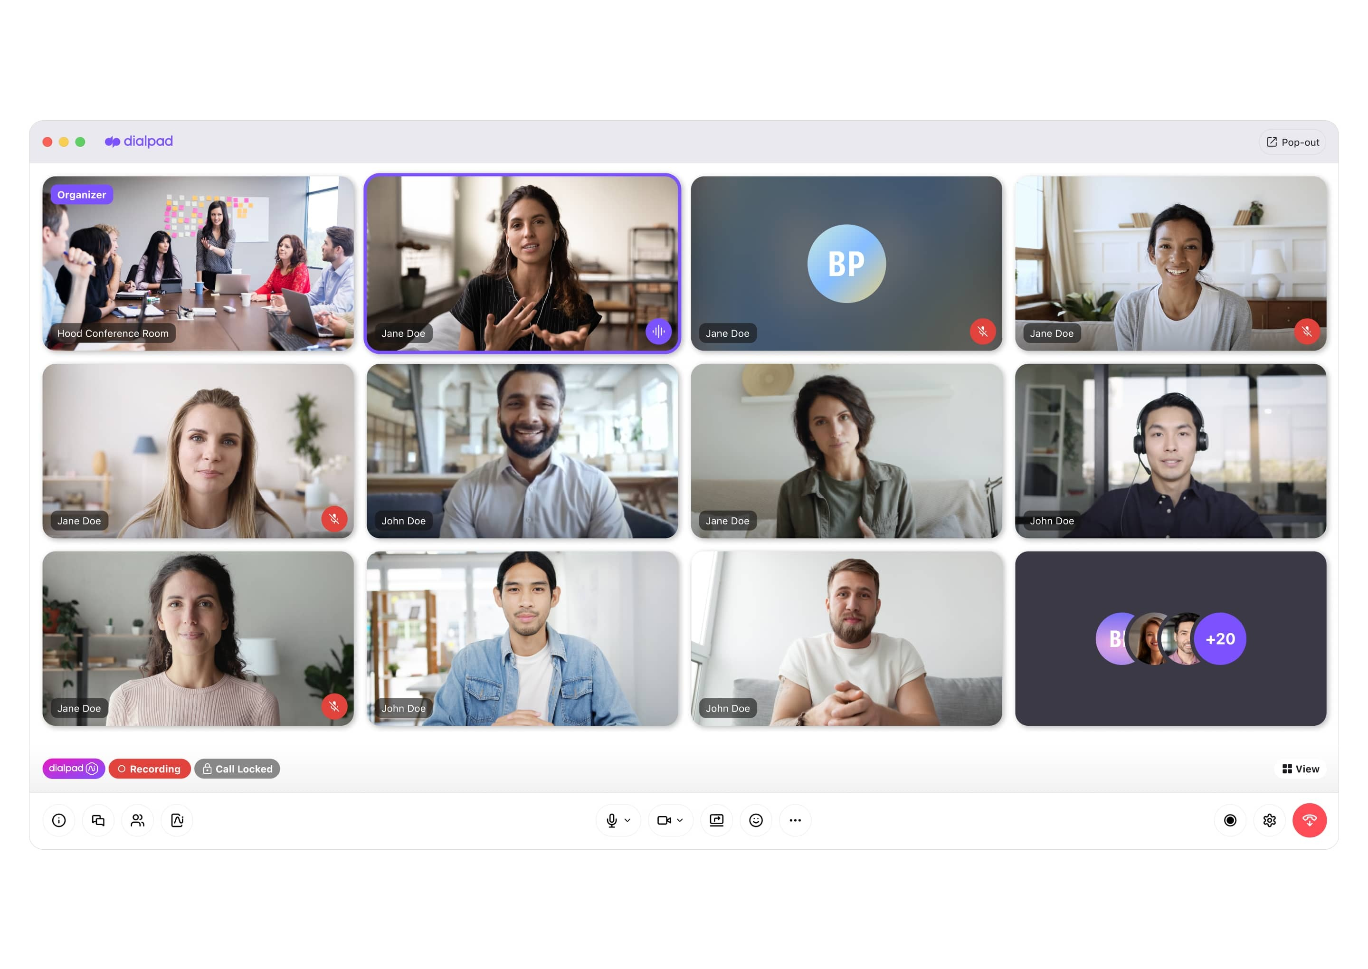
Advantages of 4G
Fast downloads and uploads
High-quality video calls
Stable internet connection
Supports advanced apps
[14]

Slide 16
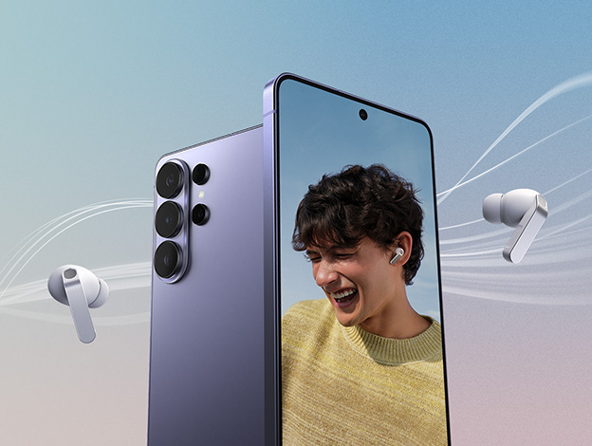
Fifth Generation (5G) – Present
Ultra-fast connectivity
Very low latency
Supports massive devices
[15]

Slide 17
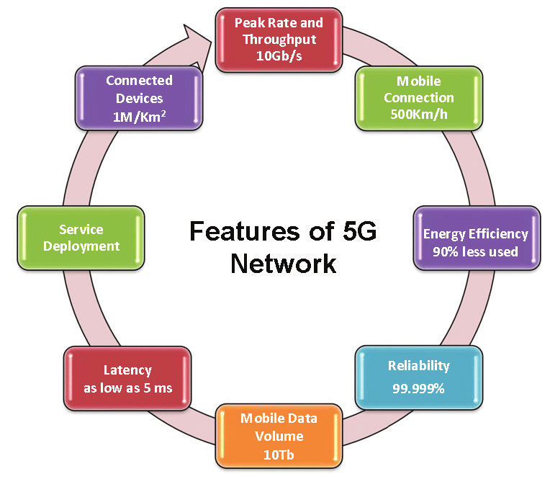
Features of 5G
Speed up to gigabits per second
Supports IoT devices
AI-powered networks
Real-time communication
[16]

Slide 18

Impact on Society
Global connectivity
Business transformation
Education access
Social networking growth
[17]

Slide 19
References
[1]https://en.todoandroid.es/What-is-the-best-high-end-Android-mobile-phone/
[2] https://lingolandedu.com/en/english-english-dictionary/morse-code
[3] https://www.barrettcommunications.com.au/wp-content/uploads/2024/01/AdobeStock_192969351-scaled.jpeg
[4] https://fineartamerica.com/featured/graham-bell-topical-press-agency.html
[5] https://encrypted-tbn0.gstatic.com/images?q=tbn:ANd9GcT8Nrzd_Hjd9B7b2NSYXKaxXzFFhqK0jE8O6UFfF9j_W3Pxiij9
[6] https://www.nobelprize.org/prizes/physics/1909/marconi/biographical/
[7] https://encrypted-tbn3.gstatic.com/images?q=tbn:ANd9GcR6lfmakHYBHjE-2rE0RX7wHl6WfS_g1AirTJ6eqwVI_K_3iYVd
[8] https://www.nist.gov/image/ac-radio-lowelljpg
[9] https://newatlas.com/mobile-pnone-40-year-anniversary-photos/25677/
[10] https://research.a-star.edu.sg/articles/highlights/weakness-of-2g-mobile-phone-networks-revealed/
[11] https://blog.xoxzo.com/2018/08/10/history-of-3g/
[12] https://www.mobilefun.co.uk/blog/2009/06/using-sat-nav-on-the-iphone-3g-and-iphone-3gs/
[13] https://www.freepik.com/free-photos-vectors/samsung-mobile
[14] https://www.dialpad.com/jp/features/video-call/[15] https://www.samsung.com/uk/smartphones/galaxy-s26-ultra/
[16] https://vajiramandravi.com/upsc-exam/5g-technology/
[17] https://www.ironorbit.com/what-is-5g-and-why-should-you-care/
BOOK FOLLOWED :THE CELLPHONE: THE HISTORY AND TECHNOLOGY OF THE GADGET THAT CHANGED THE WORLD BY GUY CLEMENS.

Slide 20


