Slide 1
Newton’s Divided Difference Polynomial Method of Interpolation
Author: Autar Kaw et. al.
Textbook: TEXTBOOK: NUMERICAL METHODS WITH APPLICATIONS

Slide 2
Newton’s Divided Difference Method of Interpolation

Slide 3
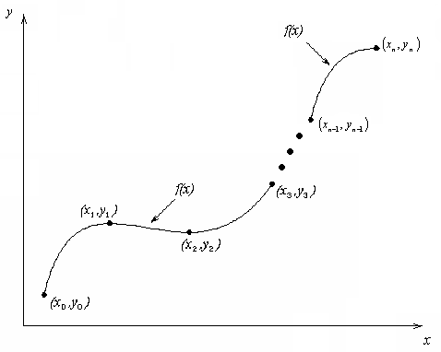
What is Interpolation ?
Given (x₀,y₀), (x₁,y₁), …… ,(x_{n},y_{n}), find the value of ‘y’ at a value of ‘x’ that is not given.

Slide 4
What is Interpolation ?
Given (x₀,y₀), (x₁,y₁), …… ,(x_{n},y_{n}), find the value of ‘y’ at a value of ‘x’ that is not given.
Interpolation is the process of estimating unknown values that fall between known values
Application: In engineering and science, one often has a function for a limited number of data points. Interpolation is required for finding the function’s value at some intermediate points

Slide 5

Interpolants
Polynomials are the most common choice of interpolants because they are easy to:
  Evaluate
  Differentiate, and
  Integrate.

Slide 6



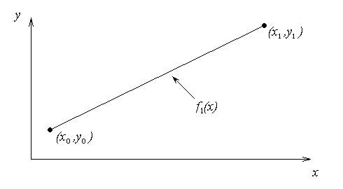

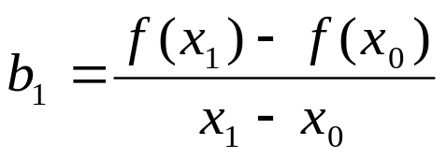
Newton’s Divided Difference Method
Linear interpolation: Given pass a linear interpolant through the data
where

Slide 7
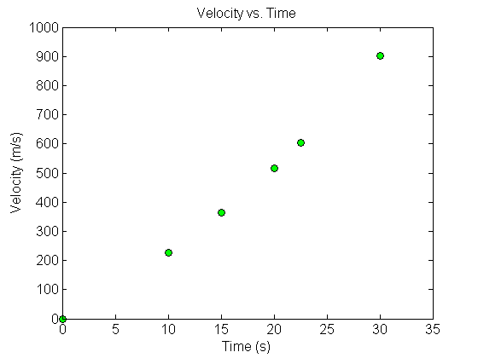



Example
The upward velocity of a rocket is given as a function of time in Table 1. Find the velocity at t=16 seconds using the Newton Divided Difference method for linear interpolation.
Table. Velocity as a
function of time
0 | 0
10 | 227.04
15 | 362.78
20 | 517.35
22.5 | 602.97
30 | 901.67
Figure. Velocity vs. time data
for the rocket example

Slide 8
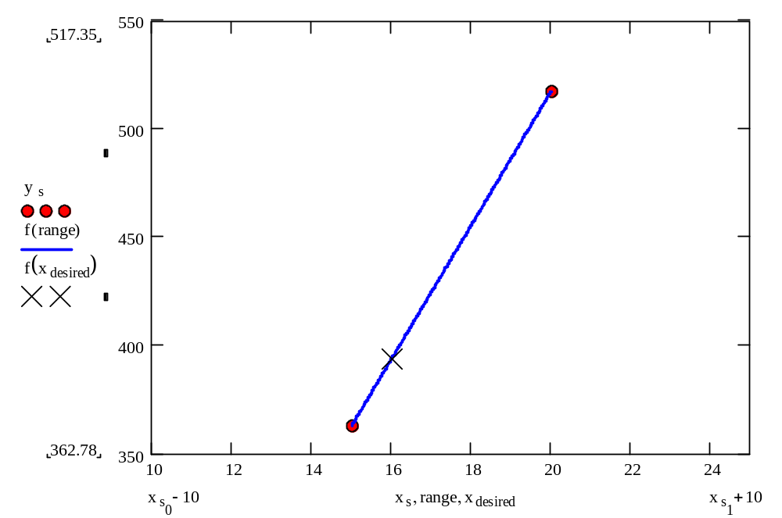
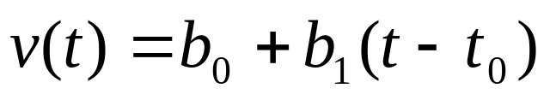
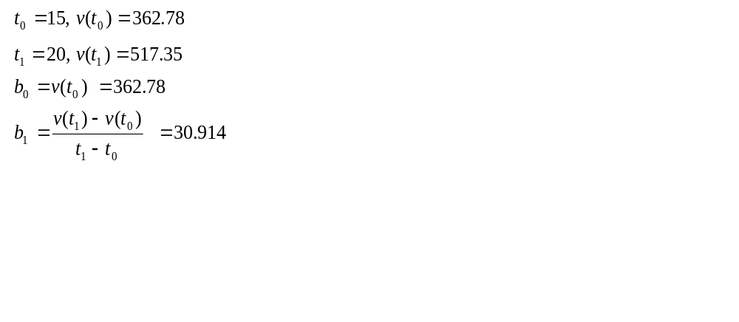
Linear Interpolation

Slide 9
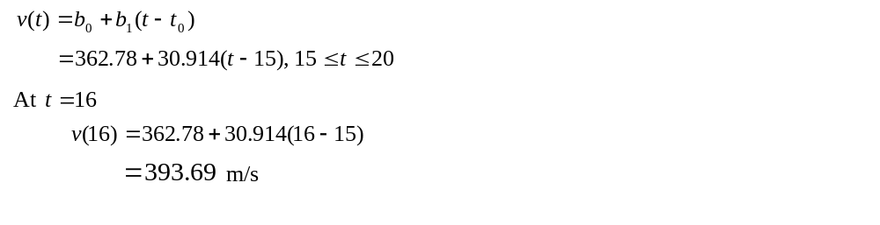
Linear Interpolation (contd)

Slide 10

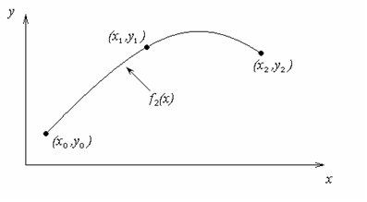
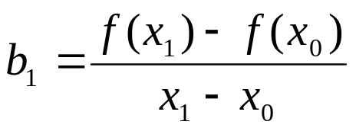
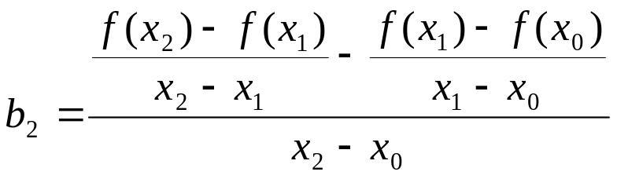
Quadratic Interpolation

Slide 11
Example
The upward velocity of a rocket is given as a function of time in Table 1. Find the velocity at t=16 seconds using the Newton Divided Difference method for quadratic interpolation.
Table. Velocity as a
function of time
0 | 0
10 | 227.04
15 | 362.78
20 | 517.35
22.5 | 602.97
30 | 901.67
Figure. Velocity vs. time data
for the rocket example

Slide 12
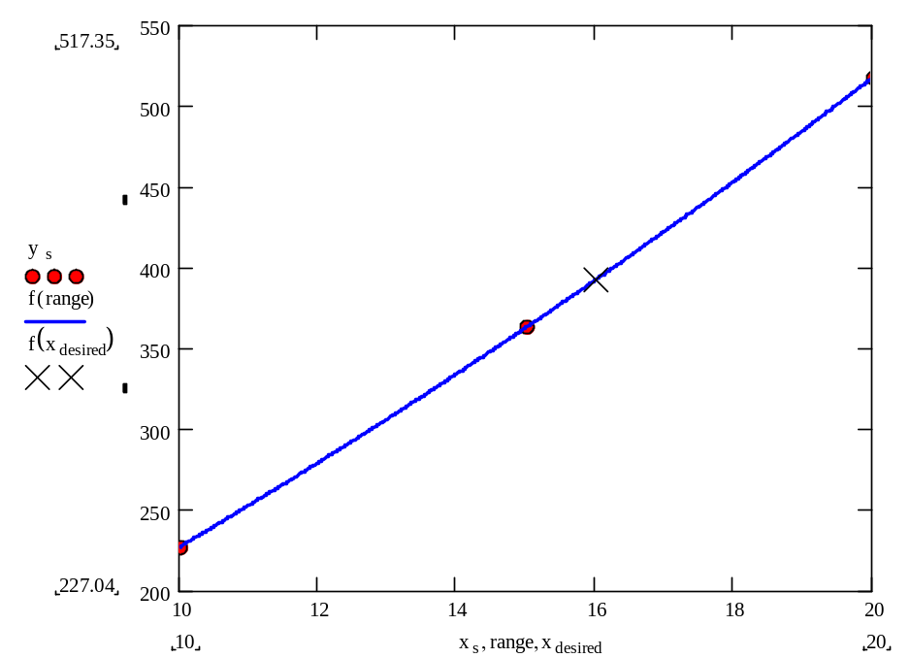
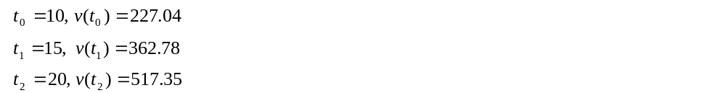
Quadratic Interpolation (contd)

Slide 13
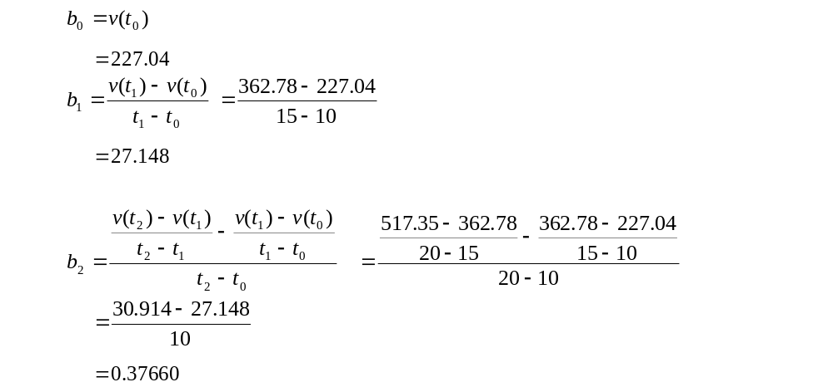
Quadratic Interpolation (contd)

Slide 14
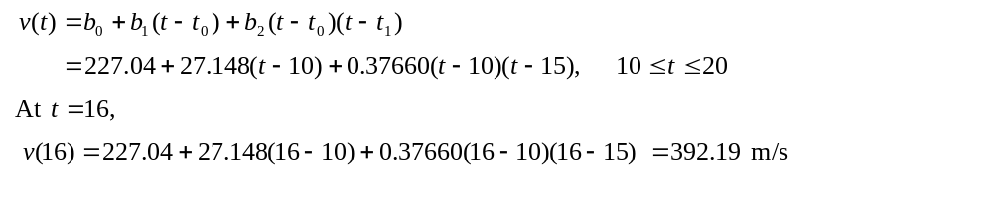
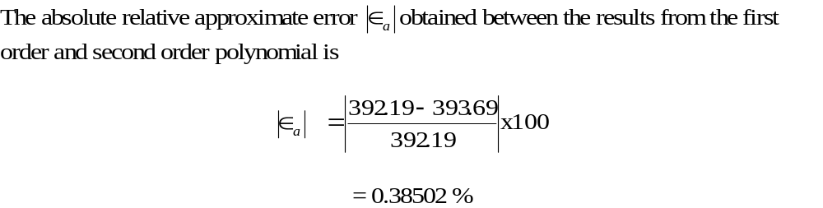
Quadratic Interpolation (contd)

Slide 15
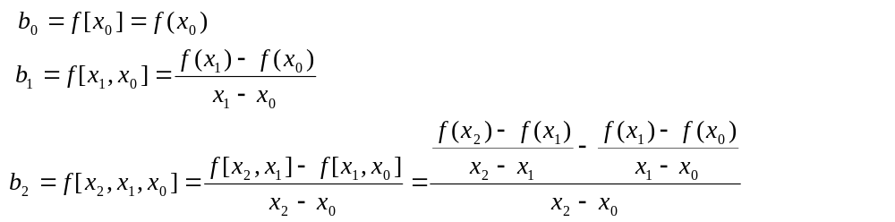
General Form
where
Rewriting

Slide 16
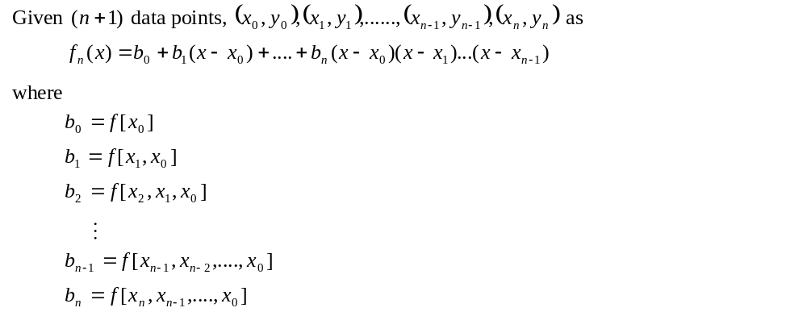
General Form

Slide 17
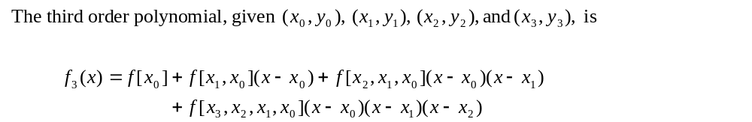
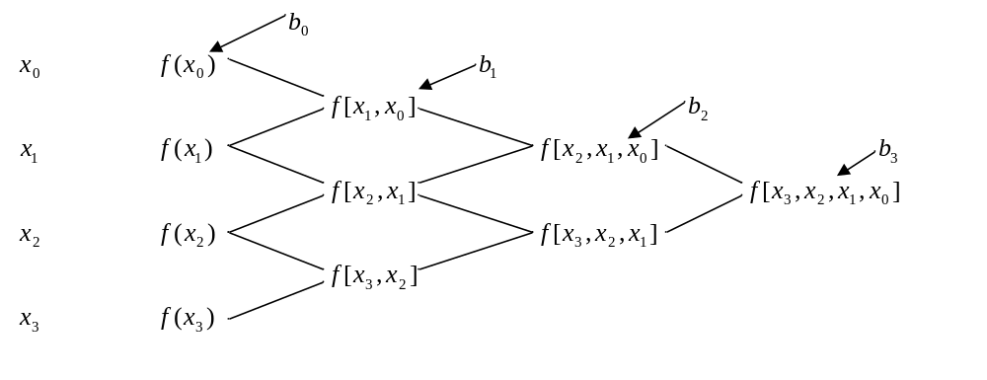
General form

Slide 18
Example
The upward velocity of a rocket is given as a function of time in Table 1. Find the velocity at t=16 seconds using the Newton Divided Difference method for cubic interpolation.
Table. Velocity as a
function of time
0 | 0
10 | 227.04
15 | 362.78
20 | 517.35
22.5 | 602.97
30 | 901.67
Figure. Velocity vs. time data
for the rocket example

Slide 19

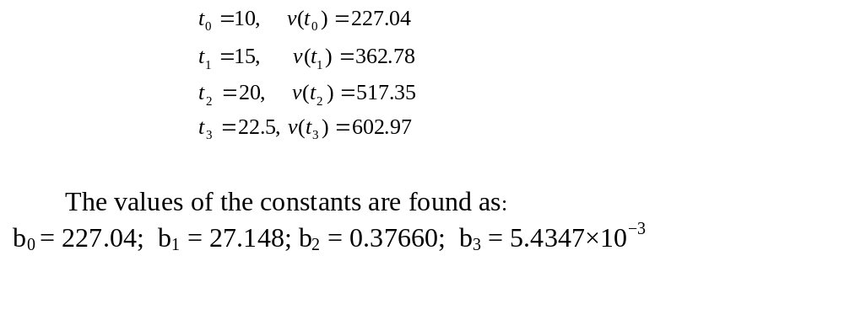
Example
The velocity profile is chosen as
we need to choose four data points that are closest to

Slide 20
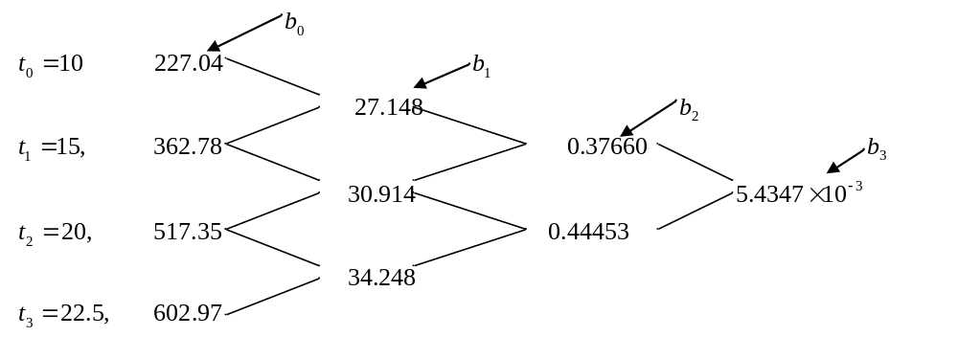
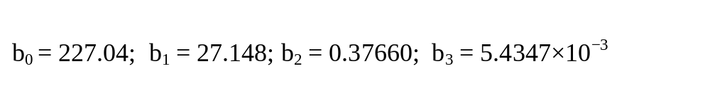
Example

Slide 21
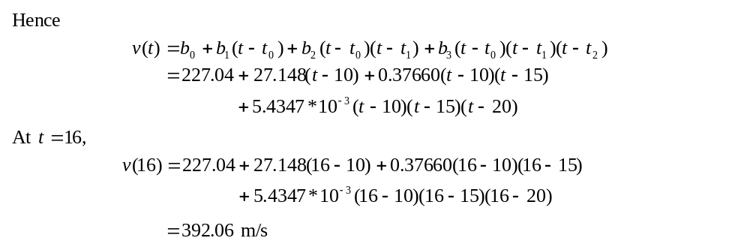

Example

Slide 22
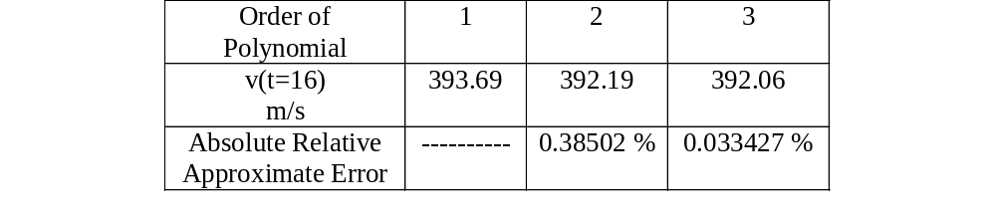
Comparison Table

Slide 23
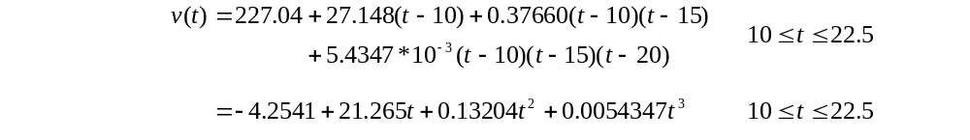
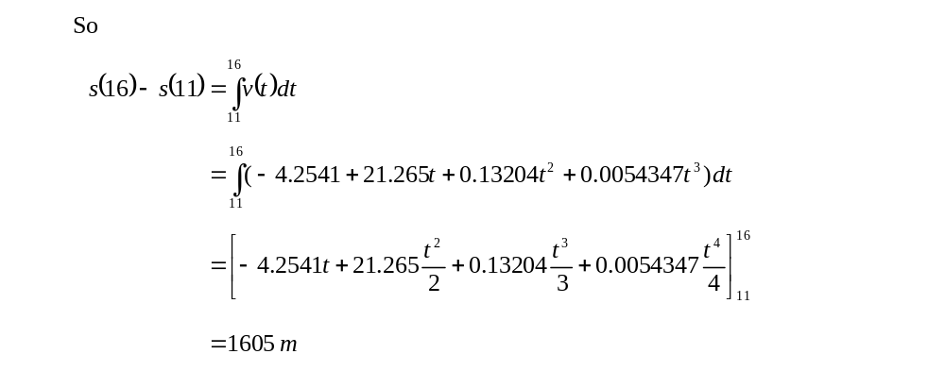
Distance from Velocity Profile
Find the distance covered by the rocket from t=11s to
t=16s ?

Slide 24
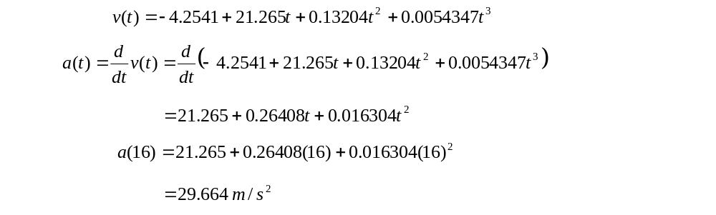
Acceleration from Velocity Profile
Find the acceleration of the rocket at t=16s given that

Slide 25
THE END

