Slide 1
The study of best fitted model to optimize machine learning accuracy
Name: Md Tamim ikbal
ID:23066608

Slide 2
Contents
Learning Objectives
Machine learning & techniques
Explain Tree models and how they works
Implementing tree models on dataset
Result and Analysis
Conclusion
references

Slide 3
Learning Objectives
Understand the basics Machine learning
Explore Three machine learning techniques and their performance
Learn how this Three Ml models works
Evaluate those models and analyze performance using a dataset
Learn feature engineering and preprocessing using the dataset
Learn About best fit model and result

Slide 4
What is Machine Learning?
In a words machine learning is a part of artificial intelligence that learn from data and make predictions or decisions without being explicitly programmed.
ML TECHNIQUES:
Supervised learning: training MODEL WITH labeled data.
Unsupervised learning: it identifies the hidden patterns from unlabeled data.
Reinforcement learning: learning through rewards and penalties.
Semi-supervised learning: it combines labeled and unlabeled data for training.

Slide 5
Explain Targeted three Ml Techniques and working procedure
Decision tree
Random forest
Ada boost

Slide 6
Decision Tree - How it Works
A decision tree is a supervised learning algorithm which is commonly used for both classification and regression tasks. This model predicts outcome as a tree-like structure where internal nodes represent attribute tests, branches represent attribute values, and leaf nodes represent final decisions or predictions.
Three important components of DT are,
Nodes : nodes are represent features.
Edges : edges are represent the decision rule.
Leaves : leaves are represent the outcomes (class labels or continuous values)

Slide 7
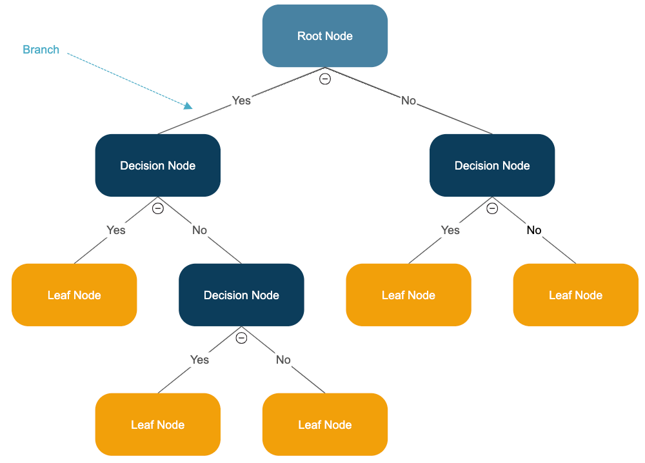
Selects the best feature to split the dataset based on the criteria like gini impurity or information gain
This process create multiple levels branches recursively, until the stopping criteria are met leaf node.
At each split of dataset, the data is divided into subgroups which are mainly more homogeneous.
Fig.1.Block Diagram of DT

Slide 8
Random Forest - How it Works
Random forest is an ensemble learning method in machine learning that uses nth number of decision trees to predict outcomes. The final prediction is occurred by combining all of the predictions of individual trees in the forest where majority of voting for classification or averaging the outcomes for regression. Random forest mainly reduced the overfitting problem in ML

Slide 9
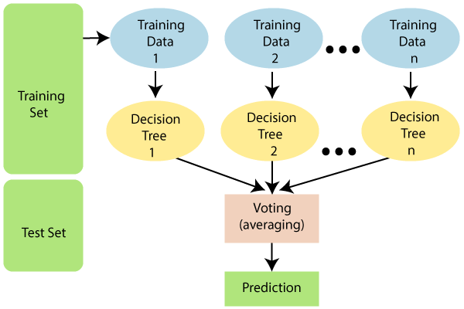
Data sampling: Select some data randomly to create subsets for each tree.
Feature selection: Select some feature randomly for each split tree
Training trees: Independently train each tree with that data
Aggregating : Use voting for classification and averaging for regression
Final outcomes: Shows final outcomes from maximum voting or averaging
Fig.2.Block diagram of Random Forest

Slide 10
AdaBoost - How it Works
ADABoost or Adaptive boost is an ensemble technique combines multiple weak learners mainly decision trees with only one split which is called "stumps" that create a strong learner. Adaboost adjusts the weight of each training model based on previous model’s error.

Slide 11
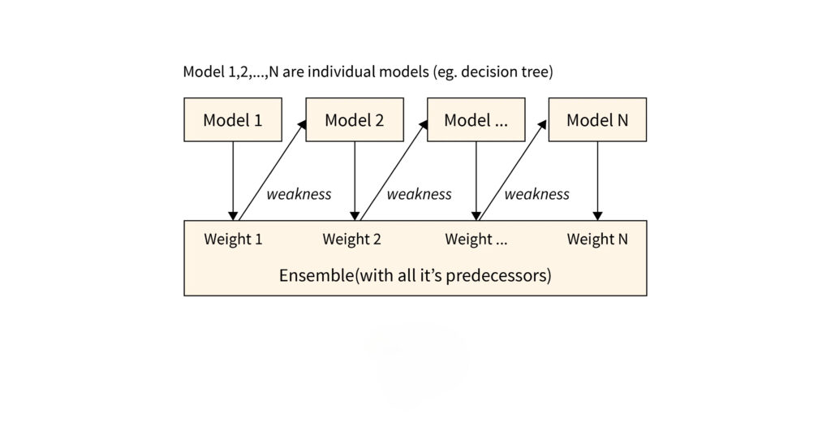
Initialize weights :It assign same weights to all training models.
Training Model: In ADABoost trains several weak classifiers sequentially, where each new classifier focuses on the mistakes made by the previous ones. It adjusts the weights of incorrectly classified instances to make them more influential for the next model.
Prediction: each weak classifier has a weight based on its accuracy. The final prediction is made by combining the predictions of all classifiers, weighted by their accuracy.
Fig.3. Block Diagram of ADA Boost

Slide 12
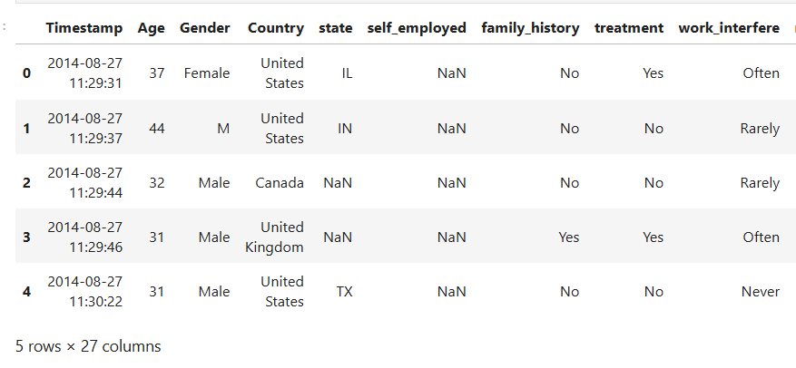
Overview of Dataset
IMPLEMENTING TREE MODELS ON DATASET
This dataset consists of 1,259 rows and 27 columns. short overview of the dataset:
This dataset contains information about employees' mental health and workplace and how these factors are connected to each other
binary, categorical, and numerical features are available
The dataset can be used for different purpose between mental health and various workplace factors but here aiming to predict whether an employee is receiving treatment for mental health or not.
Fig.4. First five records of dataset

Slide 13
Implementation
Data Preprocessing
Class Distribution
Data Splitting
Model Training and Evaluation
Visualization

Slide 14
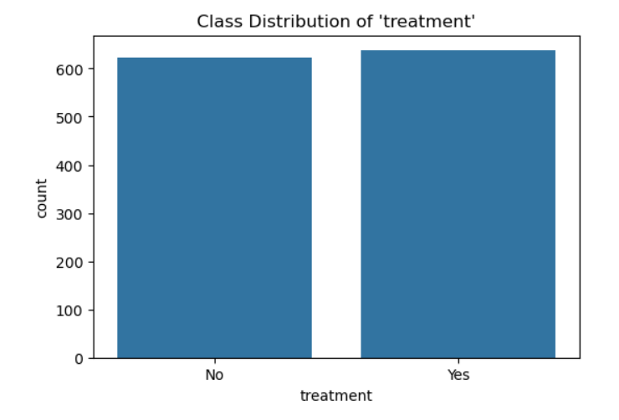
Data preprocessing:
Data cleaning: remove unwanted columns like timestamp, comments, state
Handling missing values: filled missing values.
Encoding categorical data: convert categorical variables into numerical values using label encoding. Example: gender
Class distribution:
Target variable: Treatment is the target variable , visualize this feature using countplot to see the class.
Data splitting:
Split the dataset into features and target where 80% for training, 20% for testing.
Fig.5.Countplot of Class Distribution

Slide 15
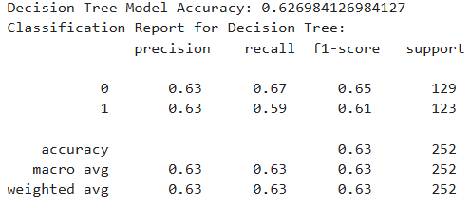
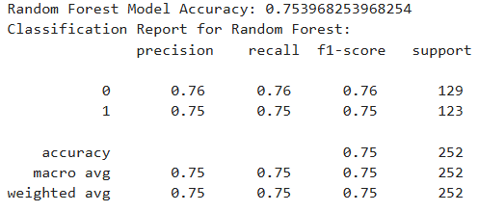
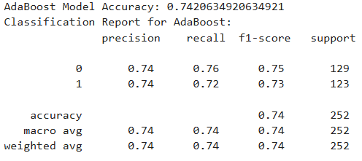
Model Training and Evaluation:
Decision tree: train a decision tree model and evaluate it using accuracy and classification reports.
Random forest: train a random forest model and evaluate it similarly.
Adaboost: train an adaboost model and evaluate its performance.
Fig.6. Classification report of DT
Fig.7. Classification report of Random Forest
Fig.8. Classification report of AdaBoost

Slide 16
Result Analysis
The project aimed to analyze the dataset and optimize the accuracy of employee is receiving mental health treatment based on their workplace factors. Here's a breakdown of their performance:
Decision tree: Decision tree model showed moderate performance.Although it could identify some patterns from dataset, it suffered from overfitting problem .Overall Accuracy is 62.70%
Random forest: This model achieving the highest accuracy of 75%. As an ensemble method, it combine multiple decision trees, which reduced overfitting and improved generalization and overall Accuracy rate is 75.40%
AdaBoost: The AdaBoost model also performed well, which has an 74.20% of accuracy rate. It combined multiple weak learners to form a strong model, but slightly underperformed compared to random forest.
Table of Classification reports:

Slide 17
Conclusion
In conclusion random forest is the best model which has achieved the highest accuracy and most reliable in predicting whether employees are receiving treatment for mental health or not. Random forest, being an ensemble of decision trees, provides a more robust and generalizable solution compared to a single decision tree and reduced overfitting problem. AdaBoost also performed well but accuracy was slightly lower than random forest where Decision tree showed the least effectiveness in comparison.

Slide 18
References
Https://www.Geeksforgeeks.Org/boosting-in-machine-learning-boosting-and-adaboost/
Https://www.Geeksforgeeks.Org/decision-tree-introduction-example/
Https://www.Tpointtech.Com/machine-learning-random-forest-algorithm
Https://www.Kaggle.Com/code/aditimulye/mental-health-at-workplace
https://www.evidentlyai.com/classification-metrics/accuracy-precision-recall

