Slide 1
OrdinalFed
IEEE WIECON-ECE 2026 · Paper ID 518
Federated Learning with Ordinal-Aware Aggregation for Diabetic Retinopathy Grading
Md Tamim Hossain, Najifa Raksanda, M. M. Tamim Sharif, Aria Nawshin Ashka
Department of Computer Science and Engineering · Military Institute of Science and Technology (MIST), Dhaka, Bangladesh
Notes:
Good morning, everyone. My name is Md Tamim Hossain, from the CSE department of MIST. Today I will present our paper, OrdinalFed. It is about training an eye-disease model across many hospitals. This is joint work with Najifa Raksanda, M. M. Tamim Sharif and Aria Nawshin Ashka.

Slide 2
Diabetic retinopathy
THE PROBLEM
Five grades of DR
13.1M
0
Healthy
1
Mild
people with diabetes in Bangladesh
2
Moderate
A major cause of blindness that we can prevent. Very few eye doctors outside big cities.
3
Severe
4
Very severe
Finding Grade 2 or higher early can save a patient’s sight.
OrdinalFed · IEEE WIECON-ECE 2026
2
Notes:
Diabetes can damage the blood vessels in the eye. This is called diabetic retinopathy, or DR. It is a major cause of blindness that we can prevent. Bangladesh has more than 13 million people with diabetes. But there are very few eye doctors outside the big cities. Doctors grade DR from 0, which is healthy, to 4, which is very severe. If we find Grade 2 or higher early, we can save a patient’s sight. So a computer that grades DR automatically would help a lot.

Slide 3

Why federated learning?
BACKGROUND
Hospitals cannot share patient images, because of privacy. Federated learning trains one model together, and the images stay at each hospital.
1
2
3
Train locally
Send the model
Combine
Each hospital trains the model on its own images
Only the model goes to the server, never the images
The server combines them into one and sends it back
This repeats for several rounds. In FedAvg, the usual method, a hospital with more images gets a bigger vote.
OrdinalFed · IEEE WIECON-ECE 2026
3
Notes:
To train a good model, we need images from many hospitals. But hospitals cannot share patient images, because of privacy. Federated learning solves this. Each hospital trains the model on its own images. Then it sends only the model, not the images, to a central server. The server combines all the models into one and sends it back. This repeats for several rounds. The usual way to combine them is called FedAvg. In FedAvg, a hospital with more images gets a bigger vote.

Slide 4
Two problems
THE CHALLENGE
PROBLEM 1
PROBLEM 2
Hospitals see different patients
Grades have an order
Some see mostly healthy eyes. Others see mostly serious cases.
The usual training method treats every mistake the same.
0.647 → 0.378
Grade 4 called Grade 3: small mistake
Grade 4 called Grade 0: big mistake
FedAvg’s score falls when the data are very uneven
QWK = a score for how close the predicted grade is to the true grade. 1 = perfect.
OrdinalFed · IEEE WIECON-ECE 2026
4
Notes:
But there are two problems. First, hospitals see very different patients. Some see mostly healthy eyes. Others see mostly serious cases. When the data are this uneven, FedAvg can break down. In our tests, its score fell from 0.647 to 0.378. (Point to the small note at the bottom.) We use a score called QWK. It checks how close the predicted grade is to the true grade. One means perfect. Second, the usual training method treats every mistake the same. Calling a Grade 4 eye “Grade 3” is a small mistake. Calling it “Grade 0” is a big one. But the usual method sees no difference.

Slide 5



Example: three very different hospitals
THE PROBLEM IN REAL LIFE
City hospital
Eye hospital
Village clinic
Many patients, but mostly healthy eyes (Grade 0)
Specialist hospital with many severe cases (Grade 3–4)
Very few patients, often early-stage disease
FedAvg vote
FedAvg vote
FedAvg vote
Very big vote
Small vote
Almost no vote
FedAvg votes by number of images, so the city hospital decides almost everything. The model learns “most eyes are healthy” and starts missing severe and early cases.
The bars are just a picture of the idea. In our tests, the two smallest hospitals really got only 5.9% of the vote.
OrdinalFed · IEEE WIECON-ECE 2026
5
Notes:
Here is a simple example. Think of three hospitals. A big city hospital has many patients, but most have healthy eyes. An eye hospital has many serious cases. A village clinic has only a few patients. FedAvg gives votes by the number of images. So the city hospital gets almost all the votes. The model learns that most eyes are healthy. Then it starts missing the serious cases and the early cases. These bars are just a picture of the idea. But we measured the same thing: the two smallest hospitals got only 5.9 percent of the vote.

Slide 6


OrdinalFed has two parts
OUR METHOD
AT EACH HOSPITAL
AT THE SERVER
1. Distance penalty
2. Votes by test score
An extra penalty when the predicted grade is far from the true grade.
The server keeps 50 test images (10 of each grade) and tests every hospital’s model on them.
True grade is 4:
Better models get a bigger vote.
Guess 3 → penalty 1
The hospitals change nothing.
Guess 0 → penalty 16
OrdinalFed · IEEE WIECON-ECE 2026
6
Notes:
Our method, OrdinalFed, has two parts. Part one is at each hospital. We add an extra penalty when the predicted grade is far from the true grade. So a far-off mistake costs much more than a near one. Part two is at the server. The server keeps 50 test images, 10 of each grade. After each round, it tests every hospital’s model on these images. Better models get a bigger vote. The hospitals do not need to change anything.

Slide 7
How the server sets the votes
OUR METHOD
1
2
3
Score
Convert
Mix
Test each model on the 50 images
Turn the scores into votes
Mix these votes with the image counts
Round 1: both count equally
Round 10: only the scores count
Image counts matter less and less each round. No hospital is ever left out.
OrdinalFed · IEEE WIECON-ECE 2026
7
Notes:
This is how the server sets the votes. First, it gives each model a score on its 50 images. Second, it turns the scores into votes. Third, it mixes these votes with the image counts. At the start, both count equally. Over the rounds, the image counts matter less and less. At the end, only the scores matter. No hospital is ever left out.

Slide 8
Same exam for every hospital
HOW ORDINALFED SOLVES IT
1
Same exam
The server tests every hospital’s model on the same 50 images, 10 of each grade.
MEASURED IN THE HARD CASE
5.9% → 40.8%
2
Fair vote
vote of the two smallest hospitals (FedAvg → OrdinalFed)
Votes move from “how many images you have” to “how well you did on the exam”.
0.378 → 0.514
3
No one left out
worst score: no crash
Every hospital keeps a minimum vote, even a tiny village clinic.
The hospitals change nothing.
OrdinalFed · IEEE WIECON-ECE 2026
8
Notes:
So, back to our three hospitals. You can think of it like a school exam. Every hospital takes the same exam. The vote depends on how well you did, not just on how big you are. And every hospital keeps a small minimum vote. In our tests, the vote of the two smallest hospitals went up from 5.9 percent to 40.8 percent. And the worst score went up from 0.378 to 0.514. The hospitals did not change anything.

Slide 9
Experimental setup
EXPERIMENTS
Dataset | DDR: more than 12,000 eye images
Hospitals | 5
Model | EfficientNet-B3
Training | 10 rounds; every test repeated 3 times
Compared with | FedAvg, FedProx and two other versions
Second test | APTOS 2019 dataset, no retraining
OrdinalFed · IEEE WIECON-ECE 2026
9
Notes:
Now, our experiments. We used the DDR dataset, with more than 12,000 eye images. We had five hospitals and used the EfficientNet-B3 model. We trained for 10 rounds and repeated every test three times. We compared our method with FedAvg, FedProx and two other versions. We also tested all models on a second dataset, APTOS 2019.

Slide 10
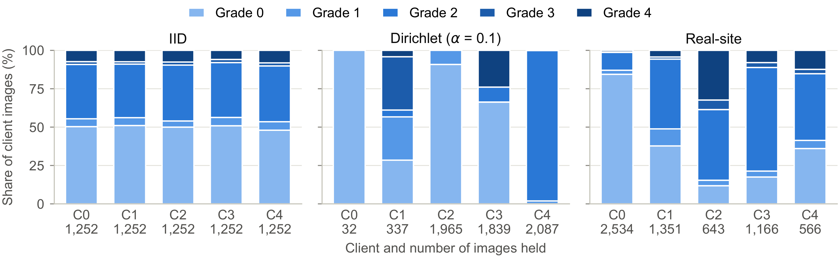
Three ways to split the data
EXPERIMENTS
Left: easy case, similar mix. Middle: hard case, each hospital gets mostly one grade (one has only 32 images, all healthy). Right: five real kinds of clinics.
OrdinalFed · IEEE WIECON-ECE 2026
10
Notes:
We split the images among the five hospitals in three ways. Each bar is one hospital. The colours show which grades it has. (Point left.) On the left, every hospital gets a similar mix. That is the easy case. (Point to the middle.) In the middle, each hospital gets mostly one grade. That is the hard case. One hospital has only 32 images, all healthy. (Point right.) On the right, the split copies five real kinds of clinics.

Slide 11
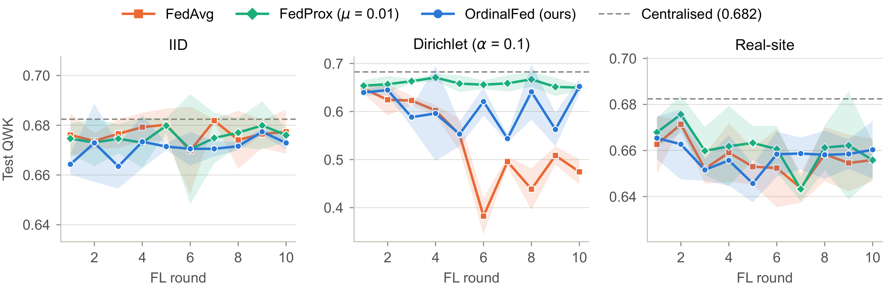
Score after every round
RESULTS
Hard case (middle): FedAvg crashes after round 5. Our method does not crash, but goes up and down. FedProx stays steady.
OrdinalFed · IEEE WIECON-ECE 2026
11
Notes:
This chart shows the score after each round. Orange is FedAvg. Green is FedProx. Blue is our method. (Point to the middle panel.) Look at the middle, the hard case. FedAvg crashes after round 5. Our method does not crash, but it goes up and down. FedProx stays steady. On the left and right, all methods do about the same.

Slide 12
Worst score in the hard case
RESULTS
The lowest score of each method over the 10 rounds. Higher is better.
FedAvg
0.378
OrdinalFed (ours)
0.514
OrdinalFed + Prox
0.627
FedProx
0.641
Our method lifts the worst score from 0.378 to 0.514, and the hospitals change nothing. FedProx is the most steady.
OrdinalFed · IEEE WIECON-ECE 2026
12
Notes:
Here is the worst score of each method in the hard case. Higher is better. FedAvg falls to 0.378. Our method keeps it at 0.514. FedProx is the most steady, at 0.641. Our method plus FedProx gets close, at 0.627.

Slide 13

Why does it work?
TESTING EACH PART
What we tested (hard case) | Worst score
Votes by image count (FedAvg) | 0.378
Distance penalty only | 0.380
Votes by test score | 0.586
Equal votes for all | 0.630 (best)
KEY INSIGHT
Small hospitals get a bigger voice
Vote of the two smallest hospitals:
5.9%
40.8%
FedAvg
Ours, round 10
The penalty alone does not help. With only 50 test images, the scores are too noisy to rank hospitals.
OrdinalFed · IEEE WIECON-ECE 2026
13
Notes:
Why does our method help? We tested each part on its own. The new penalty alone did not help. Its score, 0.380, was the same as FedAvg. Votes based on scores helped: 0.586. But giving every hospital an equal vote helped even more: 0.630. So the real reason is simple. Small hospitals get a bigger voice. With only 50 test images, the scores are too noisy to rank the hospitals well.

Slide 14

OrdinalFed or FedProx?
CHOOSING A METHOD
 | FedProx | OrdinalFed (ours)
What changes | Training at every hospital | Only the server
Work for hospitals | Change code, tune a setting | Nothing
Small hospitals | Vote by size | Fair vote
Grade 3 cases found | 0.31 | 0.36 (better)
Worst score (steadiness) | 0.641 (better) | 0.514
USE ORDINALFED WHEN…
You can change only the server, not every hospital’s software
Hospital sizes are very different, so small clinics get drowned out
Finding rare, serious cases (Grade 3) matters
Best of both: use them together. That reached 0.627.
OrdinalFed · IEEE WIECON-ECE 2026
14
Notes:
So why use our method instead of FedProx? The difference is where the change happens. FedProx changes the training at every hospital. Each hospital must change its code and tune a setting. Our method changes only the server. The hospitals do nothing new. To be honest, FedProx was more steady in our tests. But our method is useful in three cases. One: when you can only change the server. Two: when hospital sizes are very different. Three: when finding rare, serious cases matters. Our method found more Grade 3 cases: 0.36 against 0.31. And you can use both together. That reached 0.627.

Slide 15
More results
RESULTS
≤ 0.01
0.36
Difference on the easy splits
Most Grade 3 cases found (ours)
All methods score about the same when the data are not very uneven.
Others: 0.27–0.31. Grade 3 is the rarest serious grade.
0.60–0.66
1.2 s
Score on a second dataset (APTOS 2019)
Extra server time per round
Close to a model trained on all the data (0.641).
Hospitals send nothing extra.
OrdinalFed · IEEE WIECON-ECE 2026
15
Notes:
A few more results. When the data are not very uneven, all methods score about the same. Our method found the most Grade 3 cases. On the second dataset, APTOS, all models still worked well, close to a model trained on all the data. And our method adds only about one second per round at the server.

Slide 16
Takeaways
CONCLUSION
1
Our method stops most of FedAvg’s crash
Worst score 0.378 → 0.514, and the hospitals change nothing
2
It works because small hospitals get a bigger voice
Equal votes work even better (0.630)
3
FedProx is still the most steady method
Worst score 0.641
Next: more test images, bigger images and more datasets.
OrdinalFed · IEEE WIECON-ECE 2026
16
Notes:
To sum up. One: our method stops most of FedAvg’s crash, and the hospitals change nothing. Two: it works because small hospitals get a bigger voice. Three: FedProx is still the most steady method. Our work has limits. The 50 test images are few. Grade 1 is still hard to detect. And we used one dataset with small images. Next, we want to try more test images, bigger images and more datasets.

Slide 17
Thank you
Questions?
Md Tamim Hossain · tamim0072276@gmail.com
Department of Computer Science and Engineering, MIST, Dhaka, Bangladesh
Notes:
Thank you for listening. I am happy to answer your questions.

