Slide 1
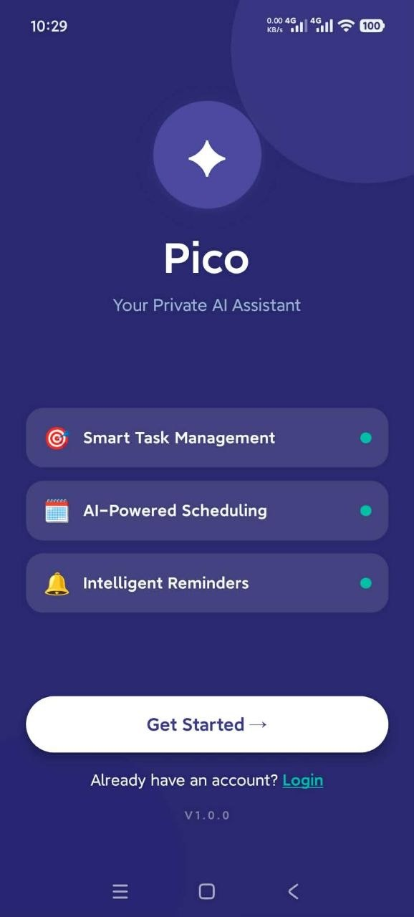
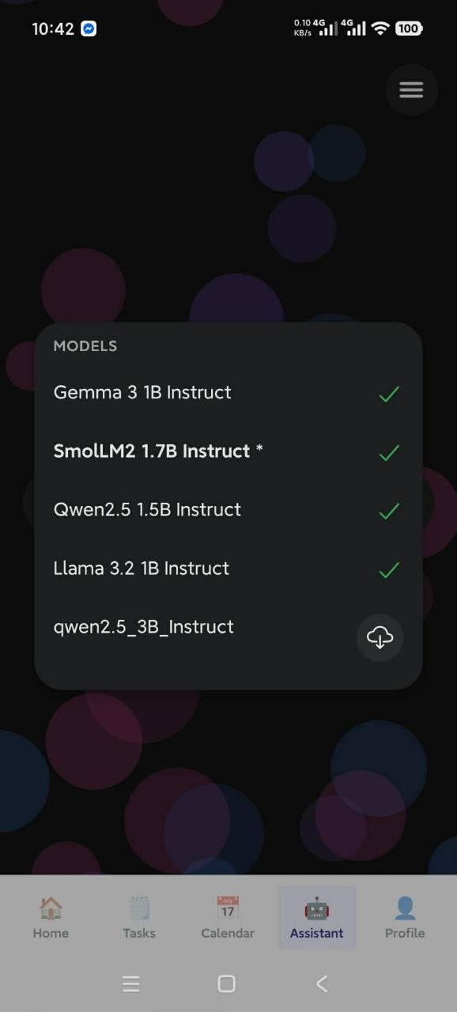
USER MANUAL
Pico
A private AI assistant that runs on your phone. The model lives on the device, so Pico manages your tasks, schedule and hardware without sending a word of it anywhere.
Version 1.0.0 · Android · CSE-464

Slide 2
OVERVIEW
What Pico does
Six capabilities that share one brain, rather than six features side by side.
On-device AI
A small language model runs locally through llama.cpp. Five models to choose from; no account, no server, no network call.
Task management
Create, search, filter, complete and delete tasks with a priority and a due date. Three ways in: the form, the tool menu, or plain chat.
Calendar
A month grid with event density dots and a day agenda, merging your device calendar with the events Pico creates itself.
Device tools
Sixteen actions Pico can take on the phone: flashlight, battery, location, timers, weather, maps, search and notifications.
Telegram sync
Point Pico at a Telegram bot and it turns incoming notices into tasks, new events, or reschedules of events you already have.
Private by design
Tasks, events, reminders and accounts sit in encrypted on-device storage. Nothing is uploaded, because there is nowhere to upload it.
What joins them together
Every one of these is a tool behind a single contract, listed in one registry. The chat, the tool menu and the notification buttons all call the same tools by the same names - which is why anything Pico can do by button, it can also do by sentence.
Pico | Overview
1

Slide 3
OVERVIEW
How a request travels
Pico answers at whichever tier can answer first, so the model only runs when it is actually needed.
You type
"turn on the flashlight"
Fast path
regex intent router
On-device model
only if no match
Tool call
parsed from the reply
The action
runs on the phone
Reply
bubble or rich card
Tier | When it runs | Speed | Needs the model?
Fast path | The phrase matches one of 15 intent rules - greetings, flashlight, battery, tasks, weather, timers, search | Instant | No
On-device model | Anything else: free conversation, or an action phrased in a way the rules did not anticipate | 1-10 s on CPU | Yes - must be downloaded
Cloud escalation | Plan My Day and Telegram sync only, and only when a key was built in; silently falls back to on-device | 1-3 s | No - falls back to it
Why it is built this way
A 1-billion-parameter model on a phone CPU is slow and occasionally wrong. Routing the obvious commands around it makes the common case instant and leaves the model for what only it can do.
Pico | Overview
2

Slide 4
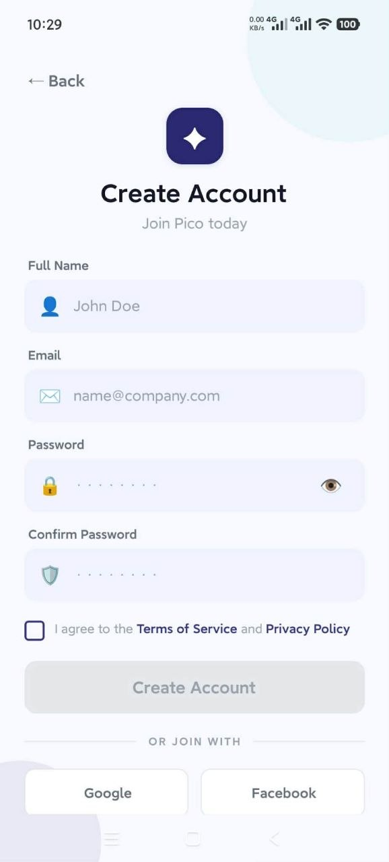
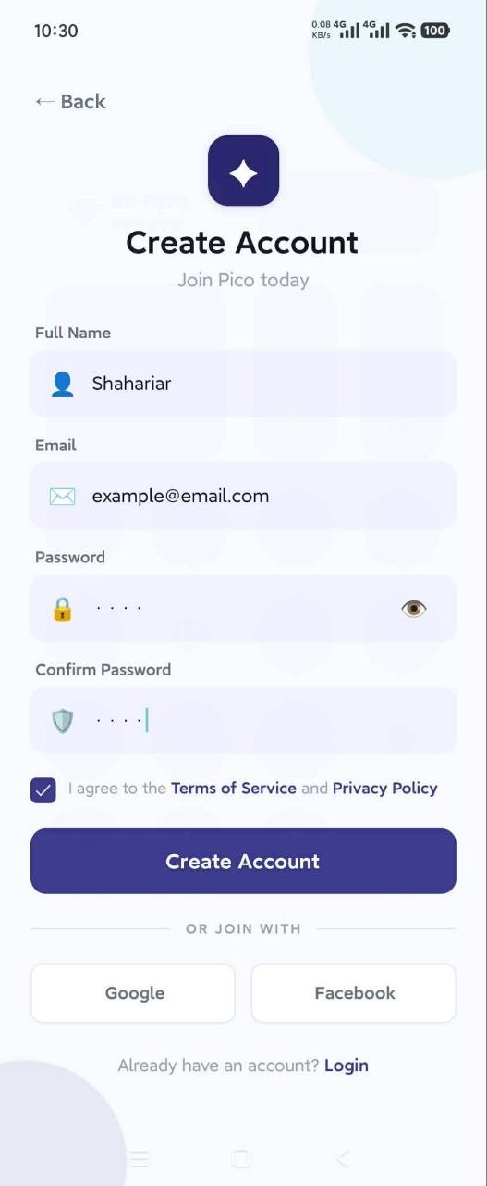
01
GETTING STARTED
PERFORMED BY User
Create an account
There is no server and no verification email - the account is made and checked entirely on the device.
1
Tap Get Started on the splash screen
Already registered on this phone? Use the Login link underneath it instead.
2
Fill in your name, email and password
The password needs at least 6 characters, and Confirm Password has to match it exactly.
3
Tick the Terms of Service box
Create Account stays greyed out until you do - sign-up is refused without consent.
4
Tap Create Account
No confirmation code arrives, because there is no mail server. You are signed straight in and land on Home.
3
1
The Google and Facebook buttons do nothing
They are leftover UI from the design mock-up, as is Forgot Password. Use email and password.
Splash
Empty form
Ready to submit
Pico | Sign up
3

Slide 5
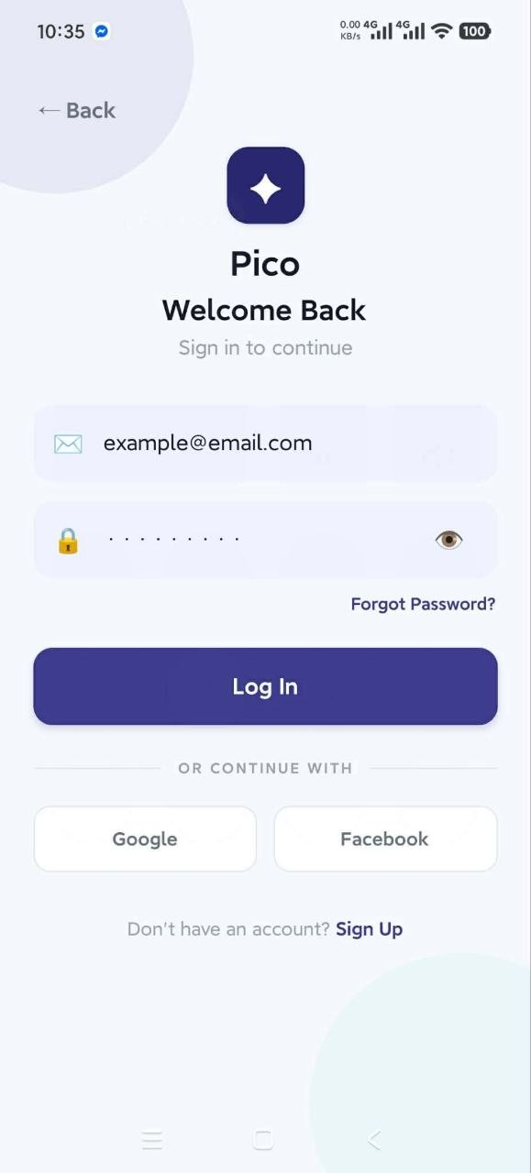
02
GETTING STARTED
PERFORMED BY User
Log in
Only needed after you sign out - otherwise Pico keeps you signed in between launches.
1
From the splash screen, tap Login
Underneath Get Started, on the "Already have an account?" line.
2
Enter the email you registered with
Matching ignores capitalisation, so the exact case does not matter.
3
Type your password - the eye reveals it
Useful for checking a long password before submitting it.
4
Tap Log In
A wrong email or password raises "Invalid email or password". Since accounts live only on this phone, one created on another device will not be found here.
5
You stay signed in from then on
The session is held in encrypted storage and survives restarts. Only Profile > Sign Out ends it.
1
Splash
Welcome Back
Pico | Log in
4

Slide 6
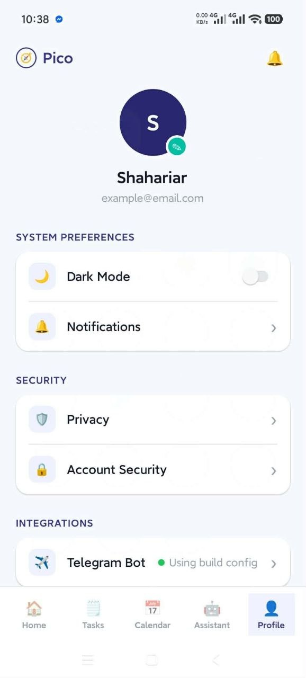
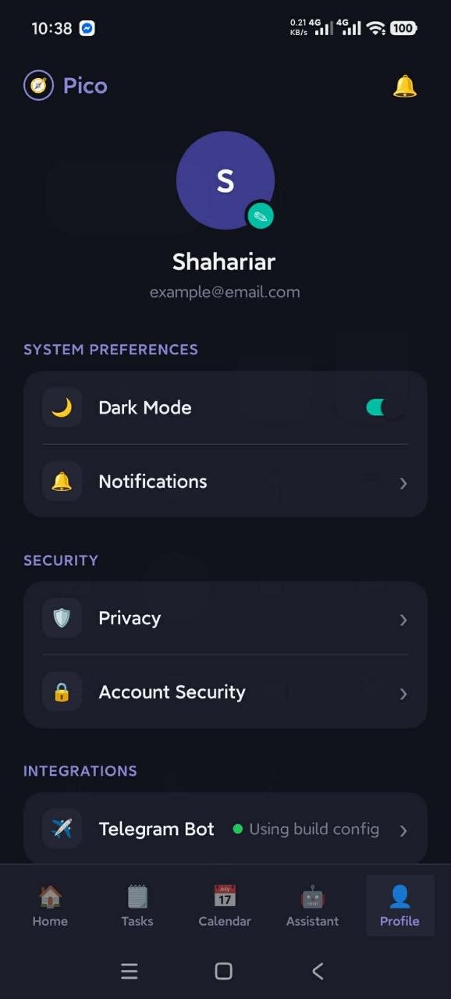
03
SETTINGS
PERFORMED BY User
Switch to dark mode
One switch in Profile, applied across the app the moment you flip it.
Where
Profile tab > System Preferences > Dark Mode.
Scope
Home, Tasks, Calendar and Profile all change at once. The Assistant is always dark by design, and the sign-in screens are always light.
Default
Light. Pico does not follow the phone's own light or dark setting.
Not remembered
The choice is held in memory only, so closing the app returns it to light. Worth knowing before you demonstrate it.
Worth showing
A two-second flip that proves the whole theme system works.
1
Light
Dark
Pico | Dark mode
5

Slide 7
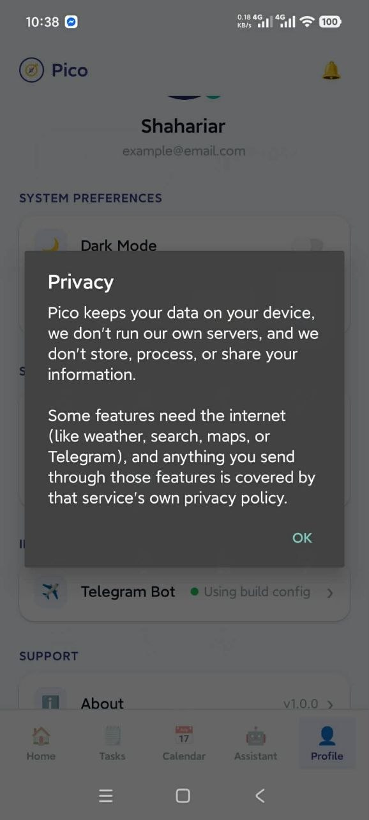
04
SETTINGS
PERFORMED BY User
Read the privacy notice
Pico states plainly what stays on the phone and what does not.
1
Profile tab > Security > Privacy
The shield row, directly above Account Security.
2
Read what Pico does and does not do
Your data stays on the device; Pico runs no servers of its own and does not store, process or share your information.
3
Note the exception it names
Weather, search, maps and Telegram need the internet, and anything sent through them is covered by that service's own privacy policy.
4
Tap OK to close
Nothing is recorded and no consent is collected - it is a statement, not a prompt.
1
Why this claim holds
There is no Pico backend at all. Tasks, events, reminders and accounts are written to the phone's encrypted Keystore-backed storage, and the AI model runs on the device's own CPU - so your prompts are never transmitted to be answered.
Profile > Security
The notice
Pico | Privacy notice
6

Slide 8
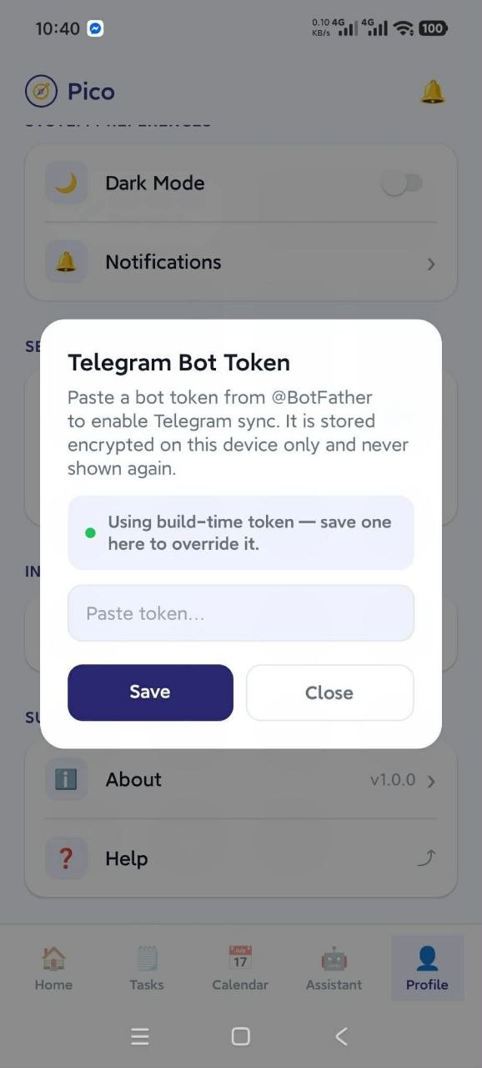
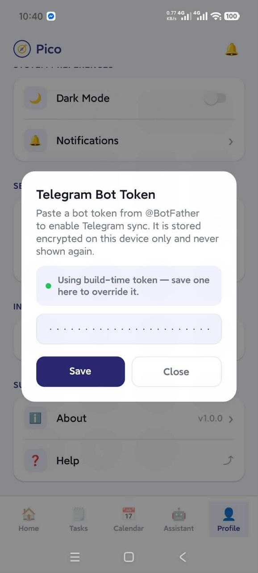
05
INTEGRATIONS
PERFORMED BY User
Set up the Telegram bot key
The setup step behind the Telegram updates tool - without a token, that tool only reports that one is missing.
1
Create a bot in Telegram with @BotFather
It replies with a token. Send your new bot a message or two so the sync has something to read.
2
Profile tab > Integrations > Telegram Bot
The row shows its current state: Connected, Using build config, or Not connected.
3
Paste the token into the dialog
It is written to encrypted device storage and never displayed again - the field shows dots from then on.
4
4
Tap Save
A saved token overrides any build-time one. Remove saved token also resets the sync position, so a new token starts clean.
5
Run a sync to confirm
Assistant > tool menu > Telegram updates, or type "check telegram". Only messages newer than the last sync are read.
2
Integrations
Token dialog
Pasted
Pico | Telegram setup
7

Slide 9
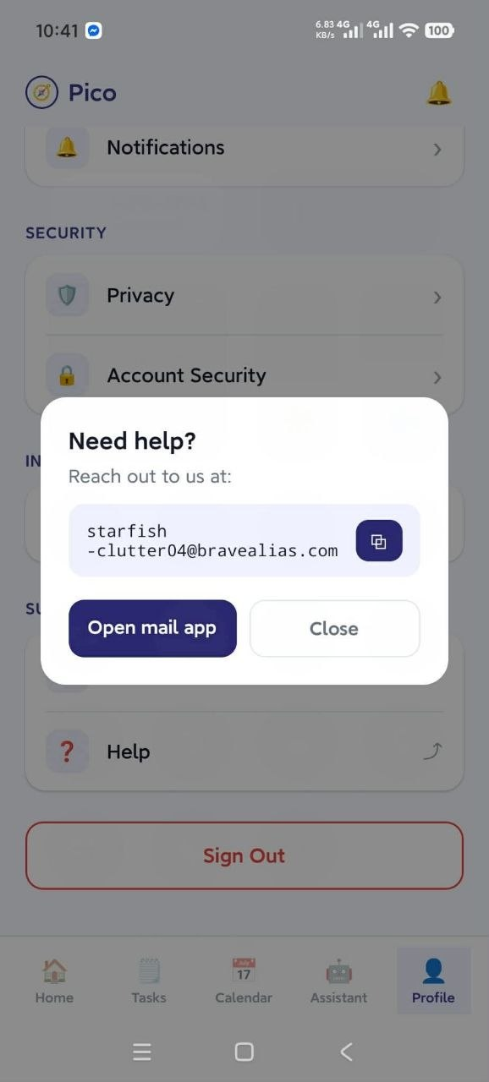
06
SUPPORT
PERFORMED BY User
Reach out for help
One dialog with the support address, a copy action and a direct route into your mail app.
1
Profile tab > Support > Help
The question-mark row, under About.
2
The support address is shown and selectable
You can long-press to select the text directly if you would rather not use either button.
3
Tap the copy icon to share the address
It opens the phone's share sheet with the address as the message, so you can send it to yourself or paste it elsewhere.
3
4
Or tap Open mail app
This composes a new email to support with the subject line "Pico Help" already filled in.
5
Close returns you to Profile
About, on the row above, opens the project's GitHub page in your browser instead.
1
Profile
Need help?
Pico | Help
8

Slide 10
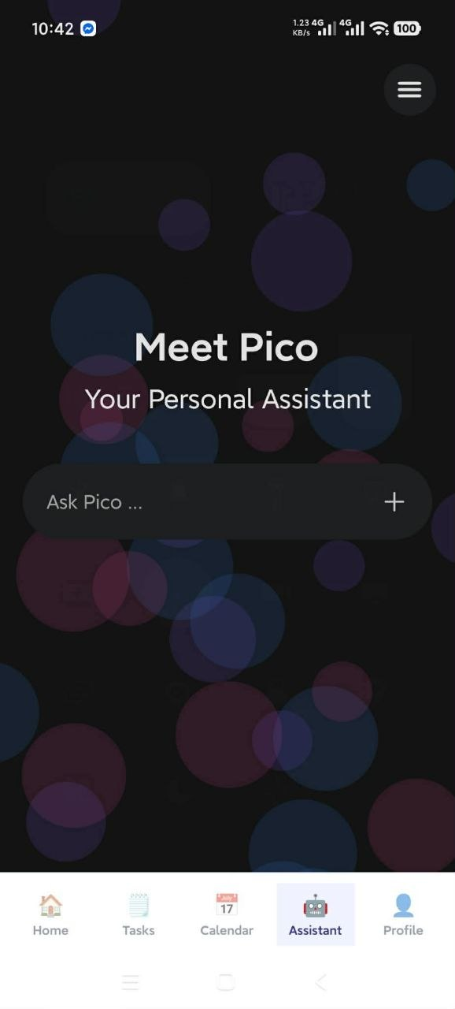
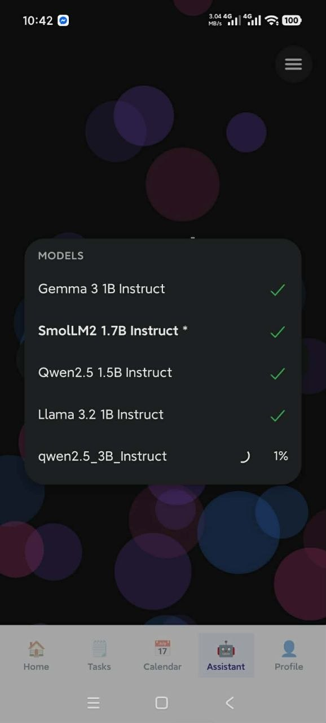
07
THE ASSISTANT
PERFORMED BY User
Download an on-device model
Until a model is on the phone, Pico answers only from the fast path. This is the one step that needs the internet.
1
Open the Assistant tab and tap +
The plus beside the chat box opens the model sheet. It is the only way in - there is no model setting in Profile.
2
Pick from the five models offered
Gemma 3 1B Instruct, SmolLM2 1.7B, Qwen2.5 1.5B, Llama 3.2 1B and Qwen2.5 3B. Smaller models answer faster.
3
Tap the cloud icon and stay on Wi-Fi
Models run from roughly 800 MB upward. Only one downloads at a time - the other rows disable until it finishes.
4
1
4
A tick means it is on the device
Downloading does not select it. Tap the model's name to activate it - an asterisk marks whichever model is live.
3
5
Watch the percentage while it runs
Leaving the sheet does not cancel the download. Switching models later keeps both on the phone.
Assistant tab
The model list
Downloading
Pico | Model download
9

Slide 11
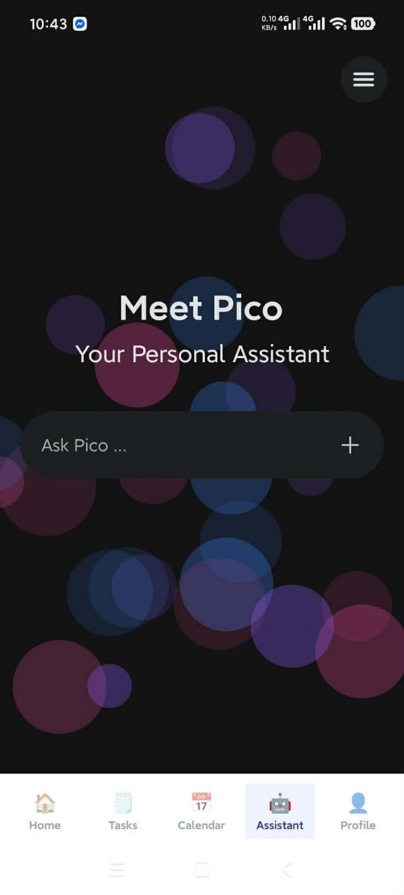
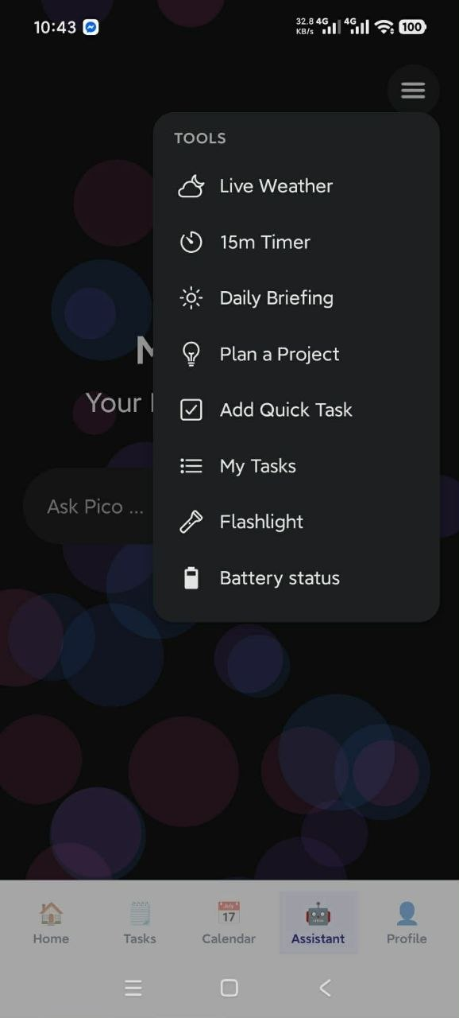
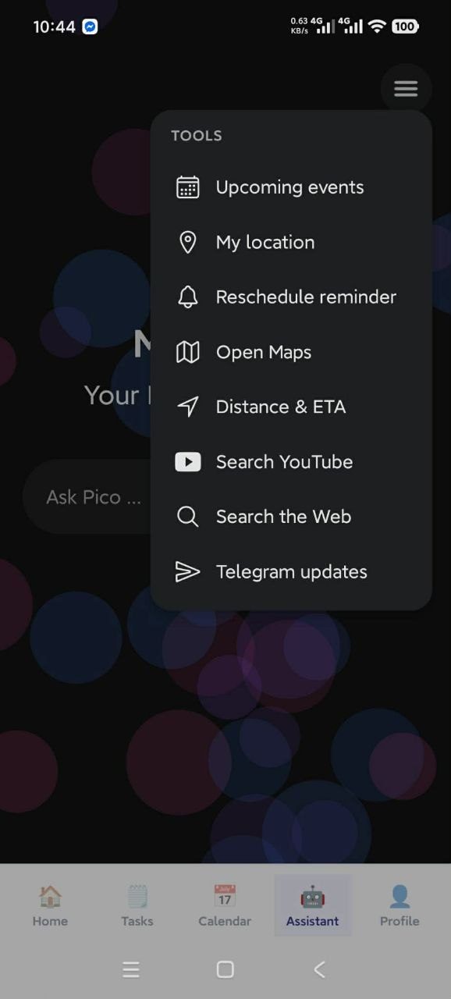
08
THE ASSISTANT
PERFORMED BY User
The tool menu
Everything Pico can do to the phone, on a button - for when you want the action without composing a sentence.
1
Tap the menu icon, top right
It sits above the chat, clear of the message list.
1
2
Eight actions are visible at first
Live Weather, 15m Timer, Daily Briefing, Plan a Project, Add Quick Task, My Tasks, Flashlight and Battery status.
3
Scroll for the other eight
Upcoming events, My location, Reschedule reminder, Open Maps, Distance & ETA, Search YouTube, Search the Web and Telegram updates.
4
Tap one and it runs immediately
A spinner shows on that row while it works, then the menu closes and the result is posted into the chat as Pico's reply.
5
The model is never consulted here
Buttons call the tools directly, so every one of them works even with no model downloaded.
Assistant tab
Tools, top
Tools, scrolled
Pico | Available tools
10

Slide 12
THE ASSISTANT
What each of the sixteen tools does
The same tools the model calls when you phrase a request in chat.
Tool | What it does | Needs
Live Weather | Temperature, feels-like, high and low, humidity, wind, rain chance | Internet + location
15m Timer | A 15-minute focus timer that rings as a notification | Notifications
Daily Briefing | Battery, weather, today's events and pending tasks in one card | Offline
Plan a Project | Breaks a goal into 3-4 subtasks and saves them to your list | Model or cloud
Add Quick Task | Writes one fixed demo task at High priority | Offline
My Tasks | Lists your pending tasks, five at a time | Offline
Flashlight | Toggles the torch, reading its current state first | Camera
Battery status | Charge level and whether the phone is charging | Offline
Tool | What it does | Needs
Upcoming events | Device calendar events for the next seven days | Calendar
My location | Current GPS latitude and longitude | Location
Reschedule reminder | Fires a notification carrying Yes / No buttons | Notifications
Open Maps | Hands off to the Google Maps app | Internet
Distance & ETA | Road distance and drive time, without live traffic | Internet + location
Search YouTube | Opens YouTube search results for a query | Internet
Search the Web | Opens a Google search in the browser | Internet
Telegram updates | Fetches bot notices and syncs them to tasks and events | Internet + token
Four of these are button-only
Distance & ETA, Open Maps, Search YouTube and Search the Web are not in the list the model is shown, so it cannot call them on its own. Reach them from this menu, or with the exact chat phrasings in the cheat-sheet - "how far is Gulshan 2", "navigate to...", "play...", "search for...".
Pico | Available tools
11

Slide 13
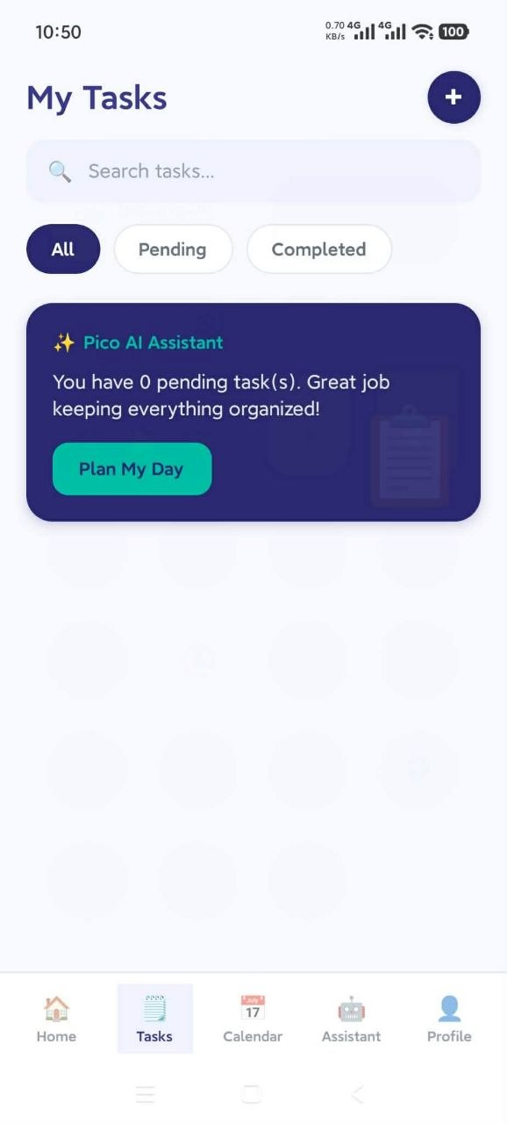
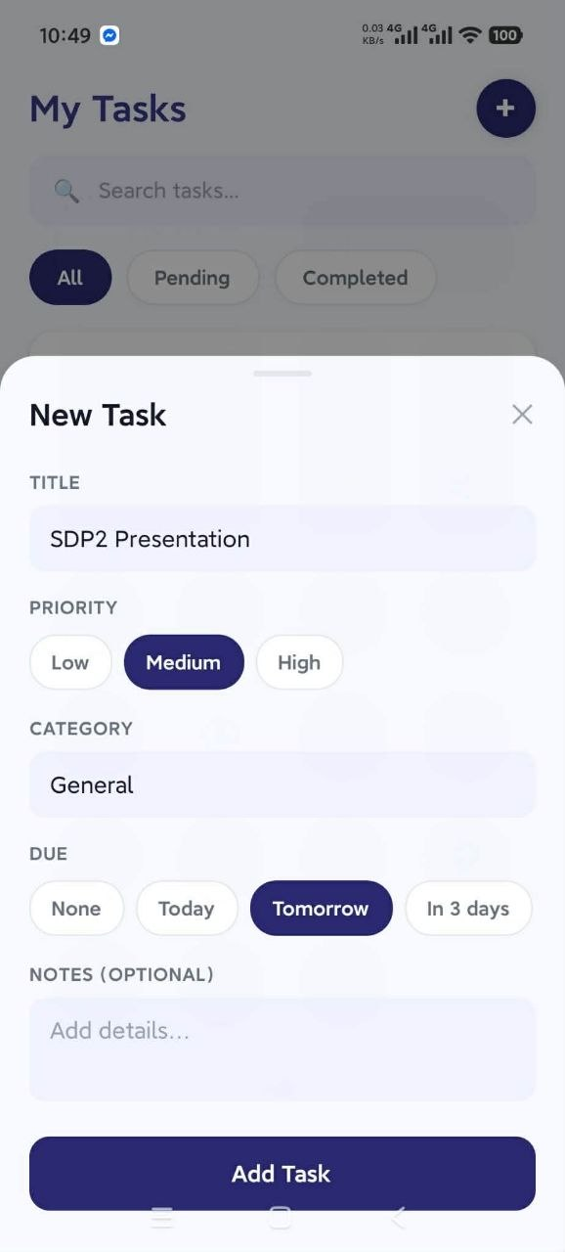
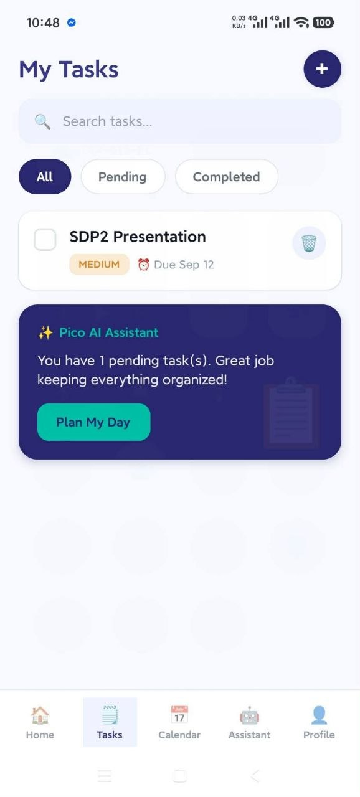
09
TASKS
PERFORMED BY User
Add a task
The form gives you every field. Chat and the tool menu reach the same list by other routes.
1
Tasks tab > the + button
Top right. A New Task sheet slides up from the bottom.
1
2
Give it a title
The only required field. Saving without one raises "Add a title" and nothing is written.
3
Choose a priority
Low, Medium or High, defaulting to Medium. This drives the colour of the pill in the list and the High Priority count on Home.
2
4
Set a category
Free text, defaulting to General. Tasks created by the Telegram sync arrive tagged Telegram.
5
Pick a due date, and add notes if you want
None, Today, Tomorrow, In 3 days or In 1 week - each resolved to midnight on that day. Notes are optional.
6
Tap Add Task
It appears in the list immediately, and every counter in the app updates with it.
Empty list
New Task
Saved
Pico | Add a task
12

Slide 14
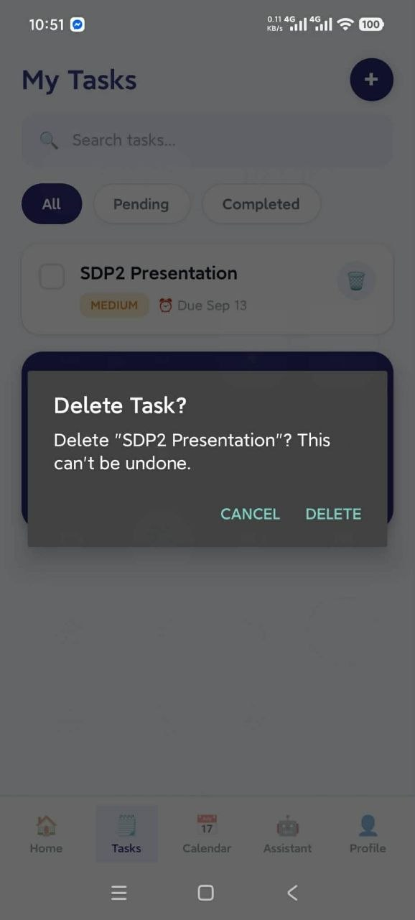
10
TASKS
PERFORMED BY User
Delete a task
Deliberately two steps, because there is no undo.
1
Tap the bin icon on the task
On the right-hand edge of the card. It has a generous tap target, so it is hard to miss and hard to hit by accident.
2
Read the confirmation - it names the task
"Delete 'SDP2 Presentation'? This can't be undone." Naming the task means you cannot delete the wrong one by muscle memory.
1
3
Tap DELETE to remove it, CANCEL to back out
Deletion is permanent - there is no bin to recover it from, and the data export will not contain it afterwards.
4
To keep a task but mark it done, use the checkbox instead
Completed tasks stay in the list with a strikethrough and show under the Completed filter.
Deleting everything at once
Profile > Account Security > Delete all data erases every task, event and reminder together, along with your account. Step 14 covers it.
The task list
Confirm
Pico | Delete a task
13

Slide 15
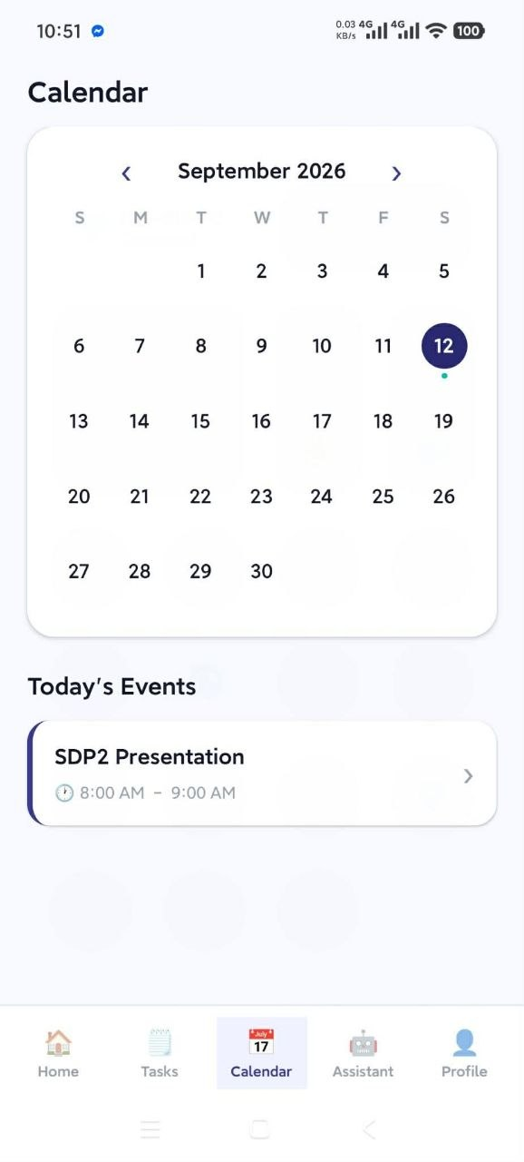
11
CALENDAR
PERFORMED BY User
View the calendar
A month at a glance, then the agenda for whichever day you tap.
1
Open the Calendar tab
It asks for calendar permission the first time. Refuse it and the screen shows a lock with a Grant access button instead of a grid.
2
Move between months with the arrows
Jumping to another month selects day 1; coming back to this month re-selects today.
3
3
Today is ringed, the selected day is filled
Two different states, so you never lose track of where today is while browsing ahead.
4
Dots under a day count its events
Up to three, then it stops - the dots show how busy a day is, not an exact number.
5
Tap a day to read its agenda
Listed under the grid, all-day events first and then by start time, each with its calendar's own colour down the left edge.
5
6
Tap an event to open it in the phone's calendar
Pico hands off to the native calendar app at that date. Pull down on the list to refresh.
Two calendars feed this screen
Your real Android calendar, and the separate store Pico writes to when it creates an event from chat. This screen merges both - but an event Pico made will not appear in Google Calendar.
Calendar
Pico | Calendar
14

Slide 16
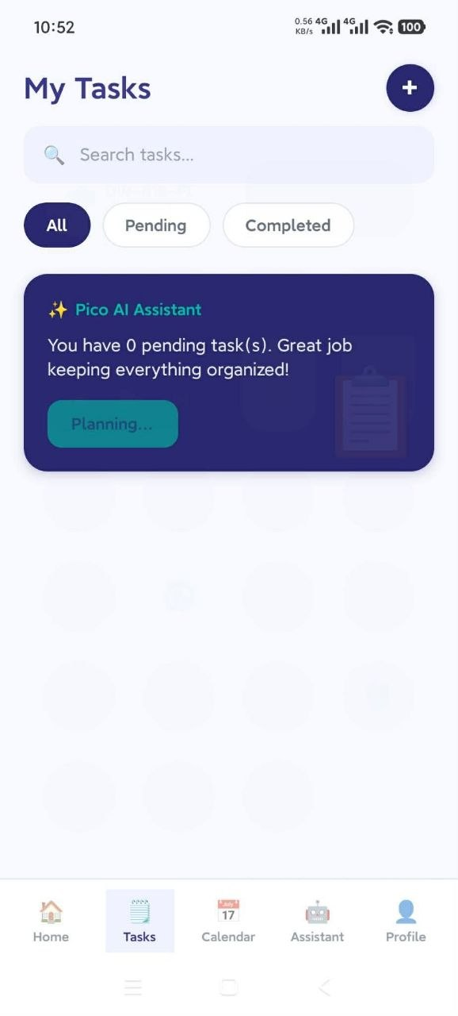
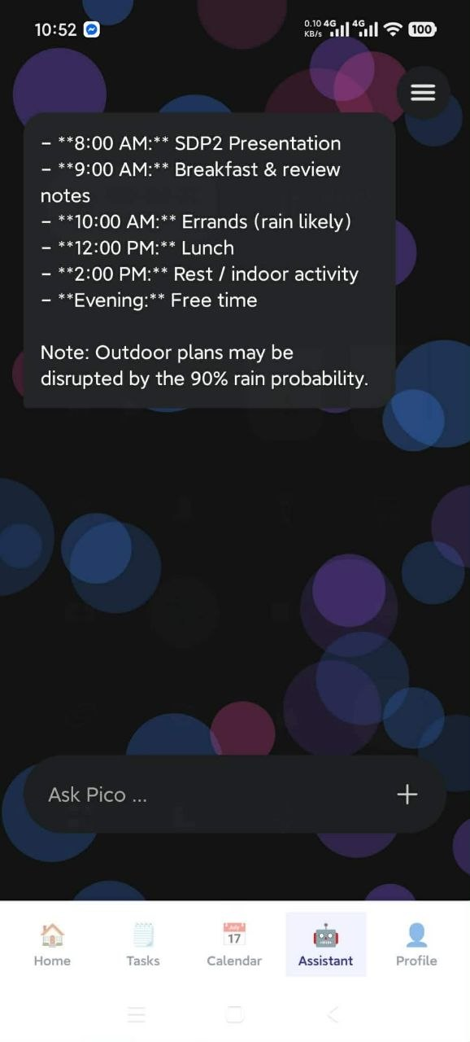
12
THE ASSISTANT
PERFORMED BY On-device AI
A tool call end to end: Plan My Day
The clearest demonstration of the pipeline - one tap runs several tools and hands their output to the model.
1
Tap Plan My Day
On the Pico AI Assistant card, at the bottom of Tasks or on Home. Typing "plan my day" in the chat does exactly the same thing.
2
The button reads Planning... while it works
Behind it, a planner decides which read-only tools to run - normally your tasks, your calendar and the weather.
1
3
Those tools run and their output is collected
A tool that cannot reach the internet is marked unavailable rather than failing the whole plan.
4
The finished plan is posted into the Assistant
An hour-by-hour schedule built from what you actually have on, plus a note about anything that might disrupt it - here, a 90% rain chance against outdoor plans.
Where the writing happens
Plan My Day tries the cloud model first and falls back to the on-device one when there is no key or no signal. If both are unreachable it still answers, using the deterministic daily briefing instead - so the button never simply fails.
Planning...
The plan, in chat
Pico | Tool call example
15

Slide 17
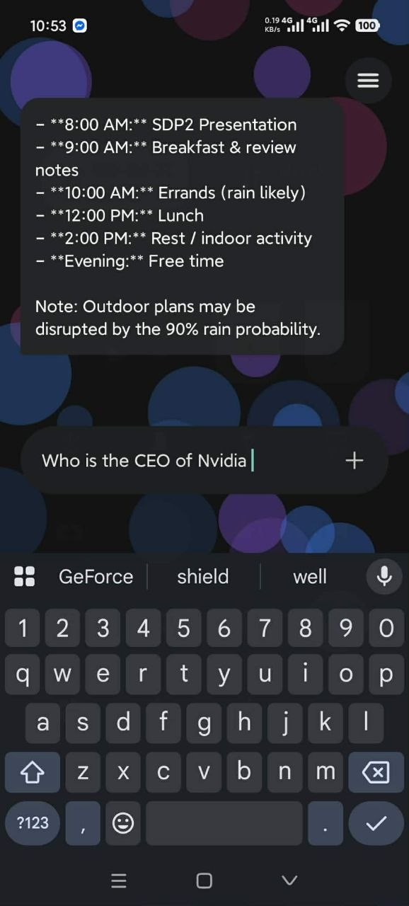
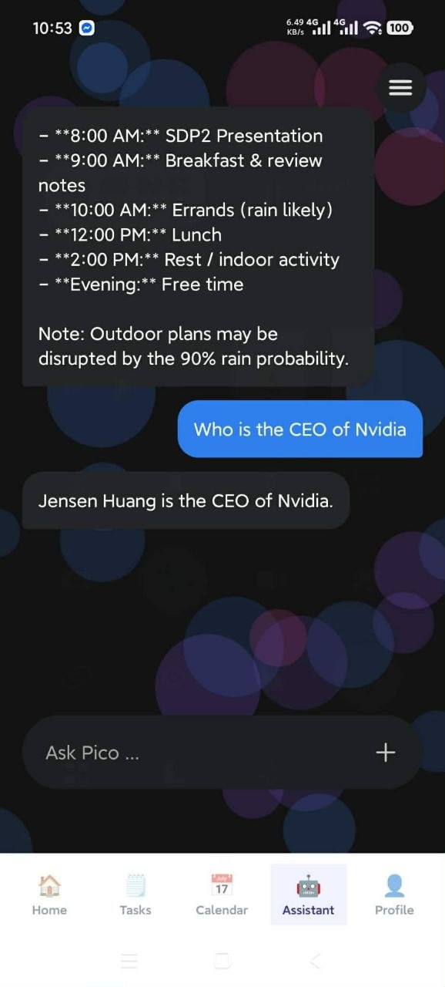
13
THE ASSISTANT
PERFORMED BY On-device AI
Just talking to Pico
When nothing needs doing, the on-device model answers in plain prose.
1
Type into Ask Pico and send
The send key on the keyboard submits. Input locks while Pico is working, so a question cannot be sent twice.
2
Pico is thinking means the model is running
It only appears on this path. Fast-path commands answer with no indicator at all, because there is no wait.
3
Your message is the blue bubble on the right
Pico's replies are the dark bubbles on the left.
1
4
The answer comes from the model on the phone
Nothing is looked up and nothing is transmitted - which also means answers are limited to what a 1B-parameter model knows, and it can be confidently wrong.
5
For anything live, ask it to search
"search for..." opens a real web search in the browser instead of guessing from the model's memory.
Typing
The answer
Pico | Normal chat
16

Slide 18
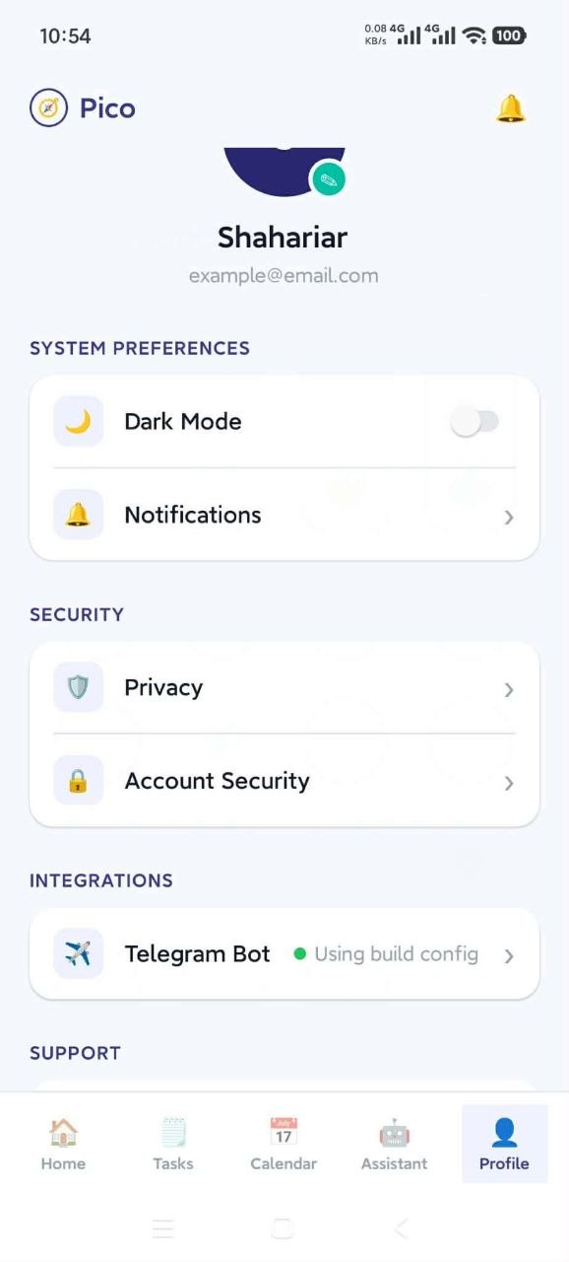
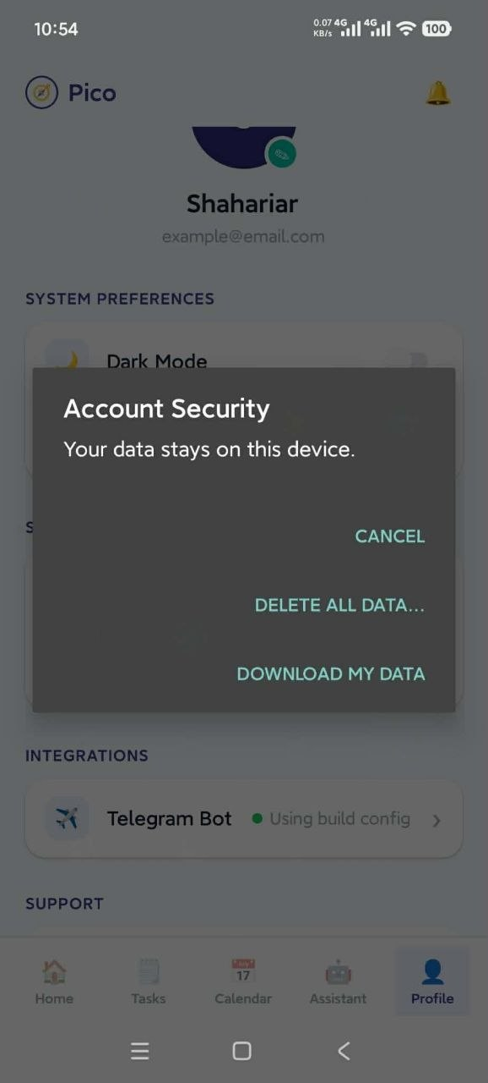
14
PRIVACY
PERFORMED BY User
Download or delete your data
Both controls sit behind one row, and one of them is irreversible.
1
Profile tab > Security > Account Security
The padlock row. The dialog opens with a reminder that your data stays on this device.
2
Download my data exports everything as JSON
Your tasks, events and reminders, with a timestamp, handed to the phone's share sheet so you can mail it to yourself or save it.
3
Delete all data erases the lot
Tasks, events, reminders, the saved Telegram token, the Telegram sync position, every account on the device - and it signs you out.
4
There is no undo and no grace period
The erase happens the moment you confirm. Export first if you want a copy.
3
2
What the export never contains
Passwords are not included. They are held separately, and the export is written from your tasks, events and reminders only.
Profile > Security
Account Security
Pico | Your data
17

Slide 19
R
Reference
Where each feature lives, everything you can say to the Assistant, and what to do when something misbehaves.
A feature-to-screen lookup table
The complete Assistant command cheat-sheet
Offline and online, feature by feature
Troubleshooting for what actually goes wrong
Tool menu

Slide 20
REFERENCE
Where everything lives
Every feature in Pico and the shortest route to it.
I want to... | Go to | Notes
Create an account | Splash > Get Started | Local only - no email verification
Log back in | Splash > Login | Only needed after signing out
Switch to dark mode | Profile > Dark Mode | Resets to light when the app restarts
Read the privacy notice | Profile > Privacy | States what leaves the device
Connect Telegram | Profile > Telegram Bot | Needs a token from @BotFather
Contact support | Profile > Help | Copies the address or opens your mail app
Download or change the AI model | Assistant > + | Tap a name to activate it; * marks the live one
Run a device action by button | Assistant > menu icon | Sixteen tools, no typing
Add a task with full detail | Tasks > + | The only route that accepts notes
Delete a task | Tasks > bin icon | Confirms by name; cannot be undone
See my month | Calendar tab | Dots show density; tap a day for its agenda
Plan my day with AI | Tasks or Home > Plan My Day | Result is posted into the Assistant chat
Just ask a question | Assistant > Ask Pico | Needs a downloaded model
Export or erase everything | Profile > Account Security | JSON export, or an irreversible wipe
Pico | Feature lookup
18

Slide 21
REFERENCE
PERFORMED BY User
Assistant cheat-sheet: instant commands
Matched before the model is consulted, so they answer with no wait - and work even with no model downloaded.
Say this | And Pico will | Also matches
hi / hello / hey | Greet you | hola, sup
who are you / what can you do | Introduce itself and list its abilities | -
what is today / what time is it | Give the full date and the clock time | today's date, current date
turn on the flashlight | Switch the torch on | torch on, light on
turn off the flashlight | Switch it off | torch off, kill the light
battery | Report charge and charging state | how much juice, power level
my tasks | List pending tasks, five at a time | show todos, what tasks do I have
upcoming events | Read the next seven days of calendar | my calendar, my schedule, agenda
where am I | Give GPS coordinates | my location, current location
daily briefing | Battery, weather, today's events, pending tasks | brief me, good morning, how is my day
mark buy groceries as done | Complete the matching task | complete X, finish task X
plan my day | Build a plan from tasks, events and weather | plan today, what should I do today
plan my final presentation | Break the goal into 3-4 saved subtasks | break down X, help me prepare for X
timer for 20 minutes | Schedule a notification | set an alarm, countdown
weather | Full local forecast | forecast, do I need an umbrella
Pico | Command cheat-sheet
19

Slide 22
REFERENCE
PERFORMED BY On-device AI
Cheat-sheet: the rest
The remaining instant commands, then everything that hands over to the on-device model.
STILL INSTANT
NEEDS THE MODEL - EXPECT A SHORT WAIT
Say this | And Pico will
how far is Gulshan 2 | Road distance and drive time
navigate to Dhaka University | Hand off to Google Maps
play Bohemian Rhapsody | Open YouTube search results
search for the UCL score | Open a Google search
check telegram | Fetch and sync bot notices
Say this | And Pico will
add a task to buy milk tomorrow, high priority | Create it, reading title, priority and category out of the sentence
schedule a meeting on Friday at 3pm | Create an event, parsing the date and the time
who is the CEO of Nvidia | Answer from the model's own knowledge, offline
anything conversational | Reply in prose rather than running a tool
If a command is not recognised
Phrase it the way the cheat-sheet does. The instant tier matches on keywords, so "illuminate the room" will not find the flashlight - it goes to the model, which may or may not work it out. Four tools - distance, maps, YouTube and web search - are reachable only through these phrasings and the tool menu; the model cannot call them.
Pico | Command cheat-sheet
20

Slide 23
REFERENCE
What works offline, and what does not
There is no Pico server. The features that use the internet talk to third parties directly.
Where your data lives
Tasks, events, reminders, accounts and the Telegram token sit in expo-secure-store, encrypted by the Android Keystore.
Where the AI runs
On the phone's CPU through llama.cpp. Your prompts and your task list are never sent anywhere to be answered.
What is never collected
No analytics, no telemetry, no crash reporting, no advertising ID - there is no server account to hold them.
How to get it all back
Profile > Account Security > Download my data exports everything as JSON. Delete all data erases it irreversibly.
Feature | Offline? | What it contacts
Sign in, tasks, events, reminders, calendar | Fully offline | Nothing
Chat, briefings, goal breakdown, flashlight, battery, timers | Fully offline once a model is downloaded | Nothing
Weather | Online | Open-Meteo - coordinates only, no identifier
Distance and ETA | Online | Photon geocoder, then the public OSRM router
Maps, YouTube, web search | Online | Hands off to the relevant app or site
Telegram sync | Online | api.telegram.org, carrying your bot token
Plan My Day, Telegram interpretation | Falls back to on-device | NVIDIA NIM, only if a key was built in
Pico | Offline and online
21

Slide 24
REFERENCE
When something does not work
The failures that actually happen, and what each one means.
The chat says the model was not found
No model has been downloaded, or the active one was removed. Open Assistant > + and download one. Tool-menu actions keep working.
The first message after opening is slow
The model is being loaded into memory. It happens once per launch; every message after it is quicker.
Every reply is slow
The model runs on the CPU with no GPU offload. A 3B model on a mid-range phone will feel heavy - switch to Gemma 3 1B.
A model download will not start
Only one downloads at a time; the other rows stay disabled until it finishes. Check free space - models run from 800 MB upward.
The calendar is empty or shows a lock
Permission was refused. Tap Grant access; after a second refusal Android stops asking and Pico opens system settings instead.
Login says invalid email or password
Accounts live only on the phone that created them. An account made on another device will not be found here.
Dark mode was light again after a restart
Expected - the theme is held in memory only and is not saved between launches.
Telegram says the token is missing
No bot token is saved: Profile > Telegram Bot. If a sync returns nothing, those messages were already read - the offset only moves forward.
An event created in chat is missing
It is not lost. Events Pico creates go to its own encrypted store, which the Calendar tab merges into the view - but the Notifications list and the Home bell badge read the Android calendar only, so it is not counted there.
Pico | Troubleshooting
22

Slide 25
Thank you
Questions welcome - on any workflow in this manual, or on what runs behind it.
Assistant
Tasks
Calendar
Telegram
On-device AI
Privacy
Pico - User Manual - v1.0.0

