Slide 1
Group 16

Slide 2
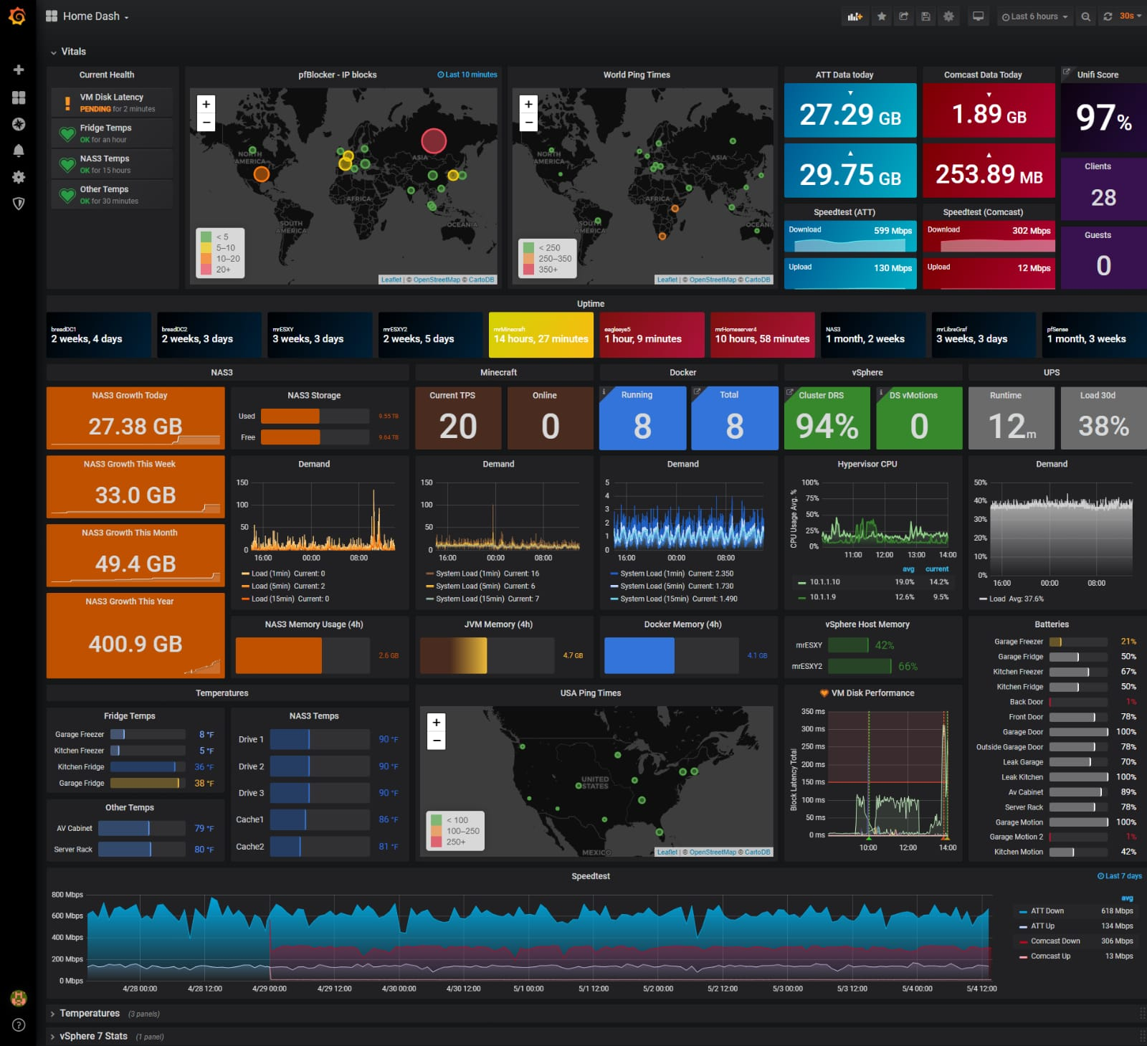
Grafana
A tool for displaying information and metrics that are on the server.
The system displays the data using graphs without sorting and filtering information.

Slide 3
So what’s the problem?
Numerous graphs can make mistakes in data analysis.
Using Grafana requires specific knowledge.
Exposing employees to data that is not relevant for their job.

Slide 4
What do we do?
Our system creates a buffer between Grafana and the customer which creates a convenient and easy-to-use interface.
The system presents the data in a way that suits for the company.
creates a division of the graphs according to the employee’s role.

Slide 5
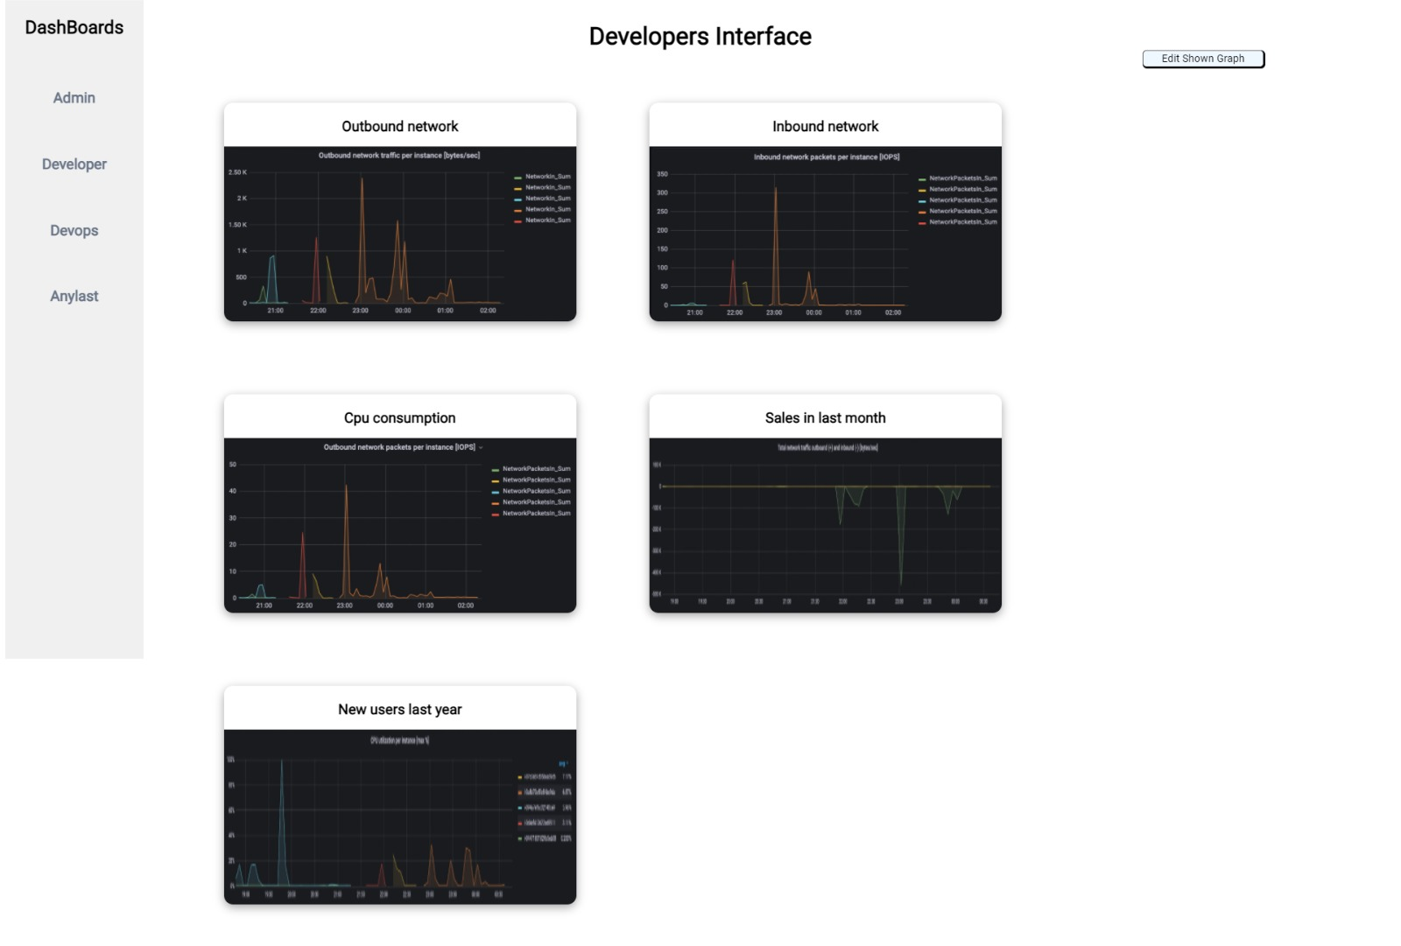

Slide 6
Solutions
Time is Money!
Compartmentalization – confusion, mistakes and leak prevention

