Slide 1
Indoor State Estimation
With MarvRx Inc
Chinemelu Ezeh, Oskar Weigl, Thomas Morris, Ryan Savitski and Josh Eldson

Slide 2
Project Aim
Solve the localisation problem of Autonomous Systems in GPS denied environment.
Important application in Aerial Photography and Pipeline Surveillance.
Offer a cheap solution

Slide 3
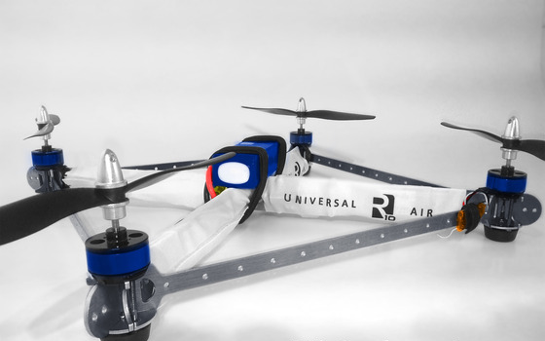
Who are Mavrx Autonomy?
Start-up company in autonomous aerial vehicles for high definition imaging.
Secured £500,000 in kick-starter funding.

Slide 4
Presentation Overview
High Level Design
Feature Extraction, State Estimation
Low level design
Floodfill, System Model Derivation
Demonstration
Commercialisation

Slide 5
Solution Overview
Robot moves around in the room increasing its location uncertainty.
It observes features with need to be added to its internal map
It re-observes these features and makes corrections to adjust its localisation.

Slide 6
High Level Design
Feature Extraction
We use planes as landmarks extracted using Floodfill algorithm and Xtion Pro RGB-D camera
State Estimation
We employ the Extended Kalman Filter Algorithm to estimate quad’s state.

Slide 7
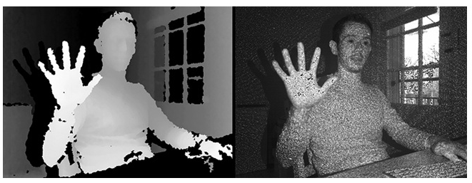
How Depth Camera Works
Xtion uses an infrared projector and sensor.
Depth map (left) is reconstructed from the light coding of the image(right).
Techniques used include analysis of parallax and analysis of blur.

Slide 8
Feature Extraction
We extract planes using Point Cloud Library and Flood fill algorithm.
Xtion Pro camera produces depth information for pixels.
We use this to estimate equation of local plane.
Group locals into cluster.

Slide 9
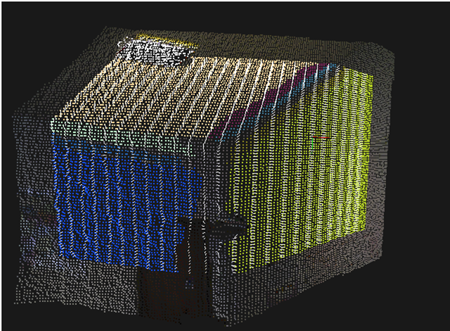
Feature Extraction(DBSCAN)

Slide 10
State Estimation
Using the Extended Kalman filter we track:
Position
Speed
Attitude(Yaw, Pitch, Roll)
We model our system using inertial sensor data and do not use a physical model of the quadcopter.

Slide 11
Kalman Filter Algorithm
Prior State Knowledge
Prediction step based on motion model
P_{k-1|k-1}
x_{K-1|k-1}
Next timestep
K ←K+1
P_{k|k-1}
x_{K|k-1}
Update step
Compare prediction to measurement
Measurements
Extracted features/ Planes
P_{k|k}
x_{K|k}
Output estimate of state

Slide 12
Mathematics of Kalman Filter
Predict Stage
Predicted state estimate
Predicted covariance
Update Stage
Innovation residual
Innovation residual covariance
Optimal Kalman Gain
Update state estimate
Update Covariance Estimate

Slide 13
Demonstration

Slide 14
Commercialisation
Unmanned Aerial Vehicle(UAV) Applications
Security: Border Control, Disaster Monitoring.
Civilian: Aerial Photography, Pipeline Surveillance.
Europe to spend over £1billion on UAVs from 2008 to 2015.

Slide 15
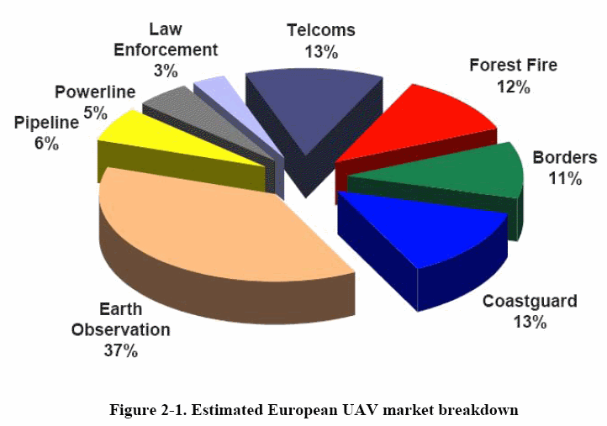
Market Breakdown

Slide 16
Summary & Conclusion
We were able to provide a proof of concept to the localisation problem
Localisation is a first step towards full autonomy.
Autonomous Quadcopters are very useful in border control, aerial photography, etc.
Our solution consists of plane extraction using DBScan and Extended Kalman filter for estimation.

Slide 17
References
http://www.barnardmicrosystems.com/L4E_uav_market.htm
More Information on Our R10 quadcopter
https://r10plus.uair.co/r10

