Slide 1
CSCI 318 Software Engineering Practices & Principles
Final Report
Yeung Chung Hang 5632262 Tam King Chak 5633795
Wong Hoi Kei Gloria 5980446

Slide 2
Overview
evolution of web development
Early time (HTML and CSS)
- Text-based
- Present simple contents
- Minimal interaction

Slide 3
Overview
read---> read-write
Combine internet function application
E.g. sharing, data upload
- become two way communication
- become more interactive

Slide 4
Overview
HTML,CSS and JavaScript
- web front-end
- design, construct, implement
- make content, fonts and interactive

Slide 5
Limitation of web application by comparing to equivalent native application
Web application
Network connection is required
Native application
Internet is not required
Concern on environment with software and hardware resources

Slide 6
Evaluation of quality of web application developed by vanilla JavaScript
Lack of modularity
Class-less program language
Low understandability
Spend more time understand the language
Timeliness is a challenge
Development is unlimit
Low reusability
Direct against the own application

Slide 7
Evaluation of ReactJS as modern web front-end solution
component -based
High modularity
Built by encapsulated component that can manage their own state
Separation of concerns
Separate different task to different developer to take the responsibilities
Spend less time to solve the problem in order to reduce the cost and risk

Slide 8
Evaluation of ReactJS as modern web front-end solution
High reusabilities
Maybe some is hard-coded
High performance
State how change , the component is rerendered

Slide 9
Evaluation of ReactJS as modern web front-end solution
React is declarative.
Timeliness maybe is a challenge
High Productivity
Development tool
Debug and inspect the data e.g. redux DevTools and react developer tool
High Understandability
High reparability

Slide 10
Evaluation of ReactJS as modern web front-end solution
High Evolvability
Two major version 15 and 16 in two years
High Portability
Different platform, different system and different browser
E.g. react native, react music, react game kit
E.g. safari , Chrome

Slide 11
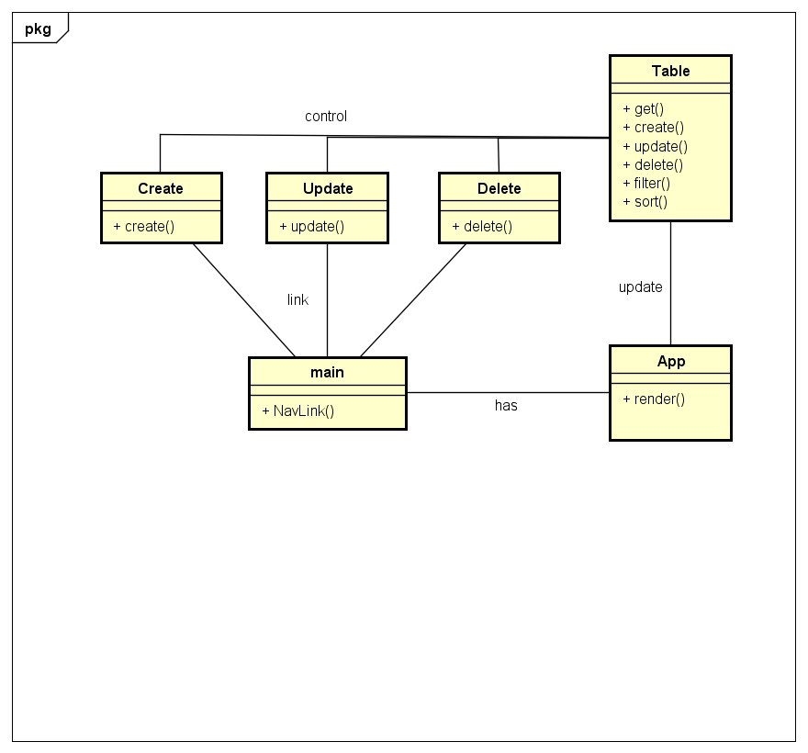
Design and implement
Architectural Design
Notes:
App render main, navbar contain create update delete, control table, update to render

Slide 12
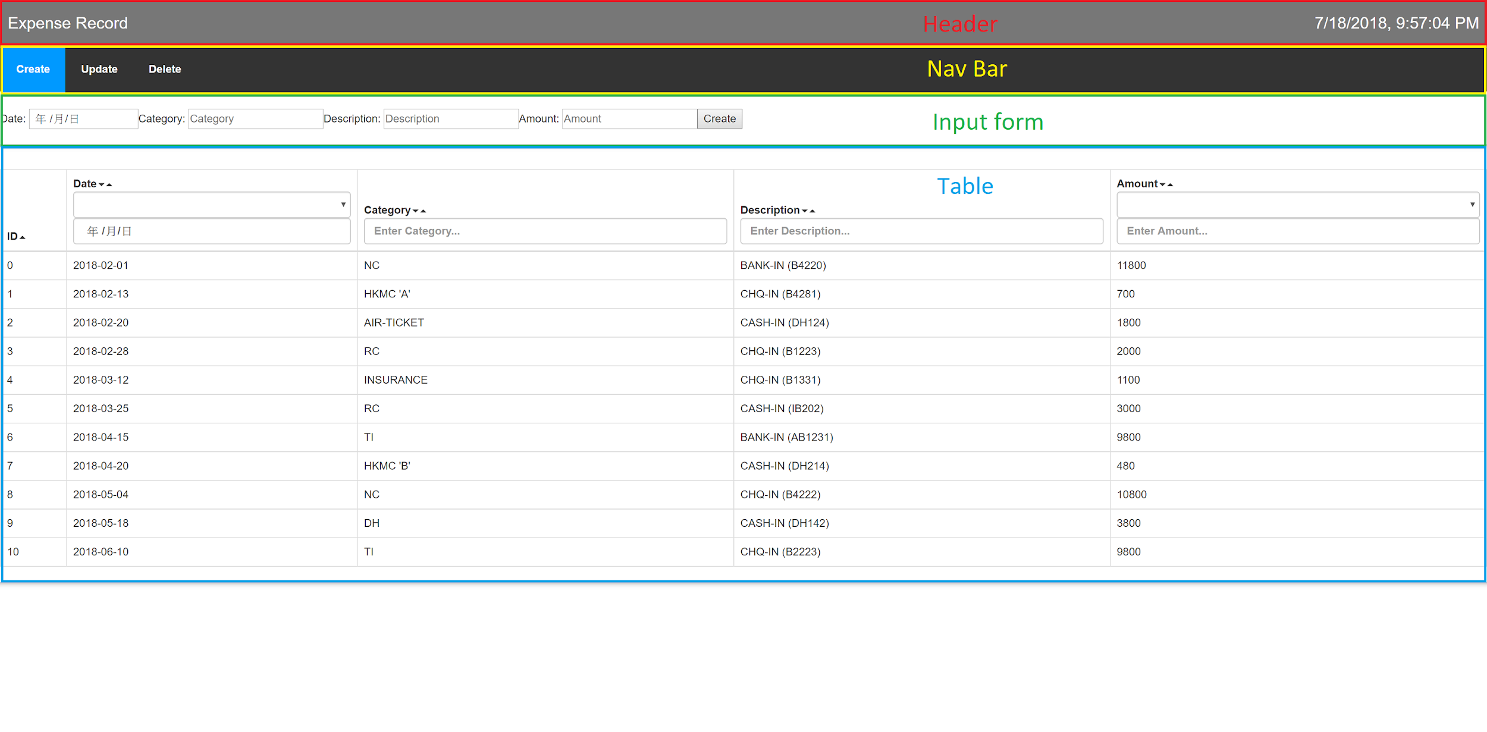
Design and implement
Outline

Slide 13
Demonstration
http://123.202.160.161

