Slide 1
PROJECT TITLE : SECURE DATA HIDING IN IMAGES USING STEGANOGRAPHY
CAPSTONE PROJECT
SECURE THE DATA TO PREVENT HACKERS.
Presented By : TAMILKUMAR P.
Student Name: Tamilkumar P.
Department :B.E/CSE(CYBER SECURITY).
College Name
: J.J College Of Engineering And Technology.

Slide 2
OUTLINE
Problem Statement
Technology used
Wow factor
End users
Result
Conclusion
Git-hub Link
Future scope

Slide 3
Problem Statement
Steganography is a technique used to hide data within images to ensure secure communication. It embeds secret information in digital images without noticeable changes. The goal is to prevent unauthorized access while maintaining the image's integrity. This method is useful for confidential data transmission and avoiding detection.

Slide 4
Technology used
For implementing Data Hiding in Images Using Steganography, the following technologies are commonly used:
Languages: Python, Java, C/C++.
Libraries: OpenCV, Pillow, Stegano, Cryptography, PySteg.
Tools: StegExpose (detection), TensorFlow/Keras (AI-based).
Platforms: MATLAB (research), Android/iOS (mobile apps), Docker (deployment).

Slide 5
Wow factors
Invisible Data Embedding – Hides secret data within images without noticeable changes.
High Security – Combines encryption with steganography for enhanced protection.
Resistant to Detection – Difficult to detect using conventional methods like StegExpose.
Minimal Data Loss – Uses advanced algorithms (LSB, DCT, DWT) for lossless hiding.
Cross-Platform Usability – Works on mobile, web, and desktop applications.
AI-Enhanced Steganography – Can integrate deep learning for intelligent data hiding.
Steganalysis Defense – Detects and prevents steganographic attacks using counter-techniques
Scalability – Can be extended for digital watermarking, copyright protection, and secure communication.

Slide 6
End users
Cybersecurity Experts – To protect sensitive data and prevent unauthorized access.
Government & Defense – For secure communication and intelligence operations.
Journalists & Whistleblowers – To transmit confidential information safely.
Researchers & Academicians – For digital watermarking and forensic analysis.
Businesses & Corporations – To secure proprietary data and prevent information leaks.
Law Enforcement Agencies – For covert investigations and evidence protection.
Social Media Users – To protect personal information from cyber threats.
Healthcare & Finance Sectors – To secure confidential records and transactions.

Slide 7
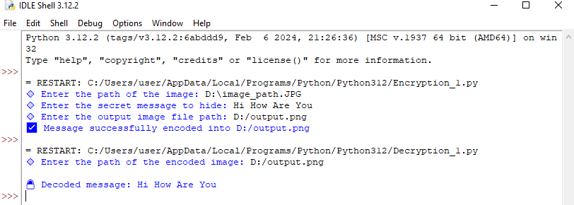
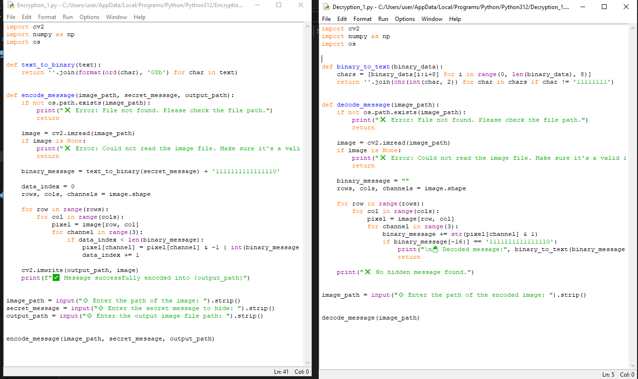
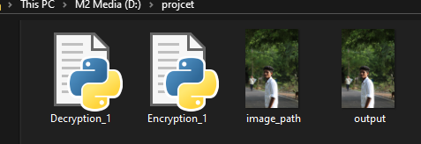
Results

Slide 8
Conclusion
Steganography provides a powerful and secure method for hiding data within images, ensuring confidentiality preventing unauthorized access. By embedding secret information without altering the visual integrity, this technique is ideal for secure communication, digital watermarking, and cybersecurity applications. Advanced algorithms like LSB, DCT, and AI-driven methods enhance data security while minimizing detection risks. This project stands out by offering an efficient, scalable, and resilient approach to secure data transmission, making it valuable for various sectors, including defense, finance, and digital forensics.

Slide 9
GitHub Link
https://github.com/Tamizh-2005/Steganography.git

Slide 10
Future scope
AI-Driven Steganography – Using deep learning for smarter and more secure data hiding.
Quantum Cryptography Integration – Enhancing security with quantum-safe encryption.
Real-Time Steganography – Implementing live data embedding for secure messaging apps.
Blockchain-Based Steganography – Ensuring data integrity and traceability.
Multi-Layered Security – Combining steganography with biometric authentication.
Steganalysis Defense Mechanisms – Developing advanced techniques to resist detection.
Cross-Media Steganography – Expanding data hiding to videos, audio, and 3D models.
IoT and Smart Devices – Securing communication in Internet of Things (IoT) networks.

Slide 11
THANK YOU

