Slide 1




QUERY EVALUATION USING PAGING MODULE TO SECURE DB IN SCPU FOR PRIVACY AND DATA CONFIDENTIALITY
BATCH NO:39
Guided By:
Mrs.B.UMA MAHESWARI M.Tech
Assistant Professor.
Team Members:
S.TAMIZHARASAN(411611104083).
R.UDAYASHANKAR(411611104084).
PDKV
DOMAIN: DATABASE SECURITY

Slide 2
ABSTRACT
BATCH NO:39
Most information systems and business applications have a web front end and they need to be universally available to clients around the world.
These web applications, which can be accessed from anywhere, become so widely exposed and exploited by hackers
The main motive of this project is to develop the Trusted DB. Trusted DB, with privacy and data confidentiality using SCPU.
It allows clients to execute SQL queries with privacy and under regulatory compliance constraints.
Trusted DB achieves this by leveraging server-hosted tamper-proof trusted hardware in critical query processing stages.
PDKV

Slide 3
EXISTING SYSTEM
BATCH NO:39
Network security practitioners put more resources and efforts into defending against SQL INJECTION ATTACKS.
Hackers will develop and deploy the next generation of SQLIA bonnets with different control architecture.
A SQLIA is an attack that is aimed at subverting the original intent of the application
Through this hacker can easily enter into a user account and access their own information.
If a DBA knows the password, he can easily access user account without user permission.
PDKV

Slide 4
PROBLEMS IN THE EXISTING SYSTEM
BATCH NO:39
Bypasses the login authentication.
Selects secure information from database tables
Attempts to add additional SQL statements to the existing SQL statement
Execute oracle function or custom function from the select statement.
PDKV

Slide 5
PROPOSED SYSTEM
BATCH NO:39
The proposed system developed, eradicates the drawbacks of the existing system.
The security level very much enhanced from its actual level. The DBA cannot view the user details in its original form.
The hacker cannot enter the user login by using the tricky queries, cannot run the inbuilt function in it etc.
Usage of secure co-processor(SCPU) provides way for the extended safety and security of the data
PDKV

Slide 6
ADVANTAGES OF PROPOSED SYSTEM
BATCH NO:39
Avoid unauthorized access to the application
User cannot get secure information from database
User cannot add SQL queries to the existing SQL statement
User cannot call oracle function or custom function.
PDKV

Slide 7
LITERATURE SURVEY
BATCH NO:39
Using Secure Coprocessors For Privacy Preserving Collaborative Data Mining And Analysis.
Aggregation Queries In The Database-as-a-service Model.
To Cloud Or Not To Cloud? Musings On Costs And Viability.
Distributing Data For Secure Database Services.
Chip-secured Data Access: Confidential Data On Untrusted Server.
Trusted DB: A Trusted Hardware Based Outsourced Database Engine.
Crypt DB: Protecting Confidentiality With Encrypted Query Processing.
Ghost DB: Querying Visible And Hidden Data Without Leaks.
Incorporating A Secure Coprocessor In The Database-as-a-service Mode.
Two Can Keep A Secret: A Distributed Architecture For Secure Database Services.

Slide 8
BATCH NO:39
USING SECURE COPROCESSORS FOR
PRIVACY PRESERVING COLLABORATIVE DATA MINING AND ANALYSIS
Provide solution which doesn’t need part administering, work in hostile environment.
Data perturbation make data joining problematic.
PCIXCC hardware implemented using PCI-X adaptor.
security comp
Ethernet
serial port interfaces
Cryptographic accelerator
Provide fast hardware implementation of algorithms, MD5 & SHA-1 and less power consuming
PDKV

Slide 9
Aggregation Queries in the Database-as-a-Service Model
BATCH NO:39
Bucketization:
2 strategies to perform
Equi-width:
Reveals the accurate bucket width histogram
Equi-depth:
Have the same no of items by hiding the actual distribution of values
Bucketization has an unavoidable side effect of privacy loss
PDKV

Slide 10
To Cloud Or Not To Cloud? Musings On Costs and Viability
BATCH NO:39
Deals with the process of cost calculation by which they can be used in cloud or not.
Discovered two scenarios
Unified client.
Multi client.
Levels:
Home
Small enterprise
mid enterprise
Large enterprise
PDKV

Slide 11
Distributing Data for Secure Database Services
BATCH NO:39
For providing data privacy entire database is encrypted.
It provides a drawback of heavy network traffic.
Heuristic search techniques based on greedy hill climbing method is used to obtain optimal solution.
The decryption cost is calculated for every query, which increases the memory storage.
Cost estimation is used to find the best possible partition which minimizes the No. of bytes transmitted across the network.
PDKV

Slide 12
Chip-Secured Data Access: Confidential Data on Untrusted Server.
BATCH NO:39
Concentrates only over the data confidentiality and doesn’t address the problem of the privacy.
C-SDA a client based security component is used as an mediator between the client and the encrypted database.
Provides the in-depth analysis of the existing security solutions and concludes on the intrinsic weakness of traditional server based approach.
C-SDA takes the form of the security software, which act as an incorruptible mediator.
Privacy is easier to enforce than confidentiality as they use the symmetric key algorithm.
PDKV

Slide 13
Trusted DB: A Trusted Hardware Based Outsourced Database Engine
BATCH NO:39
Today the cloud providers offers a database service as part of their overall solution.
Customers inherently trust the provider (third party) without the assurances of Privacy and Data Confidentiality.
This can be overcome by encrypting the data without decrypting the inputs.
Trusted DB on the other hand utilizes secure, tamper and resistant hardware.
The cost-based comparison of solutions shows the cost advantages of using trusted hardware.
PDKV

Slide 14
Crypt DB: Protecting Confidentiality with Encrypted Query Processing
BATCH NO:39
Online application are vulnerable to theft of sensitive information by adversaries and by DBA.
Crypt DB provide confidentiality for attacks backed by SQL DB.
Works by executing SQL Queries over the Encrypted data using several schemes.
Crypt DB also chains the encryption keys to the user password.
Process of encrypting the sensitive data is used here.
PDKV

Slide 15
GhostDB: Querying Visible and Hidden Data Without Leaks
BATCH NO:39
The basic idea is to remove all sensitive data from internet-accessible places.
So, we use a Smart USB key containing the private data.
Once we connect the Smart USB key to laptop or any other device it will connect private and public data.
The general purpose storage and processing environment are referred as Untrusted and the USB key is referred as secured.
Ghost DB works in mono-user environment on the secure USB key.
PDKV

Slide 16
Incorporating a Secure Coprocessor in the Database-as-a-Service Mode
BATCH NO:39
Processor serves as a neutral party between the clients and the service provider.
In the DAS model, the client DB is stored at the service provider.
Benefits:
By outsourcing databases clients can reduce the total cost of operation.
The service provider can offer the Service to Multiple clients.
The clients can be assured of the QOS.
Guards the privacy of data not only from malicious outside attackers but also from the service provider also.
PDKV

Slide 17
Two Can Keep a Secret: A Distributed Architecture for Secure Database Services
BATCH NO:39
The use of external database service promises reliable data storage at a low cost.
The client can fetch the entire Database from the server ,Decrypt it and execute the queries.
So to overcome this we use a process of partition the database into two and we save the data into it.
The two database are logically independent database systems that cannot communicate with each other.
Here the client maintains the a permanent channels of communication to each server without encryption.
PDKV

Slide 18
SYSTEM REQUIREMENTS
BATCH NO:39
SOFTWARE REQUIREMENTS:
Operating System : Windows XP
Front-End : Mod PL/SQL
Back-End : Oracle 10g
Tool : PL/SQL Developer
HAREWARE REQUIREMENTS:
System : Pentium IV 2.4 GHZ
Hard Disk : 40 GB
RAM : 512 Mb
PDKV

Slide 19
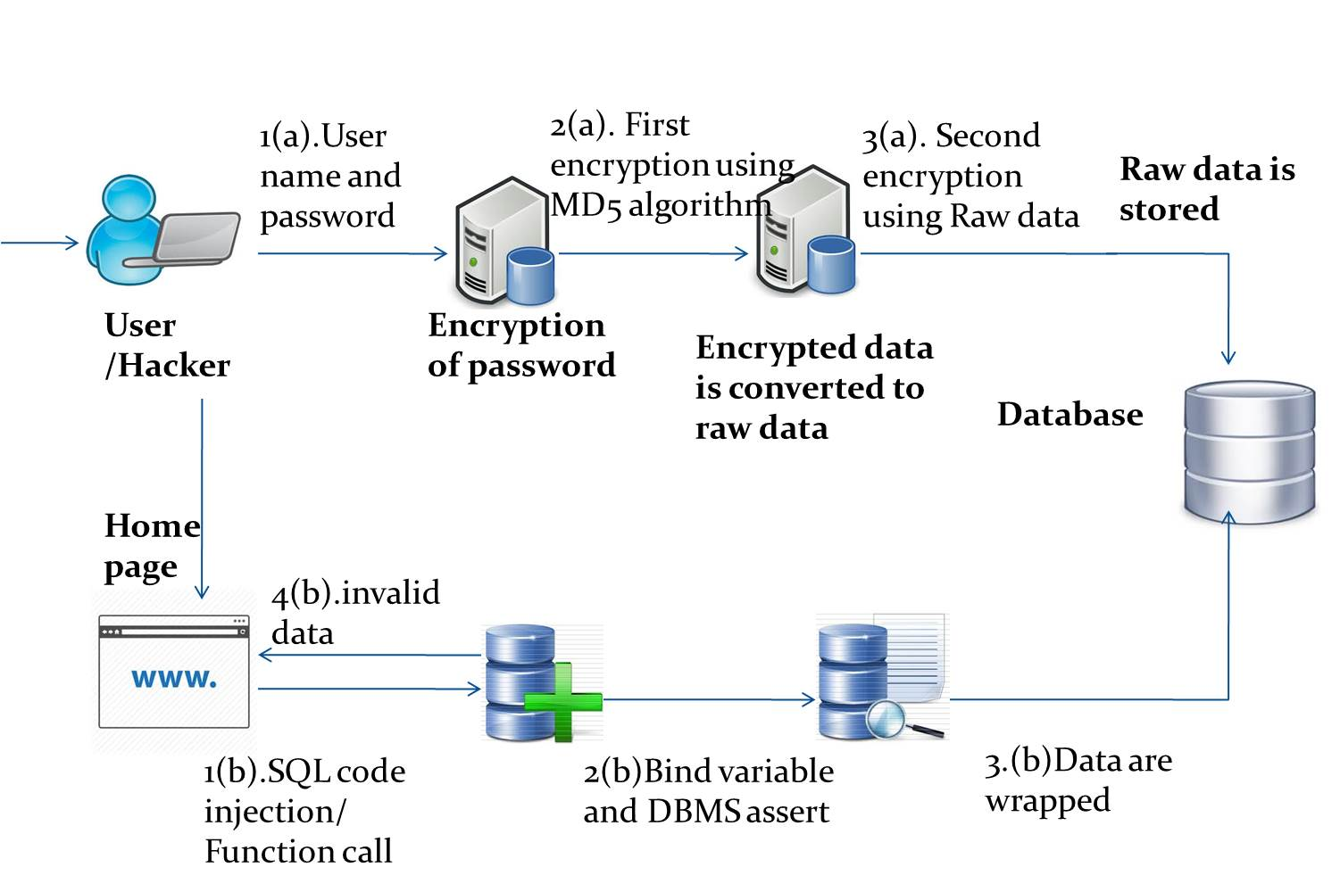
ARCHITECTURE DIAGRAM
BATCH NO:39
PDKV

Slide 20
LIST OF MODULES
BATCH NO:39
BYPASSING USER ACCOUNT
SQL code Injection
FUNCTION CALL INJECTION
ACCESSING SECURED INFORMATION
TRANSFER OF SCHEMA INFORMATION
PDKV

Slide 21
BYPASSING USER ACCOUNT
BATCH NO:39
INPUT:
USERNAME AND PASSWORD
PROCESS:
Converts our secure information into RAW Data after the convert to Hexadecimal Bit Using Md5 Algorithm And Stores To The Database (username & Password)
OUTPUT:
Encrypted DATA BITS
PDKV

Slide 22
SQL code Injection
BATCH NO:39
INPUT:
HARD TAUTOLOGICAL SQL QUERIES
PROCESS:
Equates Each Query To Bind Variables And Then Query Is Checked For Its Condition
OUTPUT:
The Tautological Based Attacks Are Avoided
PDKV

Slide 23

FUNCTION CALL INJECTION
BATCH NO:39
INPUT:
Hard Union ,Piggybacked SQL Queries
PROCESS:
By Passing Through DBMS_ASSERT Package , the Keywords Are Checked
OUTPUT:
Thus Each Query Is Processed Word By Word Which Avoids Running Various Function

Slide 24
ACCESSING SECURED INFORMATION
BATCH NO:39
INPUT:
Alternate Encoding SQL Queries
PROCESS:
All The Information Are Wrapped In A Same Package And Processed
OUTPUT:
Such That Accessing Methods Are Hidden From The Hacker
PDKV

Slide 25
TRANSFER OF SCHEMA INFORMATION
BATCH NO:39
INPUT:
Schema Object Name
PROCESS:
Transfers The Control From One Object To Other Using Auth Id of Current_user
OUTPUT:
Allows only the enabled schema

Slide 26
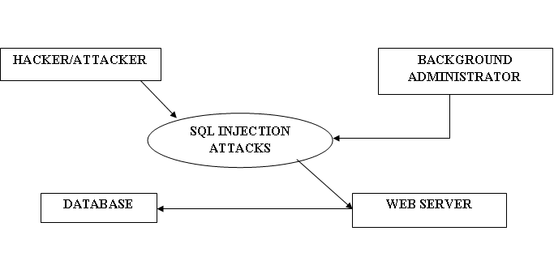
DATAFLOW DIAGRAM
BATCH NO:39
LEVEL 0
PDKV

Slide 27
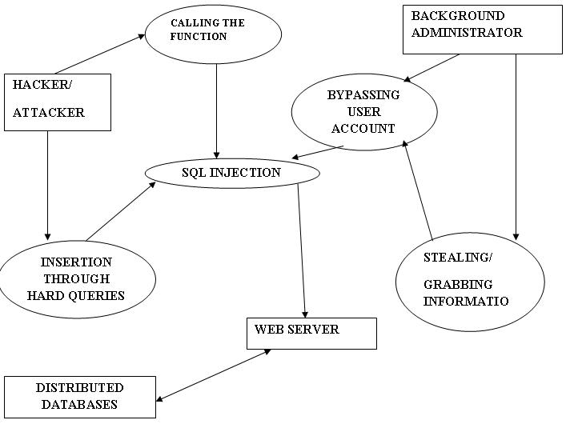
Level 1
BATCH NO:39
PDKV

Slide 28
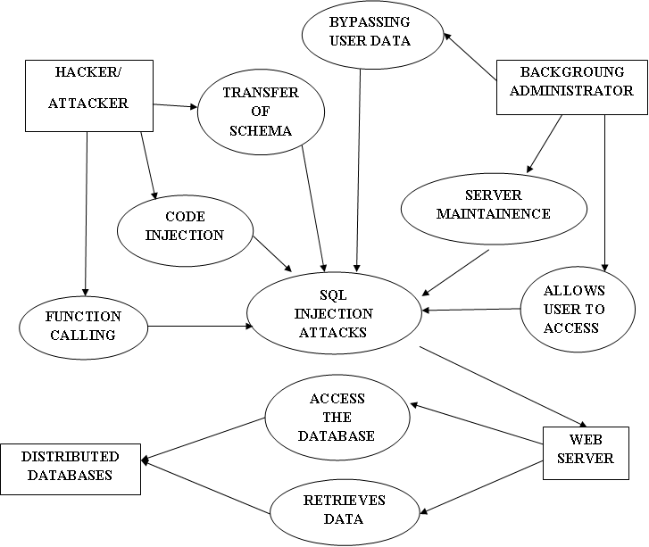
Level 2
BATCH NO:39
PDKV

Slide 29
FEASIBILITY STUDY
The objective of feasibility study is not only to solve the problem but also to acquire a sense of its scope. The key considerations are:
Economic feasibility
Technical feasibility
Operational feasibility
Economic Feasibility
Economic feasibility studies not only the cost of hardware and software but also the benefits in the form of reduced costs are considered here.
This project, if installed will certainly be beneficial since there will be reduction in manual work and increase in the speed of work.

Slide 30
FEASIBILITY STUDY
Technical Feasibility
Technical feasibility evaluates the hardware requirements, software technology, available personnel etc., as per the requirements it provides sufficient memory to hold and process.
Operational Feasibility
This study helps us predict the operational ability of the system that is being developed.
This study also helps us analyze the approach towards which the system must be developed by which development effort is reduced. Effort spend on a feasibility analysis that results in the cancellation of a proposed project is not a wasted effort.

Slide 31
TESTING
BATCH NO:39
Test | Requirement or Purpose | Action / Input | Expected Output | Actual Result | P / F
1. | Enter username, password and role | To click the register button | Password is encrypted | Same as encrypted | Pass
2. | Encrypted password | Preprocessor | Encrypted password should be converted to raw data | Same as encrypted | Pass
3. | Login with username and password | To click login button | Check with database | Same as encrypted | Pass
4. | Enter sql code in webpage text entry | To convert values to bind variable | Check with keyword | Same as encrypted | Pass
5. | Hard tautological query | Check with DBMS – assert package | DML keyword are not executed | Same as encrypted | Pass
6. | Wrapped database value | To stored all records in database with hidden | Data are hidden using wrapping | Same as encrypted | Pass
7. | Database name | Compile all value in one object | Access from another object | Same as encrypted | Pass
PDKV

Slide 32
GRAPHICAL REPRESENTATION OF SECURITY
BATCH NO:39

Slide 33
RESULTS AND DISCUSSION
BATCH NO:39
The Test cases are performed in the Linear way ,where the project passes through successfully under each stage.
Structural testing
Integration testing
Unit testing.
System testing
All the test have been tested over the project which provides an positive result.
PDKV

Slide 34
CONCLUSION
BATCH NO:39
Database protection system against SQL attacks, mainly including the protection for ordinary users and administrators is achieved.
Experiments show that this is a very effective protection system.
Our project has provided both data confidentiality and privacy at the same time.
We have implemented the concept of SCPU and Paging Module in an efficient manner.
The SCPU is placed outside the main database thus not providing any memory limitations.
PDKV

Slide 35
FUTURE ENHANCEMENT
BATCH NO:39
We can implement this project in cloud using Oracle 12c in mere future.
protection of database in wide area of network should be achieved.
The SQL protection as well as recovery of the information should be achieved in an easier manner.
The information storage capacity of a database system should be enhanced without leaking .
PDKV

Slide 36
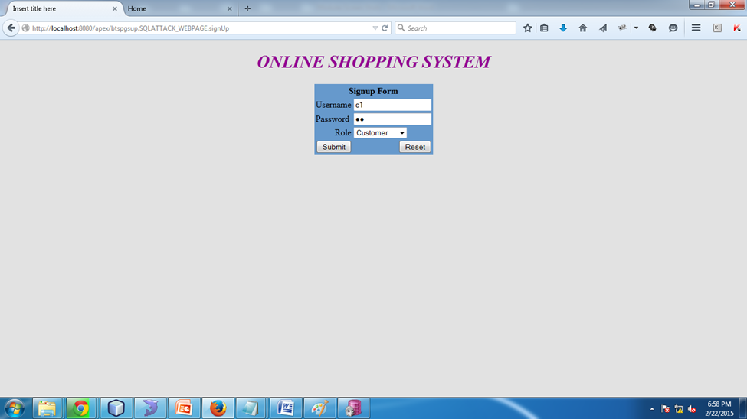
SCREEN SHOTS
BATCH NO:39
SIGN UP:

Slide 37
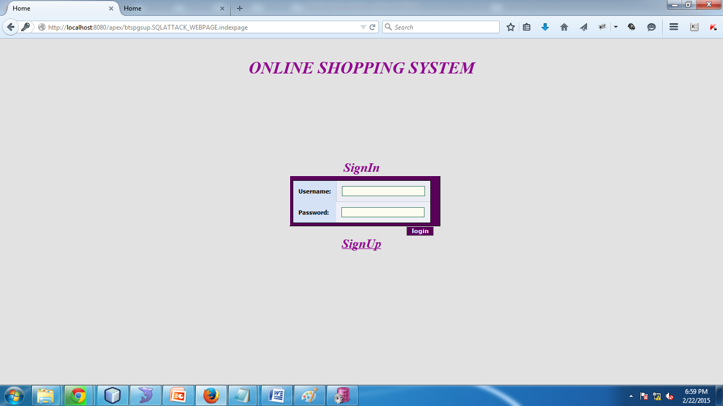
Existing Home Page:
BATCH NO:39

Slide 38
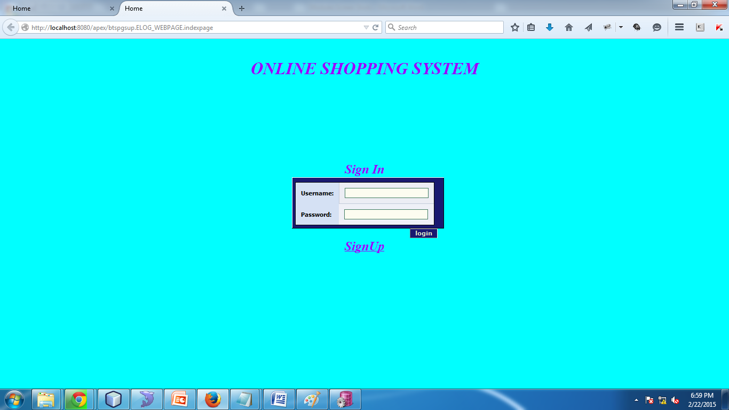
Proposed Home Page:
BATCH NO:39

Slide 39
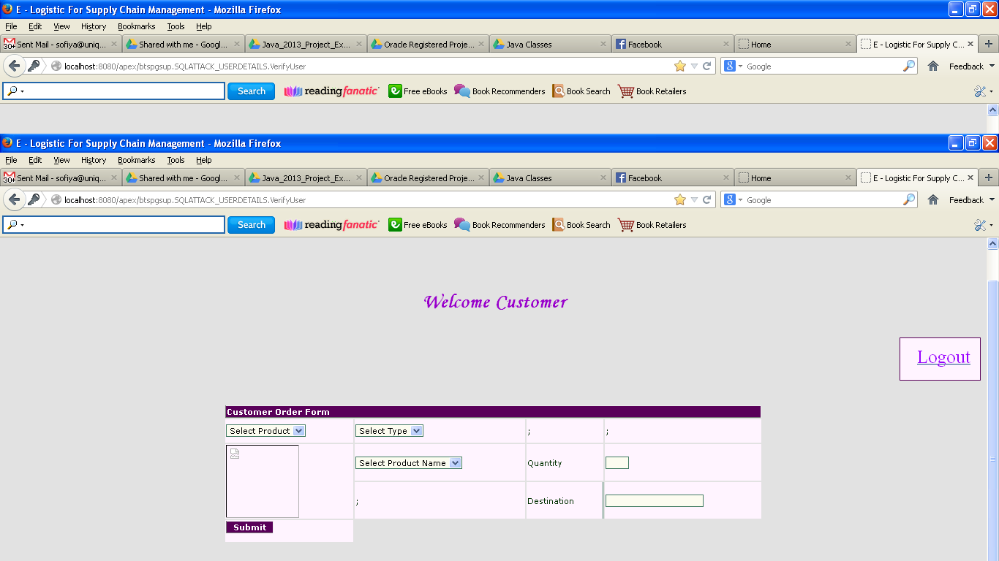
Bypass Login (allow to Next Page in Existing System):
BATCH NO:39

Slide 40
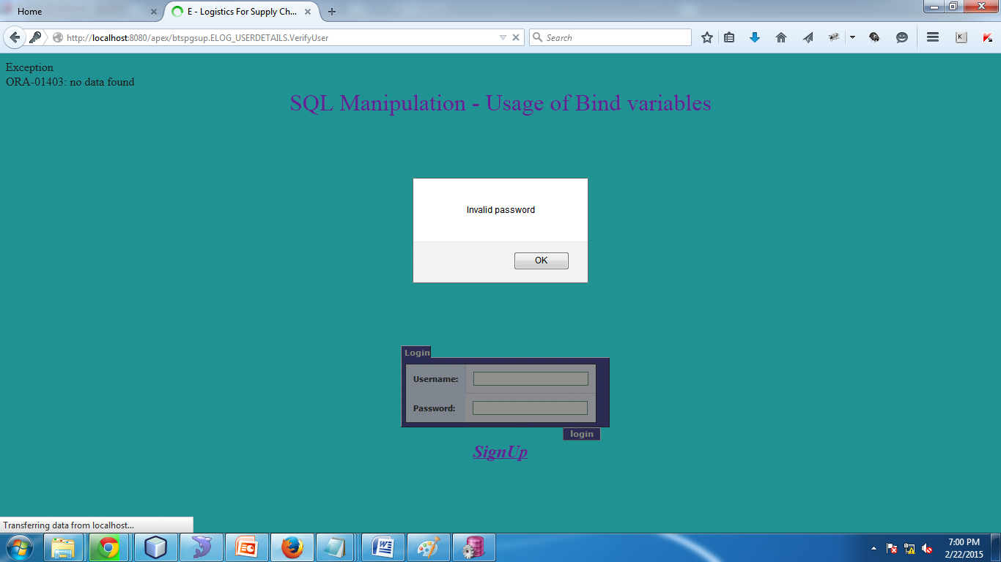
Proposed System (Not allow) because of bind variable and MD5:
BATCH NO:39

Slide 41
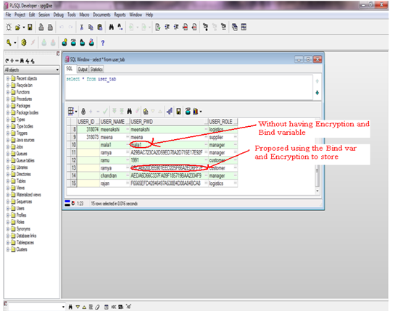
Data Storage structure of Systems:
BATCH NO:39

Slide 42
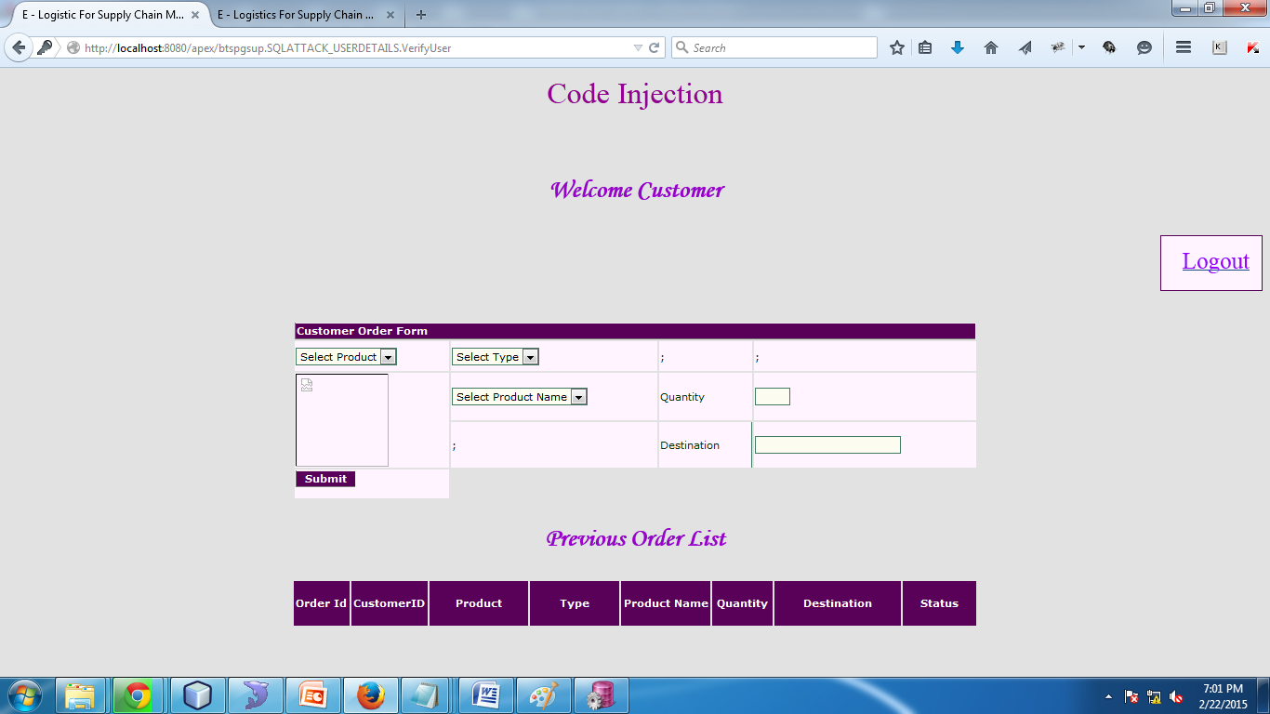
Code Injection:
BATCH NO:39

Slide 43
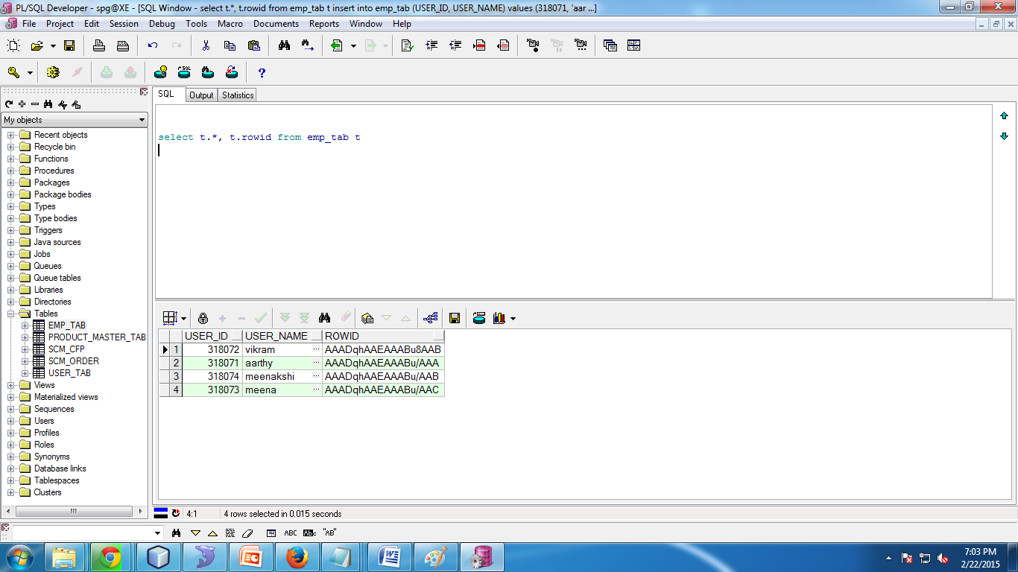
Before Code Injection Database:
BATCH NO:39

Slide 44
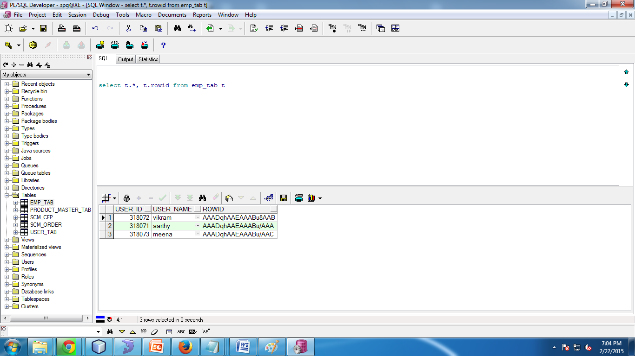
After Code Injection Database:
BATCH NO:39

Slide 45
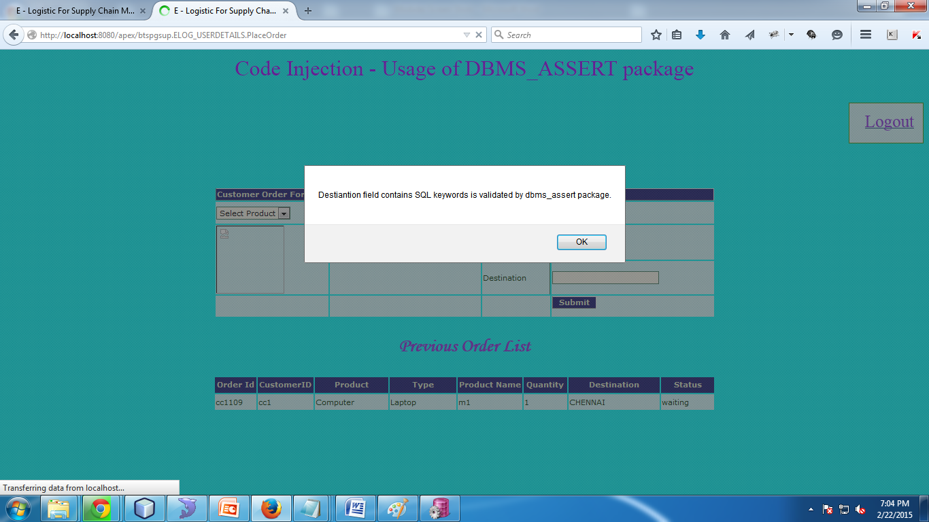
Proposed avoid the Code Injection:
BATCH NO:39

Slide 46
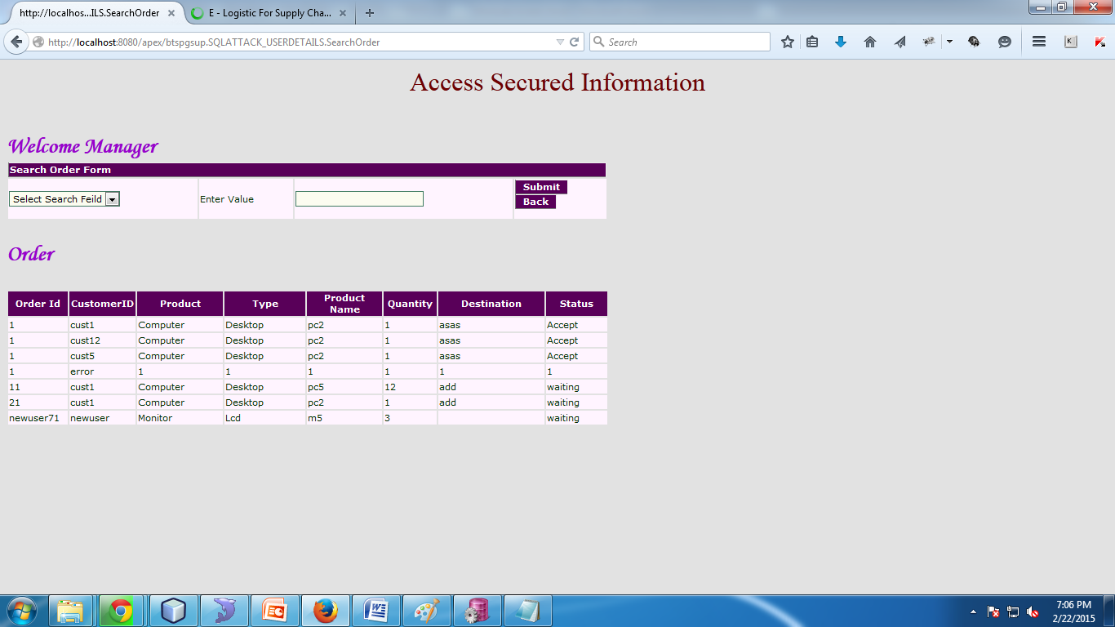
Function Call Injection: Existing:
BATCH NO:39

Slide 47
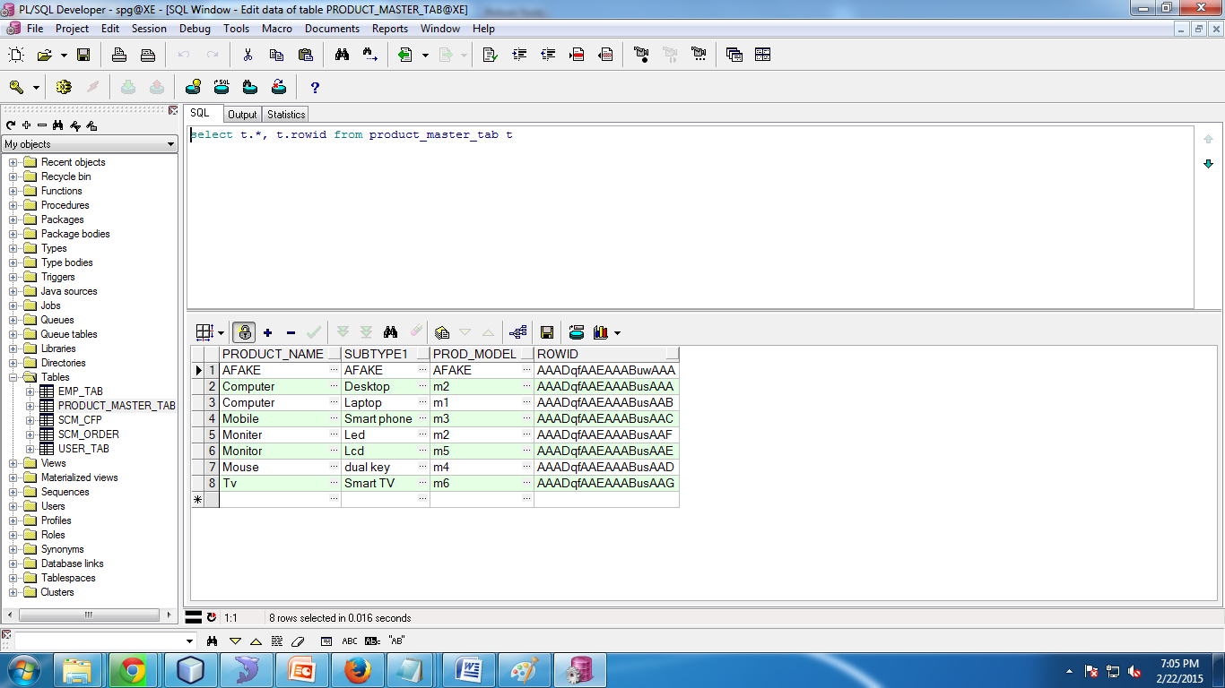
Database After Function call Injection:
BATCH NO:39

Slide 48
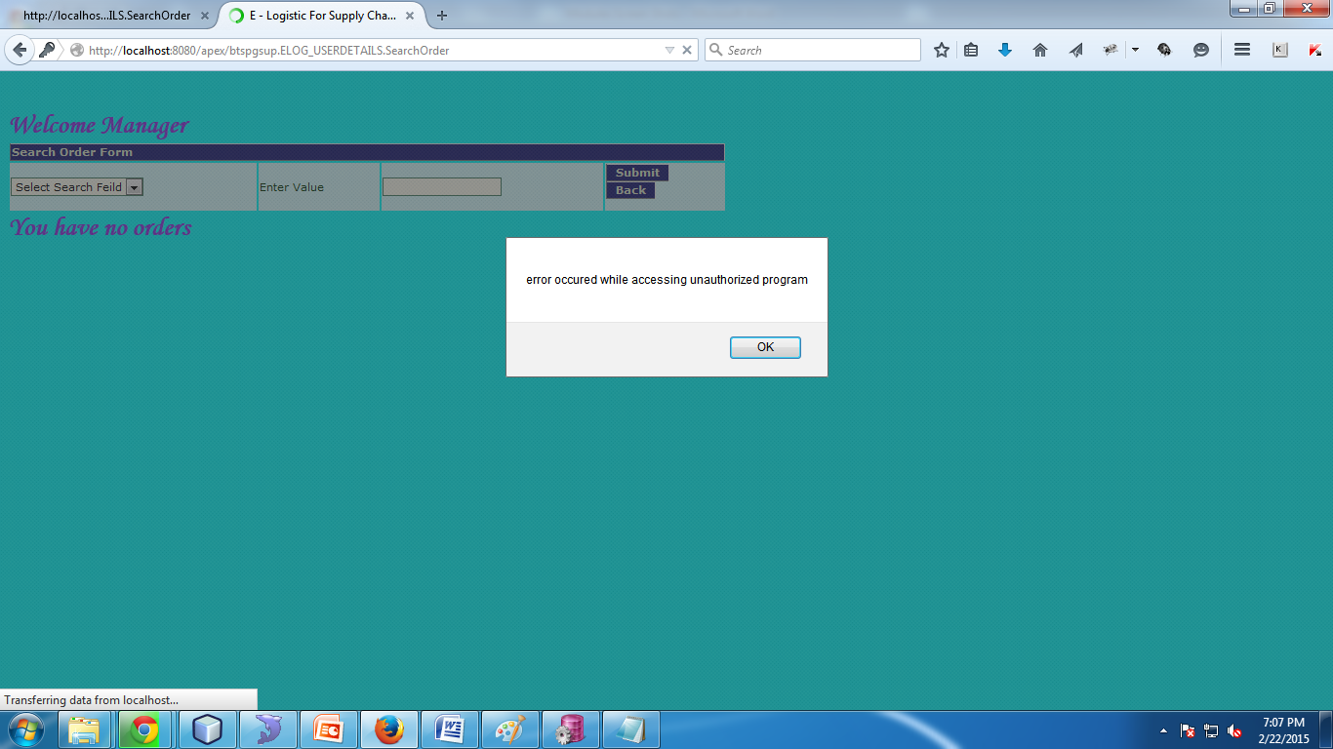
Proposed Avoid the function Call:
BATCH NO:39

Slide 49
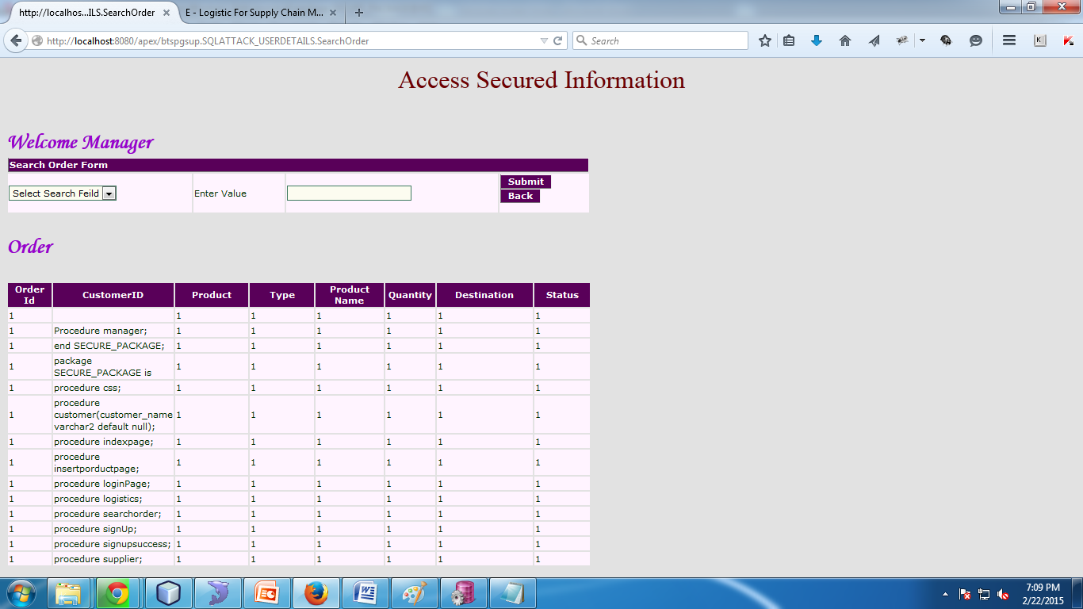
Access secure Information:
BATCH NO:39

Slide 50

BATCH NO:39
Proposed System:

Slide 51
REFERENCE PAPERS
BATCH NO:39
B. Bhattacharjee, N. Abe, K. Goldman, B. Zadrozny, C. Apte, V.R. Chillakuru, and M. del Carpio, “Using Secure Coprocessors for Privacy Preserving Collaborative Data Mining and Analysis,” Proc. Second Int’l Workshop Data Management on New Hardware (DaMoN ’06), 2006
E. Mykletun and G. Tsudik, “Aggregation Queries in the Database-as-a-Service Model,” Proc. 20th IFIP WG 11.3 Working Conf. Data and Applications Security, pp. 89-103, 2006.
R.A. Popa, C. Redfield, and N. Zeldovich, “Cryptdb: Protecting Confidentiality with Encrypted Query Processing,” Proc. 23rd ACM Symp. Operating Systems Principles (SOSP ’11), 2011.
Distributing Data for Secure Database Services V. Ganapathy, D. Thomas, T. Feder, H. Garcia-Molina, and R. Motwani, “Distributing Data for Secure Database Services,” Proc. Fourth Int’l Workshop Privacy and Anonymity in the Information Soc. (PAIS ’11), pp. 8:1-8:10, 2011.
L. Bouganim and P. Pucheral, “Chip-Secured Data Access: Confidential Data on Untrusted Server,” Proc. 28th Int’l Conf. Very Large Data Bases (VLDB ’02), pp. 131-141, 2002.
PDKV

Slide 52
REFERENCE PAPERS
BATCH NO:39
S. Bajaj and R. Sion, “TrustedDB: A Trusted Hardware Based Outsourced Database Engine,” Proc. Int’l Conf. Very Large Data Bases (VLDB), 2011.
A. Iliev and S.W. Smith, “Protecting Client Privacy with Trusted Computing at the Server,” IEEE Security and Privacy, vol. 3, no. 2, pp. 20-28, Mar./Apr. 2005. Ghost DB: Querying Visible and Hidden Data Without Leaks.
Y. Chen and R. Sion, “To cloud or Not to Cloud?: Musings on Costs and Viability,” Proc. Second ACM Symp. Cloud Computing (SOCC ’11), pp. 29:1-29:7, 2011. Two Can Keep a Secret: A Distributed Architecture for Secure Database Services
N. Anciaux, M. Benzine, L. Bouganim, P. Pucheral, and D. Shasha, “GhostDB: Querying Visible and Hidden Data Without Leaks,” Proc. 26th Int’l ACM Conf. Management of Data (SIGMOD), 2007.
G. Aggarwal, M. Bawa, P. Ganesan, H. Garcia-Molina, K. Kenthapadi, R. Motwani, U. Srivastava, D. Thomas, and Y. Xu, “Two Can Keep a Secret: A Distributed Architecture for Secure Database Services,” Proc. Conf. Innovative Data Systems Research (CIDR), pp. 186-199, 2005.
PDKV

Slide 53

BATCH NO:39

Slide 54

BATCH NO:39

