Slide 1
Project Proposal - ITR
Tamizhanban A G
Aarav Shah

Slide 2
Rangoli drawing-bot
We program the robot few simple trajectories which when done in sequence will come out to be a rangoli.
We would use a calligraphy pen to draw the rangoli on the floor. The soft tip of the pen would not require applying force on the ground rather it stays above the 0 plane by some z distance.
We won’t be needing any gripper to just hold the pen at some distance above the ground.
The rangoli will be drawn using multiple, simple shapes (ex: circles)

Slide 3
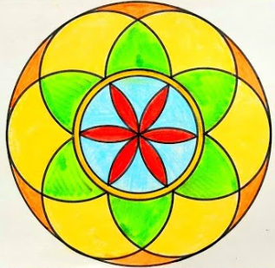

Slide 4
An Additional Complexity
We add a webcam and use a normal brush instead of a calligraphy pen.
The webcam looks at the current stroke and identifies the intensity of the stroke and once the intensity drops off, we dip it in the paint bin and start over from the last few positions.
This could be easily done with OpenCV using a simple function.

Slide 5
Thank you

