Slide 1

QUICK GLANCE Unsupervised Extractive Summarization Model Guide : Mrs L Sumathi,M.E
Cheran Sengutuvan S – 1717106
Dharshana P – 1717110
Karthika M – 1717116
Hemachandran G – 1717L01

Slide 2
Objectives:
Needless information and repetitive content makes us skip valuable articles and news.
What if an application removes all the clutters and get a quick glimpse of the whole article in a line or two?
Introducing QUICK GLANCE

Slide 3
Goals:
Preserve the meaning and key of the data.
Resource effective.
Balanced results.
User-friendly.
Architectural pattern.

Slide 4
Work Flow
1
2
Document
Sentences
Sentence vector
3
Summary
Principal Sentences
Sequential Information
5
4
Pre-processing 2. Pre-trained sentence model
3. Positional encoding method 4. PCA
5. ILP

Slide 5
Pre-processing steps:
Tokenize on white space
Convert into lower case
Remove punctuations from each tokens
Remove tokens with numbers
Remove empty strings

Slide 6


Slide 7
Positional Encoding:
We use positional encoding to effectively reflect sequential information.
The positional encoding method employs cosine and sine functions to retain the position of words.
The positional encoding matrix PE is calculated as follows

Slide 8
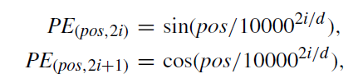
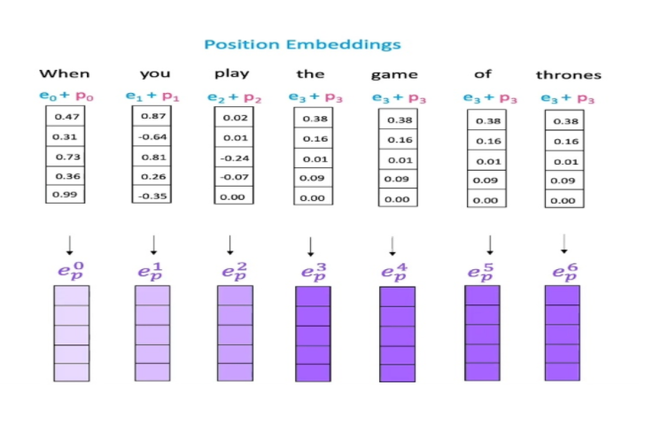

Slide 9
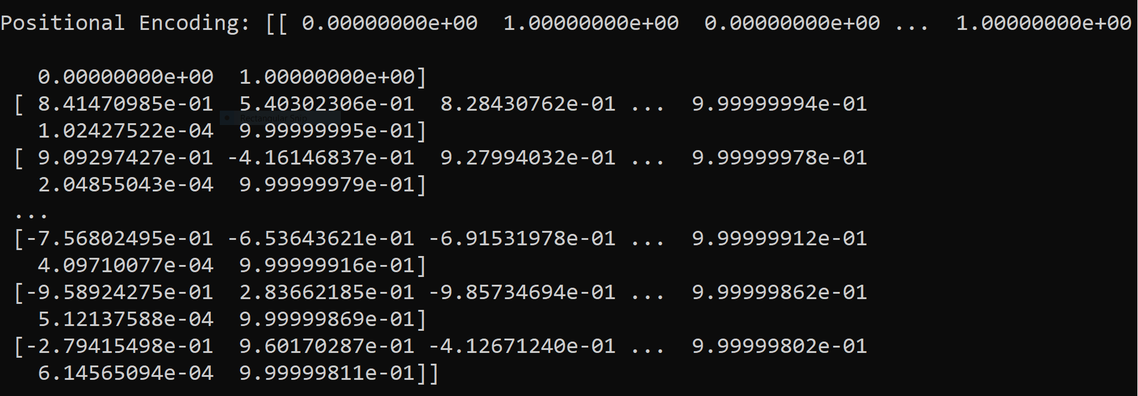

Slide 10
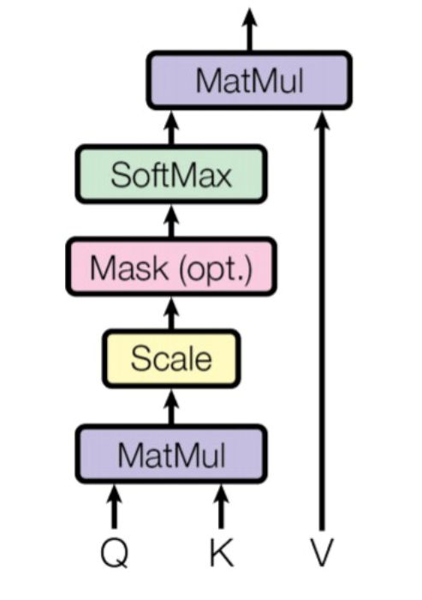
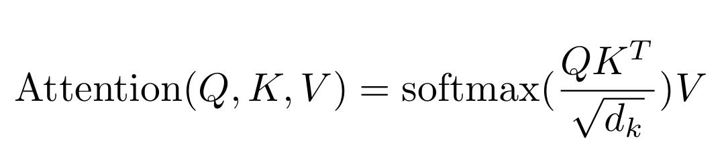
Attention:
able to attend a semantically important
concept or region of interest.
able to find the relative strength of attention
paid on multiple concepts
able to switch attention among concepts
dynamically according to task status.

Slide 11
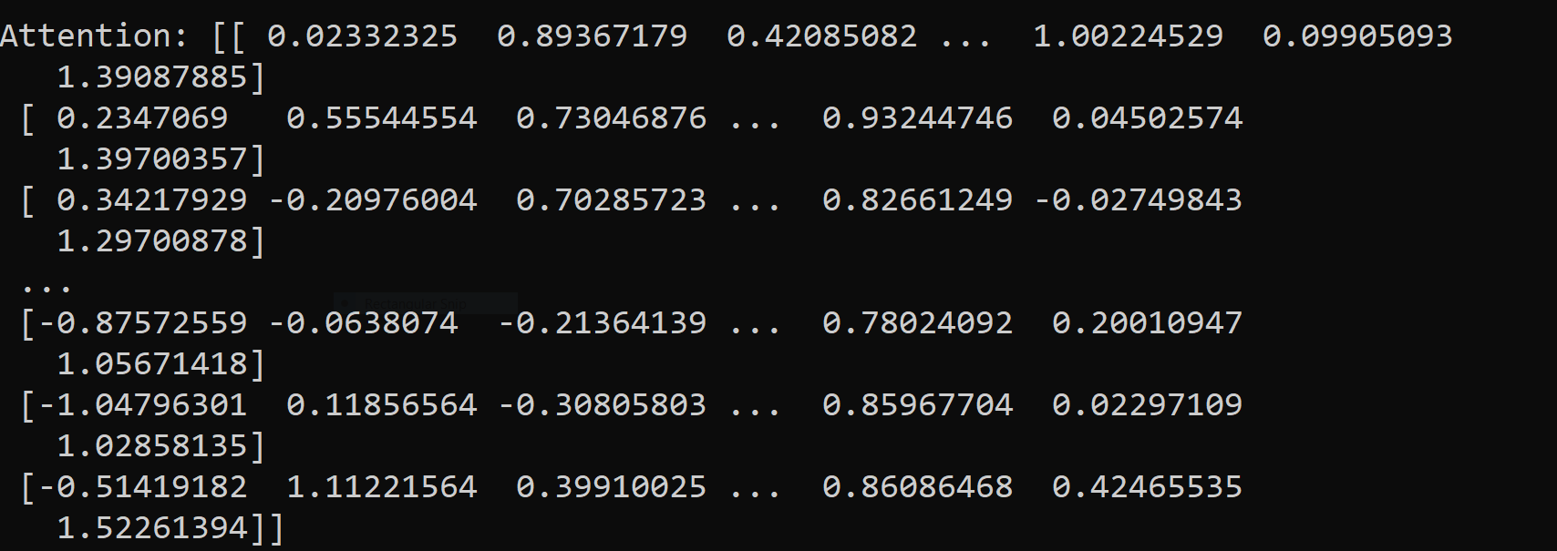

Slide 12

Principal Component Analysis:
Method used for dimensionality reduction because it is possible to explain the entire dataset through a few PCs(Principal Components).
In this process, we are calculating the sentence importance score by using cosine similarity.
Notes:
Low variance filter,
Missing value ratio,
Random forests

Slide 13
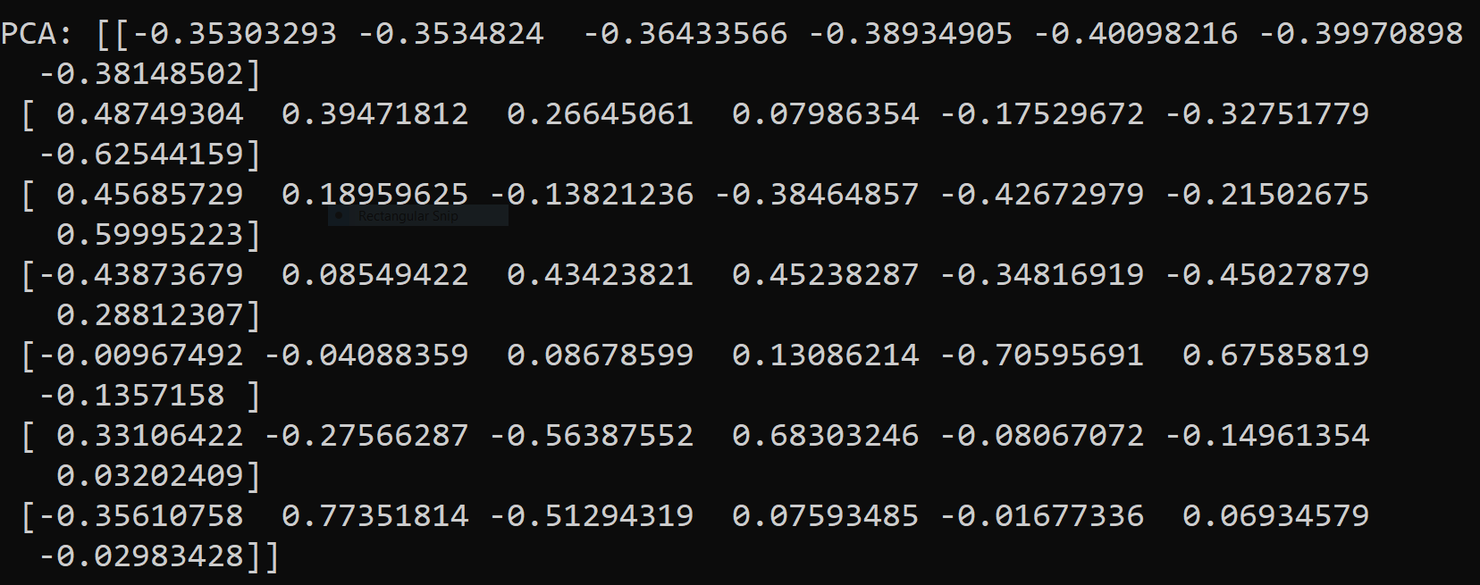

Slide 14

Integer Linear Programming
1. Formulation - reduce redundancy
2. Sentence Pruning - reduce complexity

Slide 15
Tech stack
Python
Django
HTML
Numpy, Pytorch
CSS
BS4 , pulp
Bootstrap
Sklearn
Front-End
NLTK
Back-End

Slide 16
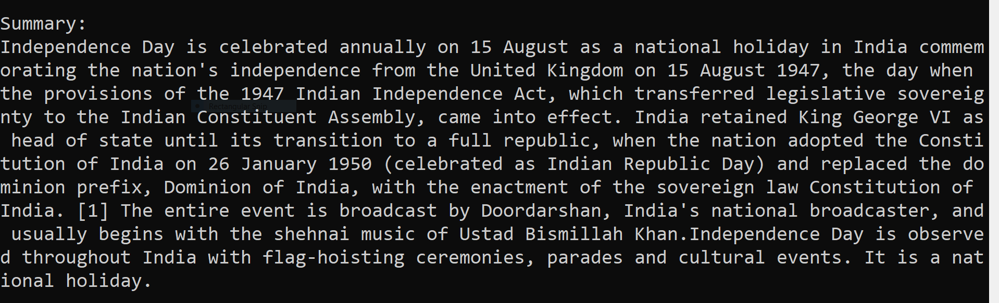
OUTPUT:

Slide 17


Slide 18
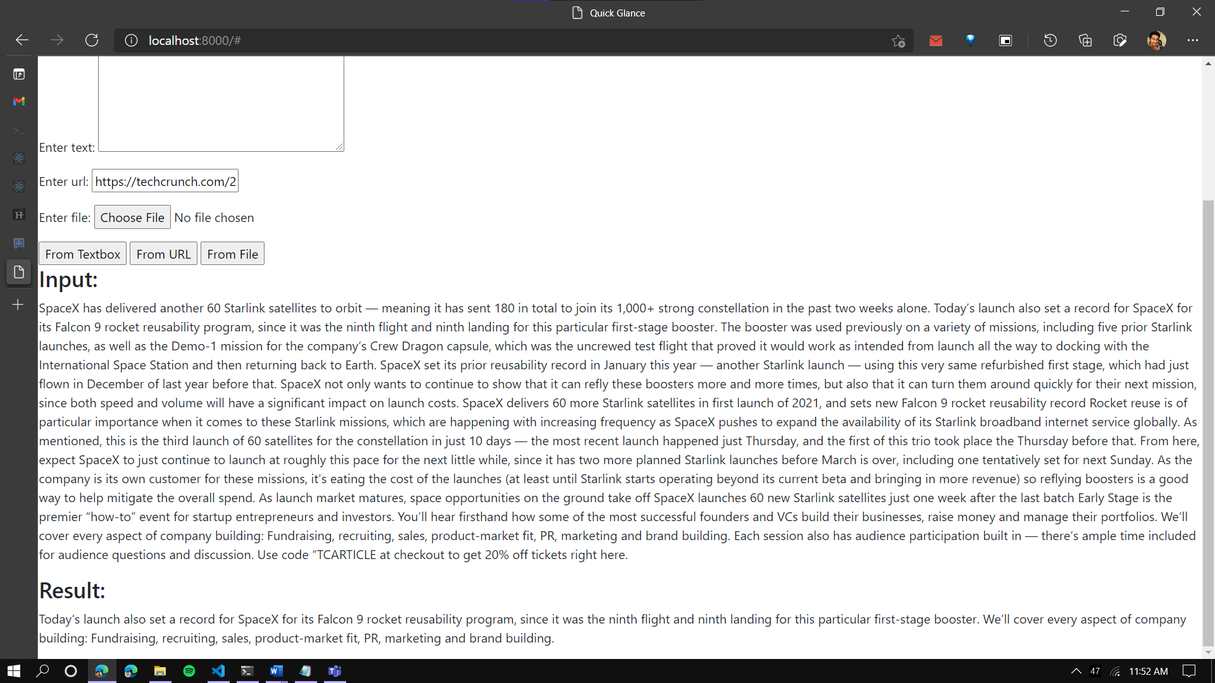

Slide 19
References:
IEEE Paper : https://ieeexplore.ieee.org/document/9321308
PE: https://www.youtube.com/watch?v=dichIcUZfOw
https://www.youtube.com/watch?v=mMa2PmYJlCo
Attention : https://www.geeksforgeeks.org/self-attention-in-nlp-2
Q, K, V : https://www.coursera.org/lecture/attention-models-in-nlp/
dot-product-attention-lO5yN

Slide 20
Thank You !!!

