Slide 1
CALCULATOR
NAME: TAMIZHSELVAN.V
ORGANIZATION: Micro IT
TOPIC: CALCULATOR

Slide 2
Introduction
This project is a desktop-based calculator application developed using Python and Tkinter.
It performs basic arithmetic operations such as addition, subtraction, multiplication, and division.
The calculator features a user-friendly graphical interface and real-time result updates.

Slide 3
Objectives of the Project
To create a GUI-based calculator using Python
To implement real-time arithmetic functionality
To enhance programming skills using Tkinter for UI
To develop an application with proper layout and event handling

Slide 4
What is a Calculator?
A calculator is a software application that allows users to perform basic mathematical operations.
This Python-based version uses Tkinter to build the interface and buttons with backend logic for calculations.

Slide 5
Tools and Technologies Used
Python 3: Core programming language
Tkinter: Built-in Python library for GUI applications
IDLE: Used as code editor
Pillow (optional): For enhanced GUI styling (if used)

Slide 6
User Interface Design
Buttons for digits and operators
Display area to show expression/result
Clear and backspace functionalities

Slide 7
Key Code Snippets
Button creation using tk.Button(...)
Entry widget to display input/output
eval() used to compute result
Functions for clear, backspace, and equal

Slide 8
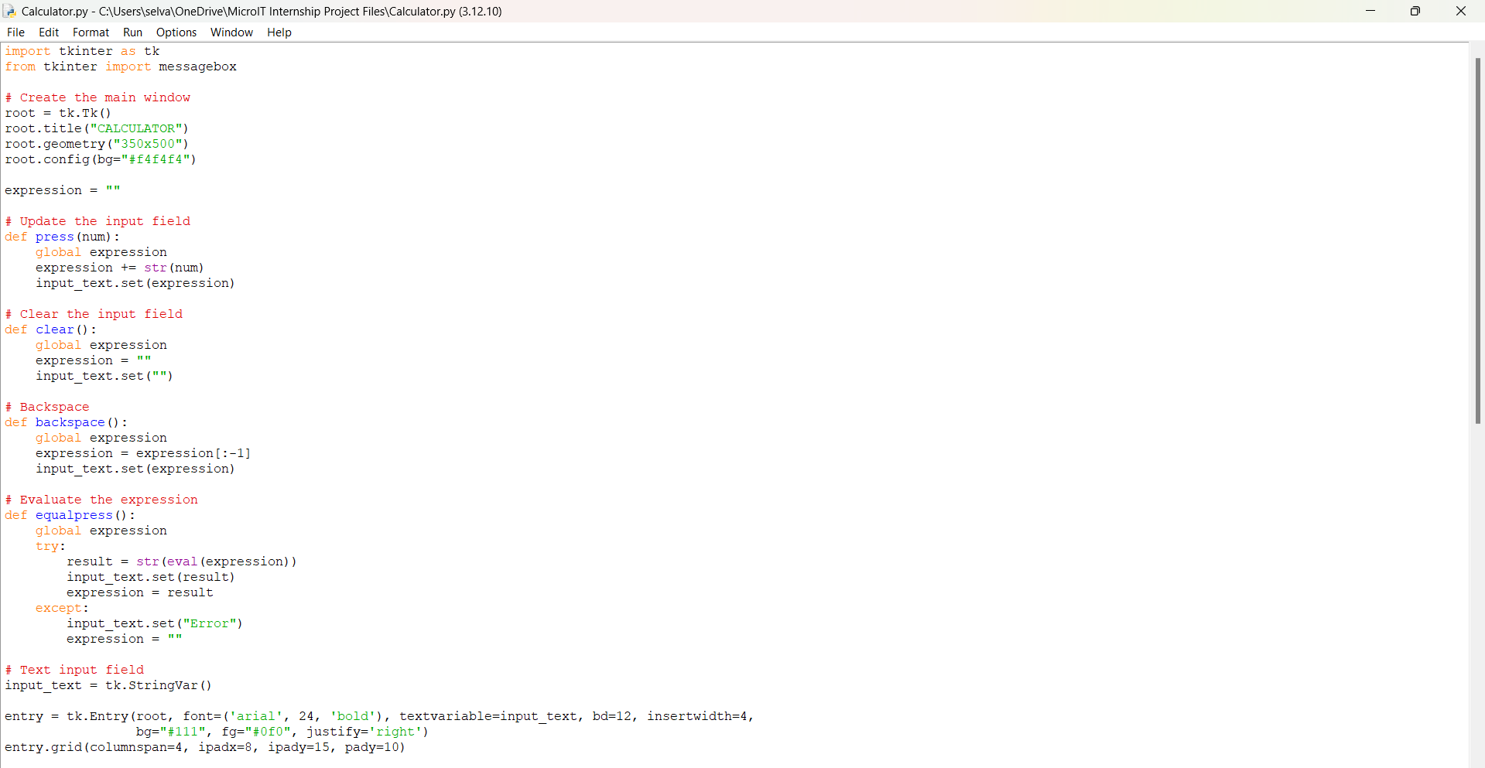
Key Code Snippets

Slide 9
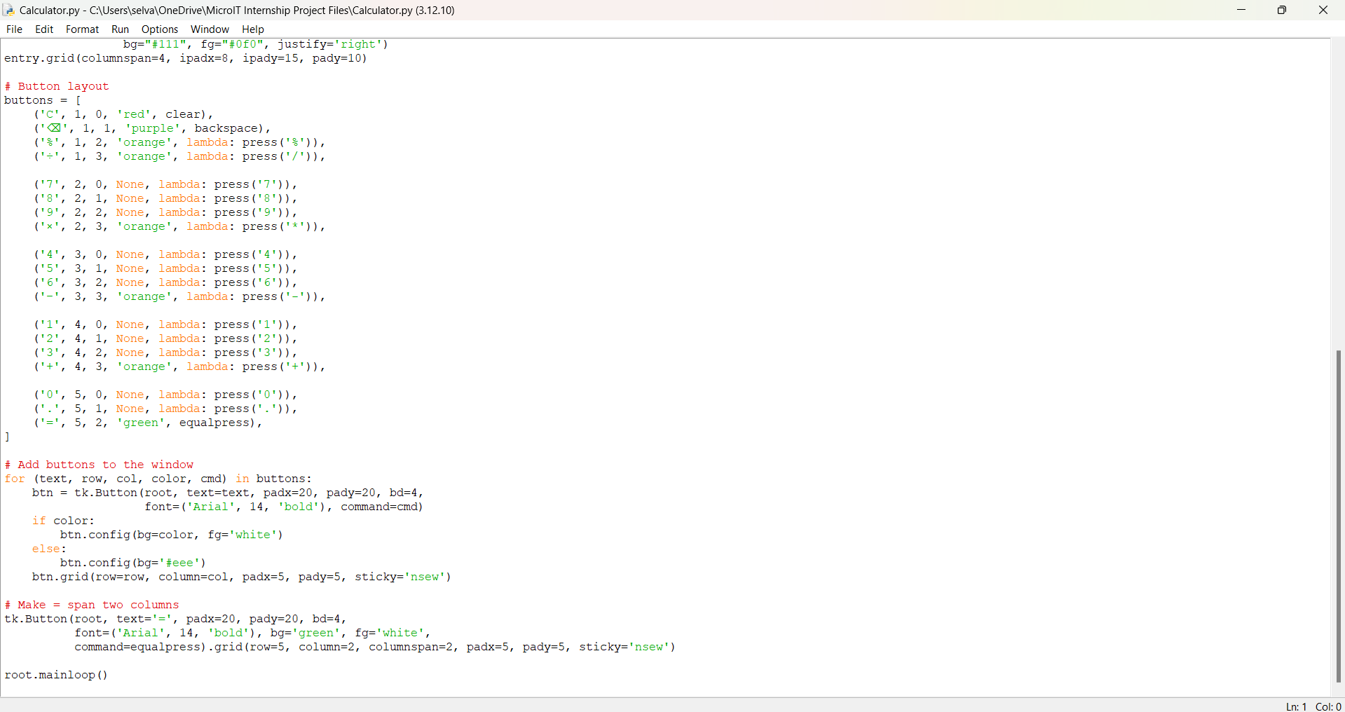
Key Code Snippets

Slide 10
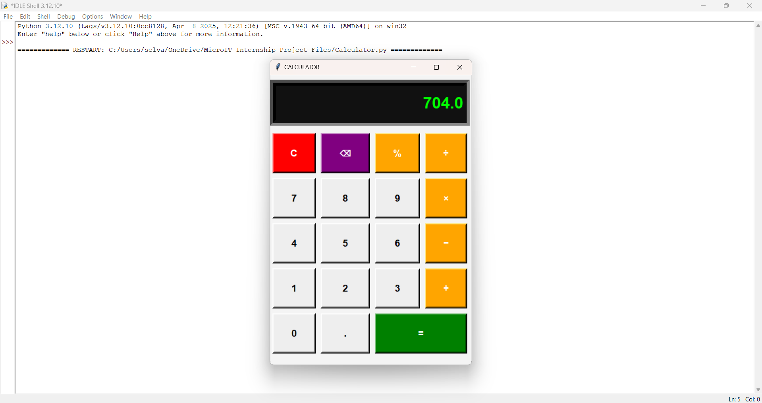
Output

Slide 11
Key Learnings
Learned to design GUIs using Tkinter
Practiced handling events and user inputs in Python
Improved logic building for arithmetic evaluation
Gained hands-on experience in developing real-world Python apps

Slide 12
Conclusion
This project helped me strengthen my Python skills and GUI development experience.
I successfully built a working calculator with a functional and intuitive user interface.

