Slide 1
NUMBER GUESSING GAME
NAME: TAMIZHSELVAN.V
ORGANIZATION: Micro IT
TOPIC: NUMBER GUESSING GAME

Slide 2
Introduction
This project is a GUI-based Number Guessing Game built using Python and Tkinter.
The user guesses a randomly generated number between 1 and 100.
The application provides real-time feedback for each guess and tracks the number of attempts.

Slide 3
Objectives of the Project
To create an interactive game using Python
To understand the use of random number generation
To develop user-friendly interfaces using Tkinter
To provide real-time validation and feedback to the user

Slide 4
What is a Number Guessing Game?
A number guessing game generates a random number within a specified range.
The user attempts to guess the number with hints like 'Too high', 'Too low', or 'Correct'.
It is a simple yet effective way to practice logic, loops, and conditionals.

Slide 5
Tools and Technologies Used
Python 3
Tkinter (for GUI development)
Random module (for number generation)
IDLE as code editor

Slide 6
User Interface Design
Entry box for user input
Buttons for submitting and restarting
Label for feedback (e.g., Too high, Too low, Correct)
Clear layout with a friendly appearance

Slide 7
Key Code Snippets
random.randint(1, 100) for generating secret number
Input handling with Entry widget
if-elif-else blocks to compare user guess
Reset function to restart the game

Slide 8
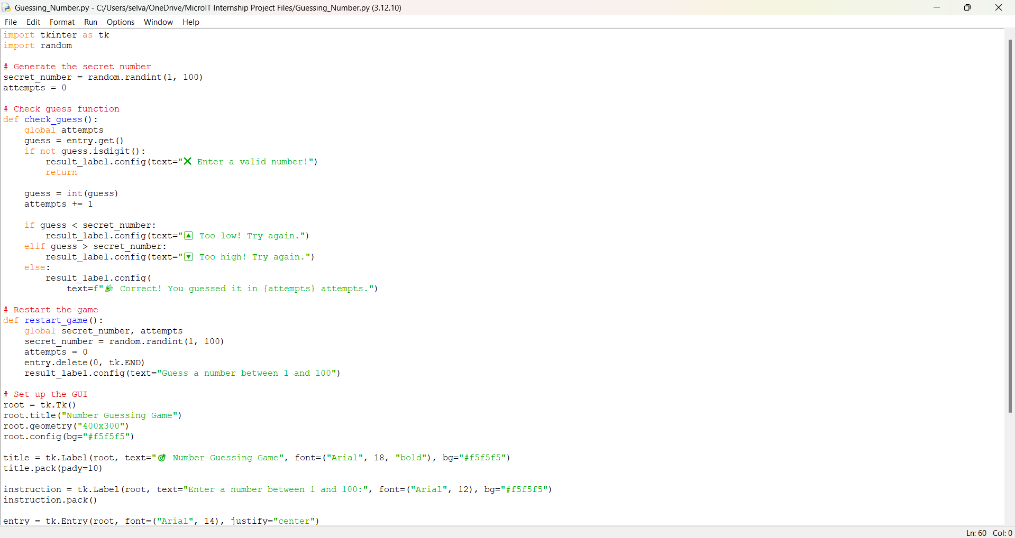
Key Code Snippets

Slide 9
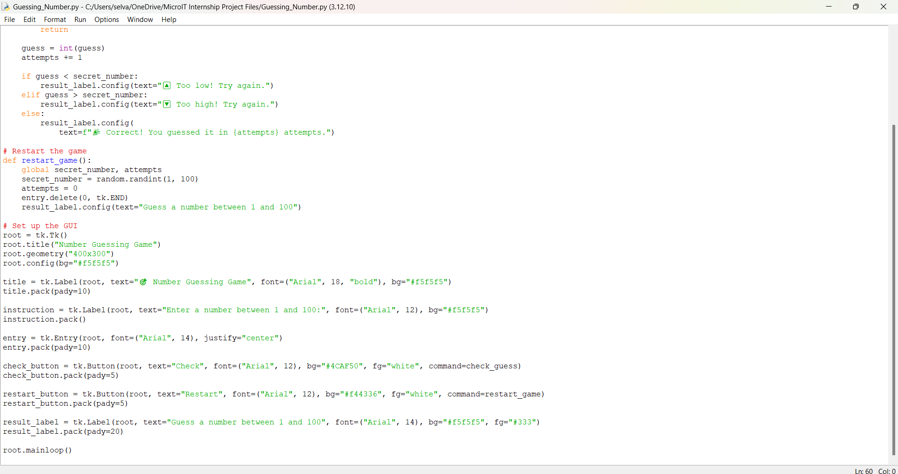
Key Code Snippets

Slide 10
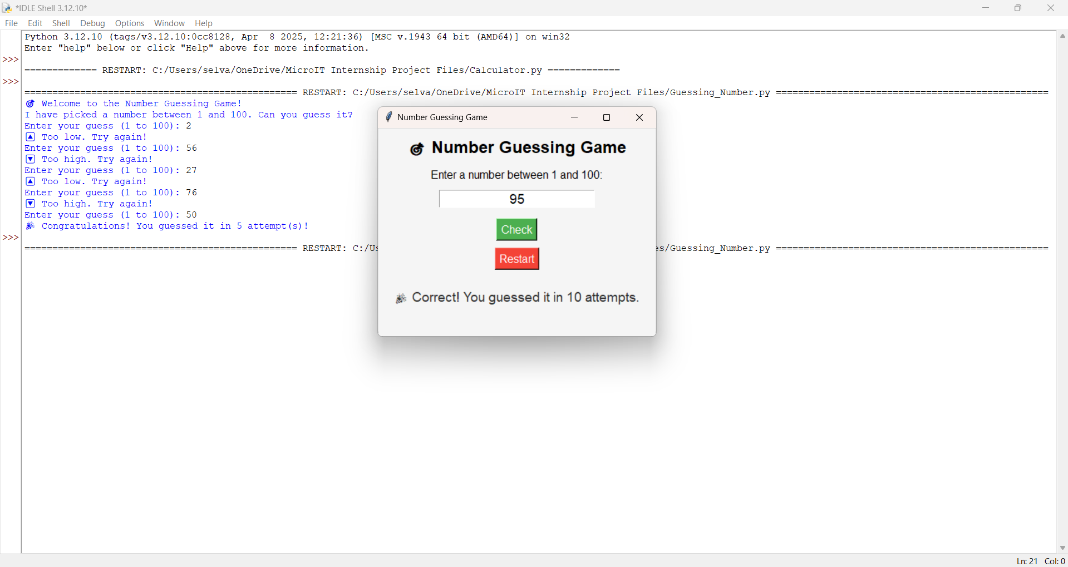
Output

Slide 11
Key Learnings
Improved understanding of conditionals and loops
Learned how to use Tkinter for simple GUI applications
Developed logical thinking and interactive design
Practiced debugging and user-friendly feedback handling

Slide 12
Conclusion
The Number Guessing Game was a fun and educational project.
It helped enhance both Python logic and GUI development skills.
The game is simple yet demonstrates key programming concepts effectively.

