Slide 1
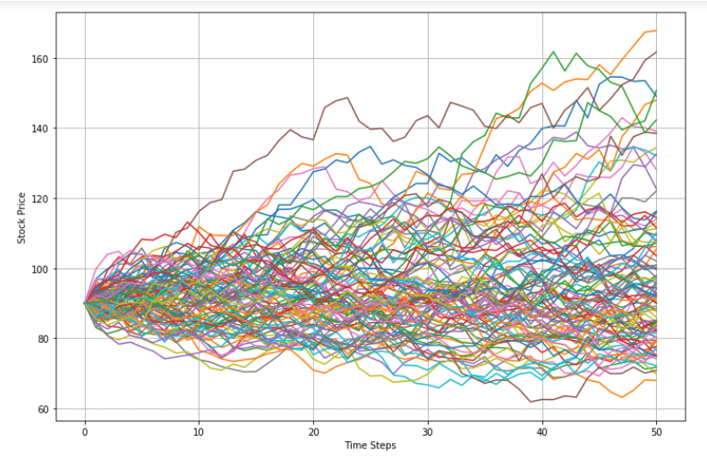
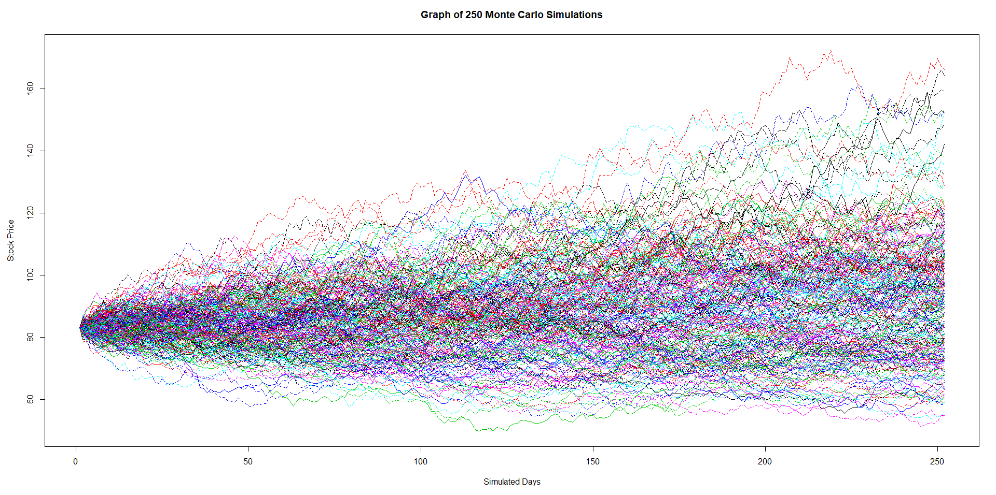
Project 1 for uw_fintech_bootcamp authors: A. Rubkevich, t. Morbiwala D. Hockenbery, M. Wojichowski
PORTFOLIO OPTIMIZER

Slide 2

This platform
Tasnim
AIMS TO OFFER A ONE-STOP ONLINE OPTIMIZATION FOR YOUR INVESTMENT PORTFOLIOS
ALLOWS A USER TO EASILY CUSTOMIZE A PORTFOLIO
TO THEIR NEEDS AND PREFERENCES
BOTH INEXPENSIVE AND HIGH QUALITY

Slide 3
the portfolio optimizer uses various functions and packages to create and analyze portfolios
Tasnim
written in Python 3.9.7 and uses the following libraries:
Os – provides functions for interacting with the operating system
pandas - to analyze and manipulate data
Dotenv – reads key value pairs from a .env and can set them as environment variables
Random – generates a random float uniformly in the semi-open range
Seaborn – for added data visualization
NumPy - to operate on large collection of high-level mathematical functions
Alpaca Trade API - to easily develop rapid trading algo
hvplot – for user friendly interactive plotting

Slide 4

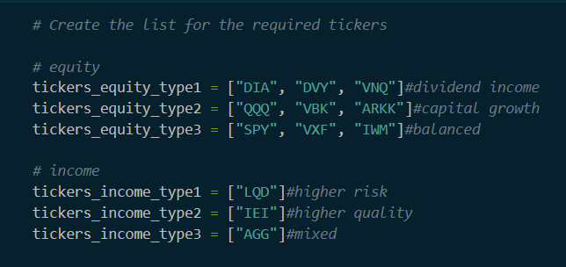
This Platform analyzes 12 ETFs
DATA SOURCE
Anastasiya
Alpaca API to obtain historical price data
Best free source for obtaining price data on ETFs

Slide 5
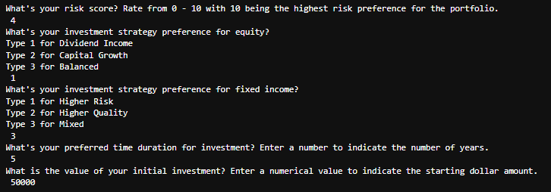
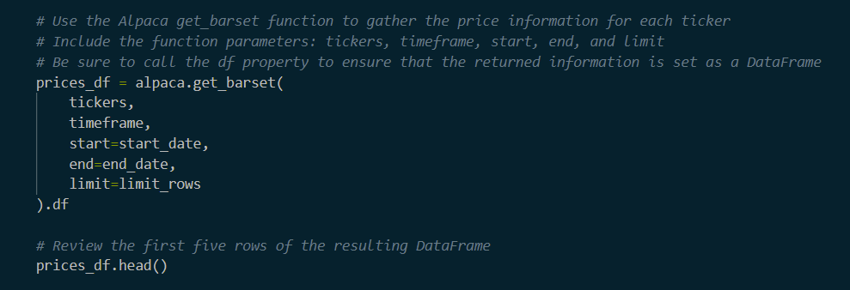
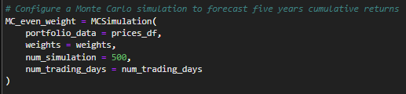
Alpaca.get_barset function: aided by user input through various questions to determine portfolio of ETFs in which to gather data for
DATA COLLECTION
Matt
IF STATEMENTS

Slide 6
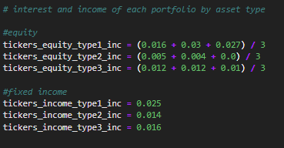
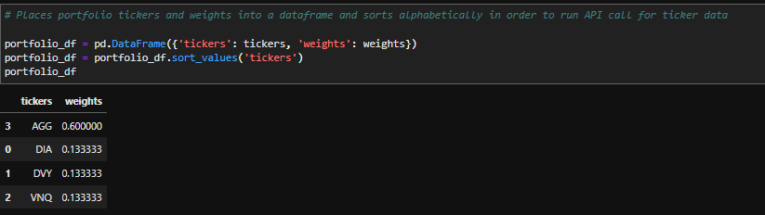
EXPLORATION - Incorporating dividend income and interest into the analysis CLEANUP - Sorting tickers alphabetically
DATA EXPLORATION AND CLEANUP
Matt

Slide 7
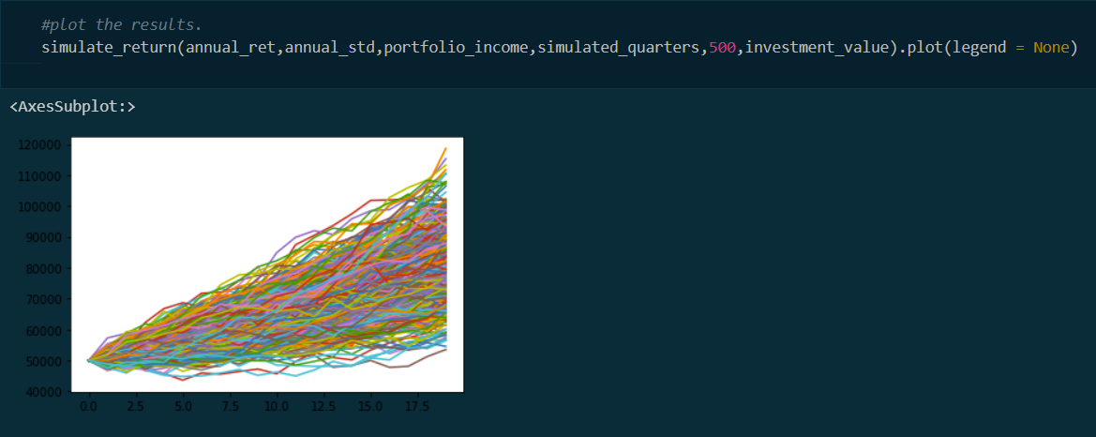
This platform uses FUNCTIONS to
David
Visualize

Slide 8
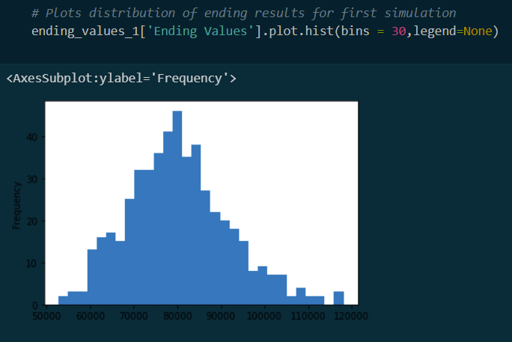
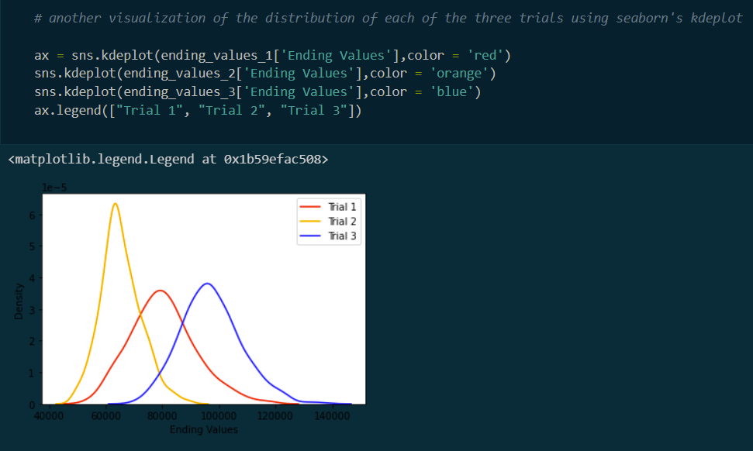
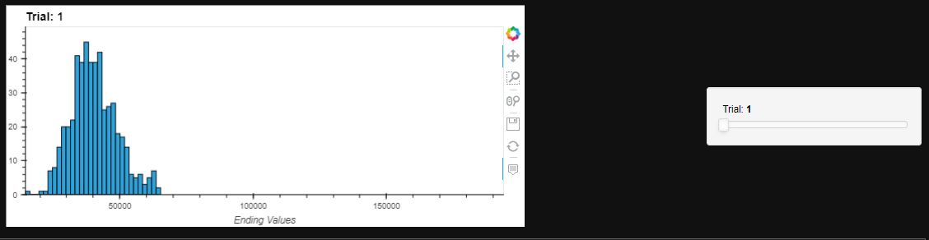
David

Slide 9
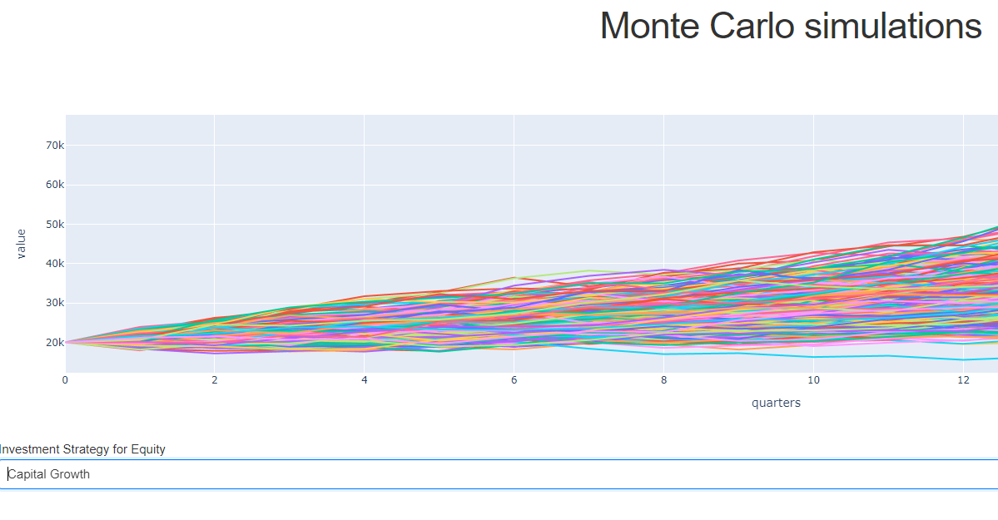
Next potential steps - potentially allow user to change equity preference or implement user toggles in dashboard
David

Slide 10
Code demonstration unanticipated problems next steps
Matt

Slide 11
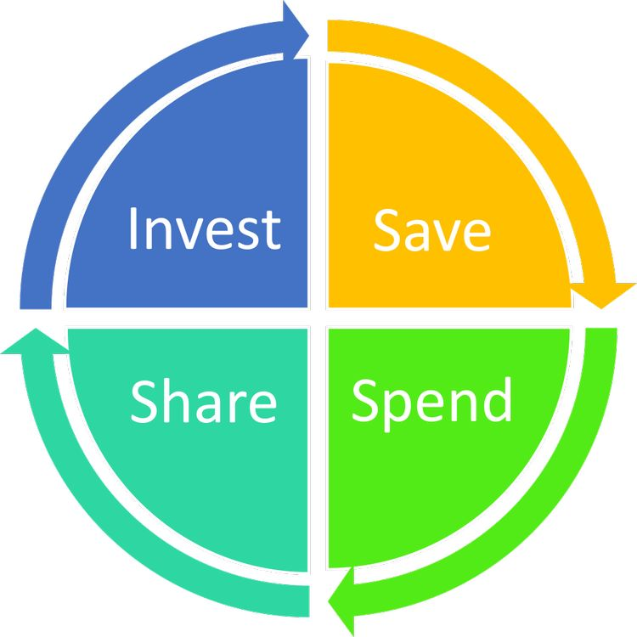
THANK YOU
AUTHORS: A. RUBKEVICH, T. MORBIWALA D. HOCKENBERY, M. WOJICHOWSKI

