Slide 1

ALCOHOL SENSING AND IGNITION PREVENTION SYSTEM

Slide 2
CONTENTS OF THE PRESENTATION
01
02
03
THE PROBLEM
THE
IDEA
THE APPROACH
THE PERTAINING PROBLEM OF THE SOCIETY CLAIMING LIVES
HOW WE WANT TO SOLVE THIS ISSUE
HOW WE STARTED SOLVING THE ISSUE
04
THE SYSTEM
OUR ATTEMPT FOR A SOLUTION

Slide 3
01
THE PROBLEM
DRUNK DRIVNG AND ITS EFFECTS

Slide 4
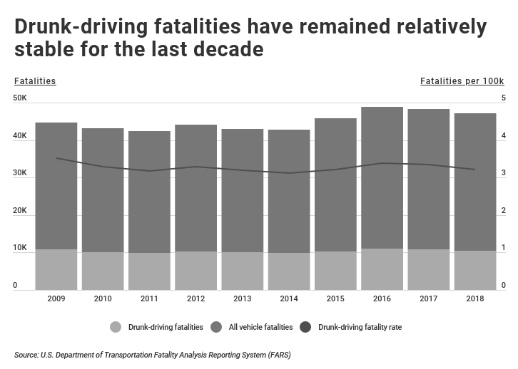
DRUNK DRIVING
According to a report by the Ministry of Road Transport and Highways on road accidents in India, drunken driving is the third major cause of road fatality, with the first being over speeding followed by lane indiscipline1. In 2019, there were 12,256 accidents related to drunken driving where 5,325 persons were killed, and 10,564 were injured1.
Drunk driving is a criminal offense under the Motor Vehicle Act 1988 in India. Section 185 of the Act states that any person who is found to have alcohol exceeding 30 mg per 100 ml of blood in their system is breaking the law.

Slide 5
MAIN REASON OF DRUNK DRIVING RELATED ACCIDENTS
Safe driving requires the ability to concentrate, make good judgements and quickly react to situations
NO AWARENESS
SLOW RESPONSE
OVER-CONFIDENCE

Slide 6
02
THE IDEA
HOW IT ALL STARTED:

Slide 7
THE SOLUTION TO THE PROBLEM
IF WE OBSERVE CLOSELY THE MAIN ISSUE OR THE DEFECT HERE IS THE DRIVER AND HIS STATE
MANY PROGRAMS BY THE LAW ENFORCEMENT AGENCIES ARE ACTIVELY TRYING TO PREVENT DRUNK DRIVING BY IMPOSING FINES BUT THESE ARE IMPLEMENTED AFTER THE DRIVER IS FOUND DRUNK AND THE DAMAGE IS ALREADY DONE SINCE THE DRIVER IS DRIVING IN HIS DRUNK STATE AND POSING AS A THREAT TO OTHER PASSENGERS ON THE ROAD
SO TO PREVENT THIS WE MUST DEVISE A SOLUTION TO STOP A DRUNK PERSON TO DRIVE THE CAR ITSELF

Slide 8
03
THE APPOACH
HOW WE WANT TO SOLVE THIS

Slide 9
SYSTEM TO DETECT ALCOHOL AND PREVENT VEHICLE IGNITION
FOCUS ONLY ON THE DRIVER
FULLY MODULAR
TAMPER PROOF
SIMPLE AND EFFECTIVE
CHEAP TO MANUFACTURE EVEN AT LARGE SCALE

Slide 10
04
THE SYSTEM
OUR ATTEMPT FOR A SOLUTION

Slide 11
THE STAR COMPONENTS
ARDUINO UNO
MQ-3 SENSOR
BATTERY KILL SWITCH
THE BRAINS
THE EYES
THE HANDS
THIS WHERE THE ENTIRE
OPERATION IS CARRIED
OUT AND CONTINOUSLY
MONITORS THE
CONDITIONS IN THE CAR
ATMOSPHERE
THIS SENOSOR
CONTINOUSLY MONITORS
THE ALCOHOL CONTENT
OF THE AIR IN THE
DRIVER SPACE
THIS IS THE SWITCH
WHICH KILLS THE
POWER TO THE IGNITION
PLUG OF THE ENGINE
AND PREVENTS
MOVEMENT OF THE
ENGINE AND IS
CONTROLLED BY THE
ARDUINO BOARD

Slide 12
OTHER ADDITIONS
16X2 LCD DISPLAY
SMOKE SENSOR
GPS MODULE
SMS MODULE (GSM)
ACCELEROMETER MODULE
IR MODULE

Slide 13
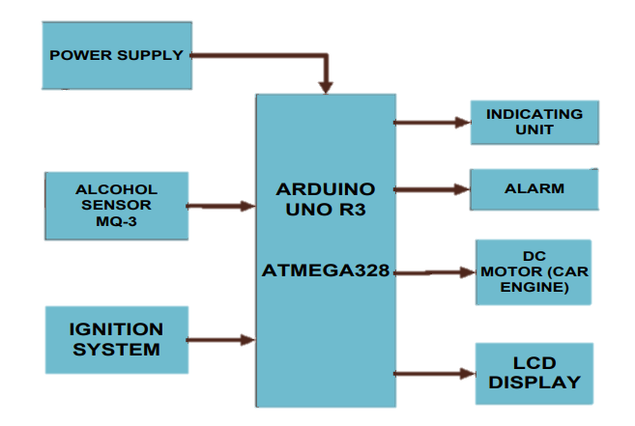
THE SIMPLIFIED REPRESENTATION
OF
CHAIN OF OPERATION

Slide 14
#1 POWER SUPPLY
OUR DEMO SYSTEM REQUIRES ONLY 5V DC TO RUN THE SMART CONTROLLER WHICH IN REAL APPLICATION CAN BE SOURCED FROM THE CAR BATTERY TO RUN ALL THE COMPONENTS

Slide 15
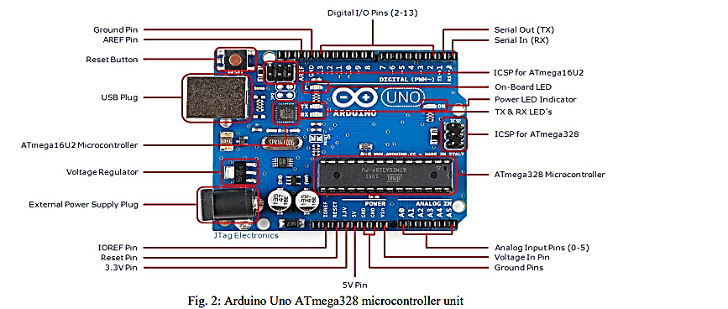
#2 ATMEGA32 MICROCONTROLLER
The proposed system is built around ATmega328 Arduino Uno microcontroller board. The unit consists of 14 pins which allows inflow and outflow of feeding (it is possible to use 6 of those pins as Pulse Width Modulation signal outputs), 6 continuous signal with time changing quantity, 16 megahertz electronic oscillator, a Universal Serial Bus port, a power connector, an on-board voltage regulator, ICSP header, and a reset button. The Atmega328 has 32 KB flash memory, 2 KB SRAM and 1 KB EEPROM.

Slide 16
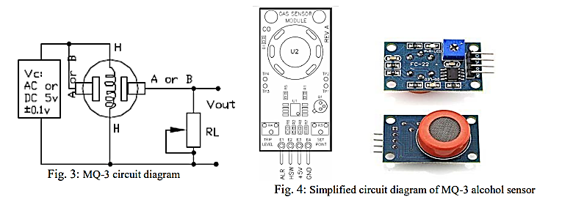
#3 MQ3 SENSOR
The sensor is made of Tin Dioxide (SnO2) sensitive layer. The sensor is configured with a high sensitivity to alcohol and small sensitivity to Benzene. It has a simple drive circuit with fast response, stability, and long life. It has an analog interface type.

Slide 17
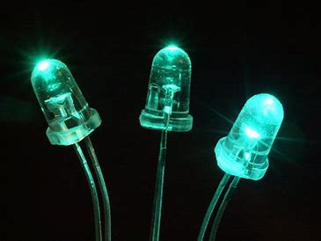
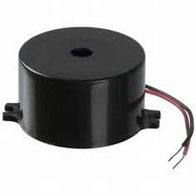
#4 ALARM & INDICATING UNIT
The alarm unit used is a buzzer which indicates when alcohol is detected. The buzzer used belongs to the PS series. The PS series are high-performance buzzers that employ Uni-morph piezoelectric elements and are designed for easy incorporation into various circuits. They have very low power consumption in comparison to electromagnetic units. It has a voltage requirement of 2V and is connected to pin 10 of the microcontroller.
BUZZER
LED INDICATOR

Slide 18
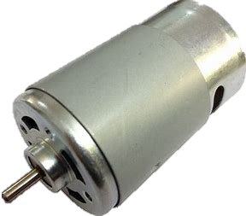
#5 DC MOTOR
An electric DC motor is used to demonstrate the concept of engine locking. Here in this work, the DC motor will be connected to pin 9 on the microcontroller, when alcohol is detected the DC motor stops in other to indicate that alcohol is detected and continue running when there is no alcohol detected.

Slide 19
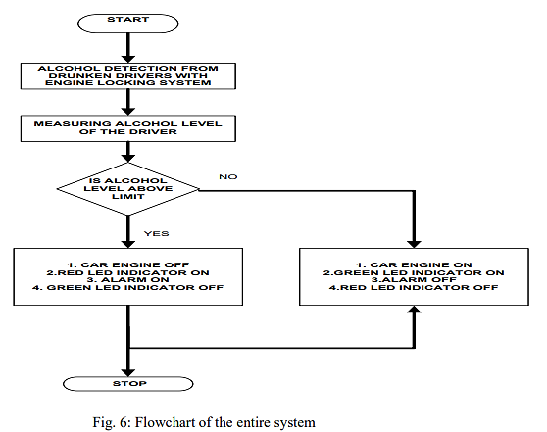

SYSTEM FLOW CHART
The system algorithm comprises of three main steps. First is to boot up the system, next is the measuring state, this stage measure the amount of alcohol level from the drivers. A prescribed set limit will be given as input to the microcontroller, once the alcohol level exceeds the limit the car will not start.
STEP 1: Power on the system
STEP 2: checks for alcohol concentration
STEP 3: if alcohol is detected
STEP 3.1: turn off car engine
STEP 4: Else
STEP 5: Car engine running
STEP 6: Go to step 1

Slide 20
EVALUATION OF THE SYSTEM
LEVEL OF DRUNKNESS
Voltage Output | 200 - 300ppm 1 – 1.5V 20 – 30% | 300 – 400ppm 1.5 – 2V 30 – 40% | 400 – 500ppm 2– 2.5V 40 – 50%
LCD DISPLAY | INTOXICATED | SLIGHTLY DRUNK | DRUNKENNESS
ALARM | OFF | OFF | ON
IGNITION SYSTEM | ON | ON | OFF
INDICATOR | LED GREEN | LED GREEN | LED RED

Slide 21
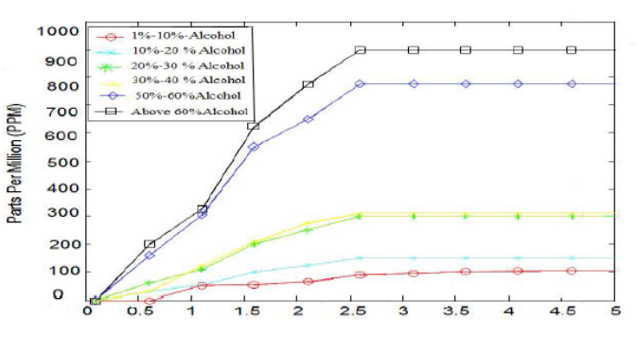
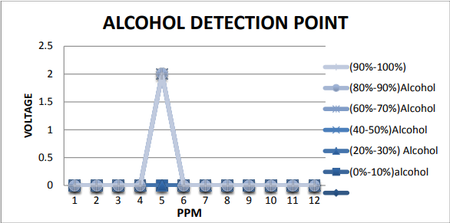
TEST RESULTS
WE HAVE THE FOLLOWING TEST RESULTS TO BASE OUR MODULE OPERATION ON TO DETERMIINE THE STATE OF THE TEST SUBJECT AND THE LEVEL OF ALCOHOL IN THE SUBJECT’S BLOOD
WE CAN UTILIZE THIS TO FINE TUNE THE SENSORS OPERATION RANGE BASED ON THE LOCATION OF THE SENSOR IN THE VEHICLE AND THE DISTANCE FROM THE PERSON IN THE VEHICLE

Slide 22
CONCLUSION
HERE WE PROPOSED A METHOD TO SENSE THE PRESENCE OF ALCOHOL FROM THE BREADTH OF THE DRIVERS AND CURTAIL THE CATASTROPHIC EFFECTS IT CAN HAVE ON SOCIETY. THE SYSTEM WAS DESIGNED UTILIZING ARDUINO UNO ATMEGA328 AND MQ-3 SENSOR AND ITS ACCURACY AND ITS ABILITY OF FAST RESPONSE AND SIMPLE OPERATION AND LONG CONTINOUS OPERATION AS A KEY PART OF THIS PROPOSAL AND THE MODULAR APPROACH OF THE SYSTEM.

Slide 23
THANK YOU!
DO YOU HAVE ANY QUESTIONS?
WE WOULD LIKE TO THANK GITAM UNIVERSITY,
THE HEAD OF THE DEPARTMENT OF ELECTRONICS AND COMMUNICATION ENGINEERING DR.N MOHAN KUMAR
AND ITS ESTEEMED FACULTY MRS.MANJULA R
FOR BRINIGING FORTH THIS PILOT PROGRAM FOR PROVIDING US THIS OPPURTUNITY TO LEARN AND GAIN VALUBLE REAL WORLD EXPERIENCE
WE LEARNT ABOUT THE USE OF THE VARIOUS ELECTRONICS WE LEARN AND THEIR USES IN VARIOUS SITUATIONS

