Slide 1
DBMS Project : LIBRARY MANAGEMENT
DONE BY:
BHARADWAJ AYINAPURAPU – B170010CS
CHAITANYA TOKKA – B170129CS
AVINASH TAMMINEDI – B170801CS
CHAKRADHAR KANDULA – B170886CS

Slide 2
PROJECT OVERVIEW
Project which enables access to the library in a much easier and comfortable way to students and staff. It allows them to access basic functionalities of library like issue, return, renew books, from their PC, online.
Students / Staff members have to login with their email and password, select their required book(s) and place a issue request.
They are allowed take the book only once the admin confirms their request.
Same goes with return and renew requests.

Slide 3
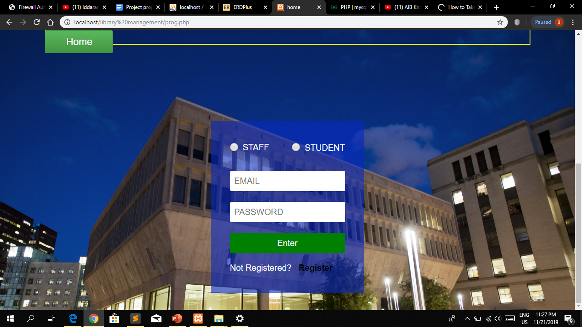
HOME PAGE

Slide 4
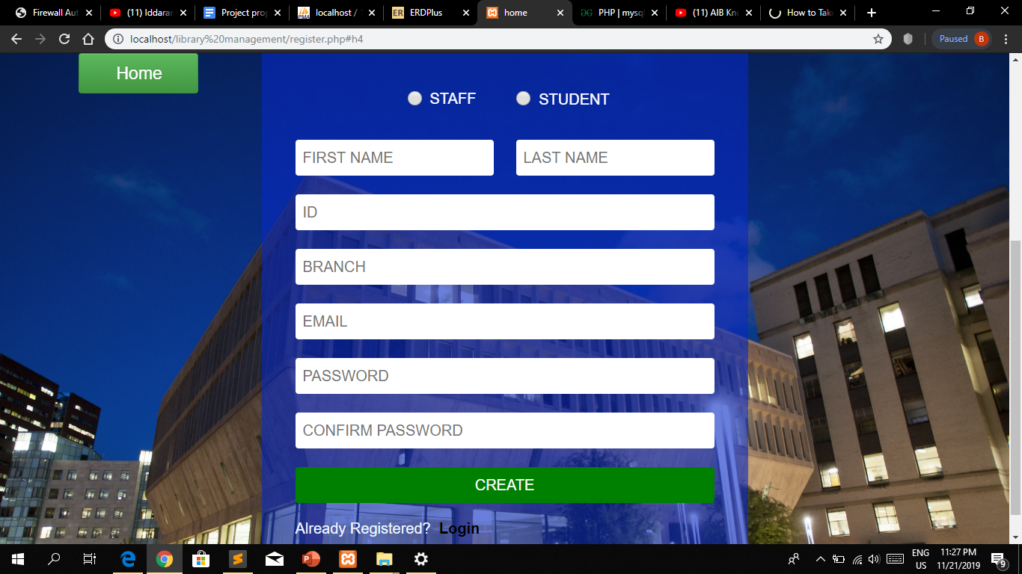
REGISTER PAGE

Slide 5
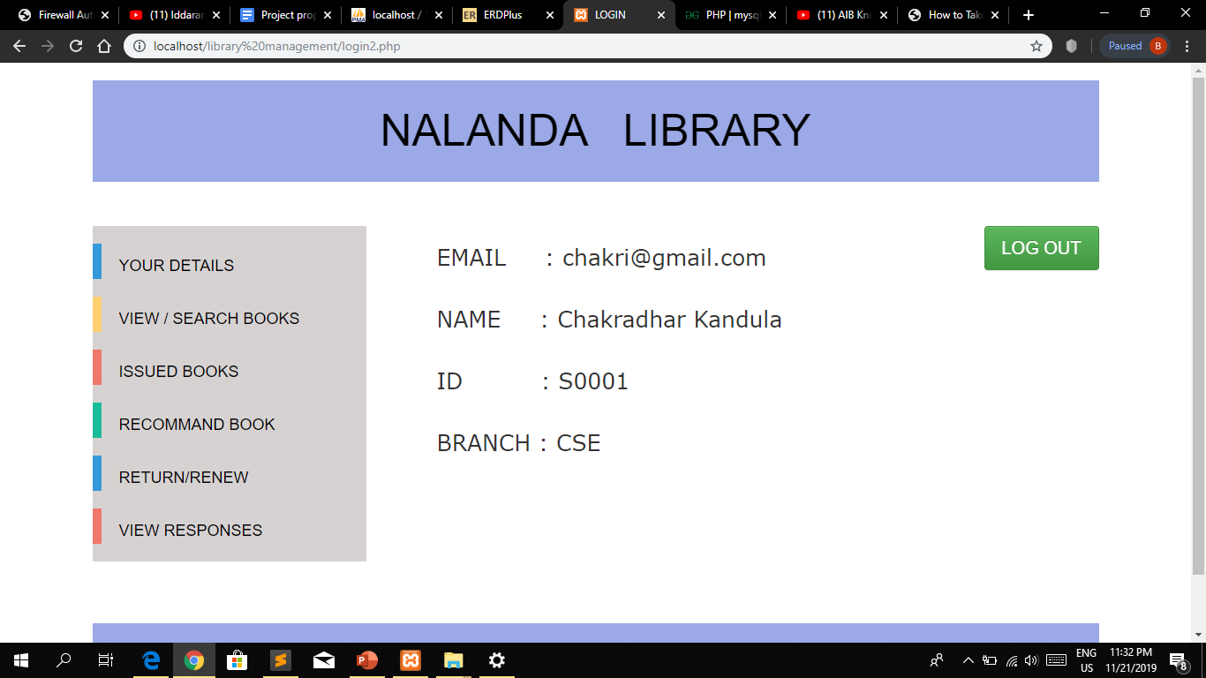
VIEW DETAILS

Slide 6
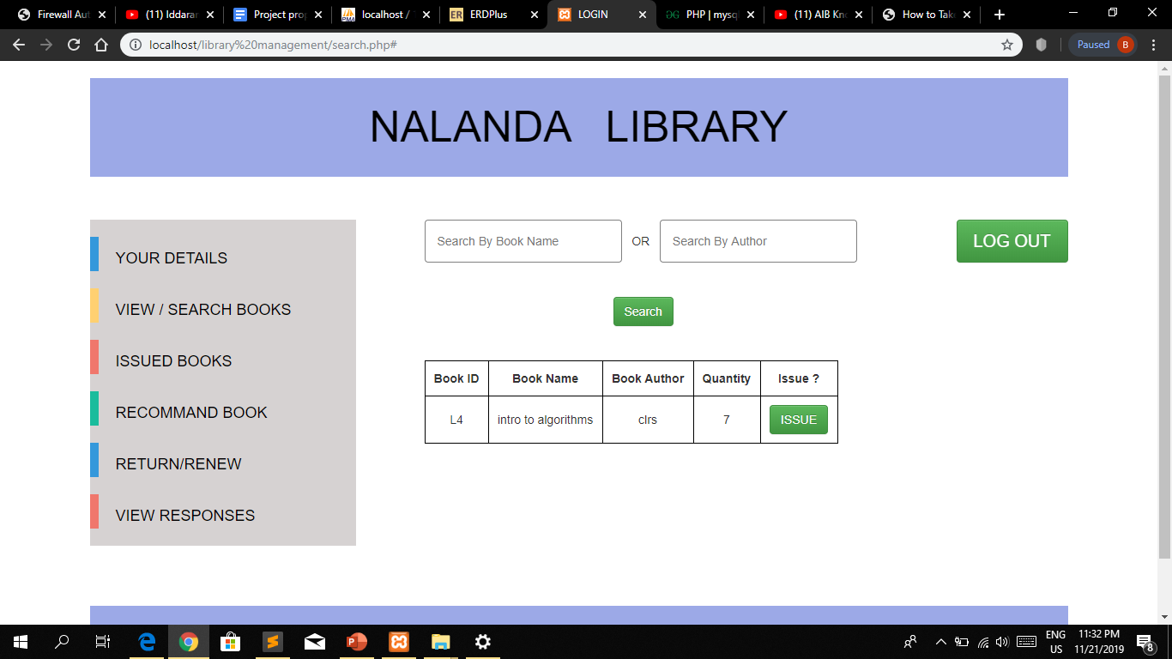
SEARCH BOOKS

Slide 7
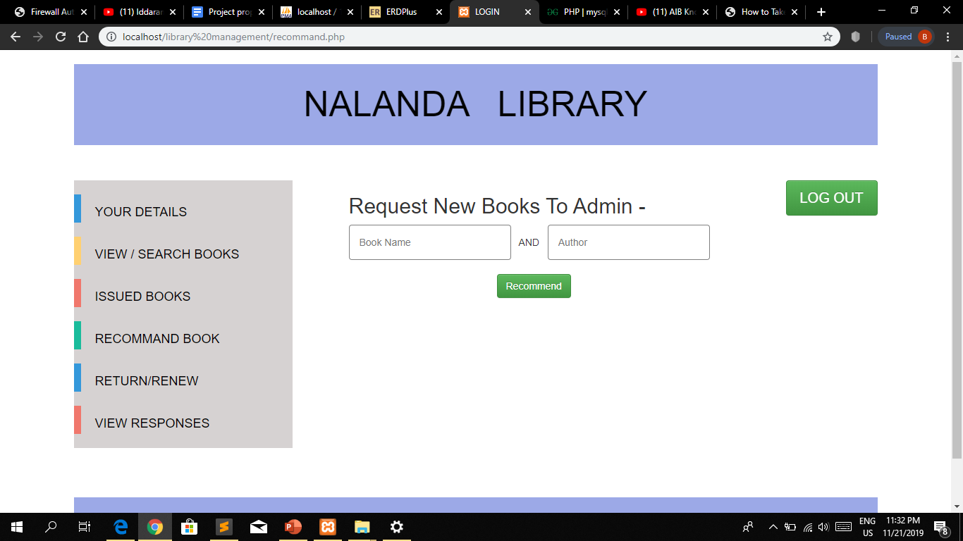
RECOMMEND BOOKS

Slide 8
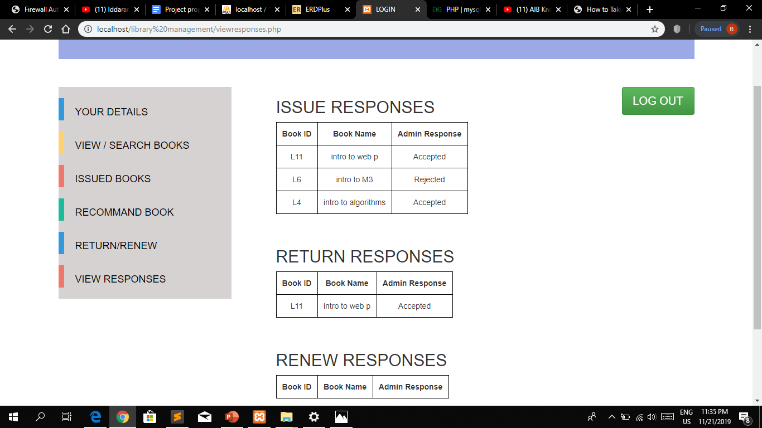
VIEW RESPONSES

Slide 9
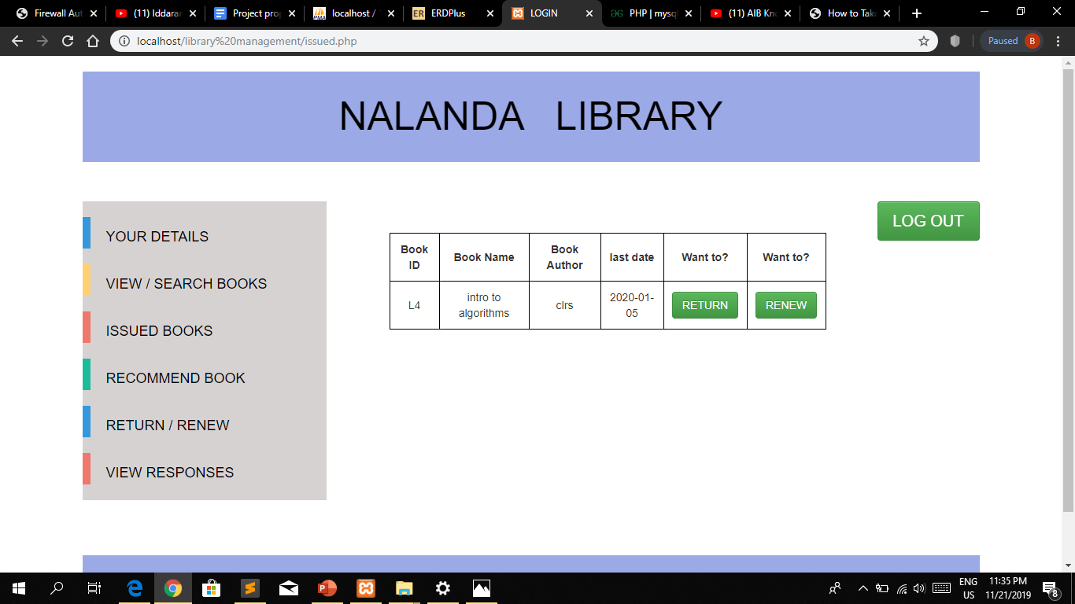
ISSUED BOOKS

Slide 10

RETURN/RENEW BOOKS

Slide 11
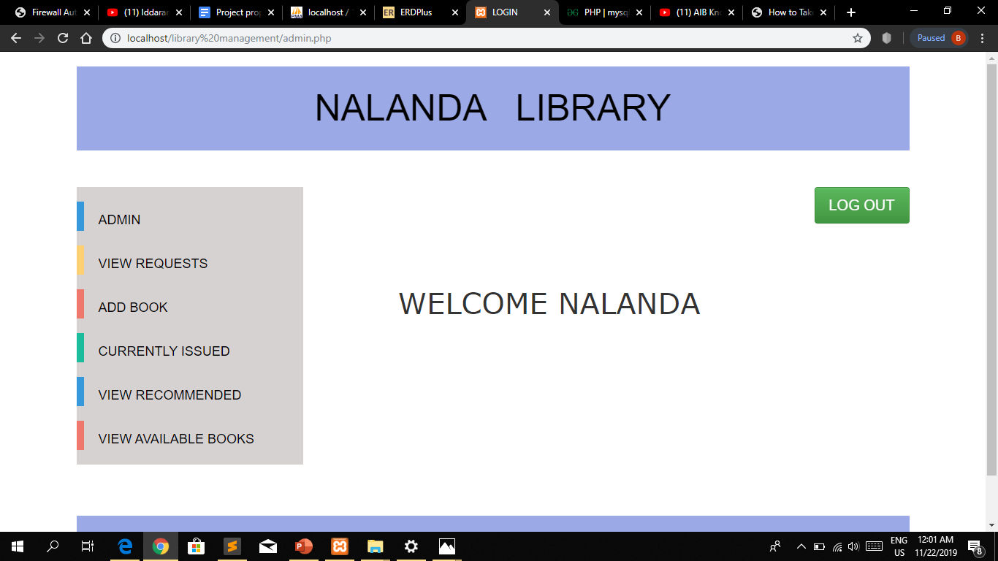
ADMIN HOME PAGE

Slide 12
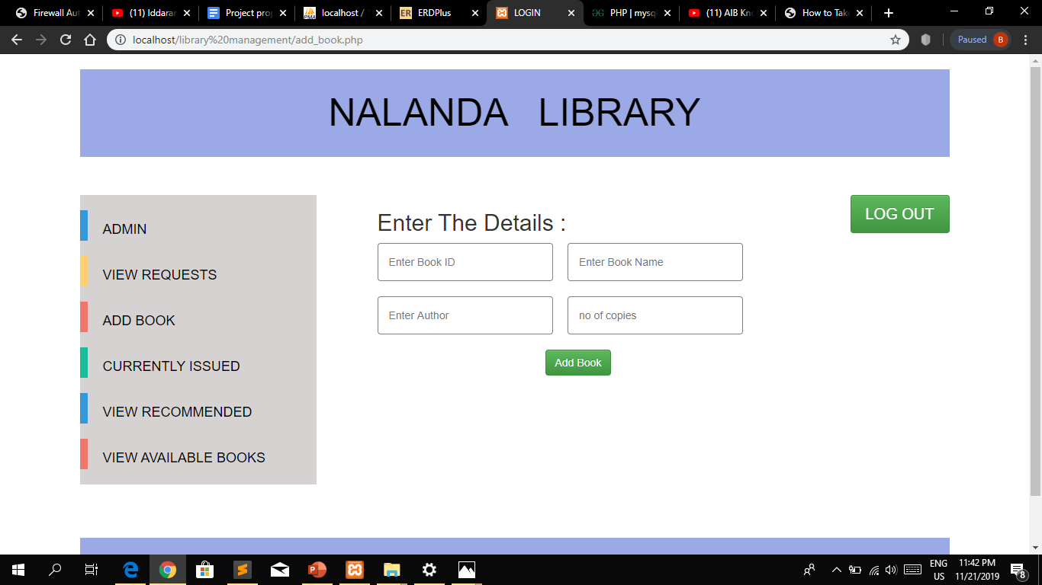
ADD BOOK

Slide 13
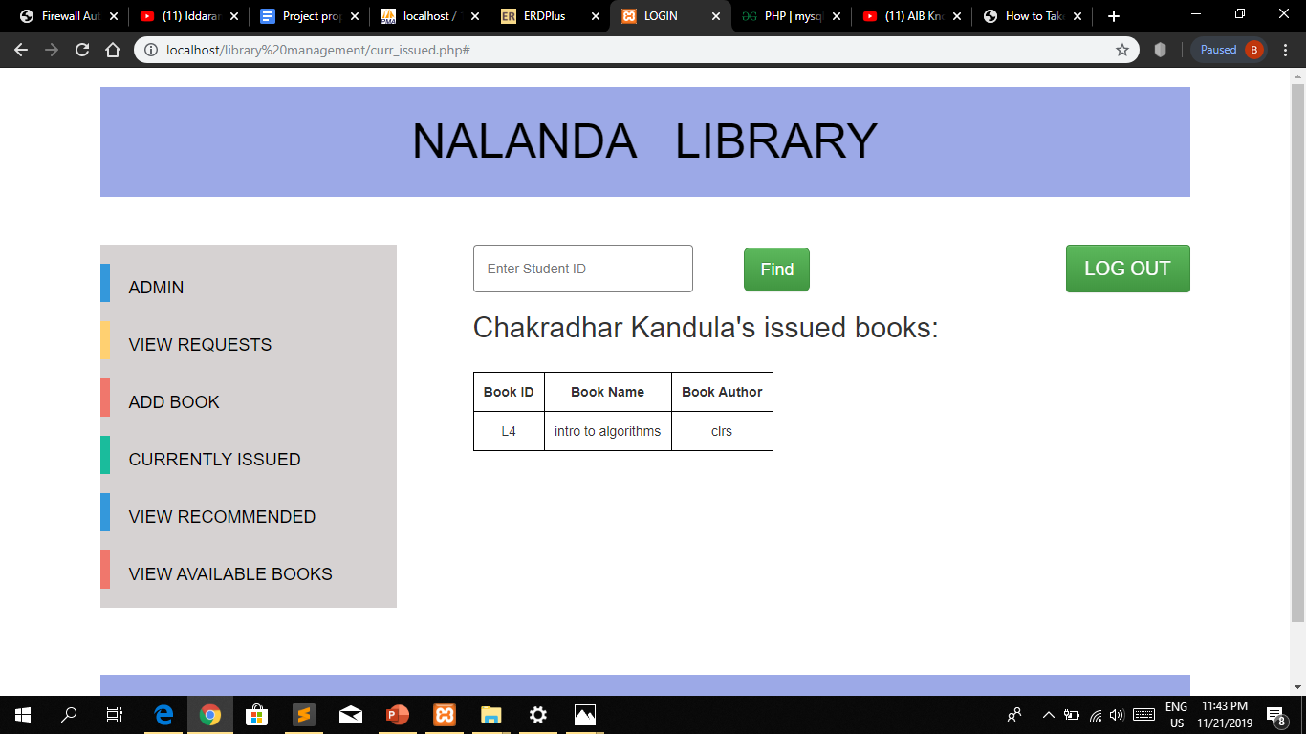
CURRENTLY ISSUED

Slide 14

VIEW RECOMMENDED

Slide 15
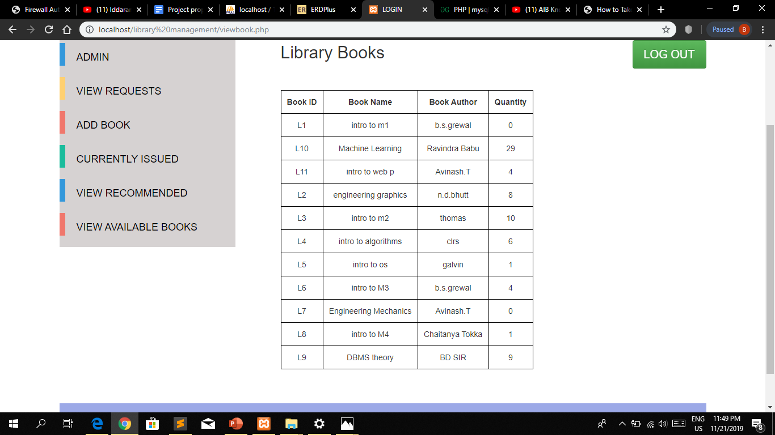
VIEW AVAILABLE BOOKS

Slide 16
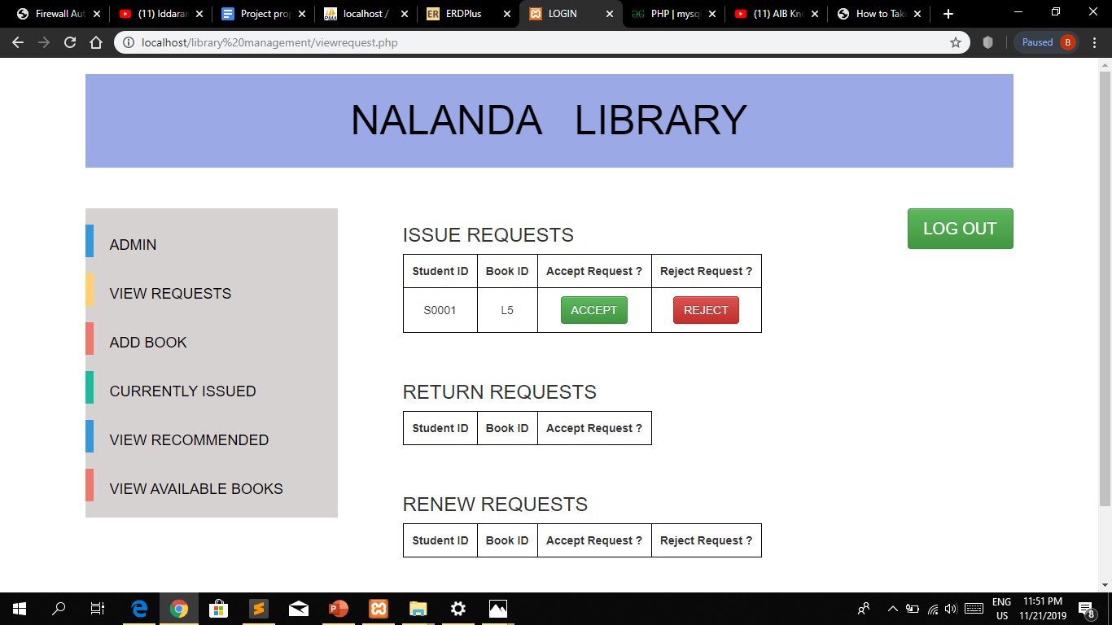
VIEW REQUESTS

Slide 17
VIEW THE USER MANUAL FOR MORE DETAILS !! THANK YOU

