Slide 1
Instructions
Batch-13

Slide 2
We need the following packages :-
Django
Imutils
Numpy
Open-cv
Collections
Sklearn
Dlib

Slide 3
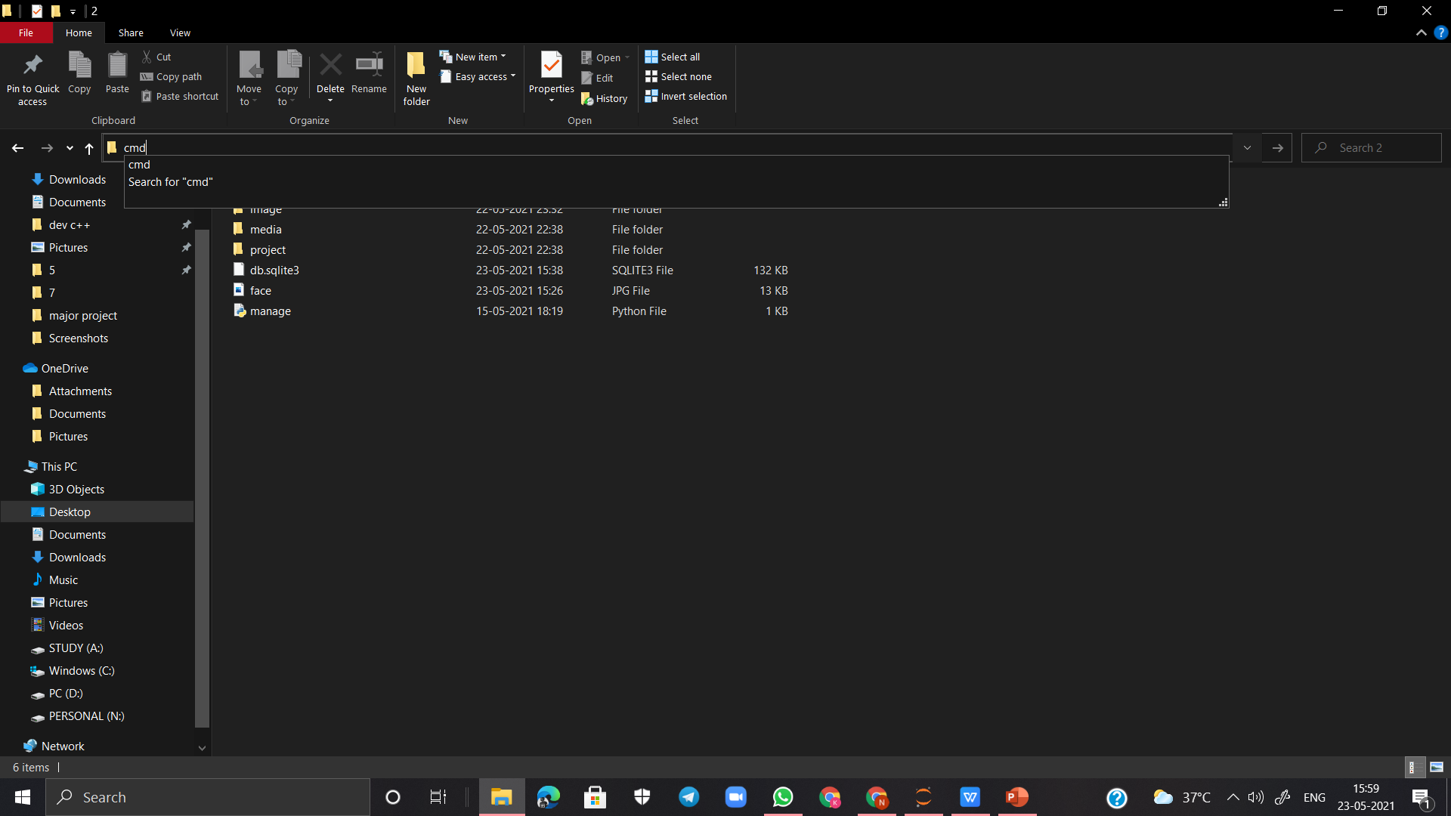
First extract file and run cmd from where the file is store

Slide 4
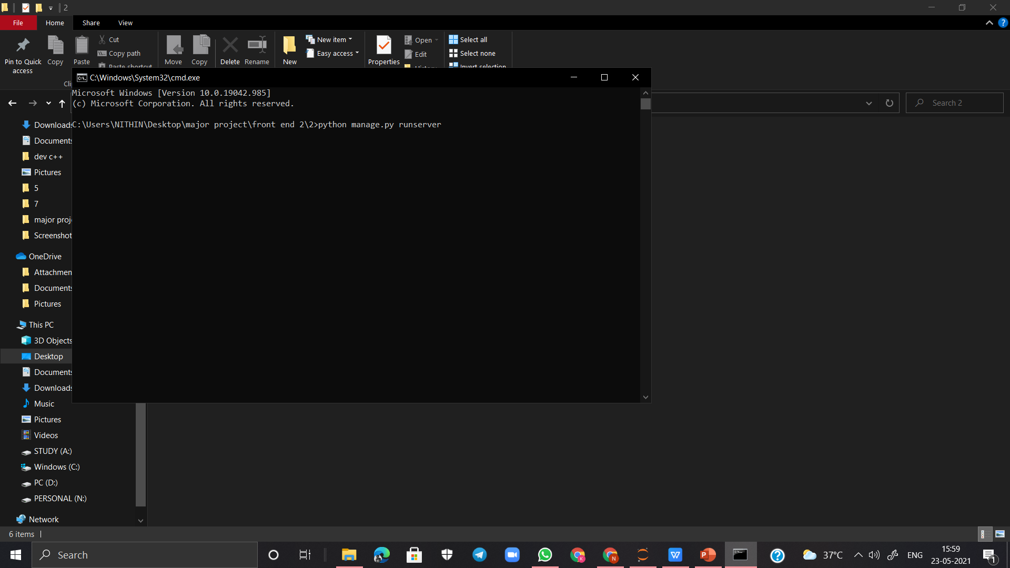
Run the command – python manage.py runserver in cmd

Slide 5
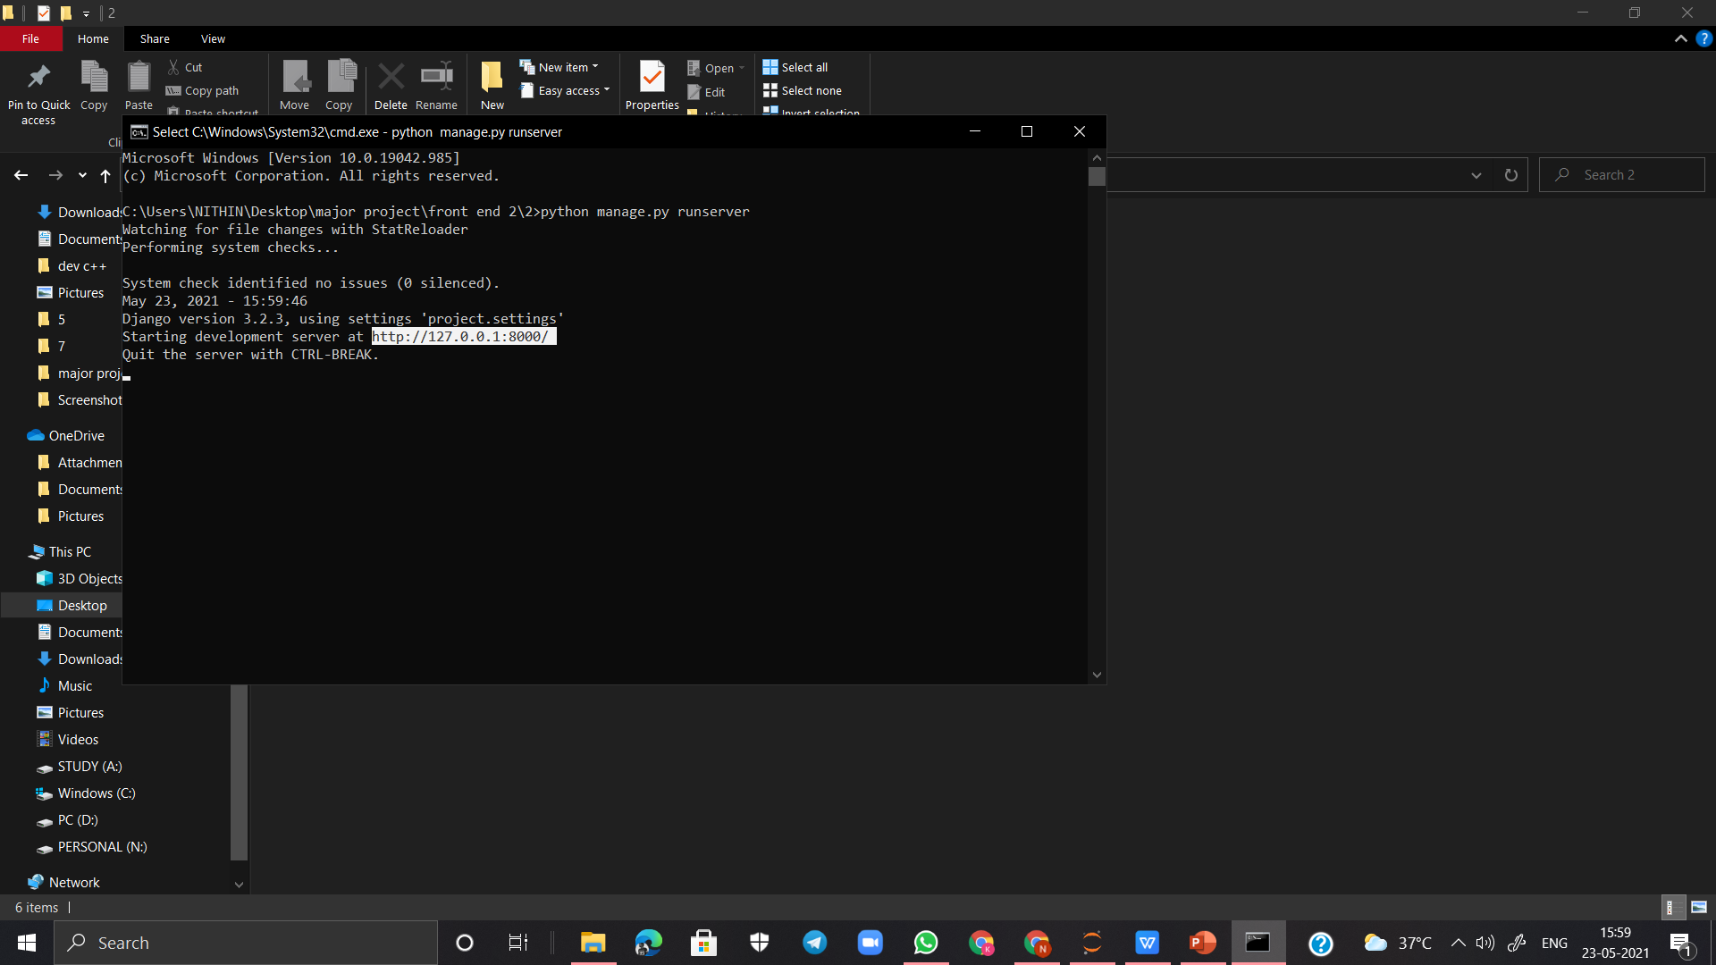
Copy the link generated in cmd

Slide 6
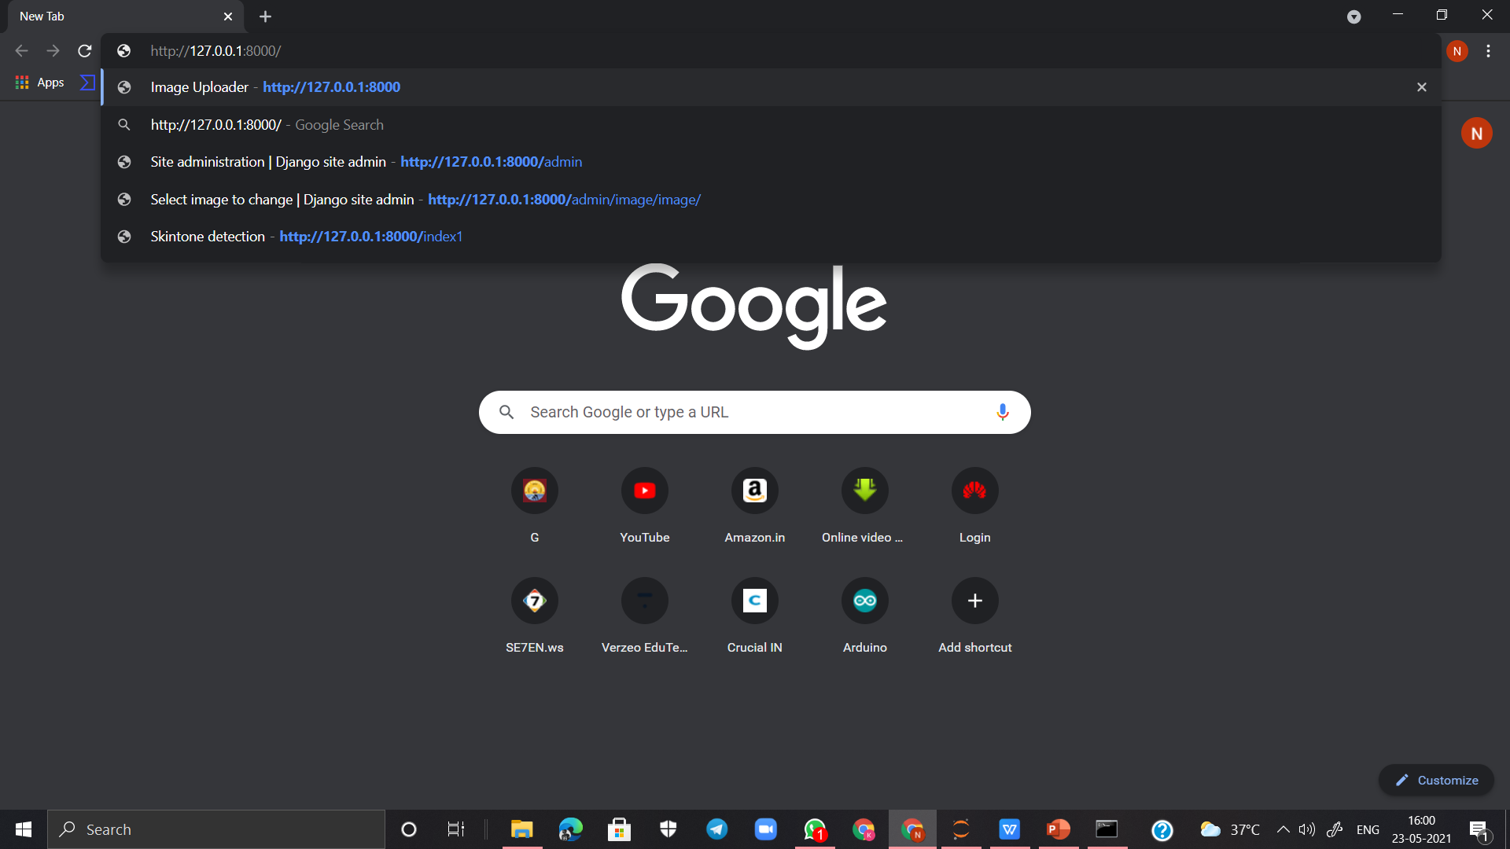
paste the link in browser

Slide 7
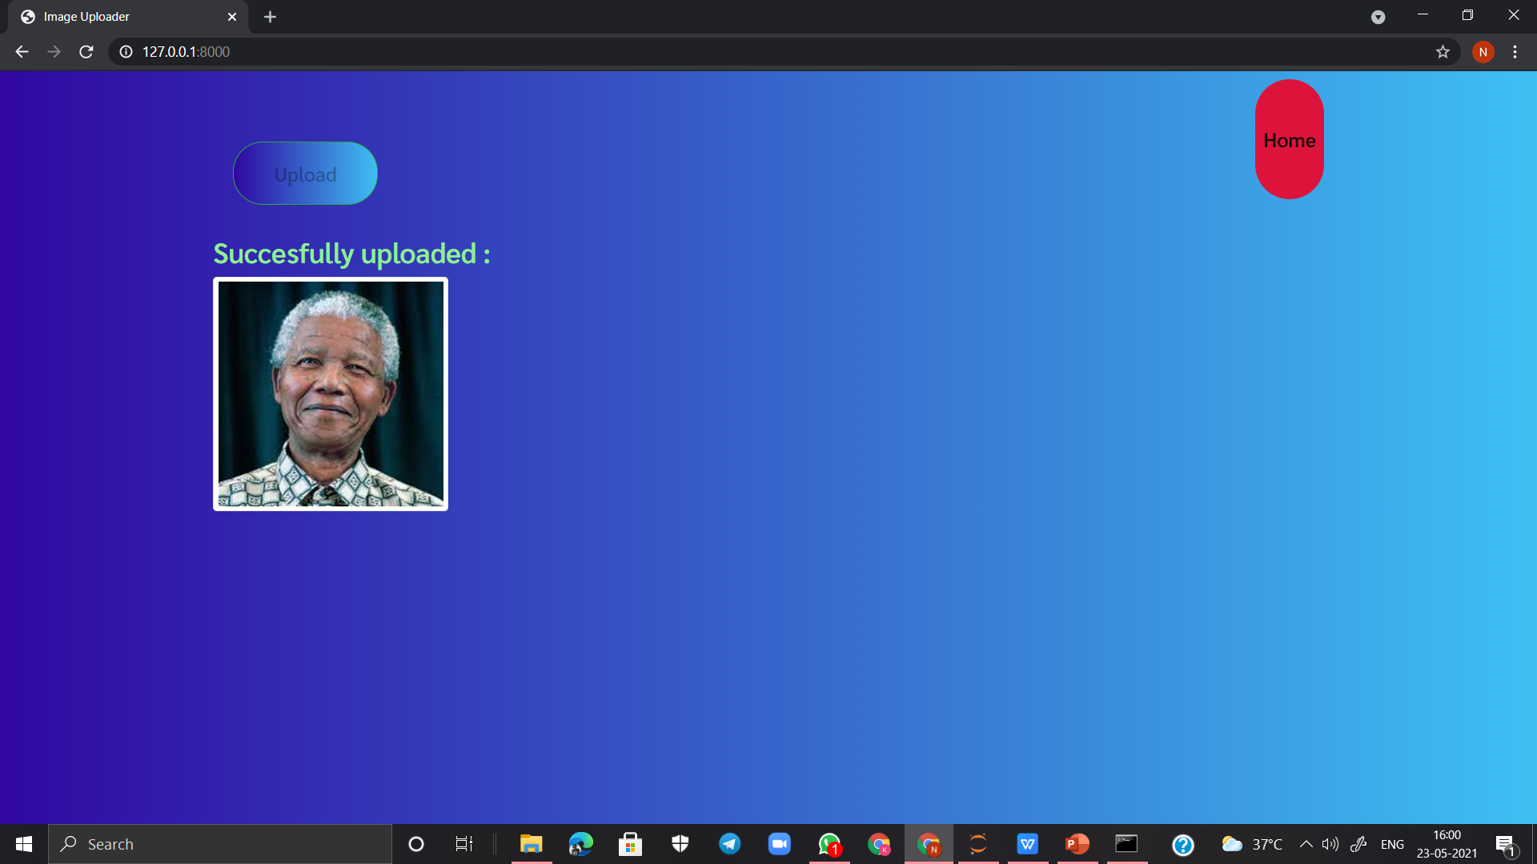
Upload your image

Slide 8
Now create django super user with the command
Python manage.py createsuperuser
And fill user crediantials

Slide 9
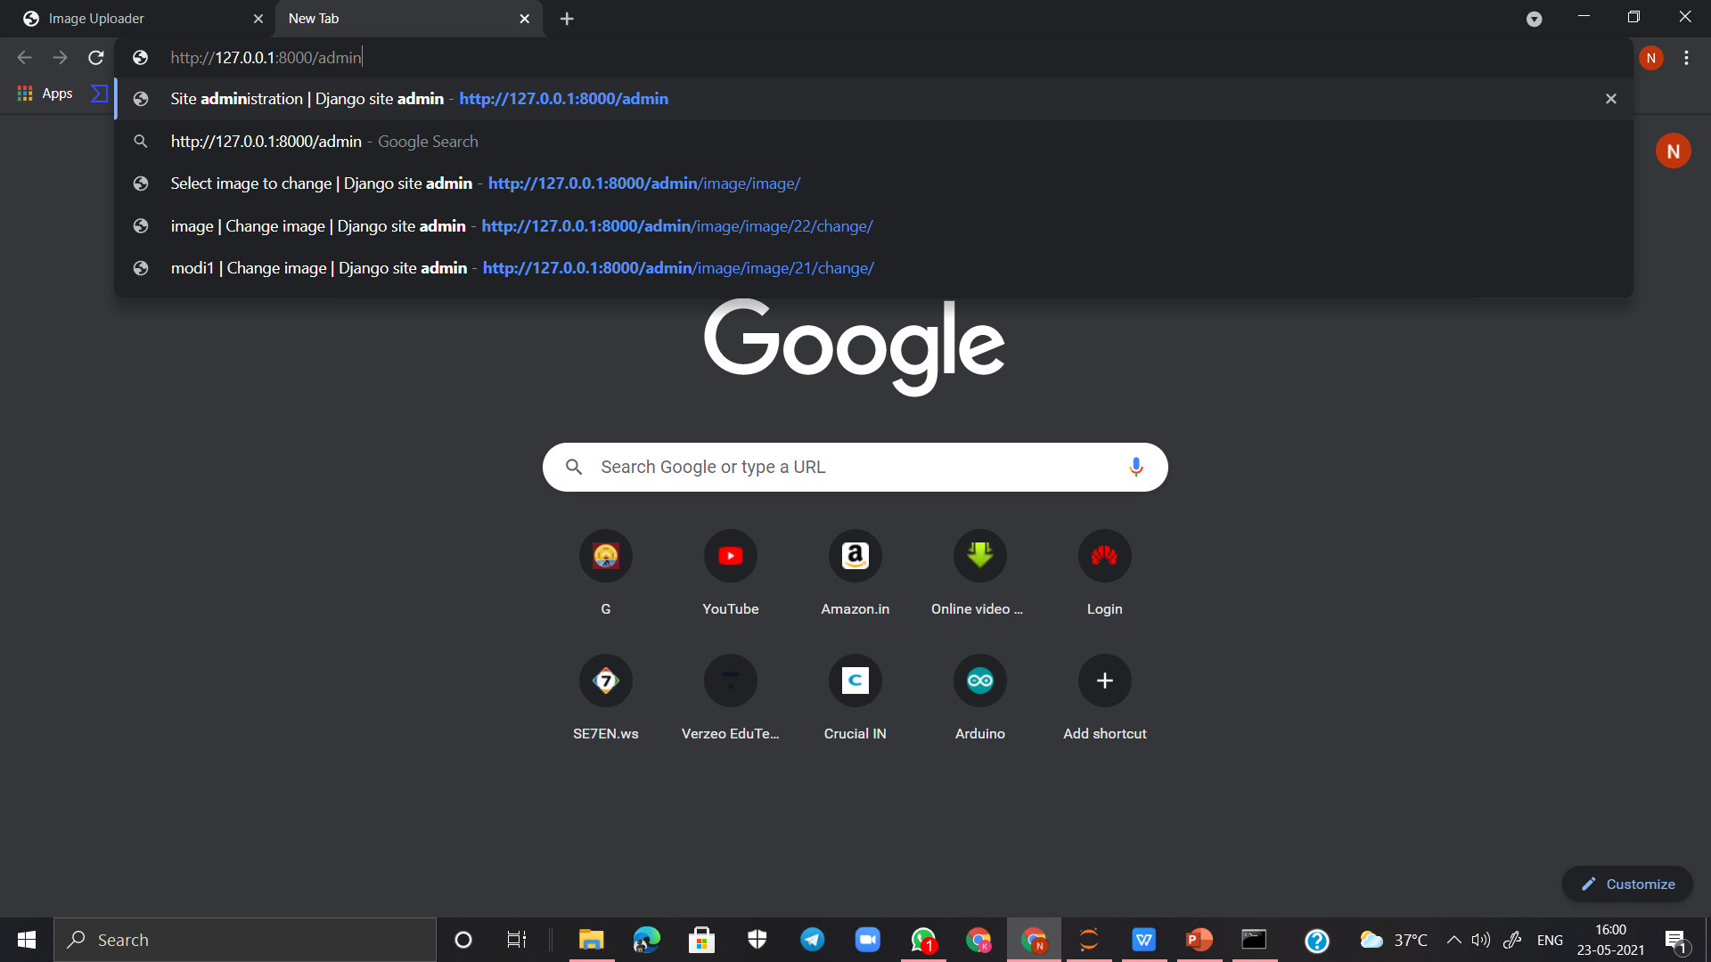
Go to djando administration page

Slide 10
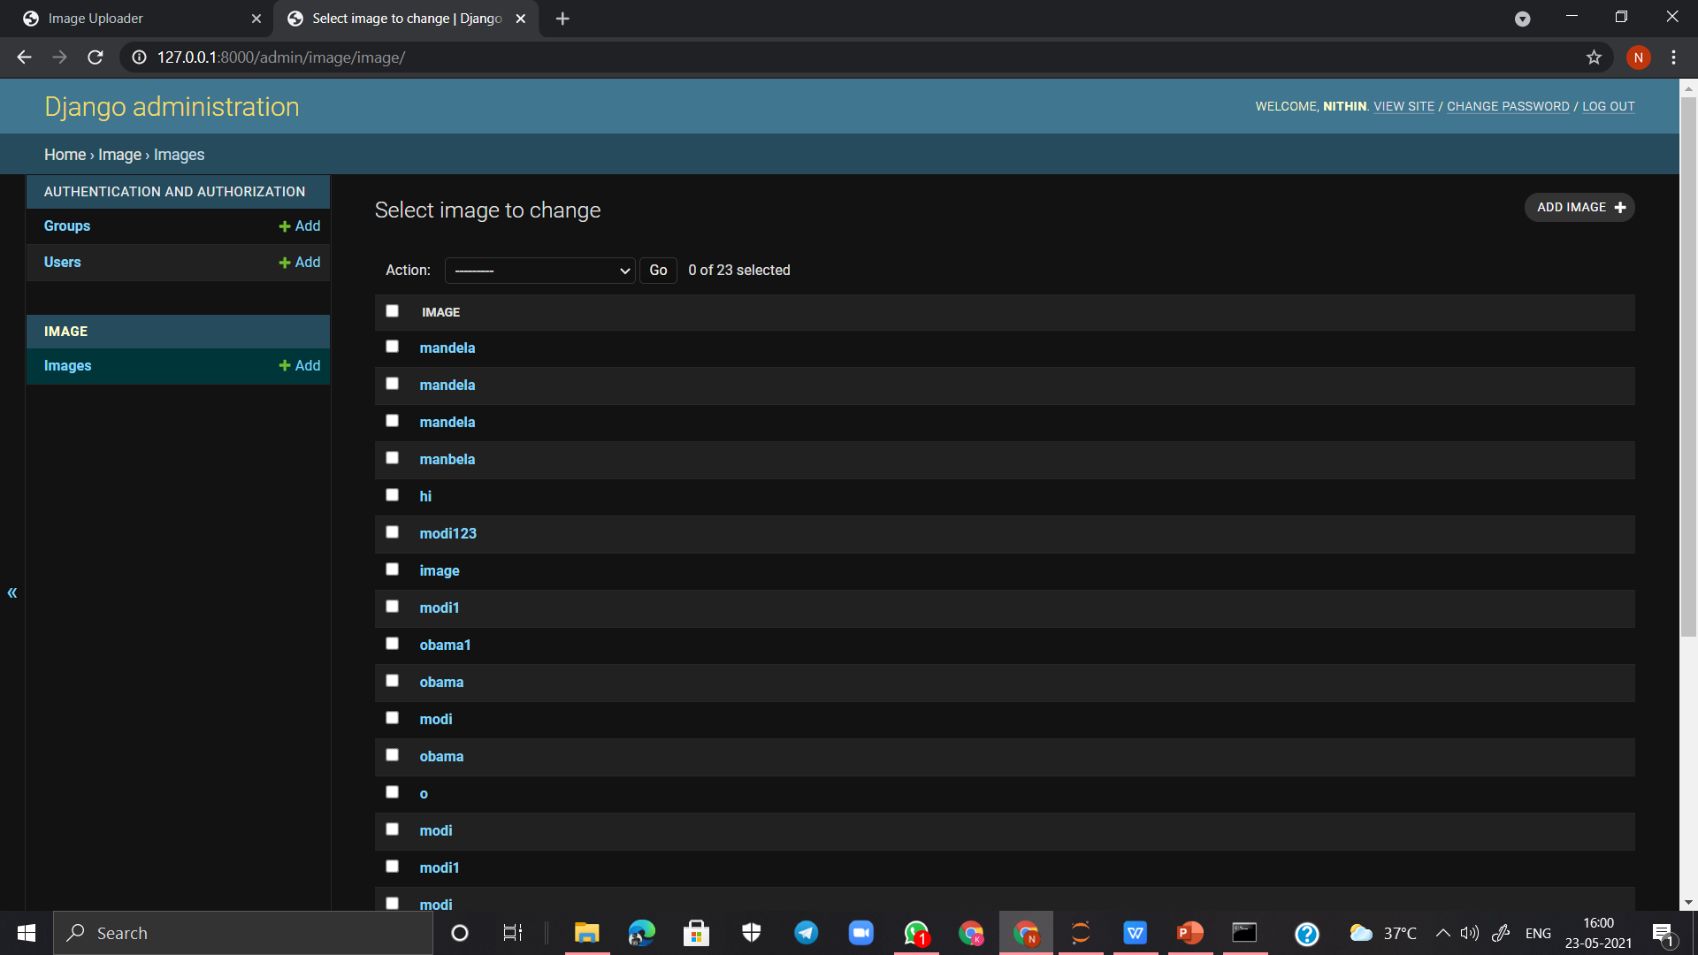
Go to image folder

Slide 11
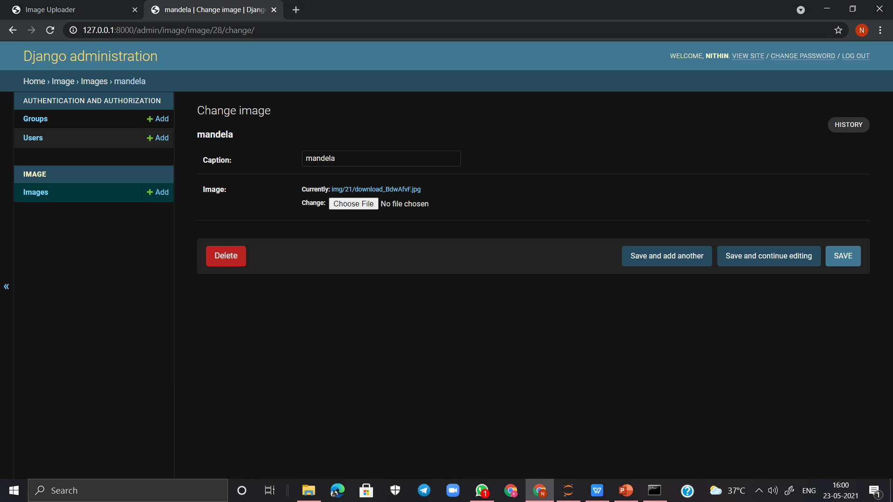
Copy the link of uploaded image

Slide 12
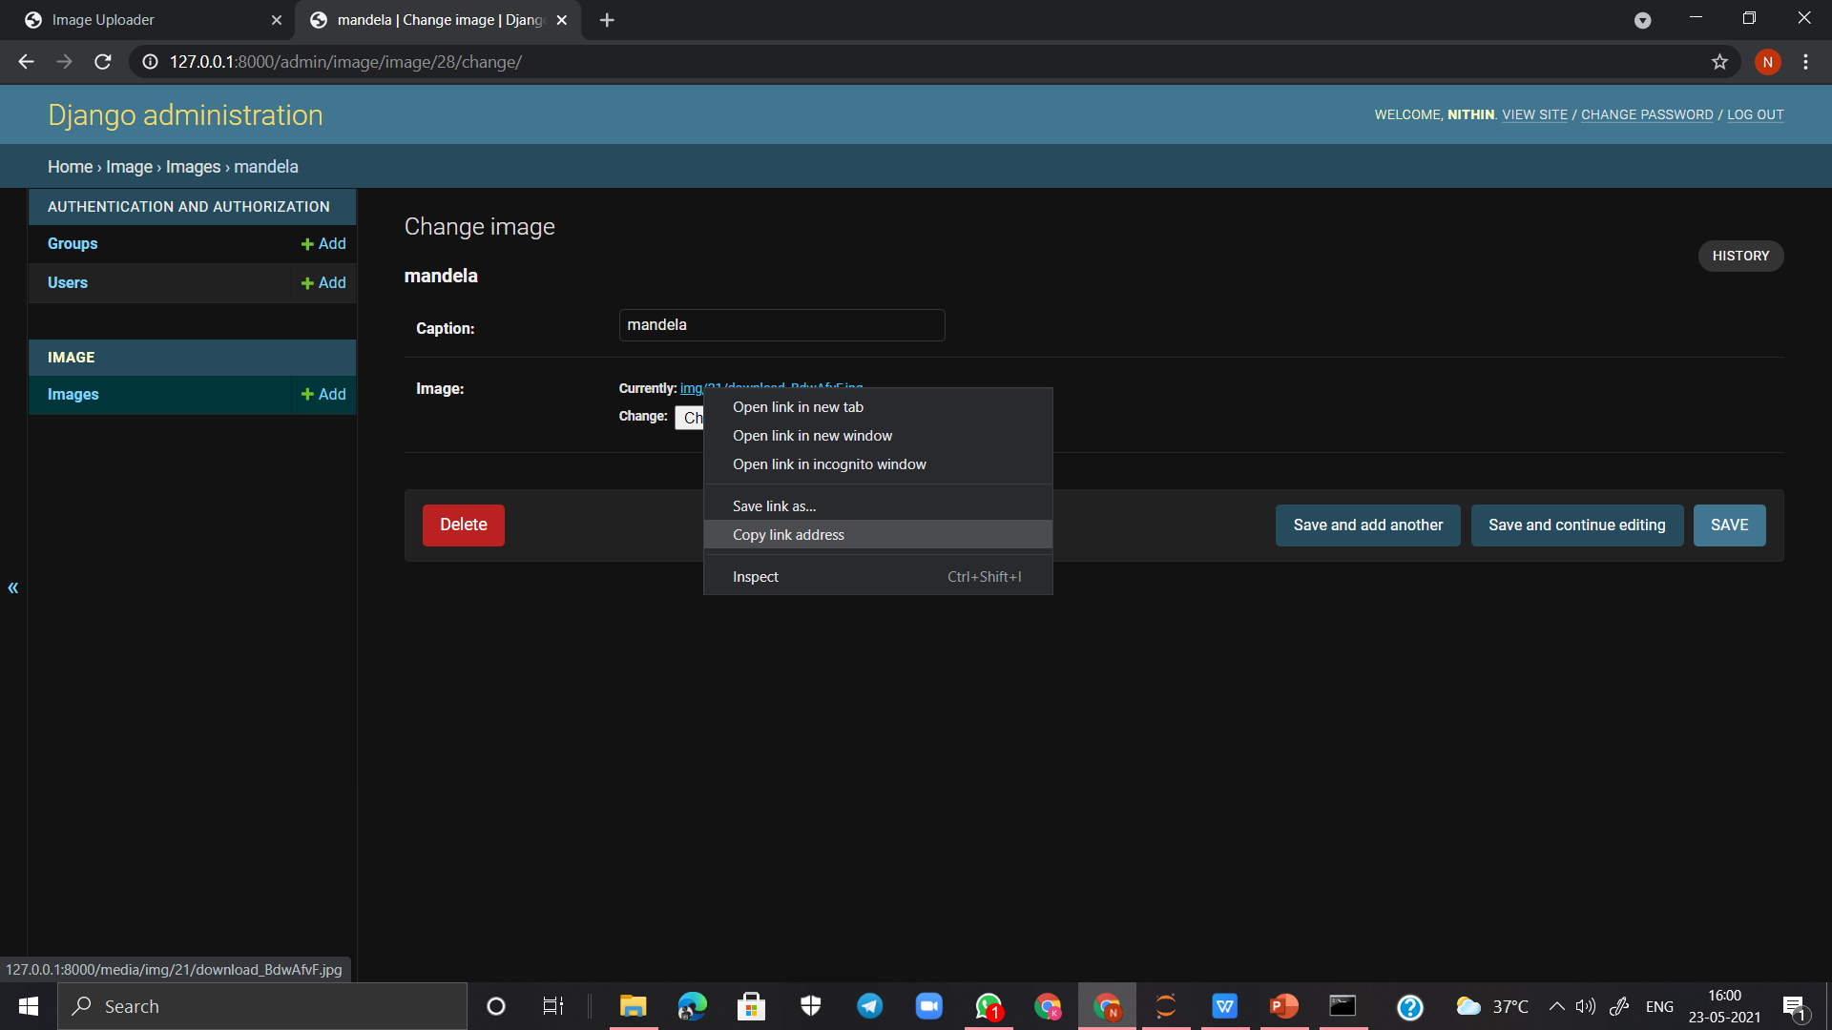

Slide 13
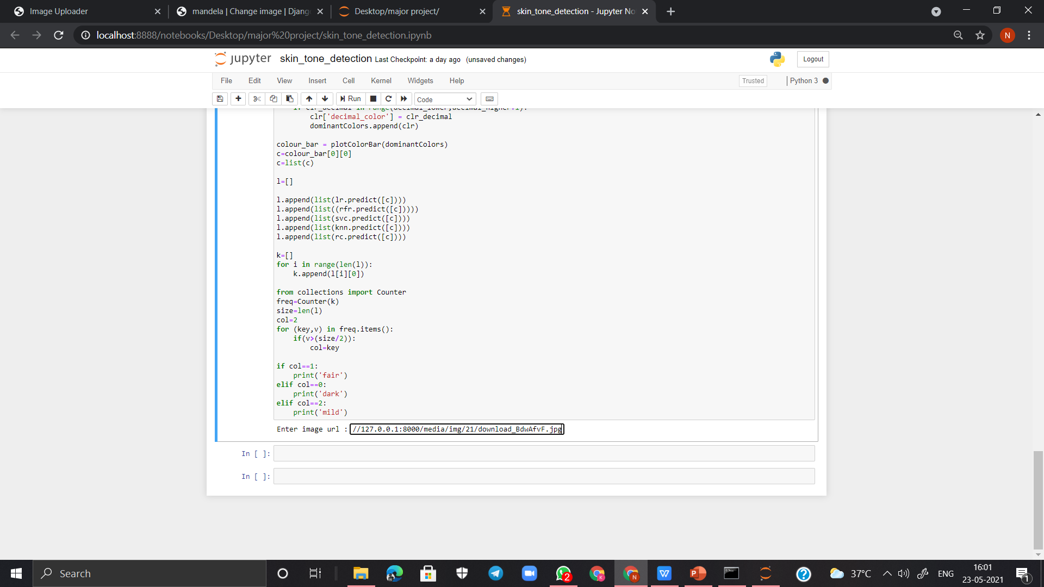
Paste it in python file

Slide 14
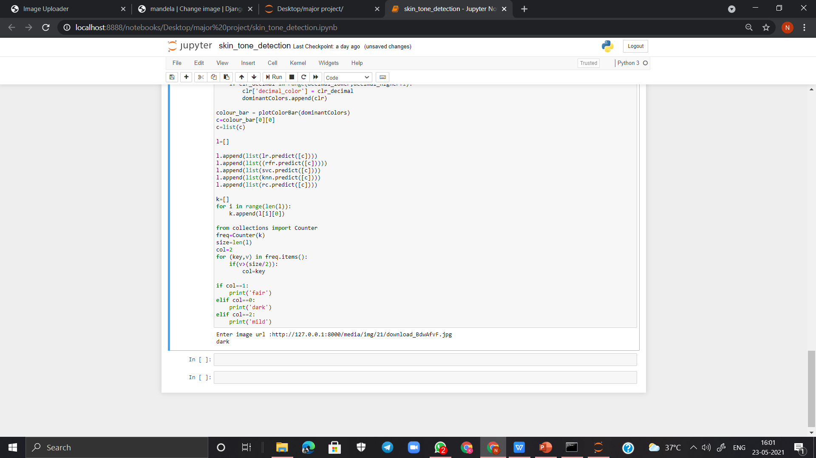
It will predict skintone

