Slide 1

Investigation of Particulate Matter 2.5 and Other Air Pollutants impact on COVID-19 Pandemic
capstone Project
Course data-606
By:
Niko Darby, Snehika Pandey, and Tamrat Workineh

Slide 2
Introduction

Slide 3
Why PM2.5 ?
The team, concerned with the increasing number of deaths of the target residents due to the Covid – 19, initiated this project to investigate if there is association between the gaseous elements (PM2.5) and covid disease. To contribute for the Environment advocates .

Slide 4
The Goal ‘as a part of the team project ‘ is to examine if PM2.5 influences the increase or decrease of COVID-19 transmission rates - while also taking COVID-19 mortalities into consideration.
Goal :

Slide 5
Project Description:
The datasets were collected from the US –Environmental Protection Agency (US- EPA).

Slide 6
Initially the dataset collected contained 879, 531 Columns and 29 Rows
State Code
Address
Longitude
Latitude
Parameter Occurrence Code
Datum
County Code
Site Num
Longitude
Parameter Name
Sample Duration
Pollutant Standard
Date Local
Units_ of_ Measure
Event Type
Observation Count
Observation Percent
Date of Last Change
AQI
Method Code
Method Name
Arithmetic Mean
1st Max Value
1st Max Hour
Local Site Name
State_ Name
County _Name
City Name

Slide 7
What Study Show
“ Outdoor and indoor air pollution cause respiratory and other diseases and is an important source of morbidity and mortality. ” WHO

Slide 8

Method:
To evaluate the Environmental Pollutants PM2.5, CO, NO2, and O3 on the Incidence and Mortality of Covid 19 in DMV, the study use historical data obtained from Environmental Protection Agency and National Climate data Center. Data Visualization, Machine Learning, Prediction and Linear Regression model and correlation analysis of PM2.5, CO, NO2, and O3 data will be made to determine their impact on the Pandemic.

Slide 9
Dimension Reduction:
Data Reduction improves the interpretation of the parameters of the machine learning model by removing irrelevant data.
Workable Datasets:
DeathIncrease: Monthly Death Rate of the target due to Covid
Ozone_ Contain: Monthly Ozone Concentration of Ozone
NO2_Contn: Monthly Ozone Concentration of Nitrogen Oxide
CO_ Concn: Monthly Ozone Concentration of Carbon Monoxide
Temp_ Avg: Monthly Ozone Concentration of Temperature
SO2 _Content: Monthly Ozone Concentration of Sulfur Dioxide
PM2.5_Contn Monthly Ozone Concentration of PM2.5

Slide 10
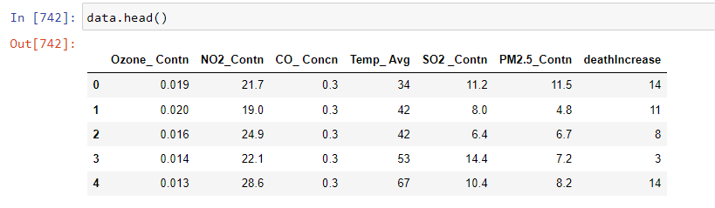
Partial View of workable dataset

Slide 11
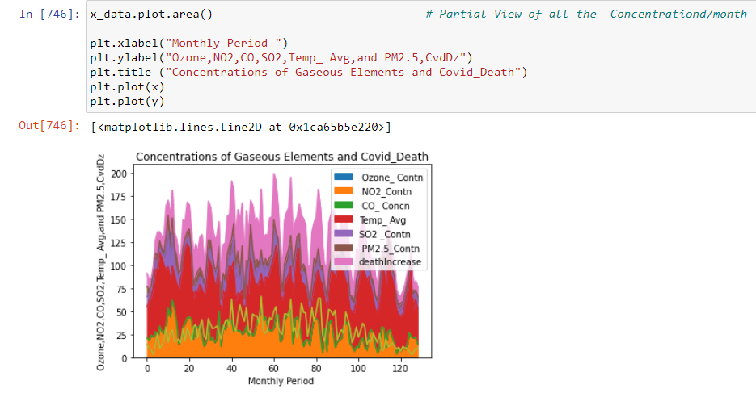

Slide 12
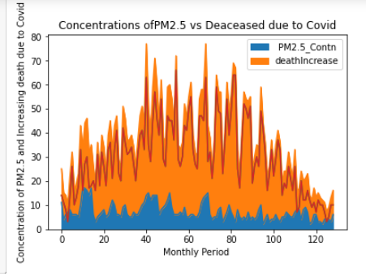

Slide 13
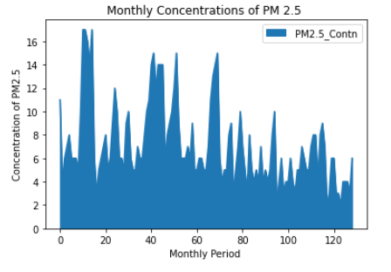

Slide 14
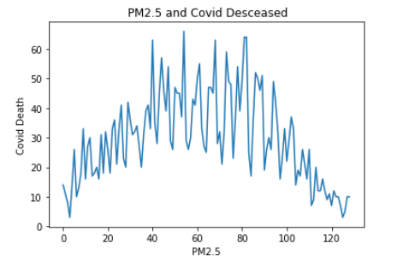

Slide 15
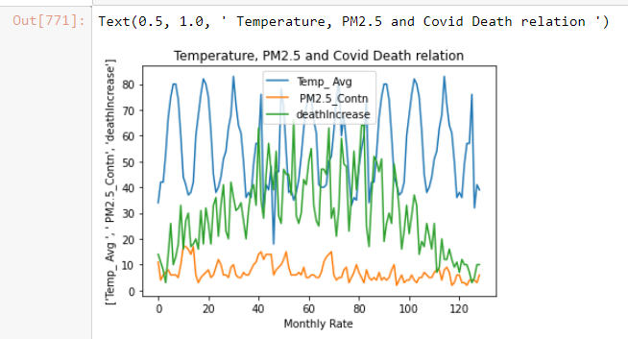

Slide 16
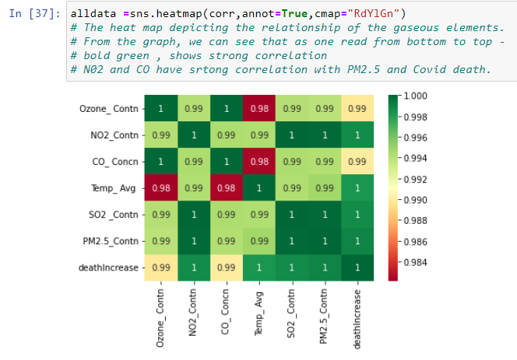
The heat map depicting the relationship of the gaseous elements

Slide 17
Regression Analysis Model

Slide 18
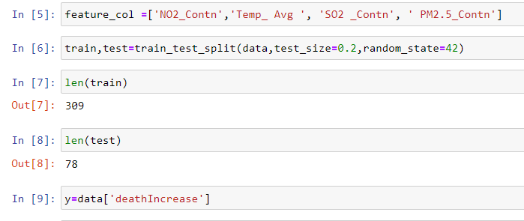
Train Test Split

Slide 19
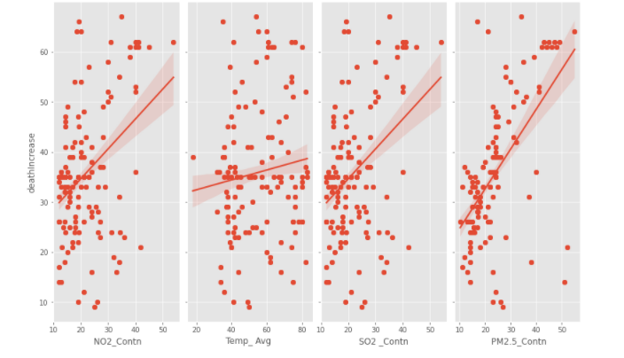

Slide 20

Evaluating the Regression Model

Slide 21
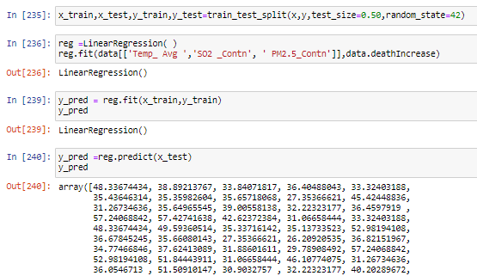

Slide 22
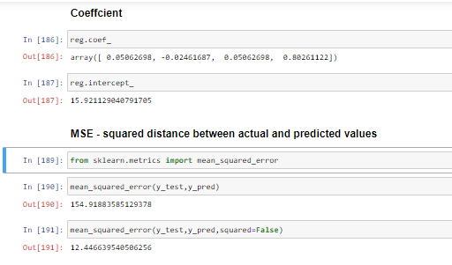
MSE ,R Square, Adjusted R Square, RMSE, MAE

Slide 23
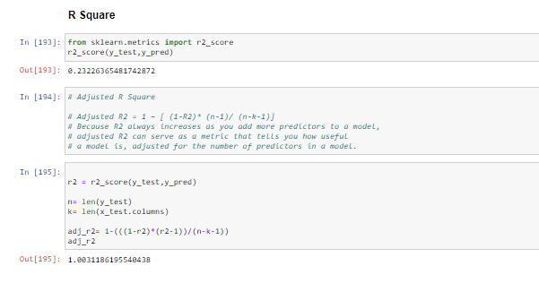

Slide 24
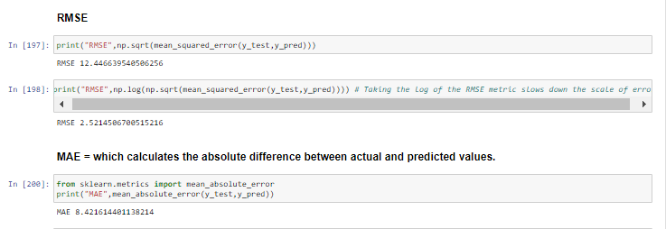

Slide 25

The regression equation for the linear model takes the following form: y = b 0 + b 1 x 1. In the regression equation, y is the response variable, b 0 is the constant or intercept, b 1 is the estimated coefficient for the linear term (also known as the slope of the line), and x 1 is the value of the term.
Taking PM2.5 as feature and Increase death due to Covid as a target
PM2.5 and Increase death due to Covid relationship
b₀ = ȳ - b₁x̄ x̄ = 24.0434 ȳ = 35.8837 b₀ = 35.8837 -0.7944*24.0434 = 16.7833
R Square (R²) equals 1.0
Correlation (R) equals 0.8777
It means that there is a very good direct relationship between the predictor and the predict

Slide 26
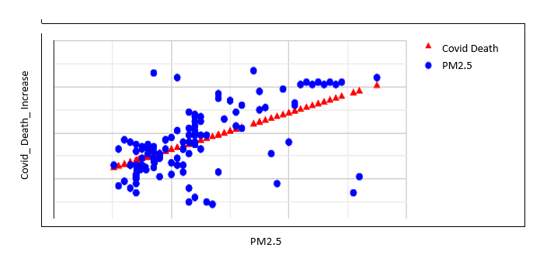

Slide 27
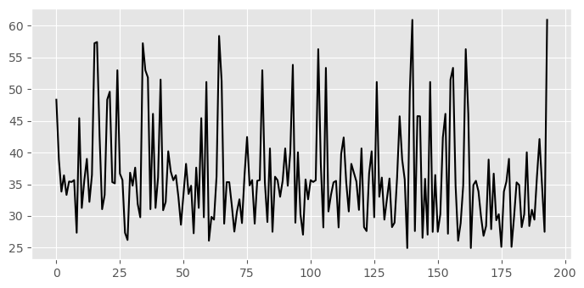

Slide 28
References:
Effect of environmental pollutants PM2.5, CO, No2, and O3 on the incidence and mortality of SARS-CoV-2 infection in five regions of the USA
(PDF) Effect of environmental pollutants PM2.5, CO, No2, and O3 on the incidence and mortality of SARS-CoV-2 infection in five regions of the USA (researchgate.net)
Evaluating the Contribution of PM2.5 Precursor Gases and Re-entrained Road Emissions to Mobile Source PM2.5 Particulate Matter Emissions (epa.gov)
Washington Air Quality Index (AQI) and Washington, D.C. Air Pollution | AirVisual (iqair.com)
Effects of SO2 and NOx emission reductions on PM2.5 mass concentrations in the southeastern United States - PubMed (nih.gov)
Order History | Climate Data Online (CDO) | National Climatic Data Center (NCDC) (noaa.gov)
Effect of Environmental Pollutants PM2.5, CO, NO2, and O3 on the Incidence and Mortality of SARS-CoV-2 Infection in Five Regions of the USA
World Health Organization, Air pollution (who.int)

