Slide 1
From Principal Subspaces to Principal Components with Linear Autoencoders
翁婉庭

Slide 2
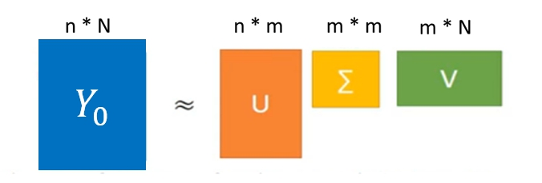


目的
利用Linear autoencoders做PCA
→ Recover the loading vectors from Autoencoders weights
→方法:Singular-value decomposition(SVD)
SVD
$∴m$ columns of U =the loading vectors of Y :$({w_{1}\text{,}w}_{2}$, $w_{3}$……. $w_{m})$
PCA $Y$：觀測向量(input vector)
$W$：orthogonal matrix
Linear autoencoders

Slide 3
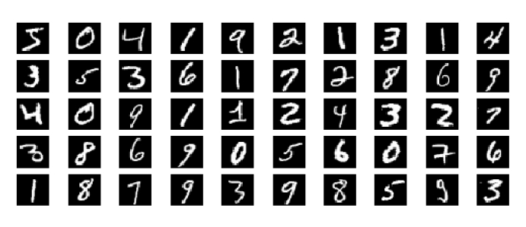
實驗
dataset :MNIST
60000 grayscale images handwritten digits
each of the images size is 28*28(patches)
dimention reduction:
28*28=784 dimention
→ 16 dimention
method: SVD
Hypothesis:
(PCA)The first 16 loading vectors of Y
= (Linear autoencoders)the first 16 left singular vectors of the matrix weight
28*28

Slide 4
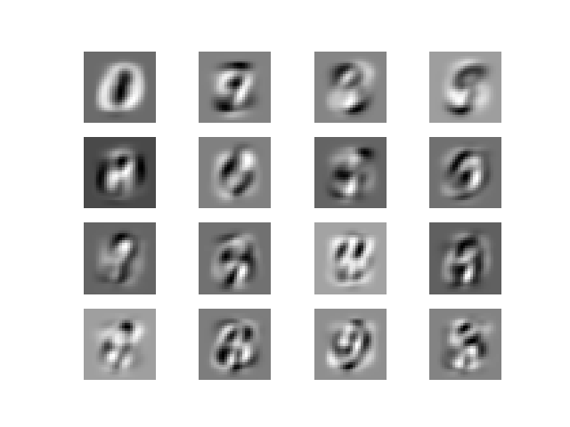
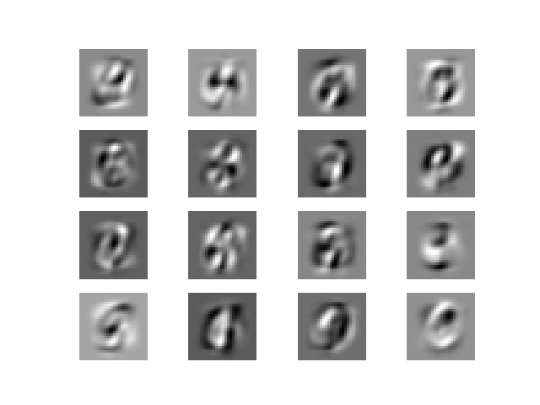
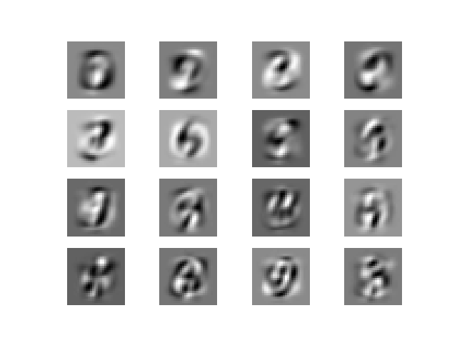
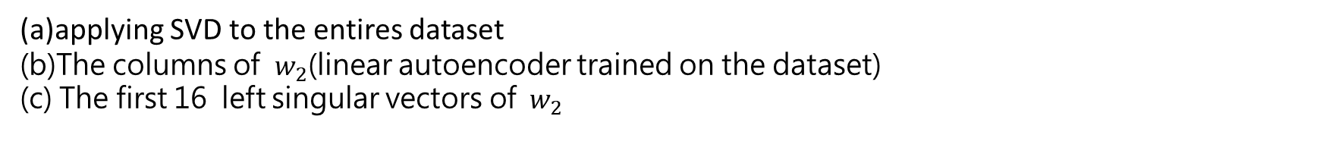

結果
*MNIST經過PCA分析後，依照數字去區分，這裡取的是數字0所求的結果
(a)PCA
(b)$w_{2}$
(c)LinearAutoencoders_PCA
(a)applying SVD to the entires dataset
(b)The columns of $w_{2}$(linear autoencoder trained on the dataset)
(c) The first 16 left singular vectors of$w_{2}$

Slide 5

比較
The columns of weights(b)
are entirely different from
the loading vectors(a)
(a)PCA
(b) $w_{2}$

Slide 6
比較
the left singular vectors in (c)
are very close to
the loading vector in (a)
(a)PCA
(c)LinearAutoencoders_PCA

Slide 7
結論
recovering the loading vectors
→simply applying SVD to the weight matrix of one of the two layers
用linear autoencoder 做PCA 的優點:
*process high-dimentional data
*process datasets with large numbers of observations

