Slide 1
Directed Research – ABCD Challenge
Tamoghna Chattopadhyay
under the guidance of
Prof. Anand Joshi

Slide 2
ABCD Challenge
ABCD – Adolescent Brain Cognitive Development
Challenge : Predicting Residual Fluid Intelligence Scores from T1 weighed MRI scans.
Dataset provided has around 3700 training data and 415 validation data.
The goal of ABCD is to determine how childhood experiences (such as sports, videogames, social media, unhealthy sleep patterns, and smoking) interact with each other and with a child's changing biology to affect brain development and social, behavioral, academic, health, and other outcomes.
Data was acquired from NIH NDAR (National Institute of Health : Data Archive). Prior Approval was obtained by Prof Joshi through USC to get the data.
The Data was downloaded on my system – Windows Laptop with Intel Core i7, 16 GB RAM, 2 TB HDD, 500 GB SSD and NVIDIA GEFORCE GTX GPU inbuilt.

Slide 3
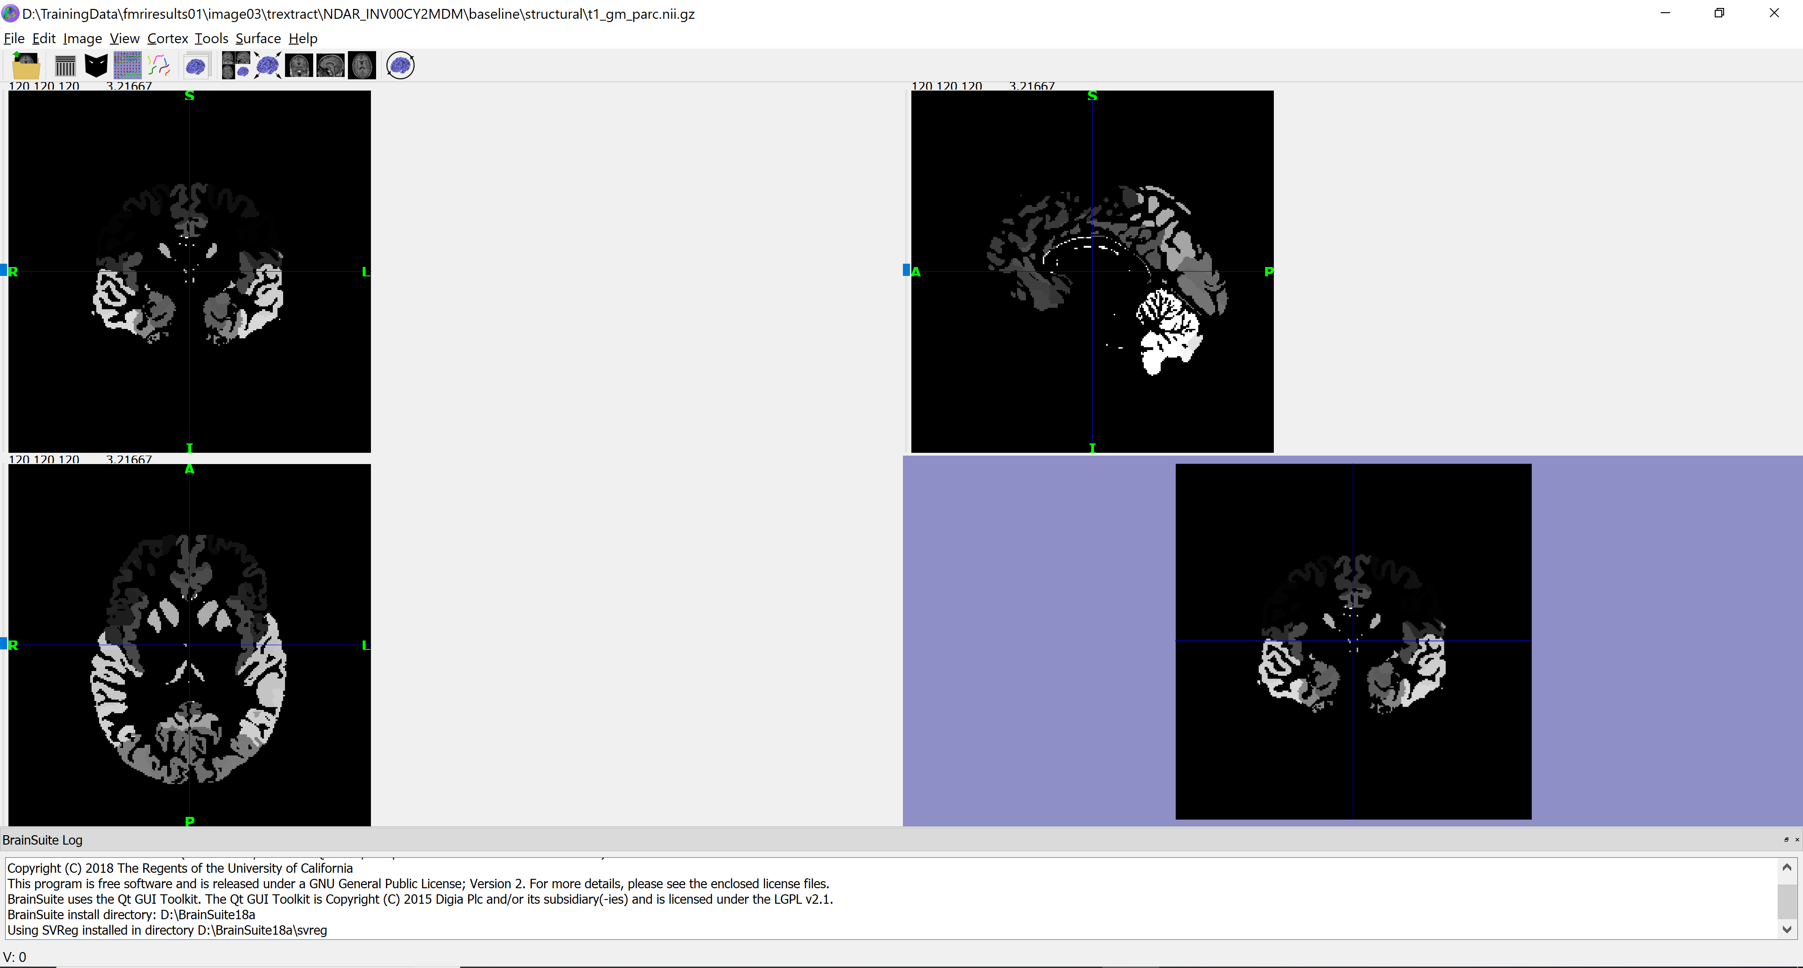
Example of Dataset
The dataset was in a tar file and was extracted and viewed on BrainSuite.

Slide 4
Additional Data
Some Additional Data provided in a csv file was as follows:
Collection_id: The record’s Collection of origin
(structure shortname)_id: The globally unique row ID of the record in the NDA database
Dataset_id: The record’s dataset of origin
Subjectkey: The NDA GUID, a subject’s globally unique ID across NDA src_subject_id: The subject identifier used at the site where the data was collected
interview_age: Age rounded to whole months
Subject sex
Etc.
This data was only provided for the training dataset and not for the validation dataset. So it’s upto us to determine whether to use this additional data.

Slide 5
Getting Features from MRI Scans
Used python package nilearn to get data from 3D MRI scans. Nilearn is a Python module for fast and easy statistical learning on NeuroImaging data. Image is one of the functions available through nilearn to read the data in nii.gz format.
For each scan, used:
fname = image.load_img(path + tr_result.subject[i] + p2 + "t1_gm_parc.nii.gz")
labels = fname.get_data()
lbl,cnt = np.unique(labels, return_counts=True)
In this way from the MRI scans, I scanned the amount of unique labels and stored the count of each label. These indicate the different parts of the brain and their quantity. This way, I got 116 features, from which the first feature was removed as it indicates the black color of the MRI scans which are not part of the brain.

Slide 6
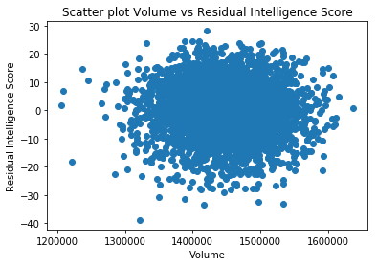
Scatter Plot of the Volume vs Fluid Intelligence Score

Slide 7
Preprocessing
Added a new feature: volume of the brain which is got using summing up the counts of different labels.
Removed features which are unique to only some brains.
Thus, finally reduced down to 114 features.
Did the same preprocessing steps for the validation dataset and got 114 features for it as well.
For the additional data provided, read the given features and used label binarizer for features like sex. This gave total 123 separate features.

Slide 8
Application of general regression algorithms
Firstly, I tried out general regression algorithms using the basic 114 features.
The metrics used for testing the validation dataset are: Mean Squared Error and R^2 metrics.
The algorithms used are:
Linear Regression
Kernel Regression
Random Forest Regression
Adaboost Regression
Gradient Boosting Regression

Slide 9
Results
Model | MSE Training | MSE Validation | R^2 Validation
Linear Regression | 86.7969396672596 | 74.18163019603759 | -0.037139312489653964
Kernel Regression | 86.7381943752874 | 74.07327667908645 | -0.03562441329183952
Random Forest Regression | 92.5590623633991 | 81.09030429427526 | -0.1337300383273834
Ada Boost Regression | 86.3894520533788 | 72.24252904697919 | -0.01002858403481132
Gradient Boosting Regression | 86.8404697087932 | 73.32030398035764 | -0.02509704169028115

Slide 10
Inference
As we can see from the results, the MSE for all the general algorithms are from 72 – 75.
But the R^2 value for all the algorithms are negative which means, the algorithms are not learning anything.
So, next option go for a neural network.

Slide 11
Basic Neural Network
Two different models:
Two hidden layers of number of neurons size (256, 256) and dropout 0.5. The hidden layers have relu activation and the output layer has linear activation. The optimizer used is Adam and the loss function is mean squared error loss.
Three hidden layers of number of neurons size (256, 512, 256) and dropout 0.5. The hidden layers have relu activation and the output layer has linear activation. The optimizer used is Adam and the loss function is mean squared error loss.

Slide 12
Results
Model | MSE Training | MSE Validation | R^2 Validation
Model - 1 | 84.7932 | 70.852137643393 | 0.00941058952602
Model - 2 | 85.0564 | 71.794711751212 | 0.00376761455995
As we can see, the MSE for the validation set are much better for the neural network models. Also, R^2 value is positive.

Slide 13
Additional Models
These models are built upon the 114 features extracted from the MRI scans.
We still have 123 additional features for the training dataset. The difficulty is they are not provided for the validation dataset.
Method : Try to predict the 123 features from the 114 features given using a neural network. This network can be trained using the training dataset. And then the total 237 features thus got can be used for training and prediction.

Slide 14
Neural Network to generate extra features
To generate the additional 123 features, from the given 114 features, we use a basic neural network model:
Input layer with 64 neurons and input dimension 114.
First hidden layer with 256 neurons and linear activation.
A dropout layer of 0.5.
Second hidden layer with 512 neurons and linear activation.
Output layer with 123 dimension.
The optimizer used was Adam and the loss function was mean squared error.
This neural network model remains same for both the upcoming model types.

Slide 15
The F.G. Neural Network
Input Layer : feature size 114
Dense : 256 Neurons Activation : Sigmoid / Linear
Dropout 0.5
Dense : 512 Neurons Activation : Sigmoid / Linear
Output Layer : feature size 123

Slide 16
Model 1
Input Layer 1 : feature size 114
Input Layer 2 : feature size 123
Dense : 64 Neurons
Activation : Relu
Dense : 256 Neurons
Activation : Relu
Dense : 128 Neurons
Activation : Relu
Concatenation Layer
Dense : 256 Neurons
Activation : Relu
Dense : 256 Neurons
Activation : Relu
Output Layer
Dense : 256 Neurons
Activation : Relu

Slide 17
Model 2
Input Layer : feature size 237 = 114+123
Dense : 512 Neurons Activation : Sigmoid / Linear
Dropout 0.5
Dense : 256 Neurons Activation : Sigmoid / Linear
Dropout 0.5
Dense : 128 Neurons Activation : Sigmoid / Linear
Output Layer

Slide 18
Final Model : Training and Validation
Input layer : 114 features
F.G. Neural Network
Output Layer : 123 features
Model1 / Model2 Neural Network
Output Layer : Intelligence Score

Slide 19
Results
Model | MSE Training | MSE Validation | R^2 Validation
Model - 1 | 82.836 | 71.7830 | 0.00360
Model - 2 | 81.7589 | 71.7456 | 0.00386
Here, The MSE and R^2 validation scores are almost as good as the original neural network model. They vary by around 1 for the MSE. The R^2 score is always positive.
The value of MSE will increase if the amount of training data increases for the neural network predicting the 123 features. This is because of the lesser number of training data available, the predictions are not as good for that network, and hence noise is introduced further on to the new networks.

Slide 20
END

