Slide 1
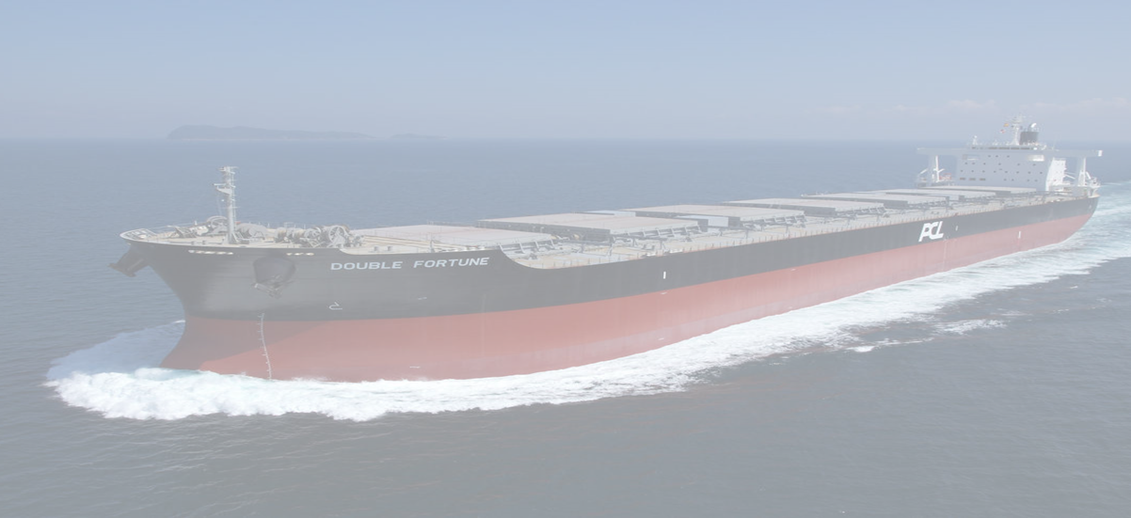


I
SHIP DESIGN PROJECT
SEMESTER 7

Slide 2
PRELIMINARY DESIGN OF BULK CARRIER (CAPESIZE)
175,000 DEADWEIGHT
II
By: B. Namratha
Reg. No. 1804609011
GUIDE: DR. V.K. KESAVADEV

Slide 3
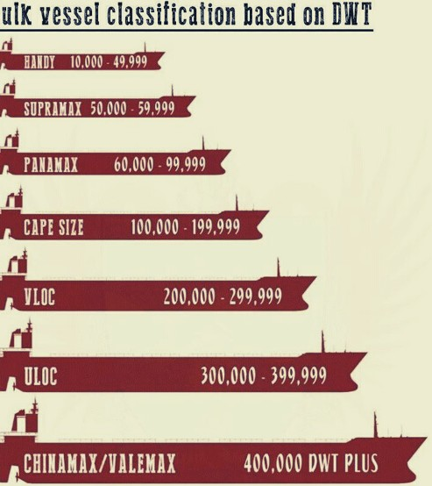

PROJECT DETAILS
III
TH
175000 DWT Bulk Carrier
A bulk carrier is a type of merchant ship that is used to transport large amounts of unpackaged bulk cargo, such as iron ore, coal, cereal, salt, aluminum, and copper ore.
Capesize ships are the largest dry cargo ships. They are too large to transit the Suez Canal and so have to pass either the Cape Agulhas or Cape Horn to traverse between oceans.
Major Capesize bulk trade routes include Brazil to China, Australia to China, South Africa to China, and South Africa to Europe.

Slide 4
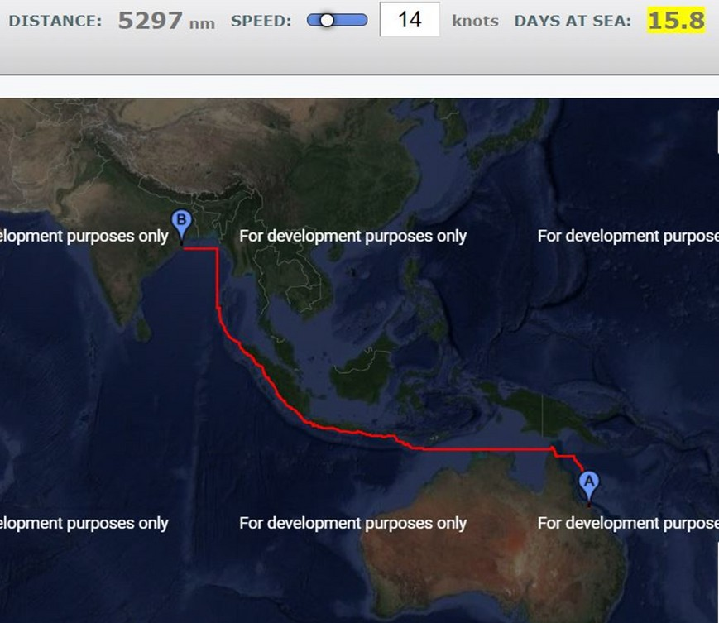
ROUTE AND VOVAGE DETAILS
CARGO DETAILS
CARGO TYPE- COAL
Specific gravity = 1.32 kg/m3
Ignition temperature: 667-
795 C
Angle of repose: 24 deg
ROUTE
ABBOT POINT TO DHAMRA PORT
ABBOT POINT- This port is capable of handling ships of maximum 2,00,000 dwt.
DHAMRA PORT- This port is capable of handling ships of maximum 1,80,000 dwt.

Slide 5
Vessel Particulars
V
Length = 281 m Length BP= 274.5M Breadth(mld)= 43.23M Depth= 22.99M Draught= 17.47M
Displacement (mld)= 185816 T
Vol. Displaced= 181283.9 CUBIC/M Speed= 14 knots
Froude number= 0.173
Cb= 0.847 Cm=0.997 Cwpa= 0.928
Cp= 0.847
Cvp= 0.9122
Midship Area= 752.96 sq.m Waterplane=11022.92 Sq. m
TH
*Vessel particulars fixed by empirical formulas and Iterative correction*

Slide 6










Coefficients
Initial Stability
KB= 9 .45 M BMT= 9 . 03M BML= 9 . 01M KG= 14 .48 M
KMT= 18 .48 M
GMT= 3 . 99 M
GML= 382 . 86 M MCT 1CM= 2451 . . 34 M
Form coefficients are ratios that numerically compare the ship's underwater form to that of regular shapes having the same majority dimension as the ship.
CB= 0.847
CM=0.997
CP (CB/CM) = 0.847
CWPA= 0.928
CVP= 0. 912

Slide 7
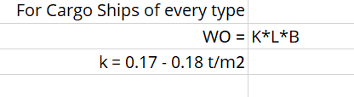
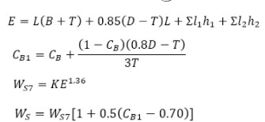

Weight Estimation
XI
Outfit Weight
LIGHT SHIP WEIGHT
DEAD WEIGHT
Steel Weight
Heavy Fuel Oil Wt.
Diesel Oil Wt. Lube Oil Wt. Freshwater wt.
Provisions Steel wt.
Machinery Wt.
Outfit wt. Margin
1207.99
73. . 66
15
53 . 72
3 . 16
16465 . 7 7
2266 . 7 61
2245 . 4 09
3%
tons
tons tons tons tons tons tons tons
Machinery Weight

Slide 8

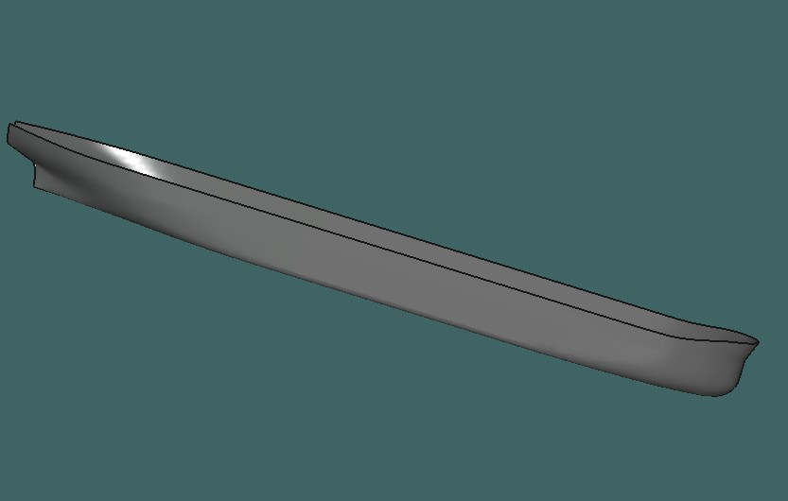
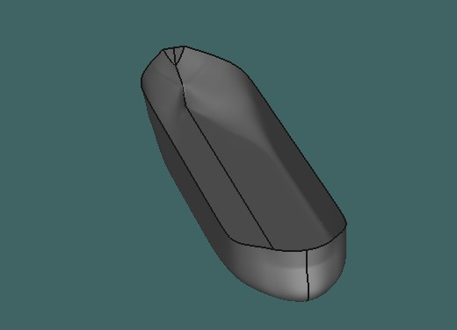
Final Model
XII
3D Hull

Slide 9
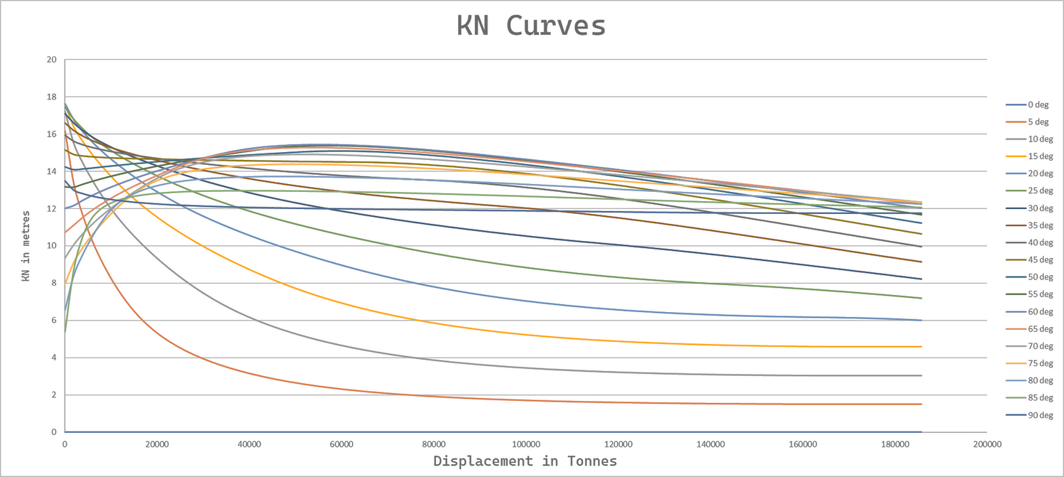
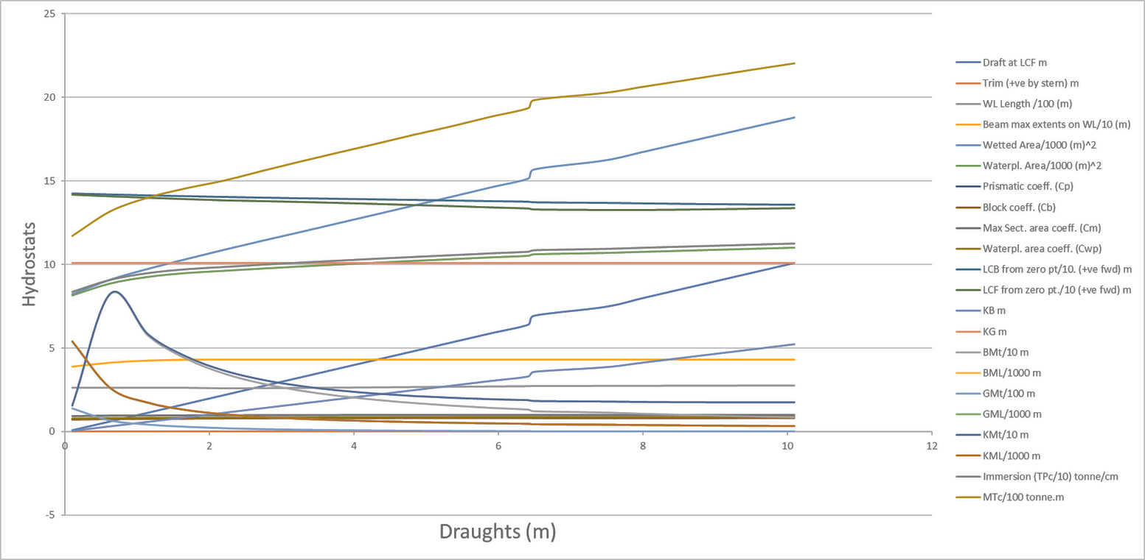
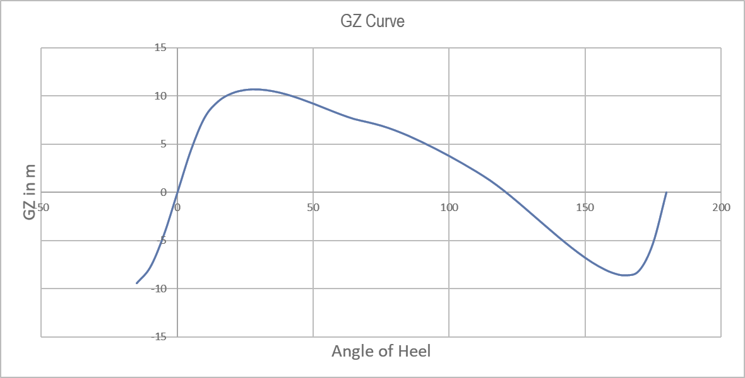
Stability Curves
XVII
TH

Slide 10

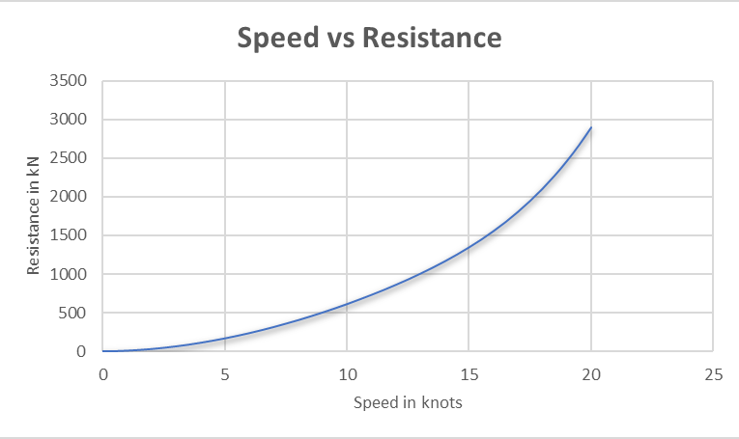
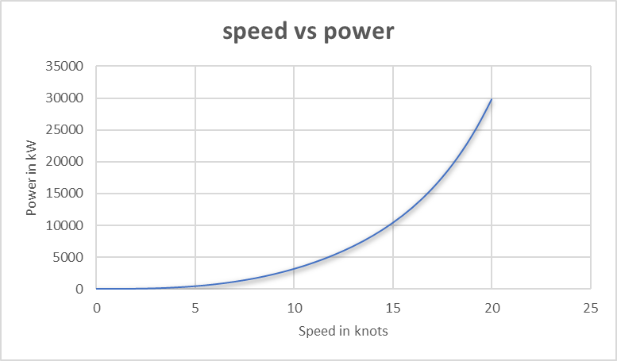
Resistance and Powering
.

Slide 11
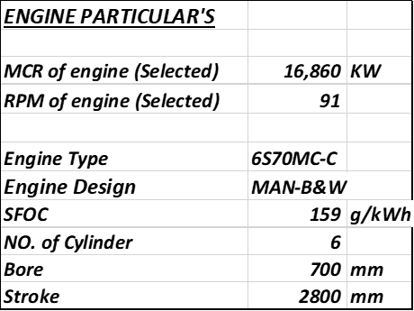
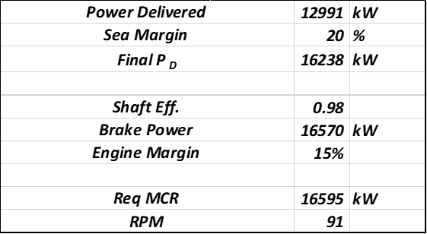
Engine Selection
XXV
.
TH

Slide 12
CONCLUSION
All the calculations performed are under 3 % of error. So, when parameters of the vessel are taken within the above mentioned error limit (including displacement) for the service speed, these preliminary calculations are valid.

