Slide 1
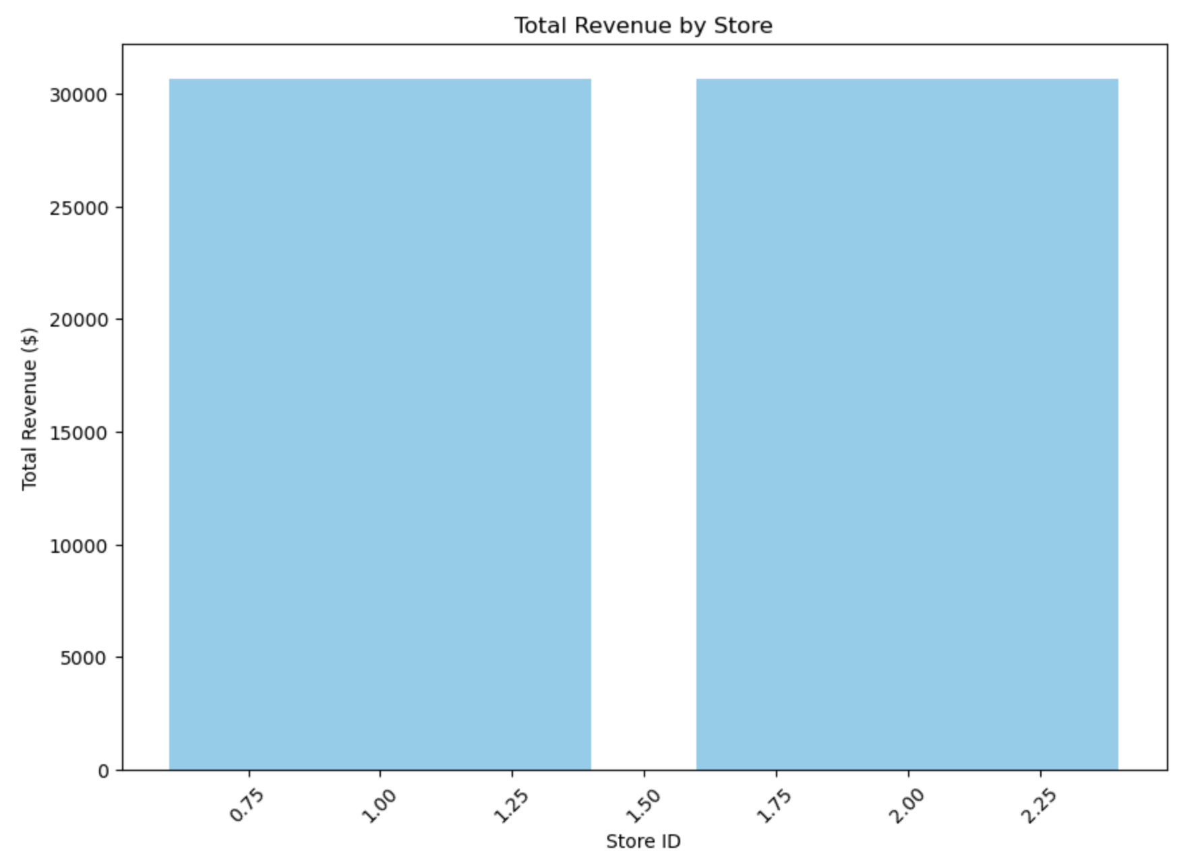
1. What is the total revenue generated by each store?
Description: This chart shows the total revenue generated by each store. It provides insights into how much each store contributes to the overall revenue, helping to identify which stores are performing the best financially.

Slide 2
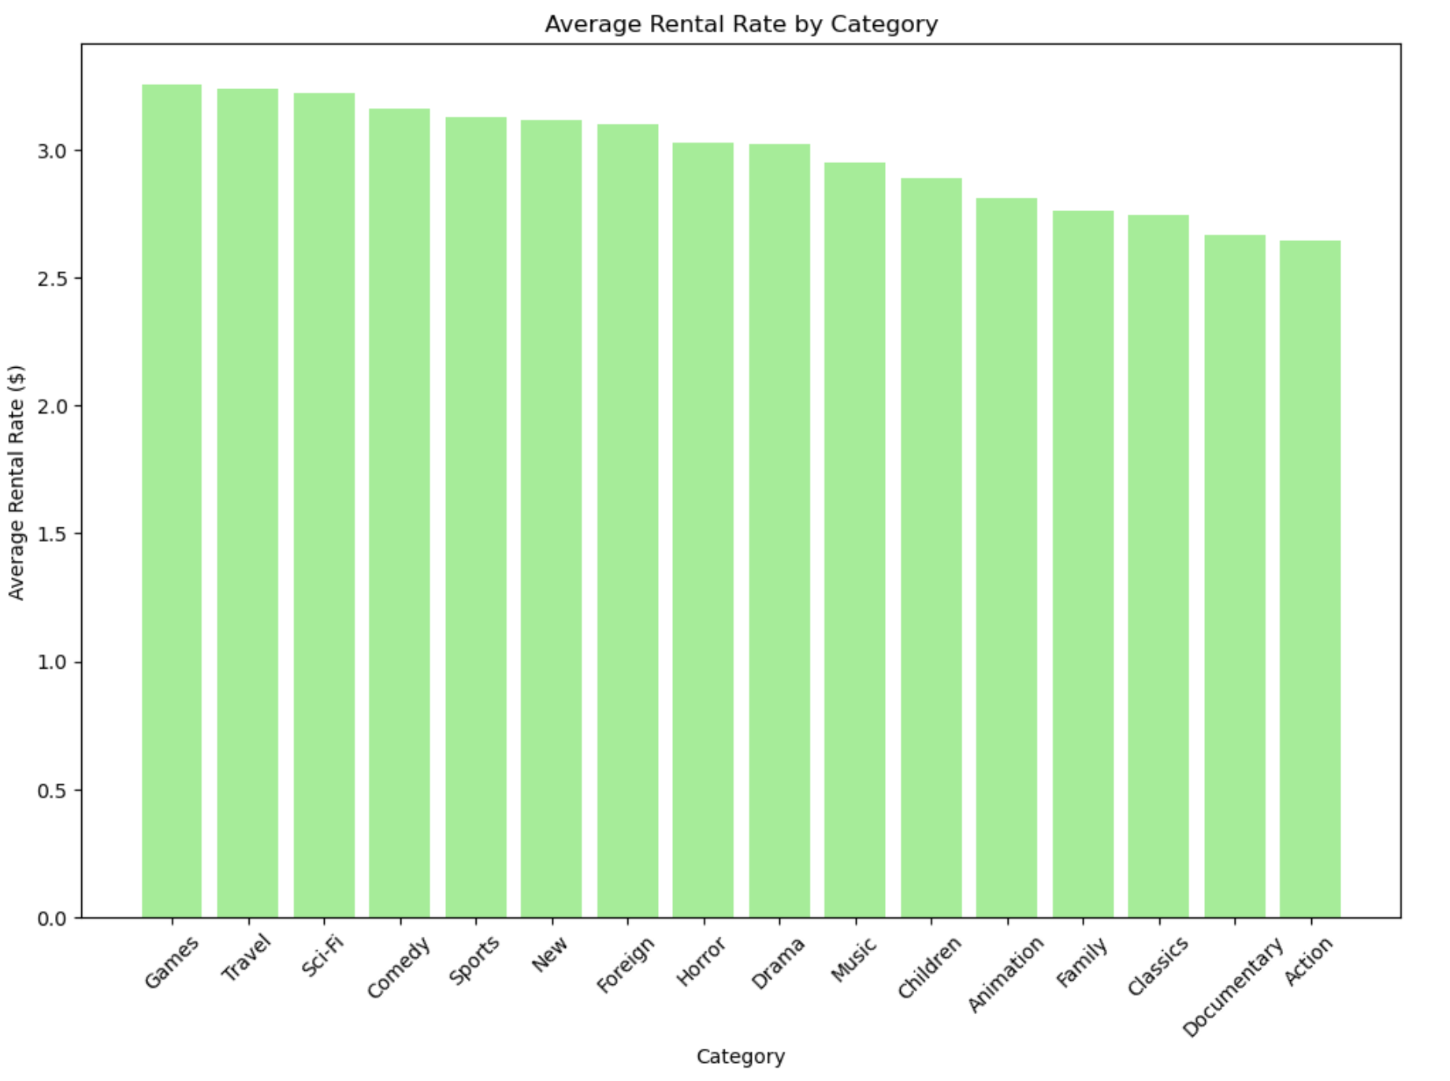
2. What are the average rental rates for each film category?
Description: This chart displays the average rental rate for each film category. It helps in understanding which categories have higher rental rates on average.

Slide 3
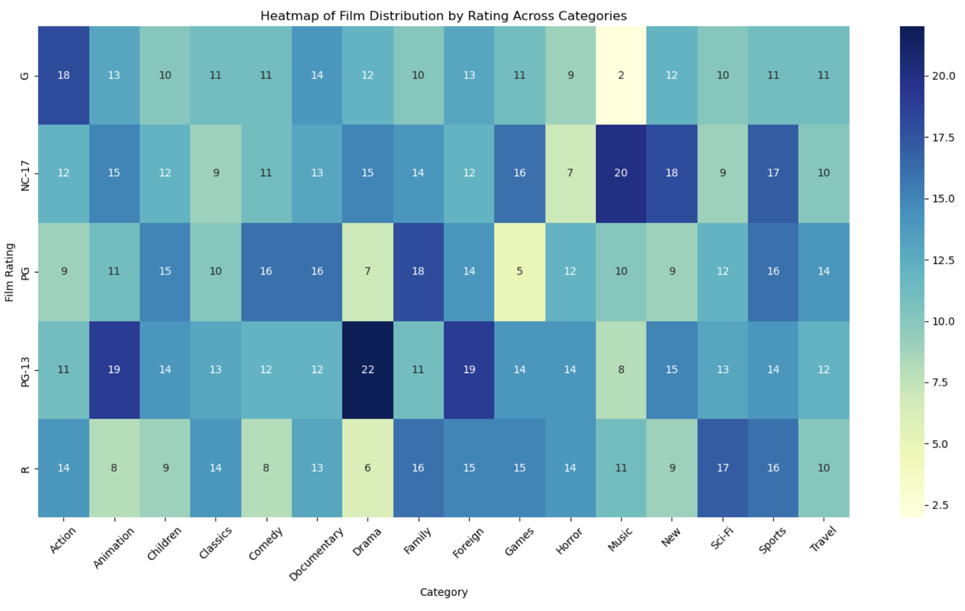
3. What is the distribution of films based on their rating across different categories?
Description: This query shows the distribution of films based on their rating across different categories. It helps to understand how ratings are distributed within each film category, providing insights into the rating trends within various categories.

Slide 4
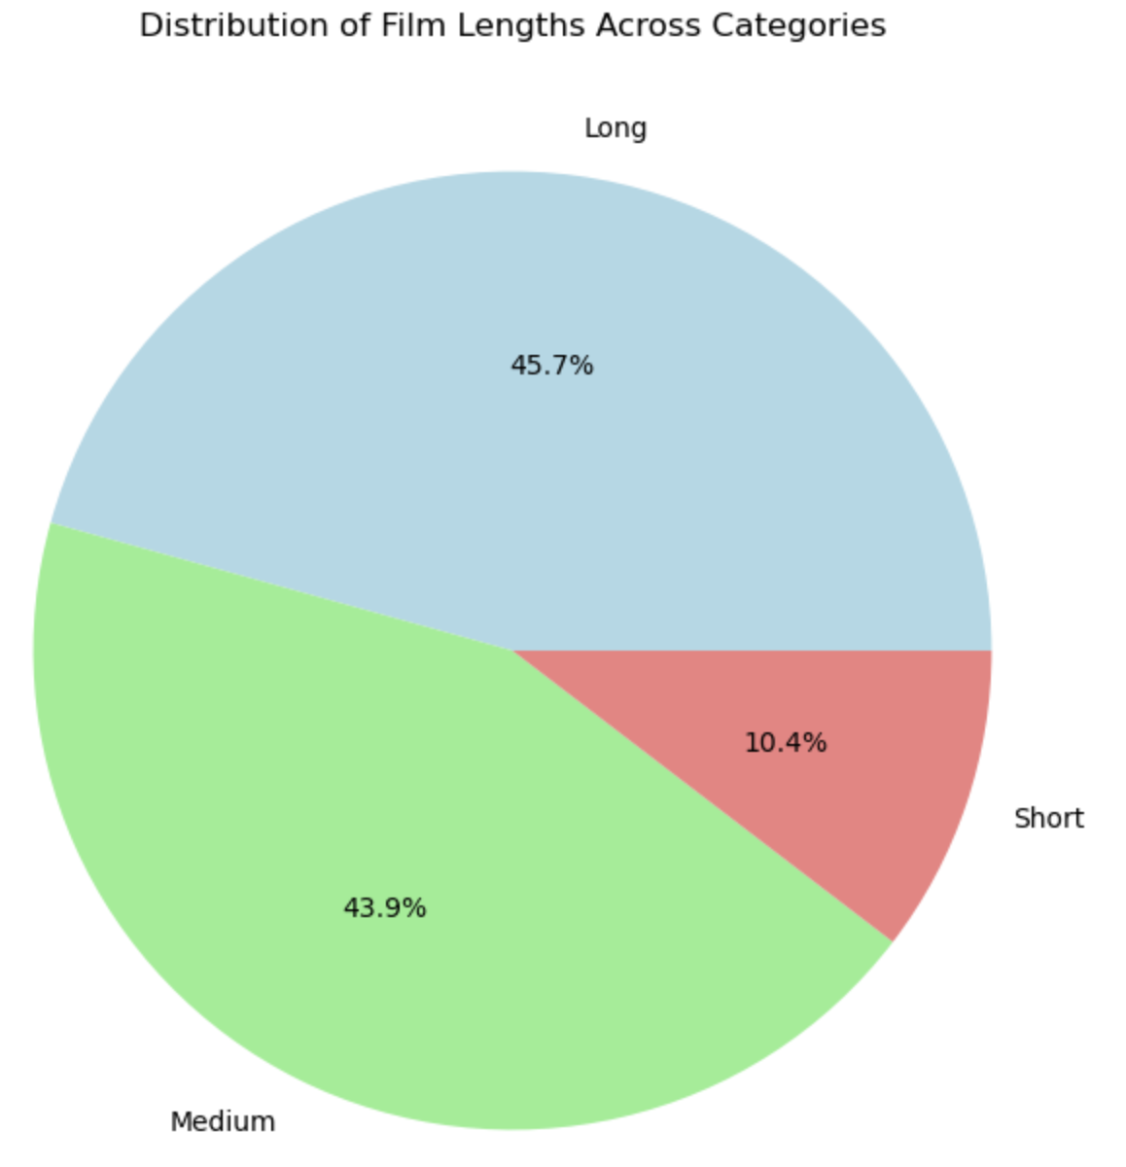
4. What is the distribution of film lengths across different length categories (e.g., Short, Medium, Long)?
Description: This chart shows the distribution of film lengths across different length categories (Short, Medium, Long). It helps in understanding how films are distributed based on their length, which can provide insights into the type of films the database holds.

