Slide 1

Team 3
Nicholas Miller, Kristie Harvick, Scott Liu, Sam Swanson, and Andrew Zhang

Slide 2
Benefitting
Recognized as the leading spinal cord injury global research foundation
Also provides countless services and programs that provide knowledge, support, resources, and community to those living with paralysis

Slide 3
The Challenge
To develop an application that motivates individuals (living with and without paralysis) to report on inaccessible places
Offer real-time information
Share experiences at a location
Help one another
Raise awareness to the general public
Improve conditions and quality of life

Slide 4
We were asked to consider..
Could individuals “adopt” specific locations and be responsible for reporting updates?
Could individuals who report gain recognition in the community?
Could we create healthy competition among contributors?
Could contributors work on teams?
How could individuals makes meaningful contributions when they may not be familiar with the challenges disabled people face?
How could individuals understand the impact that their reporting has on the paralysis community?

Slide 5
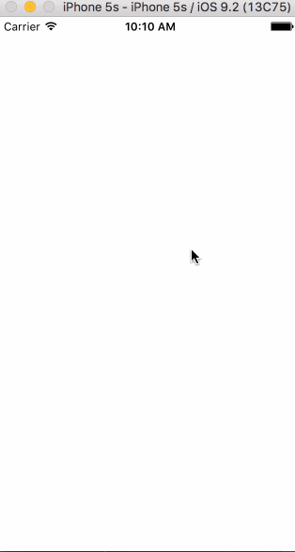
Our Solution
“Striving for a better quality of life for everyone”

Slide 6
Real world implementation
Employers can encourage employees to download
Viral videos – (ALS ice bucket challenge)
Business owners can check their score
Gives them a chance to right what they might not have realized
Company partnerships to provide rewards like gift cards

Slide 7
Impacts
Individuals with paralysis
Gives them an idea of what the trip there will look like
General public
Knowledge of
Why do people write reviews?

Slide 8
Envisioned future additions
Expand volunteer accounts
Redeeming points for gift cards
Employer accounts to monitor employees’ social responsibility
Business owner accounts
Section on improving their business

Slide 9
Questions?

