Slide 1
Team4Helping
How can we help?

Slide 2
Our Mission:
It is our objective to efficiently use existing technologies in unique ways so that we may bring critical services to those that need them and maintain the highest standards to help crowdsource our solutions.

Slide 3
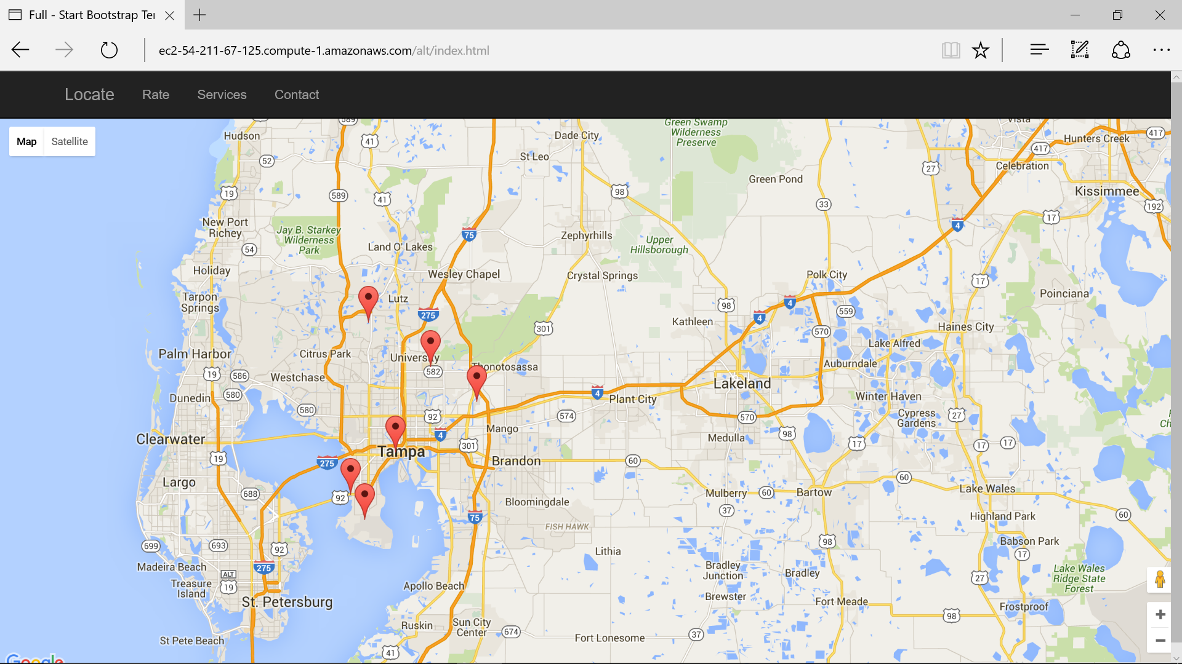
Our Application

Slide 4
How we interact with this World!
Our vision is to professionally design revolutionary services to stay pertinent in tomorrow's world by offering quality map services.
Our business is to quickly orchestrate holistic services as well as conveniently deploy web meta-services to meet our customer's needs.
We will work concertedly to continually maintain high-quality local services to stay relevant in tomorrow's world.
We’re not a Map Company, we’re a tech incubator.

Slide 5
T4-Coding For Good
Website featuring database integration and using googles APIs.
Allows users to easily add location data regarding Disability access.
This product will quantify native advertising and demonstrate strategic performance incorporate social responsibility.”

Slide 6
Technologies
Bootstrap framework.
Javascript
MySQL
PowerPoint.
Additionaly Features to Be Implemented
Mouse Over Marker Text

Slide 7
Website
http://ec2-54-211-67-125.compute-1.amazonaws.com//index.html

