Slide 1
Team4Helping
How can we help?

Slide 2
Our Mission:
It is our objective to efficiently initiate professional intellectual capital so that we may continue to dramatically utilize multimedia based sources while maintaining the highest standards to help crowdsource our solutions.

Slide 3
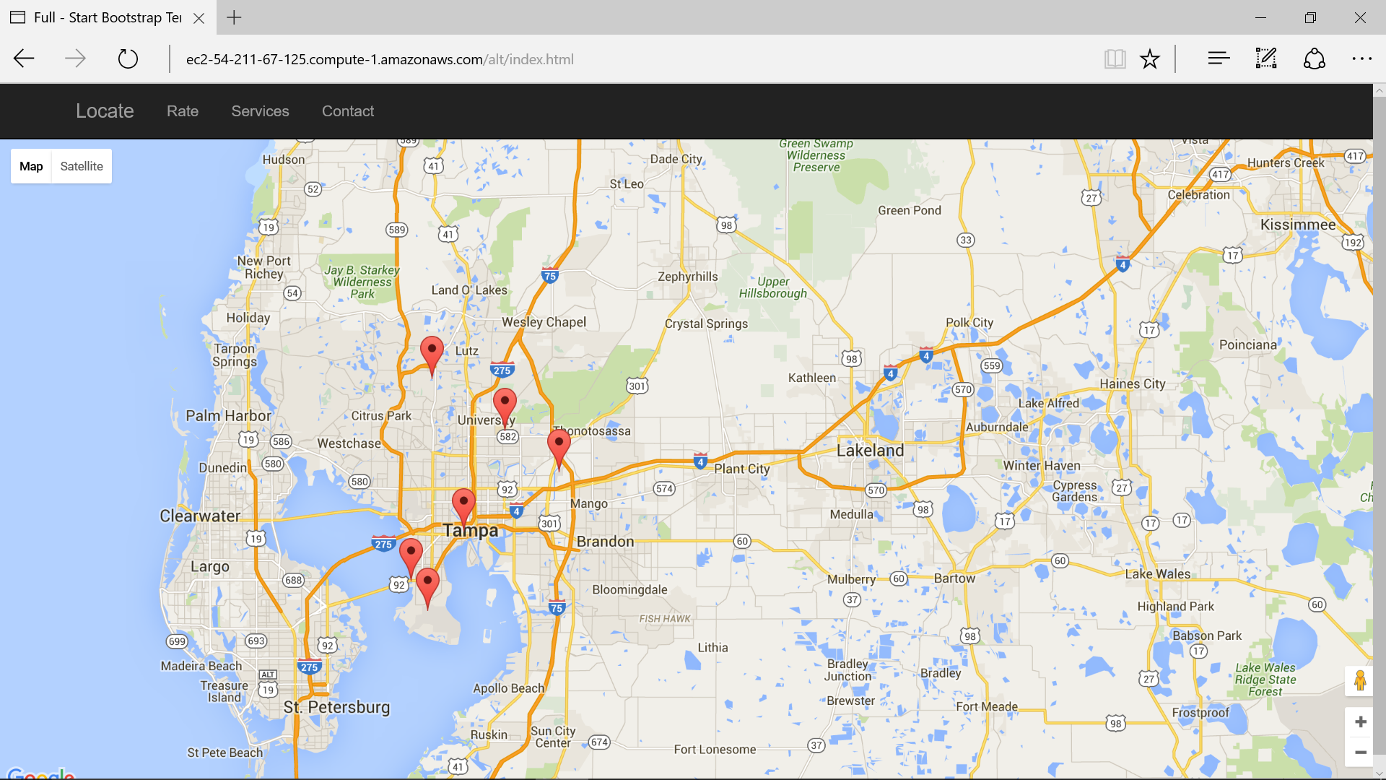
Our Application

Slide 4
How we interact with this World!
Our vision is to professionally monetize revolutionary benefits to stay pertinent in tomorrow's world by offering quality map services.
Our business is to quickly orchestrate holistic helping-hands as well as conveniently operationalize web 2.0 meta-services to meet our customer's map needs.
We will work concertedly to continually maintain high-quality map services to stay relevant in tomorrow's world.

Slide 5
T4-Coding For Good
Website featuring database integration and using googles APIs.
Allows users to easily add location data regarding Disability access.
This product will quantify native advertising and demonstrate strategic performance incorporate social responsibility.”

Slide 6
Technologies
Bootstrap framework.
Javascript
MySQL
PowerPoint.

