Slide 1
Overview
Display for nautical craft in fog/night conditions. Allows operator to navigate and avoid obstacles.
Features:
Navigation Display
Shortwave Infrared (SWIR) View
Dynamic Depth Readout
Synthetic Course Guidance
Known Obstacle Warnings (fixed obstacles, sea traffic)
GPS Moving Map
One-Touch Display Declutter Button
Night Vision-saving Red Foreground Display

Slide 2
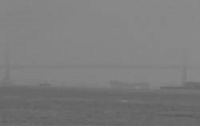

MAG CRS 121 MAG HDG 118 SPEED 3.4 KTS DEPTH 24 FT 14:51:20Z
ALL
ON/OFF
DISPLAY
IR
NAV
OFF
DEPTH
OFF
OBSTACLE
OFF
OVERLAY
OFF
*
*
*
*
*
*
*
*
*
*
*
*
*
*
*
*
MAP
OFF
Display
Brightness

Slide 3
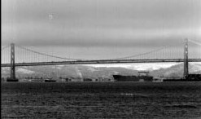
MAG CRS 121 MAG HDG 118 SPEED 3.4 KTS DEPTH 24 FT 14:51:20Z
ALL
OFF
DISPLAY
VISIBLE
NAV
OFF
DEPTH
OFF
OBSTACLE
OFF
OVERLAY
OFF
*
*
*
*
*
*
*
*
*
*
*
*
*
*
*
*
MAP
OFF
Display
Brightness

