Slide 1

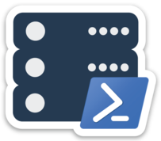
Simplifying XEvents Management with dbatools
Gianluca Sartori, MVP, DBA
Chrissy LeMaire, MVP, DBA

Slide 2


About Us
Chrissy LeMaire
PowerShell MVP
Creator of dbatools.io
Best Lightning Talk & Best Speaker - #SqlSatDublin
DBA with GDIT at NATO Spec Ops HQ
Gianluca Sartori
Data Platform MVP
Creator of XESmartTarget
Independent SQL Server consultant
DBA at Scuderia Ferrari

Slide 3
Agenda
Overview of Extended Events
Benefits & Challenges of Extended Events
Introduction to dbatools
Introduction to XESmartTarget
Demo!

Slide 4
XEvents Overview
Replacement for SQL Trace & Profiler
First introduced in 2008
Real replacement from version >= 2012
Lightweight event capture infrastructure
Deep inside SQLOS
Low performance overhead
Allows capturing events not available otherwise
Microsoft’s recommended way forward

Slide 5
What are XEvents good at?
Troubleshooting
What happened tonight at 03:40?
Tune performance
Which queries consume most resources?
Capacity Planning
How fast are my databases growing?
Baselining
Is the system behaving normally?
Alerting
Hey, look: something’s wrong here!

Slide 6
What are XEvents good at?
Works on SQL Azure
Nice and fast *
Erin Stellato says:
Creating multiple sessions that can be stopped and started as needed
Track causality
Write to multiple targets
You can now work with data in the SSMS
* Check out Jonathan Kehayias’s Measuring “Observer Overhead” of SQL Trace vs. Extended Events
dbatools.io/xeoverhead

Slide 7
So why do people keep using Traces / Profiler?
More straightforward (less complex) than Extended Events
Consistent interface for mixed environments
Faster to setup quick traces
“XEs are more efficient for the SQL Server engine, but not more efficient for the DBA”
Already have a library of Profiler templates
Ignorance of XML / Querying all the generated XML is outrageous
Templates work remotely across all instances
* Gathered from Erin Stellato’s Why do YOU avoid Extended Events?
dbatools.io/whyprofiler
Notes:
Can’t help you with the mixed environments, but we can help you migrate to newer ones!

Slide 8
So why do people keep using Traces / Profiler?
XEvents are persistent / must be stopped
Ability to import PerfMon data and look at Trace and PerfMon counter data at the same time
Consistent user experience across SSAS and Database Engine
Easy to train others
Replaying traces
MS Premier Support still asks for traces
xe_file_target_read_file is a CPU hog
* Gathered from Erin Stellato’s Why do YOU avoid Extended Events?
dbatools.io/whyprofiler
Notes:
Can’t help you with the mixed environments, but we can help you migrate to newer ones!

Slide 9
That’s a lot of valid reasons not to switch ☹
Notes:
Story time?

Slide 10
But what if we could make it less painful?
Notes:
You ever heard of dbatools?

Slide 11
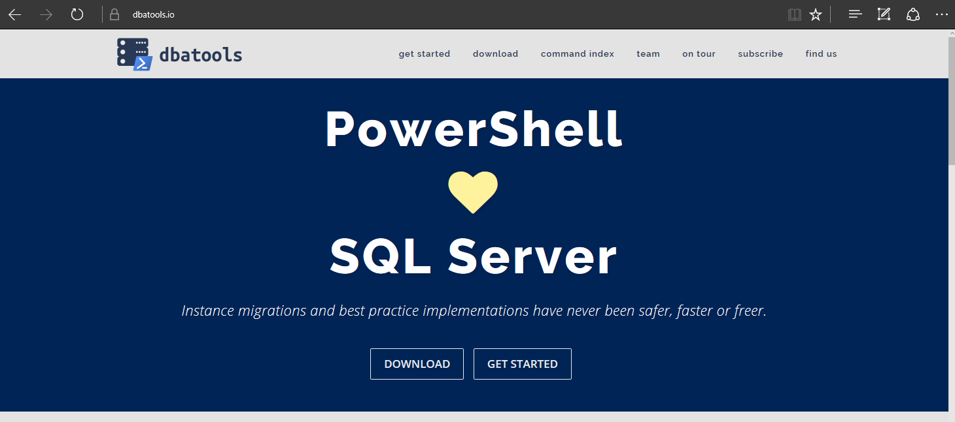
dbatools
Notes:
Can’t help you with the mixed environments, but we can help you migrate to newer ones!

Slide 12
Support
SQL Server 2000 – 2017 *
Express – Enterprise Edition
Clustered and stand-alone instances
Windows and SQL authentication
Default and named instances
Multiple instances on one server
Notes:
Can’t help you with the mixed environments, but we can help you migrate to newer ones!

Slide 13
Install
POWERSHELL GALLERY
Install-Module dbatools
Install-Module dbatools –Scope CurrentUser
WEBSITE
dbatools.io/download
Thanks, Microsoft for the SMO! 😁

Slide 14
How to Get-Help
Extensive documentation within each command
Get-Help Start-DbaMigration -Detailed
Extensive documentation on dbatools.io
dbatools.io/Test-DbaLastBackup dbatools.io/Set-DbaSpn
Some commands have videos
dbatools.io/youtube

Slide 15
XESmartTarget
Notes:
Story time?

Slide 16
XESmartTarget
Capabilities
Write event data to database tables
Alert via email
Write to CSV
Execute T-SQL
Replay
Extensible design (code your own responses)
Free and Open Source
github.com/spaghettidba/XESmartTarget
Can be included in your projects (it’s a library!)
Notes:
Provides a way to process Extended Events with no coding required

Slide 17
demo time! sqlps.io/xecode
Notes:
Complementary
No suitable template? Use SSMS to create New Sessions
Viewing Data
Show the torturous creation of a session
Don’t use wizard
Do you drop down to?
Do you generally use a subset?
How long did it take you to get comfortable with this interface?
Do you dread it?
Favorites?
Way more options
TALK THRU THE DEMO AFTER HE CREATES HIS SESSION

