Slide 1
Spark – A Quick Primer
Sujee Maniyam
sujee@elephantscale.com

Slide 2
Spark
Fast & Expressive Cluster computing engine
Compatible with Hadoop
Came out of Berkeley AMP Lab
Now Apache project
Version 1.1 just released (Sep 2014)

Slide 3
Comparison With Hadoop
Hadoop | Spark
Distributed Storage + Distributed Compute | Distributed Compute Only
MapReduce framework | Generalized computation
Usually data on disk (HDFS) | On disk / in memory
Not ideal for iterative work | Great at Iterative workloads (machine learning ..etc)
Batch process | - Upto 10x faster for data on disk - Upto 100x faster for data in memory
 | Compact code Java, Python, Scala supported
 | Shell for ad-hoc exploration

Slide 4
Spark Vs Hadoop
Spark is ‘easier’ than Hadoop
‘friendlier’ for data scientists
Interactive shell (adhoc exploration)
API supports multiple languages
Java, Scala, Python
Great for small (Gigs) to medium (100s of Gigs) data

Slide 5
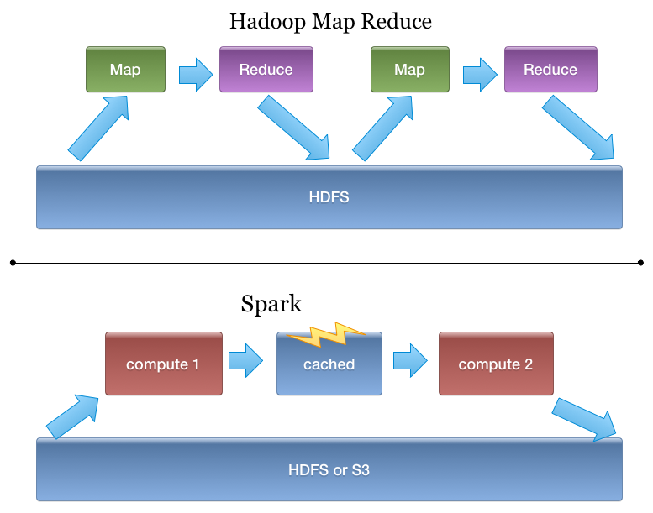
Spark Vs. Hadoop

Slide 6
Is Spark Replacing Hadoop?
Right now, Spark runs on Hadoop / YARN
Complimentary
Can be seen as generic MapReduce
Spark is really great if data fits in memory (few hundred gigs),
People are starting to use Spark as their only compute platform
Future ???

Slide 7
Hadoop + Yarn : Universal OS for Cluster Computing
Batch
(mapreduce)
Streaming
(storm, S4)
In-memory
(spark)
YARN
HDFS

Slide 8
Bit of History of Spark
Sep 2014 : v1.1
Sep 2012 : Spark 0.6
June 2013 : Apache incubator project
Feb 2014 : Apache Top Level Project
May 2014 : v1.0

Slide 9
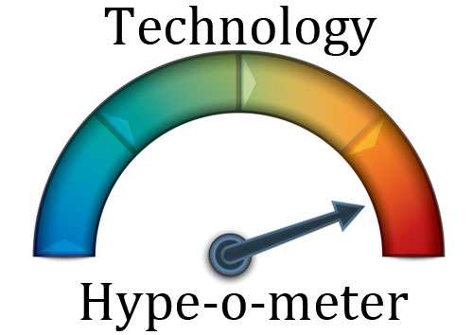
Hypo-meter ☺

Slide 10
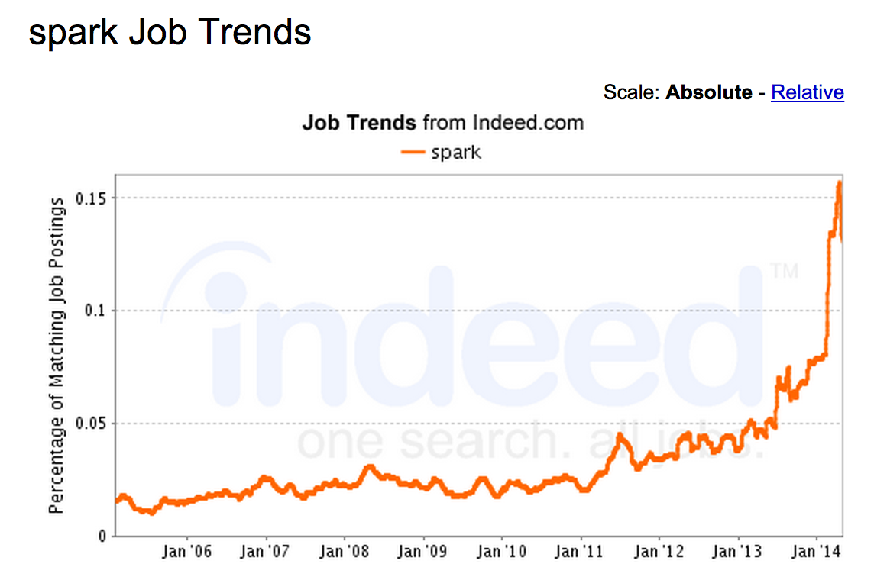
Spark Job Trends

Slide 11
Spark Eco-System
Schema / sql
Real Time
Machine Learning
Spark
SQL
Spark
Streaming
ML lib
Spark Core

Slide 12
Spark Core
Distributed compute engine
Handles compute
In case of node failures -> re-computes missing pieces

Slide 13
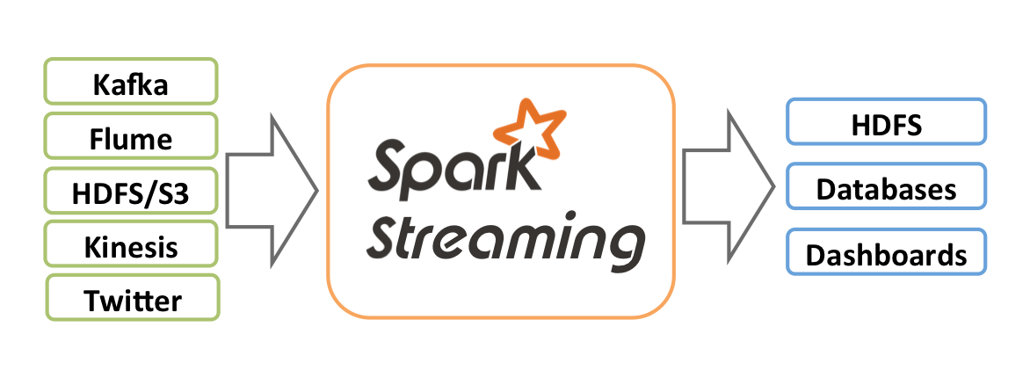
Spark Streaming
Process data streams in real time
Stock ticks / click streams …etc

Slide 14
Machine Learning (ML Lib)
Out of the box ML capabilities !
Lots of common algorithms are supported
Classification / Regressions
Linear models (linear R, logistic regression, SVM)
Decision trees
Collaborative filtering (recommendations)
K-Means clustering
…
More to come

Slide 15
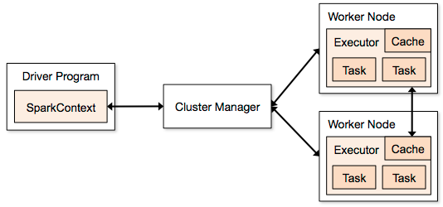
Spark Architecture
Node
Client
Standalone
Yarn
Mesos

Slide 16
Spark Architecture
Multiple ‘applications’ can run at the same time
Driver (or ‘main’) launches an application
Each application gets its own ‘executor’
Isolated (runs in different JVMs)
Also means data can not be shared across applications
Cluster Managers:
multiple cluster managers are supported
1) Standalone : simple to setup
2) YARN : on top of Hadoop
3) Mesos : General cluster manager (AMP lab)

Slide 17
Spark Data Model : RDD
Resilient Distributed Dataset (RDD)
Can live in
Memory (best case scenario)
Or on disk (FS, HDFS, S3 …etc)
Each RDD is split into multiple partitions
Partitions may live on different nodes
Partitions can be computed in parallel on different nodes

Slide 18
RDD : Loading
Use Spark context to load RDDs from disk / external storage
sc.textFile(“/data/input1.txt”) // single file
Sc.textFile(“/data/”) // load all files under dir
Sc.textFile(“/data/*.log”) // wild card matching

Slide 19
RDD Operations
Two kinds of operations on RDDs
1) Transformations
Create a new RDD from existing ones (e.g. Map)
2) Actions
E.g. Returns the results to clients (e.g. Reduce)
Transformations are lazy.. Actions force transformations

Slide 20
Transformations / Actions
RDD 1
RDD 2
RDD 3
Transformation 1
(map)
Client
Action1
(collect)

Slide 21
RDD Transformations
Transformation | Description | Example
filter | Filters through each record (aka grep) | f.filter( line => line.contains(“ERROR”))
union | Merges two RDDs | rdd1.union(rdd2)
…see docs …

Slide 22
RDD Actions
Action | Description | Example
count() | Counts all records in an rdd | f.count()
first() | Extract the first record | f.first ()
take(n) | Take first N lines | f.take(10)
collect() | Gathers all records for RDD. All data has to fit in memory of ONE machine (don’t use for big data sets) | f.collect()
…. See documentation ..

Slide 23
Partitions Explained
1G file
32M
32M
32M
32M
Task
Task
Task
Task
Result

Slide 24
RDD : Saving
saveAsTextFile () and saveAsSequenceFile()
f.saveAsTextFile(“/output/directory”) // a directory
Output usually is a directory
RDDs will be saved as multiple files in the dir
Each partition → one output file

Slide 25
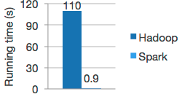
Caching of RDDs
RDDs can be loaded from disk and computed
Hadoop mapreduce model
Also RDDs can be cached in memory
Subsequent operations are much faster
f.persist() // on disk or memory
f.cache() // memory only
In memory RDDs are great for iterative workloads
Machine learning algorithms

Slide 26

Lab Time !

Slide 27
Lab : Running Spark (est : 15-30 mins)
Login to Spark node
Instructor will provide details
Update spark-labs $ cd ~/spark-labs $ git pull
Do the first lab : 1.1-intro $ cd ~/spark-labs $ cd 1.1-intro
follow the README.txt file use less or nano to read the file (less README.txt or nano README.txt)

Slide 28
Lab : Spark-shell (est : 30 mins)
Location : ~/spark-labs/1.2-shell follow README.txt

Slide 29
Lab : RDD (est 30 mins)
Location : spark-labs/1.3-rdd
Follow README.txt

Slide 30
Lab : RDD Caching (30 mins)
Location : spark-labs/1.3-rdd
Follow : cache.txt

Slide 31
Spark : map / flatMap
map() and flatMap()
One input → map() → one output ( 1 → 1 )
One input → flatap() → multiple elements ( 1 → N)

Slide 32
Map vs Flatmap Example
val input = Array ("hello world", "goodbye world", "bye bye”) val r = sc.makeRDD(input)
r.map(line => line.split(" ")).collect() // Array[Array[String]] = // Array(Array(hello, world), // Array(goodbye, world), // Array(bye, bye))
r.flatmap(line => line.split(“ “)).collect() // Array[String] = // Array(hello, world, goodbye, world, bye, bye)

Slide 33
Aggregate Functions
Function | Description | example
reduce() | Input 2, input 1 | Val sum = rdd.reduce((x,y) => x+ y)
reduceByKey() | Reduce for each key
Fold()
…

Slide 34
Word Count Example
val input = Array ("hello world", "goodbye world", "bye bye”) val r = sc.makeRDD(input)
val counts = r.flatMap(line => line.split(“ “)). map(word => (word, 1)). reduceByKey(_+_)

Slide 35

Thanks !
Sujee Maniyam
sujee@elephantscale.com
http://elephantscale.com
Expert consulting & training in Big Data

Slide 36
Credits
http://spark.apache.org/
http://www.strategictechplanning.com

