Slide 1
01 Spark Background

Slide 2
Spark
Fast & Expressive Cluster computing engine
Compatible with Hadoop
Came out of Berkeley AMP Lab
Now Apache project
Version 1.2 just released (Dec 2014)
“First Big Data platform to integrate batch, streaming and interactive computations in a unified framework” – stratio.com

Slide 3
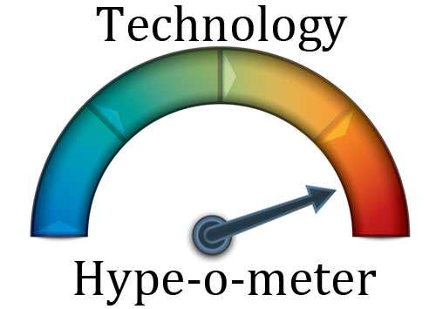
Hypo-meter ☺

Slide 4
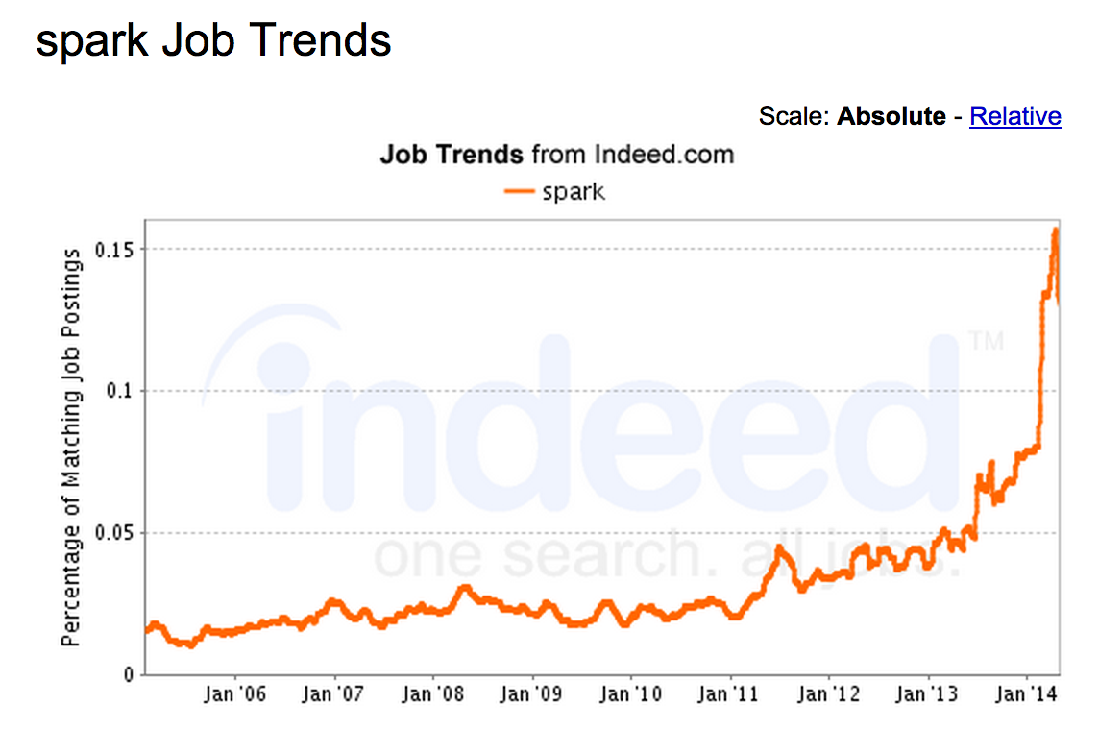
Spark Job Trends

Slide 5
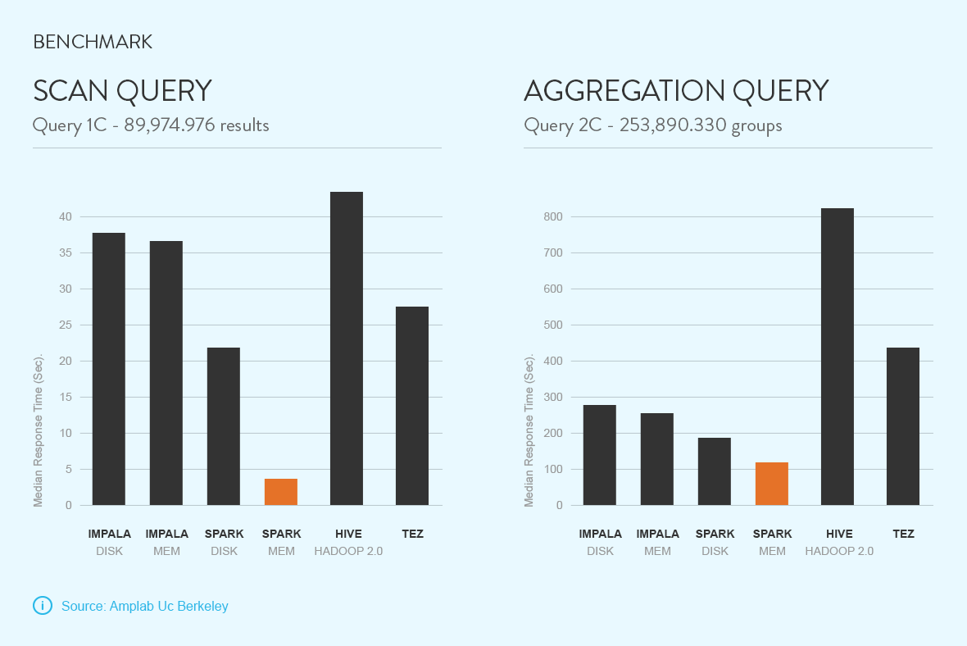
Benchmarks
Source : stratio.com

Slide 6
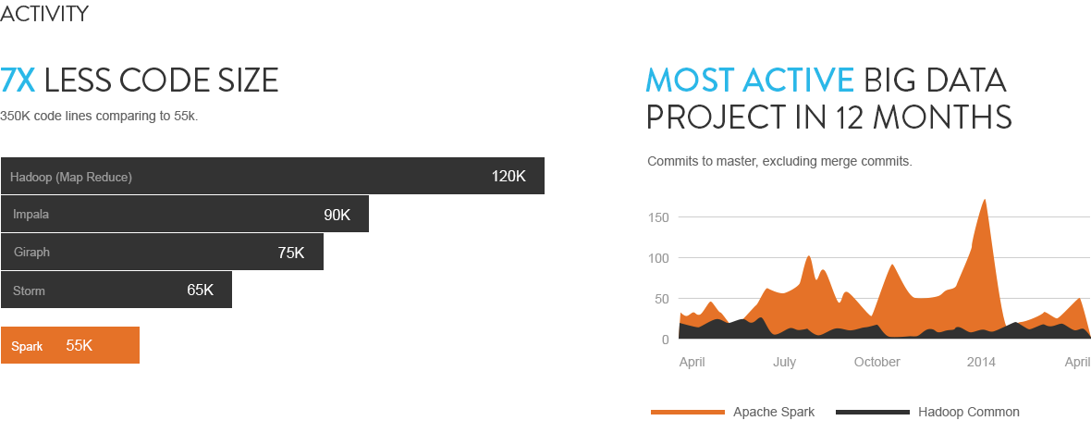
Code / Activity
Source : stratio.com

Slide 7
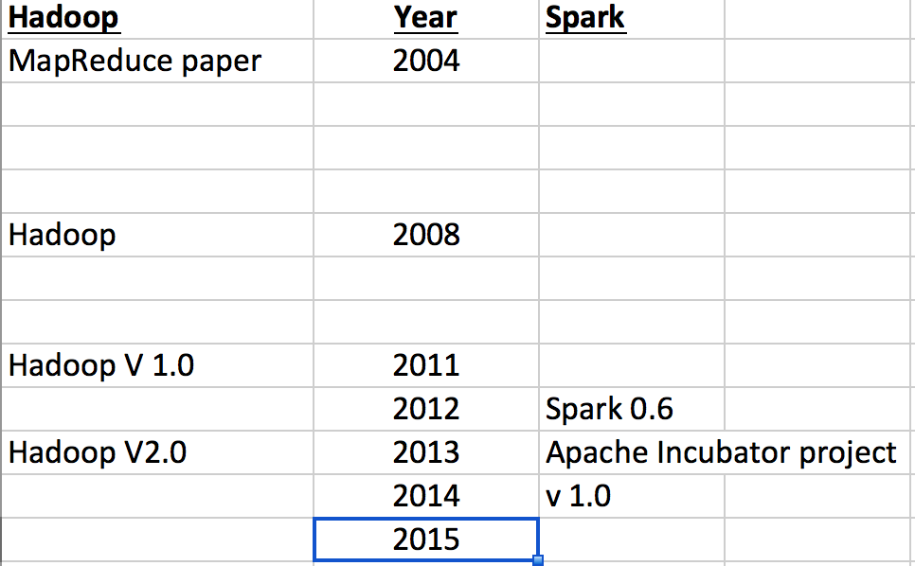
Timeline : Hadoop & Spark

Slide 8

Hadoop Vs. Spark
Spark
Hadoop
Source : http://www.kwigger.com/mit-skifte-til-mac/

Slide 9
Comparison With Hadoop
Hadoop | Spark
Distributed Storage + Distributed Compute | Distributed Compute Only
MapReduce framework | Generalized computation
Usually data on disk (HDFS) | On disk / in memory
Not ideal for iterative work | Great at Iterative workloads (machine learning ..etc)
Batch process | - Upto 2x - 10x faster for data on disk - Upto 100x faster for data in memory
 | Compact code Java, Python, Scala supported
 | Shell for ad-hoc exploration

Slide 10
Hadoop + Yarn : Universal OS for Distributed Compute
Batch
(mapreduce)
Streaming
(storm, S4)
In-memory
(spark)
Applications
YARN
Cluster
Management
HDFS
Storage
Notes:
Hadoop is evolving into a platform for other distributed applications

Slide 11
Spark Vs Hadoop
Spark is ‘easier’ than Hadoop
‘friendlier’ for data scientists / analysts
Interactive shell
fast development cycles
adhoc exploration
API supports multiple languages
Java, Scala, Python
Great for small (Gigs) to medium (100s of Gigs) data
Notes:
You can use python libraries for Machine learning ..etc

Slide 12
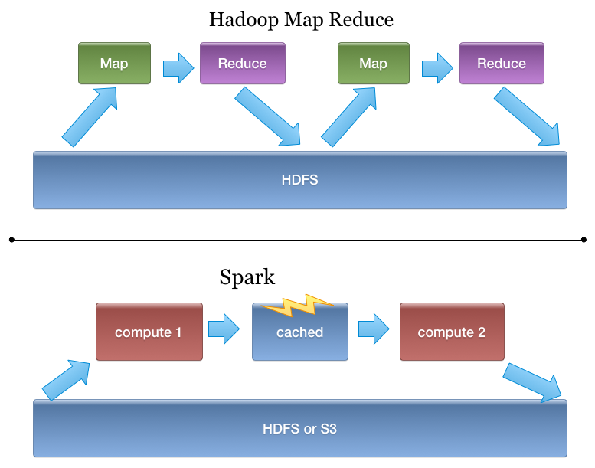
Spark Is Better Fit for Iterative Workloads
Notes:
In Hadoop data has to be persisted in HDFS between jobs
In Spark, it can be kept in memory

Slide 13
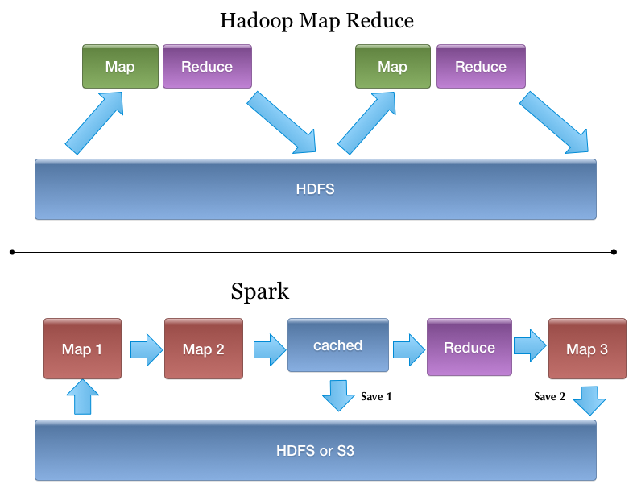
Spark Programming Model
More generic than MapReduce

Slide 14
Is Spark Replacing Hadoop?
Right now, Spark runs on Hadoop / YARN
Complimentary
Can be seen as generic MapReduce
Spark is really great if data fits in memory (few hundred gigs),
Spark is ‘storage agnostic’ (see next slide)

Slide 15
Spark & Pluggable Storage
Spark
(compute engine)
HDFS
Amazon S3
Cassandra
???
Notes:
Spark can work with lots of storage types

Slide 16


Hadoop & Spark Future ???

Slide 17
Spark : ‘Unified’ Stack
Spark supports multiple programming models
Map reduce style batch processing
Streaming / real time processing
Querying via SQL
Machine learning
All modules are tightly integrated
Facilitates rich applications
Spark can be only stack you need !
No need to run multiple clusters (Hadoop cluster, Storm cluster ..etc)

Slide 18
Spark & Competition
Use Case | Other | Spark
Batch processing | Hadoop’s MapReduce (Java, Pig, Hive) | Spark MR
SQL querying | Hadoop : Hive | Spark SQL
Stream Processing / Real Time processing | Storm Kafka | Spark Streaming
Machine Learning | Mahout | Spark ML Lib
Real time lookups | NoSQL (Hbase, Cassandra ..etc) | No Spark component. But Spark can query data in NoSQL stores

Slide 19
Migrating From Hadoop → Spark
Functionality | Hadoop | Spark
Distributed Storage | HDFS | Cloud storage like Amazon S3 Or NFS mounts
SQL querying | Hive | Spark SQL
ETL work flow | Pig | Spork : Pig on Spark Mix of Spark SQL ..etc
Notes:
It is possible to go from Hadoop to Spark
Consider the alternatives

Slide 20
‘One Ring to Rule Them All’
TODO : Insert picture from LOTR

Slide 21
Spark Eco System
Apache top level project
Databricks : supporting / developing spark
Hadoop Vendors (Cloudera / Horton Works)
Supporting Spark in their distributions
Community
Active, fast growing community
Spark packages Repository

Slide 22
Spark Packages
TODO

Slide 23
Next : Spark and Lambda Architecture

Slide 24
Lambda Architecture : A Quick Review
Came out of Twitter
Nathan Marz ..et al
‘Design Pattern’ for data infrastructure
In-corporates batch and real time components

Slide 25
Lambda Architecture
Todo insert diagram

Slide 26
Spark’s Place in a Lambda Architecture
Todo add diagram

Slide 27
Spark Use Cases
Data Scientist | Data Engineer
Ad hoc exploration Analyze data, build models Come up with ‘insights’ (recommendations ..etc) | Build data infrastructure (pipelines, processing ..etc) Productize ideas from Data Scientists (incorporate recommendation within online store)
Shells are great for ad-hoc analysis (Scala & Python) | Shells are good way to debug / test programs
Can re-use rich libraries in Scala / Java / Python | Can use already familiar languages
Interactive Development (not waiting minutes / hours for runs) | ditto
 | Unified stack (program within one stack)

Slide 28
Spark Use Cases
TODO :

Slide 29
Spark’s Scalability
Spark is fairly young compared to Hadoop
Scalability is work in progress in improving
Large spark cluster examples
TODO

Slide 30
Spark Operations
Spark Can be installed in two mediums
As part of Hadoop stack (Cloudera / Hortonworks)
Standalone
Stand-alone install is a bit ‘rough around the edges’
Monitoring solutions are slim
Sematext offerring
Need to improve:
Manageability (restarting failed nodes / processes)
Performance bottlenecks…etc

Slide 31
Next : Spark Use Cases

Slide 32
Spark Use Cases
Ooyala (video content)
Personalized video recommendations
Spark & Cassandra
Open sourced Spark Job Server (https://github.com/spark-jobserver/spark-jobserver)
http://engineering.ooyala.com/blog/fast-spark-queries-memory-datasets

Slide 33
Future of Spark
More work on scalability
More monitoring / debugging tools
Improvements on libraries (MLLib …etc)

Slide 34
Thanks! Questions ?

