Slide 1
02 Spark Introduction

Slide 2
Spark Eco-System
Schema / sql
Real Time
Machine Learning
Graph processing
Spark
SQL
Spark
Streaming
ML lib
GraphX
Spark Core
Cluster
managers
Stand alone
YARN
MESOS

Slide 3
Spark Core
Distributed compute engine
Task schedulers
Memory management
Fault recovery In case of node failures -> re-computes missing pieces
Interfacing with multiple storage systems

Slide 4
Spark SQL
Adhoc / interactive analytics
ETL workflow
Reporting
Supports HiveQL (Hive Query Language : A subset of SQL)
Natively understands
CSV : “mark, 40, M”
JSON : {“name”: “mark”, “age”: 40}
Parquet : on disk columnar format, heavily compressed
Replaces Shark (earlier SQL engine on Spark)

Slide 5
Spark SQL : Quick Example
{"name":"mark", "age":50, "sex":"M"},
{"name":"mary", "age":45, "sex":"F"},
{"name":"brian", "age":15, "sex":"M"},
{"name":"nancy", "age":17, "sex":"F"}
// … setup …
val teenagers = sqlContext.sql("SELECT name FROM people WHERE age >= 13 AND age <= 19")
[brian, nancy]

Slide 6
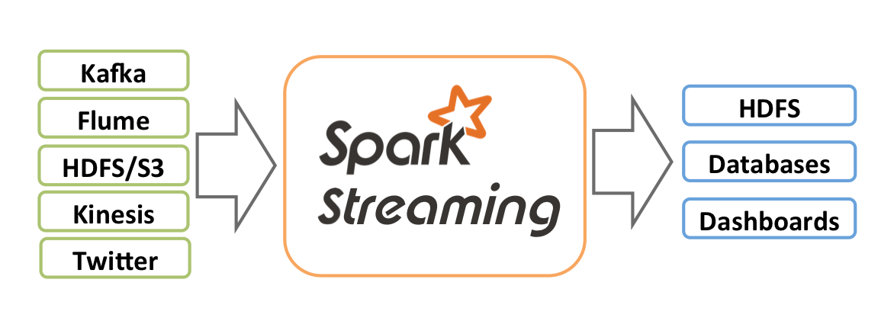
Spark Streaming
Process data streams in real time, in micro-batches
Low latency, high throughput (1000s events / sec)
Stock ticks / sensor data (connected devices / IoT – Internet of Things)
Streaming Sources
Storage

Slide 7
Machine Learning (ML Lib)
Machine learning at scale
TODO : insert diagram of HAL
Out of the box ML capabilities !
Java / Scala / Python language support
Lots of common algorithms are supported
Classification / Regressions
Linear models (linear R, logistic regression, SVM)
Decision trees
Collaborative filtering (recommendations)
K-Means clustering
More to come

Slide 8
Graphx
Graphs are every where
Facebook connections
Linked-In : ‘people you may know’
..etc
TODO : insert screen shots Kevin Bacon 6 degree seperation

Slide 9
GraphX
GraphX is a library for doing graph processing on Spark
Supported Algorithms
Page rank (Google’s)
Distance calculation
…etc

Slide 10
Cluster Managers
Spark can run on…
1) standalone
2) Hadoop YARN
3) Mesos
Standalone : if we just need Spark
Need a distributed data storage
Amazon S3 , NFS …etc
YARN : Already have Hadoop
Deploy spark on YARN
HDFS serves as data layer

Slide 11
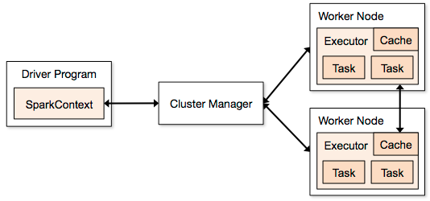
Spark Architecture
Node
Client
Standalone
Yarn
Mesos

Slide 12
Spark Architecture
Multiple ‘applications’ can run at the same time
Driver (or ‘main’) launches an application
Each application gets its own ‘executor’
Isolated (runs in different JVMs)
Also means data can not be shared across applications
Cluster Managers:
multiple cluster managers are supported
1) Standalone : simple to setup
2) YARN : on top of Hadoop
3) Mesos : General cluster manager (AMP lab)

Slide 13

Lab Time !

Slide 14
Lab : First Look at Spark (15 mins)
Login to your Spark nodes Instructor will provide details
Update the labs:
$ cd ~/spark-labs $ git pull
$ cd 1.1-intro follow README.txt file use less or nano to read the file (less README.txt or nano README.txt)

Slide 15
Spark Shell
Handy tool for ad-hoc queries
Two flavors
Python : bin/pyspark
Scala : bin/spark-shell
Shell can run in two modes
Psuedo mode : will run an embedded spark server within the same process
Remote cluster : can connect to a remote spark cluster

Slide 16
Spark Shell Execution Modes
Spark local server
shell
Spark node
Spark node
Spark master
shell
Spark node
Spark node

Slide 17
Lab : Spark Shell (15 mins)
Java / Scala users : 1.2-shell/scala.txt
Python users : 1.2-shell / python.txt (TODO)

Slide 18
Spark Data Model : RDD (Resilient Distributed Datasets)
Immutable : can not be changed
Each RDD is split into multiple partitions
Partitions may live on different nodes
Partitions can be computed in parallel on different nodes
Can live in
Memory (best case scenario)
Or on disk (FS, HDFS, S3 …etc)
RDDs have ‘lineage’ (rdd1 → rdd2 → rdd3)
Fault tolerant : if a partition is lost (node crash) it is re-computed

Slide 19
RDD Operations
Two kinds of operations on RDDs
1) Transformations
Create a new RDD from existing ones (e.g. Map)
2) Actions
E.g. Returns the results to clients (e.g. Reduce)
Transformations are lazy.. Actions force transformations
Transformations create a new RDD (original RDD is not modified, immutable!)

Slide 20
Transformations / Actions
RDD 1
RDD 2
RDD 3
Transformation 1
(map)
Client
Action1
(collect)

Slide 21
Transformations / Actions
Transformations
Actions
New RDD
[1,2,3, 3]
Map (square)
[1,4,9, 9]
[1,2,3, 3]
distinct
[1,2,3]
[1,2,3, 3]
take(2)
[1,2]

Slide 22
RDD Transformations
RDD = {1,2,3,3}
Transformation | Description | Example | Result
Map(func) | apply func to each element in RDD | r.map(x => x*2) | {2,4,6,6}
Filter(func) | Filters through each element when func is true (aka grep) | r.filter( x=> x % 2 == 1) | {1,3,3}
Distinct | Removes dupes | r.distinct() | {1,2,3}
Flatmap | Like map, but can output more than one result per element
mapPartitions | Like map, but runs on the whole partition not on each element

Slide 23
RDD Transformations
RDD1 = {1,2,3,3}
RDD2 = {2,4}
Transformation | Description | Example | Result
Union | Merges two RDDs (duplicates are kept) | r1.union(r2) | {1,2,3,3,2,4}
Intersection | Returns common elements in two RDDs | r1.intersect(r2) | {2}
Subtract | Takes away elements from one | r1.subtract(r2) | {1,3,3}
Sample | Take a small sample from RDD

Slide 24
RDD Actions
RDD = {1,2,3,3}
Action | Description | Example | Result
count() | Counts all records in an rdd | f.count() | 4
first() | Extract the first record | f.first () | 1
take(n) | Take first N lines | f.take(3) | {1,2,3}
collect() | Gathers all records for RDD. All data has to fit in memory of ONE machine (don’t use for big data sets) | f.collect() | {1,2,3,3}
…. See documentation ..

Slide 25
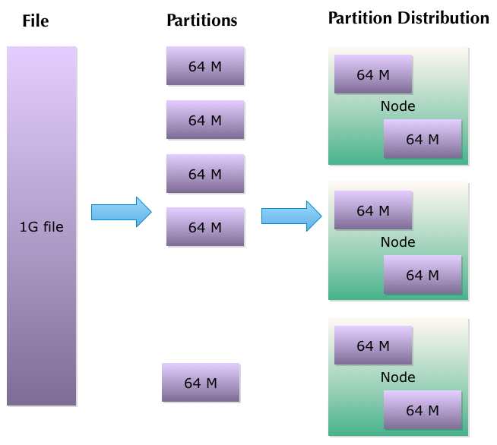
RDD Partitions
Partitions are distributed

Slide 26
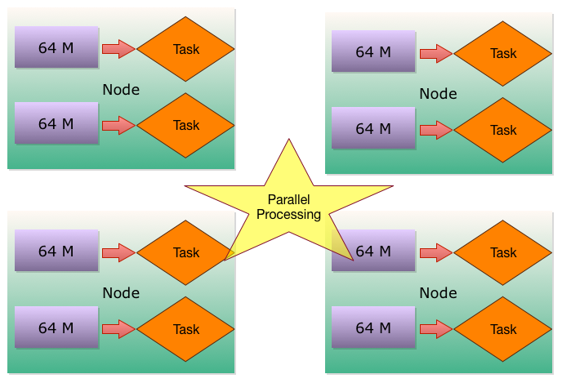
RDD Partitions & Parallel Processing

Slide 27
Creating RDDs
Method 1) Create from a collection val r = sc.parallelize (List(1,2,3,3)) ➔ r: org.apache.spark.rdd.RDD[Int] = ParallelCollectionRDD[8]
Method 2) Use Spark context to load RDDs from disk / external storage val r1 = sc.textFile(“/data/input1.txt”) // single file val r2 = sc.textFile(“/data/”) // load all files in dir

Slide 28
RDD : Saving
rdd.saveAsTextFile () and
rdd.saveAsSequenceFile()
f.saveAsTextFile(“/output/directory”) // a directory
Output usually is a directory
RDDs will be saved as multiple files in the dir
Each partition → one output file

Slide 29
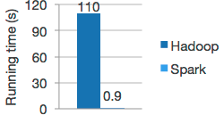
Caching of RDDs
RDDs can be loaded from disk and computed
Hadoop mapreduce model
Also RDDs can be cached in memory
Subsequent operations are much faster
f.persist(options) // on disk or memory
f.cache() // memory only
In memory RDDs are great for iterative workloads
Machine learning algorithms

Slide 30
Lab : RDD Basics (30 mins)
1.3-rdd / rdd1-scala.txt or 1.3-rdd / rdd1-python.txt

Slide 31
Lab : RDD Caching ( 30 mins)
1.3-rdd / caching.txt

Slide 32
Next : Map Reduce
Quick Map Reduce Primer
MapReduce in Spark

Slide 33
Introducing MapReduce
MapReduce is a programming ‘paradigm’
Popularized by Google MapReduce paper
Basically provides distributed computing
Hadoop uses MapReduce as it’s processing / compute framework
Map Reduce is a batch process
Not designed for real time queries

Slide 34
Parallel Computing / HPC - Before Hadoop Days
Data is copied to compute cloud
After the processing data is written back
OK for small / medium data, Not for ‘Big Data’
Compute Cloud
Storage Cloud

Slide 35
Map Reduce Thinking
Data ‘stays put’
‘code is moved to data’
‘Data Node’ also doubles as ‘Compute Node’
Data locality → massive scale
node
node
Storage
Storage
Compute
Compute

Slide 36
Parallel Computing With Map Reduce
Writing distributed computing programs from scratch is way too complicated
Challenges:
Distributing code
Distributing work load
Running computes in parallel
Collecting results from multiple workers
Handle failures
MapReduce provides a nice / easy to use framework to write distributed code.

Slide 37
Thinking in Map Reduce : Vote Count (see next slide for diagram)
Imagine we want to do a poll Want to find how people in 20s, 30s and 40s voted
Map Reduce method:
Step 1) Sort people into appropriateage group
➔ mappers
Now process each group
➔ reducer

Slide 38
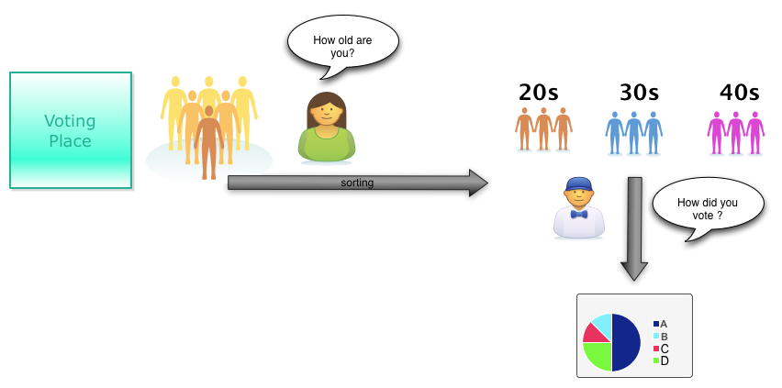
Thinking in Map Reduce : Vote Count
Notes:
All mapper do is sort them into right age groups
Reducer can process each group independently → parallelism
Map phase can be paralleled too

Slide 39
Map Reduce Principles
Jobs are executed in parallel
one job → multiple tasks
Each task is independent
They can not communicate with each other
Input is split into chunks / partitions ➔ parallelism
MR handles failures
MR jobs have to be side-effects free
e.g. incrementing a counter in database is NOT side-effect free

Slide 40
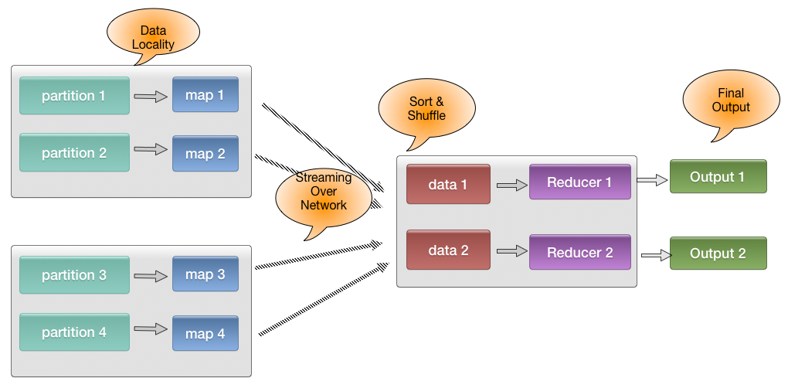
Map Reduce Data Flow

Slide 41
MapReduce In Spark
MapReduce was popularized by Hadoop framework
Spark also has built in Map Reduce
Spark Core handles shuffle / sort
Spark’s MR implementation is more efficient than Hadoop’s
2x – 10x performance on certain work loads
Spark can process in-memory data via MapReduce as well
→ super fast (upto 100x)!

Slide 42
MapReduce In Spark / Hadoop
MR Tool | Hadoop | Spark
Native | Java MapReduce | Java / Scala / Python
Hive | Define schemas and query using SQL | Spark SQL can query any Hive table
Pig | High level data flow language (Pig Latin). Creates MR code | Pig can run on Spark via Spork

Slide 43
MapReduce Functions : map / flatMap
One input → map() → one output ( 1 → 1 )
One input → flatap() → multiple elements ( 1 → N)
Input is a line : “twinkle twinkle little star” “How I wonder what you are”
map(line -> line.length) “twinkle twinkle little star” ➔ 27 “How I wonder what you are” ➔ 25
1 – 1 mapping

Slide 44
Map / FlatMap
Input is a line : “twinkle twinkle little star” “How I wonder what you are”
flatMap(line -> line.split(“,”)) “twinkle twinkle little star” ➔ [twinkle, twinkle, little , star ]
“How I wonder what you are” ➔ [how, I , wonder, what, you , are ]
1 – many mapping

Slide 45
Map vs Flatmap Example
val input = Array ("hello world", "goodbye world", "bye bye”) val r = sc.makeRDD(input)
r.map(line => line.split(" ")).collect() // Array[Array[String]] = // Array(Array(hello, world), // Array(goodbye, world), // Array(bye, bye))
r.flatmap(line => line.split(“ “)).collect() // Array[String] = // Array(hello, world, goodbye, world, bye, bye)
Array of arrays of strings !
Array of strings

Slide 46
Aggregate Functions
Function | Description | example
reduce() | 2 inputs → 1 output | Val sum = rdd.reduce((x,y) => x+ y)
reduceByKey() | Reduce for each key
Fold()
…

Slide 47
Word Count Example
val input = Array ("hello world", "goodbye world", "bye bye”) val r = sc.makeRDD(input)
val counts = r.flatMap(line => line.split(“ “)). map(word => (word, 1)). reduceByKey(_+_)
// TODO : paste output

Slide 48
Spark MapReduce Vs. Hadoop MapReduce
In Hadoop Map phase is always followed by Reduce phase
So the work flow is M → R ➔ M → R ➔ M → R
In Spark, we can stack as many mappers / reducers we want M → M → M → R → R
Spark MR is more versatile

Slide 49
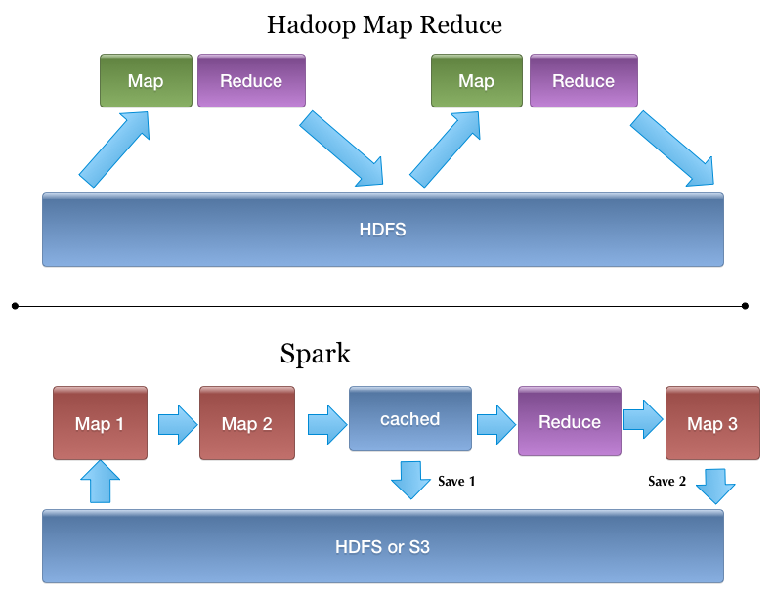
Spark MapReduce Vs. Hadoop MapReduce

Slide 50
Spark Map Reduce Internals
Task is a mapper or reducer

Slide 51
Review Questions

Slide 52
Lab : MapReduce Intro (15 mins)
1.4-mapreduce / README.txt

Slide 53
Lab : Clickstream Analysis (1.5 hrs)
1.4-mapreduce/clickstream.txt

Slide 54
Thanks! & Questions !

Slide 55
Credits
http://spark.apache.org/
http://www.strategictechplanning.com

