Slide 1
Introduction to MLlib

Slide 2
Spark Eco-System
Schema / sql
Real Time
Machine Learning
Graph processing
Spark
SQL
Spark
Streaming
ML lib
GraphX
Spark Core
Cluster
managers
Stand alone
YARN
MESOS

Slide 3
Machine Learning (ML Lib)
Machine learning at scale
Out of the box ML capabilities !
Java / Scala / Python language support
Lots of common algorithms are supported
Classification / Regressions
Linear models (linear R, logistic regression, SVM)
Decision trees
Collaborative filtering (recommendations)
K-Means clustering
More to come

Slide 4
Mllib History Timeline
0.8: MLLib Introduced (2013-03)
Recommendations (ALS)
Clustering (K-Means)
Prediction (Regression, Classification)
0.9 Version Released (2014-02)
Python support for MLlib
1.0 Version Released (2014-05)
Decision Tree learning
Sparse Vector support
SVD Dimensionality Reduction

Slide 5
MLlib History Timeline
1.1 Released (2014-09)
Basic Statistics Package
Text Feature Extraction (TFIDF, Word2Vec)
Normalization/Scaling
1.2 Released (2014-12)
New Pipeline API introduced for Mllib
Support for DataFrame extraction
Ensemble Decision Tree Learning (Random Forest, GBTs)
1.3 Released (2015-03)
New Clustering: LDA (topic discovery), GMM (Gaussian), power iteration clustering,
Classification: Multinomial Logistic Regression
Pattern Mining: FP-Growth
Model Import/Export: PMML

Slide 6
About Machine Learning
What is Machine Learning?
It is an algorithm that “learns” from data
Any algorithm which improves its performance by access to data.
Machine Learning borrows from applied statistics
Also considered a branch of AI (Artificial Intelligence).

Slide 7
Types of Machine Learning
Supervised Machine Learning:
A model is “trained” with human labeled training data.
Model then tested on other training data to see performance
Model can then be applied to unknown data.
Classification & regression usually supervised.
Unsupervised Machine Learning
Model tries to find natural patterns in the data.
No human input except parameters of the model.
Example: Clustering
Semi-Supervised Learning
Model is trained with a training set which contains mix of trained and untrained data

Slide 8
Supervised Machine Learning
Input Data is split into “training” and “test” data, both labelled.
In MLlib, use the LabeledPoint class.
If not pre-split, then do a random split.
A Model is trained using training data
Prediction is made using model.predict()
Model can be tested using comparing the test dataset
Mean Squared Error: mean(predicted – actual)

Slide 9
Supervised Machine Learning

Slide 10
Creating Feature Vectors: Feature Extraction
Machine Learning only works with vectors. Feature Vectors are an n-dimensional point in space.
Select variables from data
Turn data into numbers (doubles).
“normalize” (scale down) high magnitude data.

Slide 11
Vectors: Dense versus Sparse
Dense Vectors
Usually have a nonzero value for each variable
The “telecom churn” dataset we use in the labs is a dense dataset.
Use Vectors.dense
Sparse Vectors
Most values are zero (or nonexistent)
Text Data yields sparse vectors
One-Hot, factor variables lead to sparse vectors
Use Vectors.sparse

Slide 12
Creating Vectors
Dense Vectors with Labels (for classification)
val data = sc.textFile(“yourfile.csv")
val splitData = data.map { s =>
val parts = s.split(',').map(_.toDouble);
LabeledPoint(if (parts(0)==1) 1.0 else 0.0, Vectors.dense(parts))
}

Slide 13
What if your variable isn’t numeric?
In MLlib, it has to be numeric (a double)
What if it’s a factor variable (e.g., color = red, green blue)?
One-Hot encoding (is_red, is_green, is_blue) – only works if there’s a limited number of possible values
Quantize the data. (e.g., red = 450THz, green=550THz, blue=650THz)

Slide 14
Creating Vectors From Text
How to create vectors from text?
TF/IDF: Term Frequency Inverse Document Frequency
This essentially means the frequency of a term divided by its frequency in the larger group of documents (the “corpus”)
Each word in the corpus is then a “dimension” – you would have thousands of dimensions.
Word2Vec
Another vectorization algorithm.

Slide 15
TF/IDF in MLlib
TF/IDF can be implemented like this (in Scala):
We can “prune” uncommon terms using minDocFreq
val hashingTF = new HashingTF()
val tf: RDD[Vector] = hashingTF.transform(documents)
// TF can be used by itself, or to get TF/IDF continue:
tf.cache()
val idf = new IDF(minDocFreq = 2).fit(tf)
val tfidf: RDD[Vector] = idf.transform(tf)

Slide 16
Preparing Text
Normally, very common words like “the,” “of”, or “and” are removed – these are called stop words.
Words are usually “stemmed” down to their root – we use a package called “snowball” to accomplish this.
We also clean up text, removing numbers, punctuation, and superflous whitespace.
At the end, we have a dictionary of words, and for each document we have each of the terms as a vector dimension.

Slide 17
Next : Clustering

Slide 18
What is Clustering?
Clustering finds natural groupings in data.
Humans naturally cluster data we encounter.
Categorizing, organizing, etc.
Our brains seek patterns
Why do we cluster?
To understand our data
To find “more like this.”

Slide 19
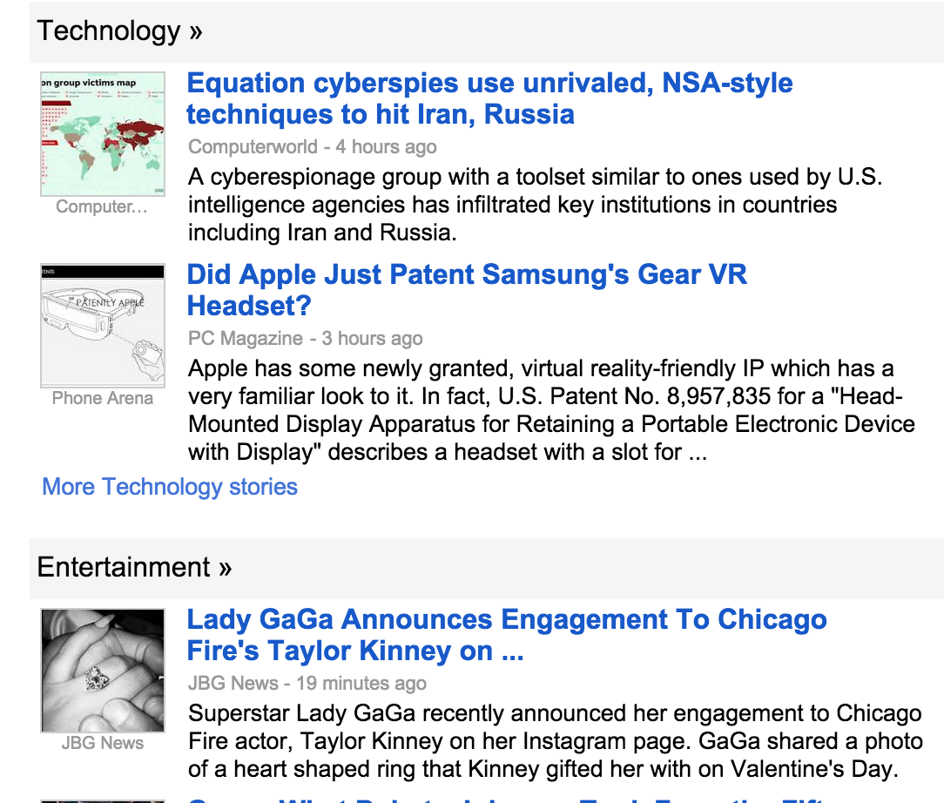
Clustering Applications
News
Classification

Slide 20
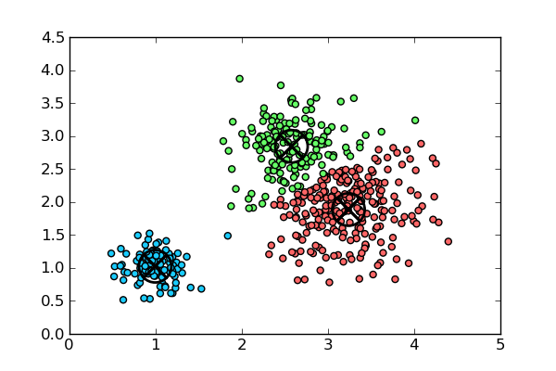
Clustering Vectors
There are many different clustering algorithms for vectors.
Simplest is k-means
K-means requires a known value of k (number of clusters) to start with.

Slide 21
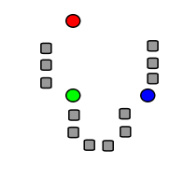
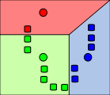
K-Means Clustering
K-Means: Simplest Clustering Algorithm.
Step 1: k numbers of points (centroids) are pre-seeded in the data. Example: 3 centroids (red/green/blue)
Step 2 : Each point in the dataset is associated with its nearest centroid, as determined by a distance measurement.

Slide 22
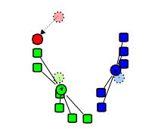
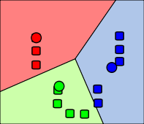
K-Means Clustering
Step 3: The centroid (geometric center) of the clustered points becomes the new centroid of that cluster. Each centroid is updated.
Step 4 : Repeat Steps 2 and 3 until convergence is reached (the points move less than the threshold amount).

Slide 23
K-Means Distance Measurements
Ways to Determine Distance
Euclidian distance – (most obvious) Euclidian, which takes the distance in Euclidian space
Cosine Distance – cosine of angle between vectors – ignores magnitude
Manhattan distance: Effectively counts the number of square blocks one would “walk” to get there without cutting corners.
Tanimoto distance Take both angle and magnitude into account.
Most algorithms attempt to balance the
Magnitude
Angle

Slide 24
K-Means Clustering Summary
K-Means is simple
Well-Understood.
Easy to Parallelize
Disadvantages are that:
Value of k must be known in advance – which may mean running the exercise many times to get optimum results.
Initial centroid positions are important; may cause long convergence.
Dense groupings of points are not especially considered
Outliers may bias results.
Clusters not broadly (hyper)spherical don’t work well for k-means.
Use hierarchical clustering for these situations.

Slide 25
K-Means in MLlib
Mllib has good support for k-means
How to perform k-means clustering in MlLib
Convert data into Vectors
Perform clustering with a specified number of iterations
Evaluate the “fit” of the cluster. Is it a good run?
If not, change the number of clusters (value of k).
Once we have a good clustering run:
Map each vector to its nearest cluster.
Group original data by its corresponding cluster.
Assign (predict) new vectors to their nearest cluster.

Slide 26
Creating Vectors for k-means in MLlib
The first step in MLlib is to turn the data into a vector.
Choose from dense or sparse depending on data.
Example: one-hot encoding – use sparse.
You need numeric vectors, so convert strings to doubles.
use .map.toDouble
Once you have an array of doubles, pass it to Vector.dense or Vector.sparse.

Slide 27
K-Means in MLlib
MLlib has a built-in function called kmeans, which performs the k-means clustering.
import org.apache.spark.mllib.clustering.KMeans
Default values: just provide KMeans(df, value-of-k)
KMeansModel clusters = KMeans.train(vectors, numClusters, numIterations)
How many iterations should you have?
“It depends”.. Too low and you might get bad results.
Too many and you waste time
Try 10-20
What if you don’t know the value of k?
Iterate, Iterate, Iterate. But how do you know if the results are good?

Slide 28
Evaluating Cluster Performance
WSSSE: Within Set Sum of Squared Errors
Double WSSSSE = clusters.computeCost(RDD<Vector>)
COST = sum of squared distances of points to cluster center.
What does this mean?
WSSSE will increase with increasing values of k.
“Law of Diminishing Returns”
High values of k give marginal gain.
We can iterate across k until we get good results.

Slide 29
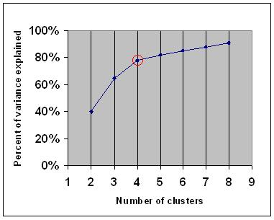
The Elbow Method
Identify the “elbow” on the curve
Example: What value of K to select in this case?

Slide 30
Using KMeansModel
How to apply the model to data?
Use predict:
KMeansModel.predict(Vector)
int clusterId = model.predict(Vector.dense())
RDD<int> = model.predict(RDD<Vector>)
Predict returns an integer
Cluster number, i.e., 0, 1, 2, 3… (k-1).

Slide 31
Relating Original Data to Clustered Data
MLLib clusters vectors, not the original data.
Vectors have no id or name property in MLLib,
Unlike Mahout’s NamedVector class
Relate Vectors to Data by creating an RDD of tuples
NamesAndData as RDD (name, Vector.dense)
Use groupBy to relate one to the other
val groupedClusters = NamesandData.groupBy{rdd => clusters.predict(rdd._2)}.collect()

Slide 32
Handling New Data
New Data be assigned on the existing model:
Make a Vector out of the new Data
Vectors.Dense(oldData)
Call KMeansModel.predict(vector), to get cluster membership as a number (integer)
The new data will not affect the existing cluster locations.

Slide 33
Clustering Lab
Mtcars dataset: data about car models.
location : mllib/kmeans
Try out the solution line-by-line

Slide 34
Streaming K-Means
How to use K-Means with Spark Streaming?
Ordinary K-means will cause centroids to converge.
New Data will not change centroids much.
We really want to take advantage of incoming data
Make algorithm “forgetful” of older data.
New Parameter: DecayFactor (how quickly to “forget”)
New Parameter: NumDimensions (must specify number of dimensions in advance – haven’t seen data yet).

Slide 35
Streaming Kmeans in MLlib
Scala code for StreamingKMeans:
val model = new StreamingKMeans()
.setK(numClusters)
.setDecayFactor(1.0)
.setRandomCenters(numDimensions, 0.0)
model.trainOn(trainingData)
model.predictOnValues(testData.map(lp => (lp.label, lp.features))).print()
ssc.start()
ssc.awaitTermination()

Slide 36
Topic Discovery (Latent Dirichlet Allocation)
Topic Discovery = finding topics based on Document terms.
Example: Twitter
What are the topics of a group of tweets
This is a type of clustering.
Each topic identified by top-N terms
To prepare, first vectorize text using TF. (not TF/IDF).
val hashingTF = new HashingTF()
val tf: RDD[Vector] = hashingTF.transform(documents)

Slide 37
LDA
We can build a topic discovery model from the TF Vectors
val corpus = parsedData.zipWithIndex.map(_.swap)
val ldaModel = new LDA().setK(3).run(corpus)
Retrieving the topics from the model.
val topics = ldaModel.topicsMatrix
for (topic <- Range(0, 3)) {
print("Topic " + topic + ":")
for (word <- Range(0, ldaModel.vocabSize)) { print(" " + topics(word, topic)); }
println()
}

Slide 38
LDA Example
Topic 1 Term | Topic 1 Weight | Topic 2 Term | Topic 2 Weight | Topic 3 Term | Topic 3 Weight
football | 0.020 | obama | 0.021 | dow | 0.019
quarterback | 0.018 | president | 0.019 | stock | 0.018
team | 0.015 | speech | 0.015 | index | 0.015
nfl | 0.013 | bill | 0.014 | market | 0.013

Slide 39
Next : Recommendations

Slide 40
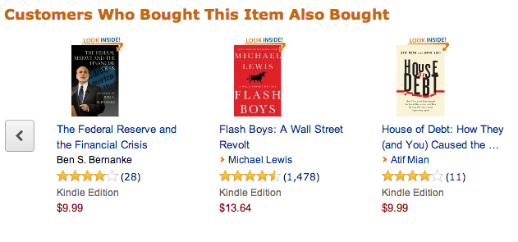
Recommendations Are Everywhere : Amazon

Slide 41





Recommended : Amazon Prime

Slide 42
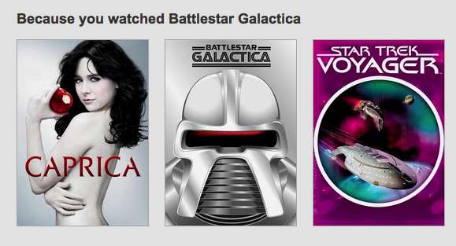
Recommendations From Netflix (With Profiles)

Slide 43
Recommendations
Recommendations are a straightforward application of the Collaborative Filtering algorithm.
Collaborative filtering relates set A to set B.
Variables in set A are given a similarity metric based on expressed relations with set B.
We can then make guess that relations between individual members of set A can be predicted by those similar.
Recommendations
Let’s call set A: users and set B: items (as this is the most obvious application of CF.
We recommend items to users based on users’ expressed preferences.

Slide 44
Collaborative Filtering
Collaborative Filtering (CF) is commonly used in Recommendations “Recommended For You” or “More Like This” functionality
Recommendations can be explicit (based on user ratings), or implicit (based on user interest)
CF is expressed as Users -> Items
However, any correlation could be modeled as users to items.
Users and Items could be the same (example: dating site)

Slide 45
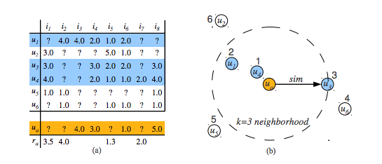
Ratings Matrix : Users / Movies

Slide 46
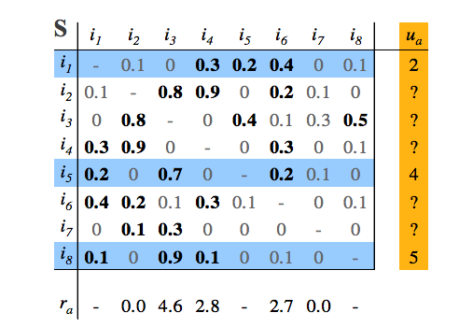
Item Ratings Matrix

Slide 47
Preparing Data for MLLib
MLLib only looks at integer userid and itemid.
Assign your data with unique integer userid and itemid.
Preferences are expressed as a Double (higher is better)
What if your preferences are binary (yes/no)?
Assign a number, say, 5.0 for yes, and 1.0 for no.
What if preferences are just “implied”?
User viewed item as 5.0, no data for unviewed item.
MLLib Rating: Integer, Integer, Double
val ratings = data.map(_.split(',') match { case Array(user, item, rating) => Rating(user.toInt, item.toInt, rating.toDouble) })

Slide 48
MLlib Recommendations Model (ALS)
Uses the Recommendations.ALS
ALS = Alternating Least Squares algorithm
Train Model using number of iterations and rank.
Class “Rating”, contains a UserId, ItemId, and numeric rating (i.e. 0-5).
Train model using training data:
val model = ALS.train(ratings, rank, numIterations, 0.01)

Slide 49
Making a Prediction
Use predict method on model (like regression/classification)
import org.apache.spark.mllib.recommendation.ALS
import org.apache.spark.mllib.recommendation.Rating
Model.predict(RDDUsersItems)
Input Takes an RDD of user – item pairs as argument(NOT Ratings)
Returns RDD of Rating (user, item, double rating)

Slide 50
Measuring CF Performance
CF in Spark is treated as a “supervised” ML task.
Best if we have some test data not part of training set to compare.
If not, can use some training data.
Calculate error = difference in predicted preference to actual.
Aggregate error as MSE (Mean Squared Error).
val MSE = ratingsAndRecs.map { case ((user, item), (r1, r2)) =>
val err = (r1 - r2)
err * err
}.mean()

Slide 51
Applying Results of Recommendations
Results is RDD[Rating]; Rating is (user, item, rating)
Finding top-4 recommendations for each user:
val recsForEachUser = recs.map { case Rating(user, item, rating) => (user, item, rating) }.collect.
groupBy(_._1). // Group By User
mapValues(_.sortBy(_._3). // Sort by Rating
take(4)). // Get top 4 ratings
mapValues(_.map(_._2)) // Store Items for each rating

Slide 52
Recommendations Lab
We will use data from a Czech dating website: libimseti
location : mllib/recs
Try out the solution line-by-line

Slide 53
Next : Classifications

Slide 54
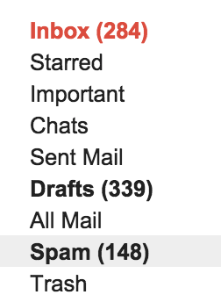
Classification Applications
Email spam or not
Is a cell a cancer cell or not

Slide 55
Classification
Classification is a model which learns from data in order to identify data into classes.
Same as regression – except categorical rather than numeric
Classification (and regression) are supervised (or at least semi-supervised) methods.
A special category of classification is binary classification: a yes/no response.

Slide 56
Review of Classification Algorithms
Naïve Bayes
Support Vector Machines (using Stochastic Gradient Descent)
Logistic Regression / MaxEntropy
Decision Trees
A basic decision tree is pretty simple.
It is a set of rules collect the rule
Decision tree learning is a means of inferring an appropriate decision tree from the data.

Slide 57
Support Vector Machines (SVMs)
Support Vector Machine is a classification method that is:
Supervised (trained)
Linear
Binary (splits into 2 classes)
Crisp (not fuzzy, not probablistic)
How does it work?
Draw a line (hyperplane) that separates the two classes
Line should perform best possible separation
Maximize distance between line and closest points.

Slide 58
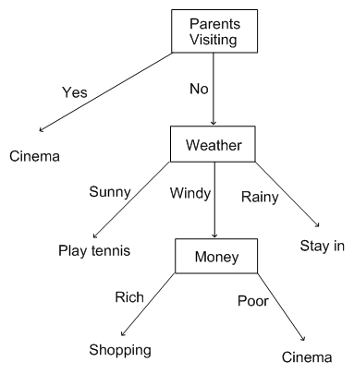
Decision Tree

Slide 59
Classification Support in MLlib
The following algorithms are well-represented in MLlib:
Linear Methods: SVM, Logistic Regression
Decision Trees
Ensemble Decision Trees (Random Forests, Gradient Boosted Trees)
Naïve Bayes

Slide 60
Making a Prediction
How do we use the model to predict new data?
Use the predict method.

Slide 61
Measuring Performance of Classifier
Use a Test Dataset (similar to ALS / Recommendations)
Binary classifiers are often compared by using the ROC curve
Receiver Operating Characteristic
Measure by area under ROC curve.
import org.apache.spark.mllib.evaluation.BinaryClassificationMetrics

Slide 62
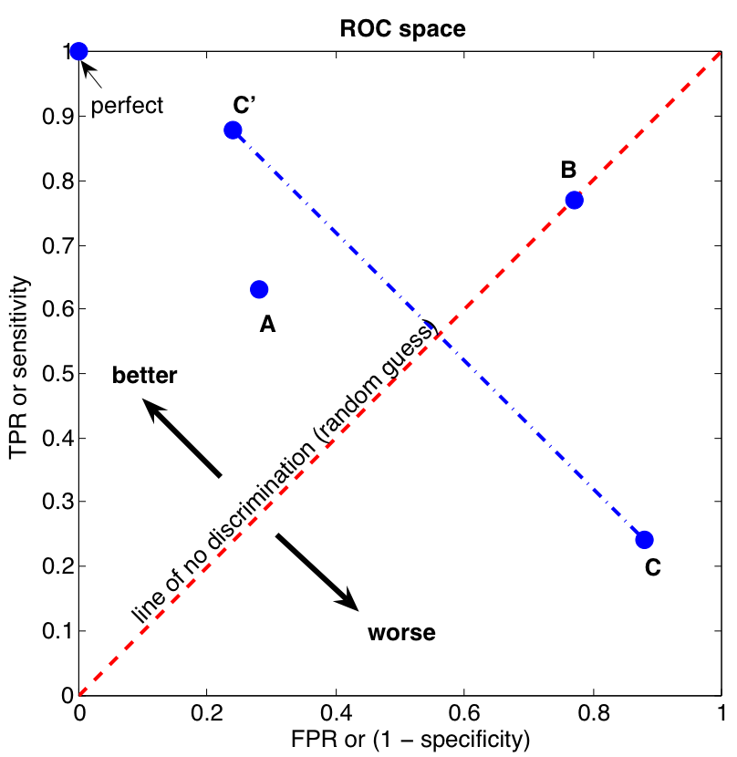
ROC Curve
Source : http://commons.wikimedia.org/wiki/File:ROC_space.png

Slide 63
Classification Lab
Use the “churn” dataset for telecom churn prediction
location : mllib/classifation
Try out the solution line-by-line

Slide 64
Thanks! & Questions !

Slide 65
Credits
http://spark.apache.org/
http://www.strategictechplanning.com

