Slide 1
Introduction to MLLib

Slide 2
Spark Eco-System
Schema / sql
Real Time
Machine Learning
Graph processing
Spark
SQL
Spark
Streaming
ML lib
GraphX
Spark Core
Cluster
managers
Stand alone
YARN
MESOS

Slide 3
Machine Learning (ML Lib)
Machine learning at scale
TODO : insert diagram of HAL
Out of the box ML capabilities !
Java / Scala / Python language support
Lots of common algorithms are supported
Classification / Regressions
Linear models (linear R, logistic regression, SVM)
Decision trees
Collaborative filtering (recommendations)
K-Means clustering
More to come

Slide 4
About Machine Learning
What is Machine Learning?
It is an algorithm that “learns” from data
Any algorithm which improves its performance by access to data.
Machine Learning borrows from applied statistics
Also considered a branch of AI (Artificial Intelligence).

Slide 5
Types of Machine Learning
Supervised Machine Learning:
A model is “trained” with human labeled training data.
Model then tested on other training data to see performance
Model can then be applied to unknown data.
Classification & regression usually supervised.
Unsupervised Machine Learning
Model tries to find natural patterns in the data.
No human input except parameters of the model.
Example: Clustering
Semi-Supervised Learning
Model is trained with a training set which contains mix of trained and untrained data

Slide 6
Creating Feature Vectors: Feature Extraction
Machine Learning only works with vectors. Feature Vectors are an n-dimensional point in space.
All your data’s variables or “features” be collected and put into the vector
Vector normalization: scale down high magnitude variables.
With much data, this involves selecting factor variables to be the dimensions

Slide 7
Creating Vectors
How to create clusters from text?
TF/IDF: Term Frequency Inverse Document Frequency
This essentially means the frequency of a term divided by its frequency in the larger group of documents (the “corpus”)
Each word in the corpus is then a “dimension” – you would have thousands of dimensions.

Slide 8
Preparing Text
Normally, very common words like “the,” “of”, or “and” are removed – these are called stop words.
Words are usually “stemmed” down to their root – we use a package called “snowball” to accomplish this.
We also clean up text, removing numbers, punctuation, and superflous whitespace.
At the end, we have a dictionary of words, and for each document we have each of the terms as a vector dimension.

Slide 9
Next : Clustering

Slide 10
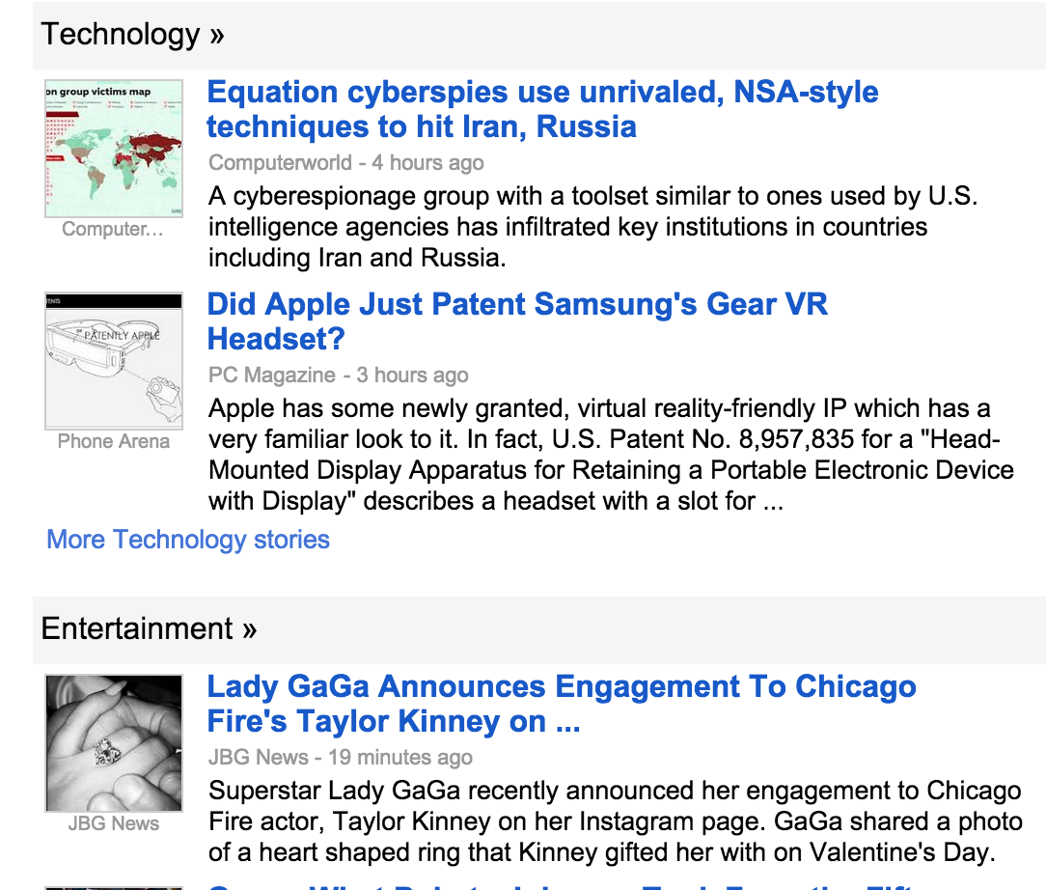
Clustering Applications
News
Classification

Slide 11
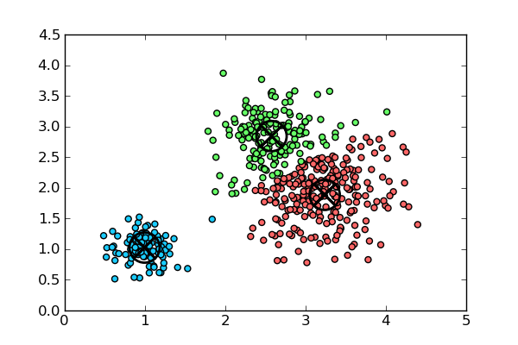
Clustering Vectors
There are many different clustering algorithms for vectors.
Simplest is k-means
K-means requires a known value of k (number of clusters) to start with.

Slide 12
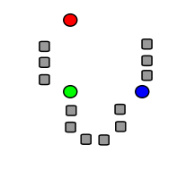
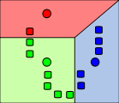
K-Means Clustering
K-Means: Simplest Clustering Algorithm.
Step 1: k numbers of points (centroids) are pre-seeded in the data. Example: 3 centroids (red/green/blue)
Step 2 : Each point in the dataset is associated with its nearest centroid, as determined by a distance measurement.

Slide 13
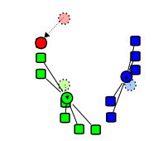
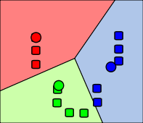
K-Means Clustering
Step 3: The centroid (geometric center) of the clustered points becomes the new centroid of that cluster. Each centroid is updated.
Step 4 : Repeat Steps 2 and 3 until convergence is reached (the points move less than the threshold amount).

Slide 14
K-Means Distance Measurements
Ways to Determine Distance
Euclidian distance – (most obvious) Euclidian, which takes the distance in Euclidian space
Cosine Distance – cosine of angle between vectors – ignores magnitude
Manhattan distance: Effectively counts the number of square blocks one would “walk” to get there without cutting corners.
Tanimoto distance Take both angle and magnitude into account.
Most algorithms attempt to balance the
Magnitude
Angle

Slide 15
K-Means Clustering Summary
K-Means is simple
Well-Understood.
Disadvantages are that:
Value of k must be known in advance – which may mean running the exercise many times to get optimum results.
Initial centroid positions are important; may cause long convergence.
Dense groupings of points are not especially considered
Outliers may bias results.

Slide 16
K-Means in MLLib
MLLib has a built-in function called kmeans, which performs the k-means clustering.
Default values: just provide kmeans(df, value-of-k)
Lab : kmeans-mtcars.scala

Slide 17
Next : Recommendations

Slide 18
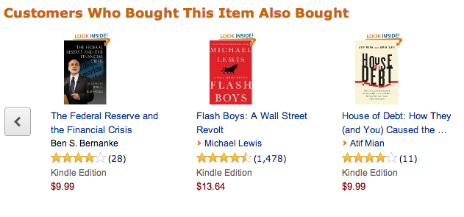
Recommendations Are Every Where : Amazon

Slide 19


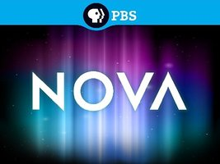


Recommended : Amazon Prime

Slide 20
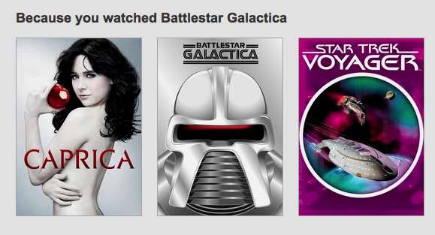
Recommendations From Netflix (With Profiles)

Slide 21
Recommendations
Recommendations are a straightforward application of the Collaborative Filtering algorithm.
Collaborative filtering relates set A to set B.
Variables in set A are given a similarity metric based on expressed relations with set B.
We can then make guess that relations between individual members of set A can be predicted by those similar.
Recommendations
Let’s call set A: users and set B: items (as this is the most obvious application of CF.
We recommend items to users based on users’ expressed preferences.

Slide 22
Collaborative Filtering
Collaborative Filtering (CF) is commonly used in Recommendations “Recommended For You” or “More Like This” functionality
Recommendations can be explicit (based on user ratings), or implicit (based on user interest)
CF usually involves concepts of Users and Items, with users expressing some preference for items. However, it need NOT actually be users and items; it could be any kind of association in which between one set of data and another.
Users and Items could be the same (example: dating site)

Slide 23
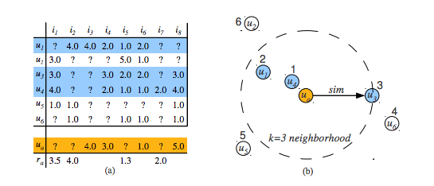
Ratings Matrix : Users / Movies

Slide 24
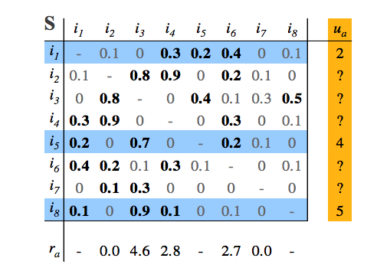
Item Ratings Matrix

Slide 25
MLLib & Recommendations
Uses the Recommendations.ALS
ALS = Alternating Least Squares algorithm
Train Model using number of iterations and rank.
Class “Rating”, contains a UserId, ItemId, and numeric rating (i.e. 0-5).
val ratings = data.map(_.split(',') match { case Array(user, item, rate) => Rating(user.toInt, item.toInt, rate.toDouble) })
Train model using training data:
val model = ALS.train(ratings, rank, numIterations, 0.01)

Slide 26
Recommendations Lab
We will use data from a Czech dating website: libimseti
location : 3-2-recommendations
Try out the solution line-by-line

Slide 27
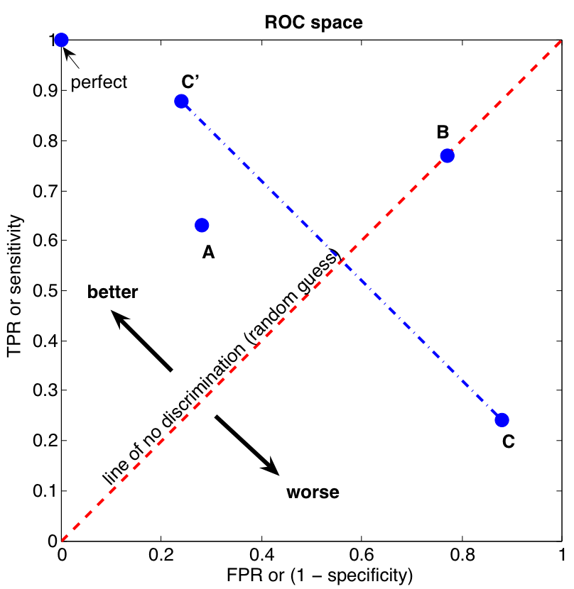
ROC Curve
Source : http://commons.wikimedia.org/wiki/File:ROC_space.png

Slide 28
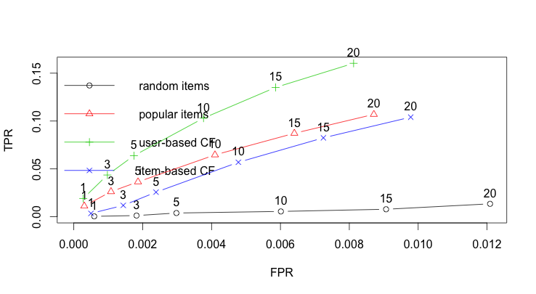
Evaluating Recommendations

Slide 29
Next : Classifications

Slide 30
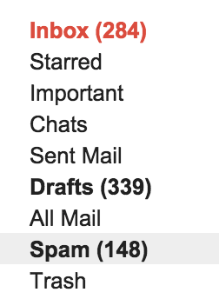
Classification Applications
Email spam or not
Is a cell a cancer cell or not

Slide 31
Classification
Classification is a model which learns from data in order to identify data into classes.
Same as regression – except categorical rather than numeric
Classification (and regression) are generally thought of as supervised (or at least semi-supervised) methods.
A special category of classification is binary classification: a yes/no response.

Slide 32
Review of Classification Algorithms
Naïve Bayes
Support Vector Machines
Logistic Regression / MaxEntropy
Decision Trees
A basic decision tree is pretty simple.
It is a set of rules collect the rule
Decision tree learning is a means of inferring an appropriate decision tree from the data.

Slide 33
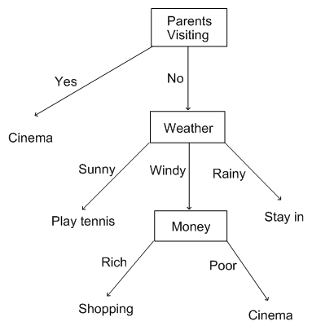
Decision Tree

Slide 34
Classification Support in MLLib
The following algorithms are well-represented in MLLib:
Linear Methods: SVM, Logistic Regression
Decision Trees
Ensemble Decision Trees (Random Forests, Gradient Boosted Trees)
Naïve Bayes

Slide 35
Thanks! & Questions !

Slide 36
Credits
http://spark.apache.org/
http://www.strategictechplanning.com

